Slide 1
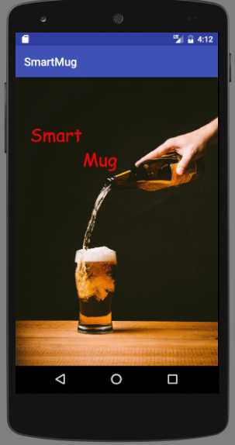
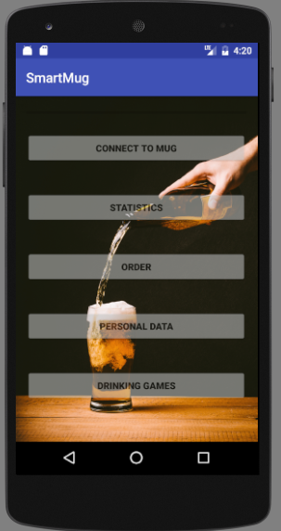
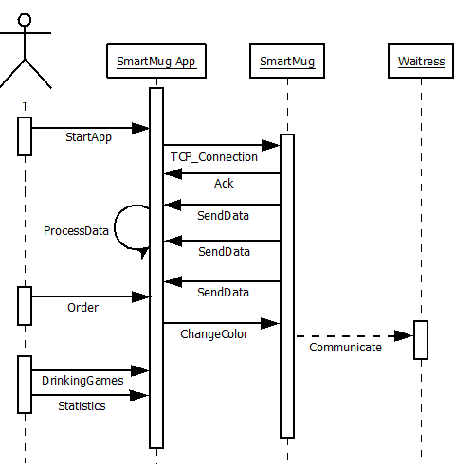
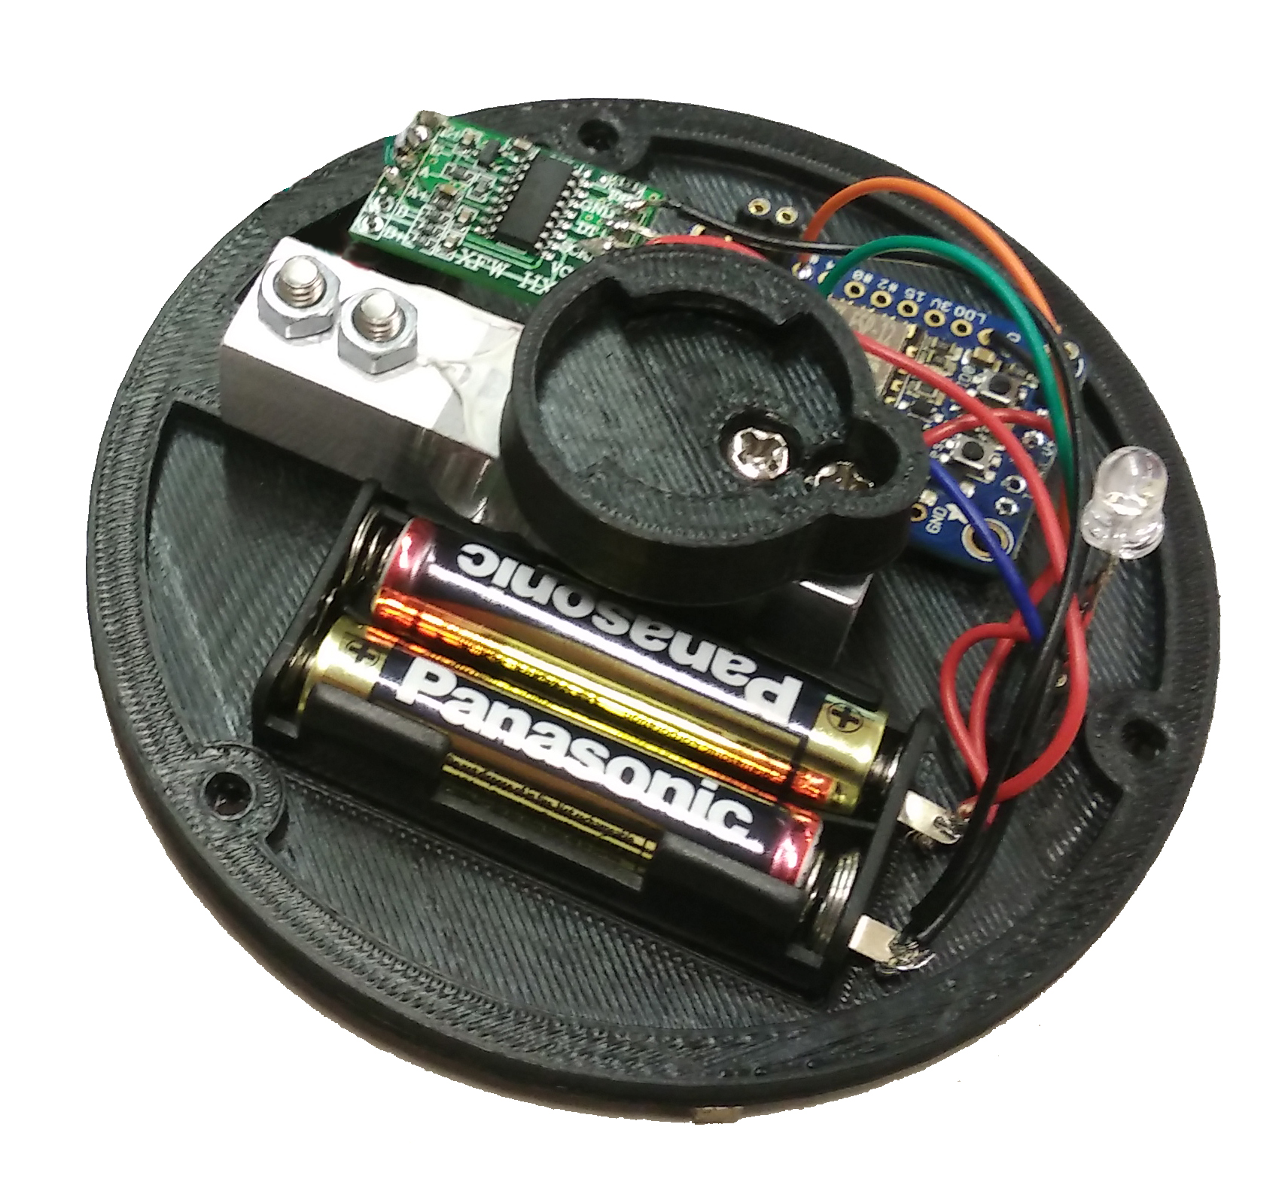
Smart Mug Don’t wait for drinks anymore
Martin Dold, Larraitz Orio,
Gürkan Karacocuk, Dennis Tritschler
Outlook
Connection to the Barkeeper
Interactive Drinking Games
Payment with app
Capacitive measurement

