Slide 1
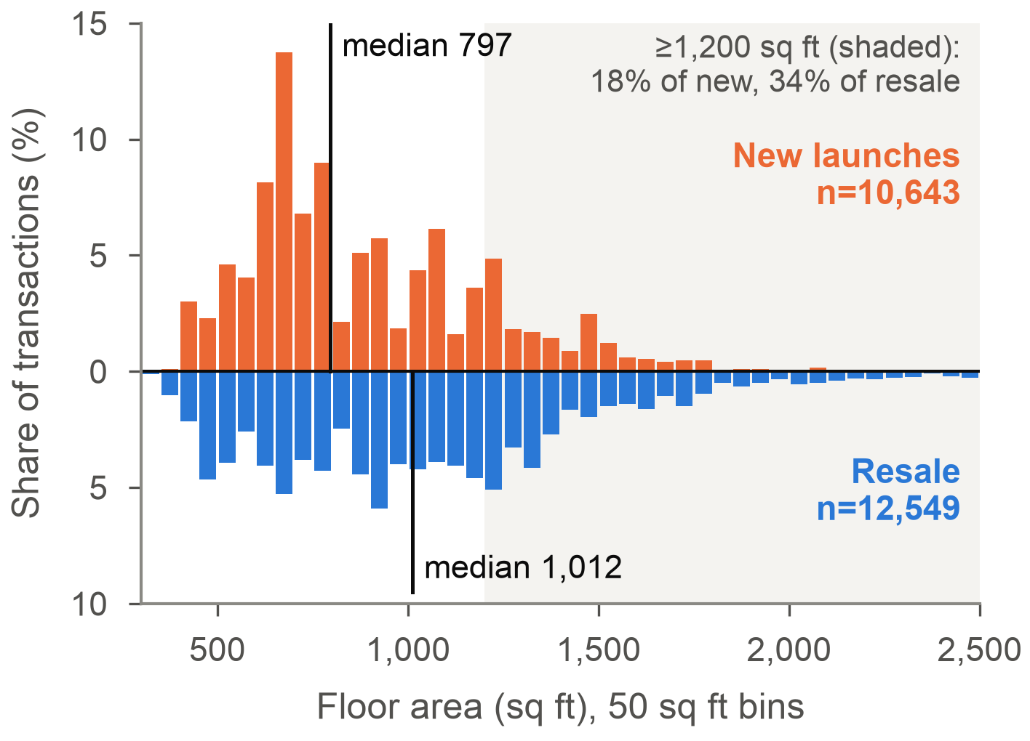
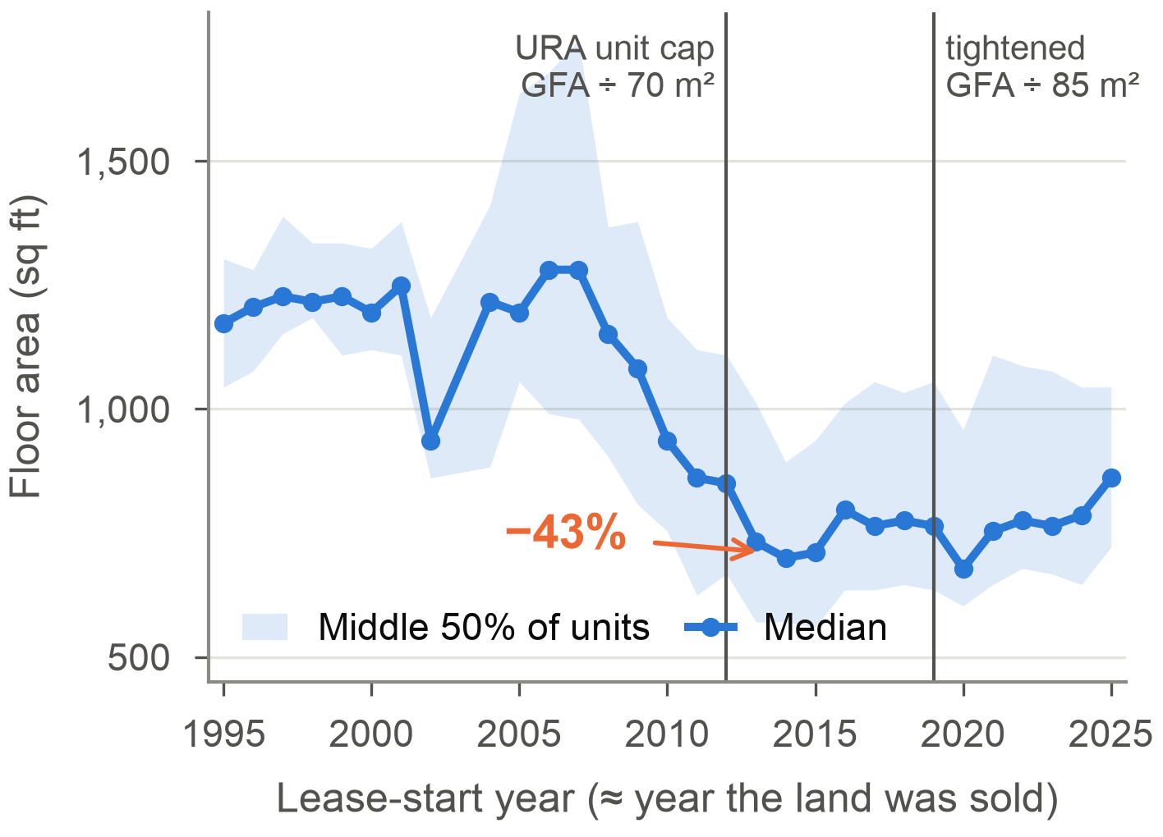
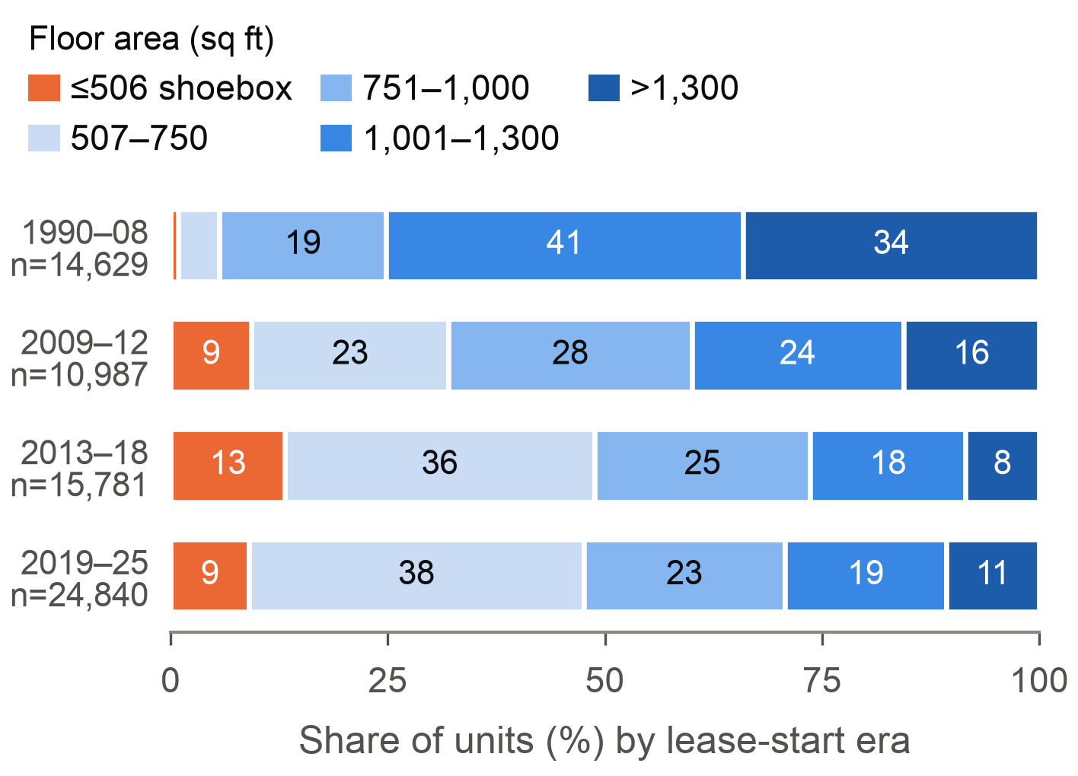
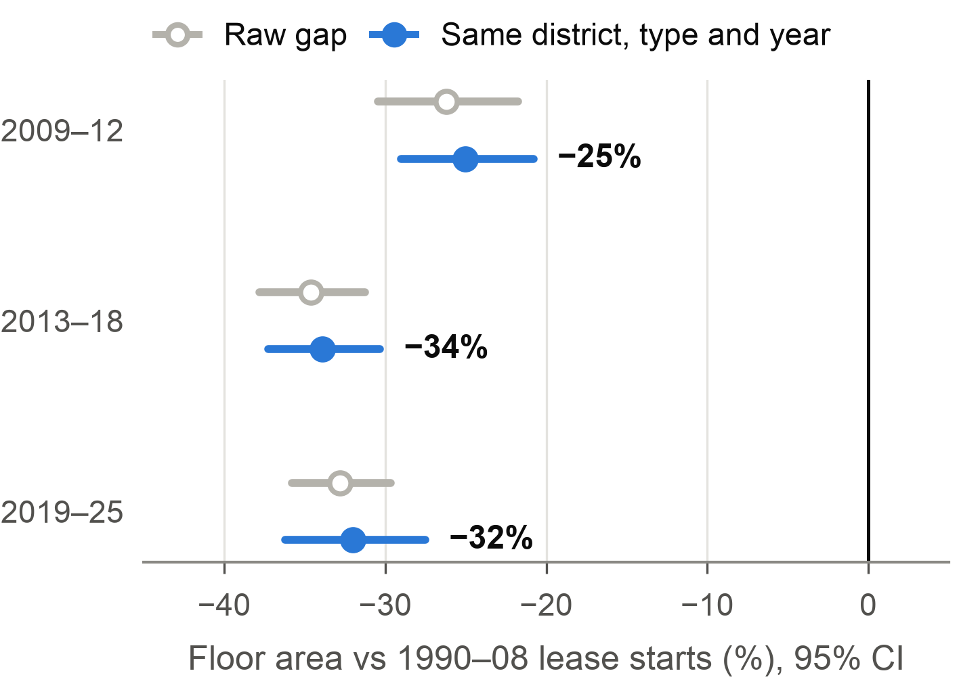
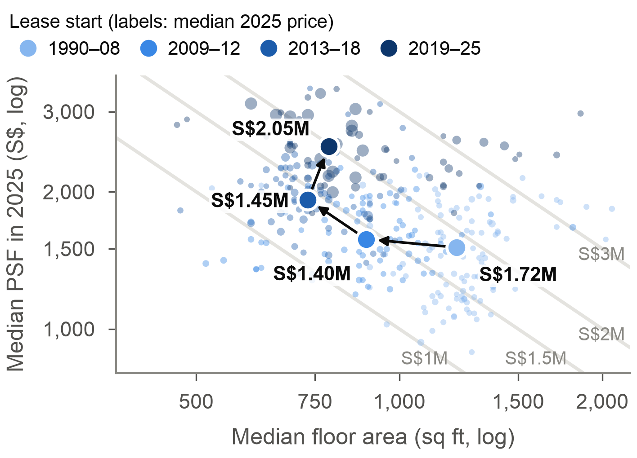
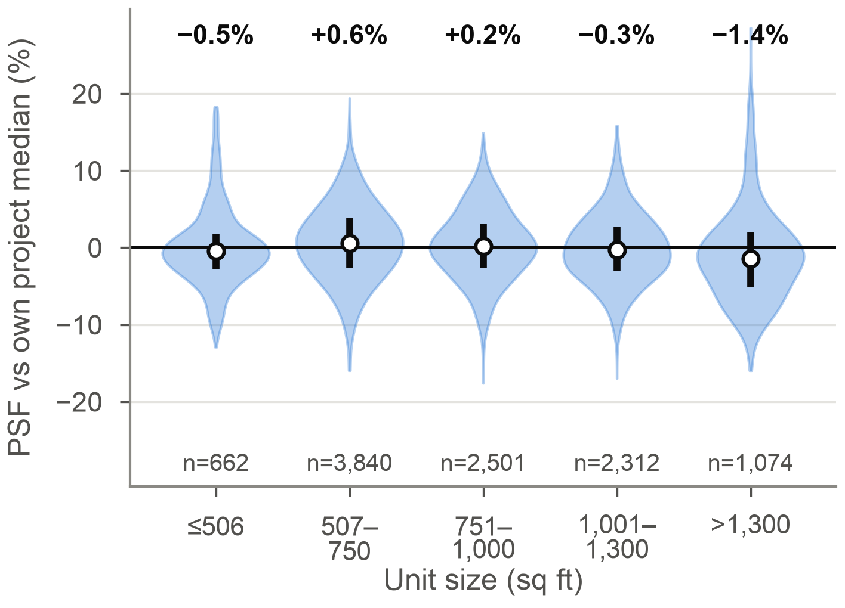
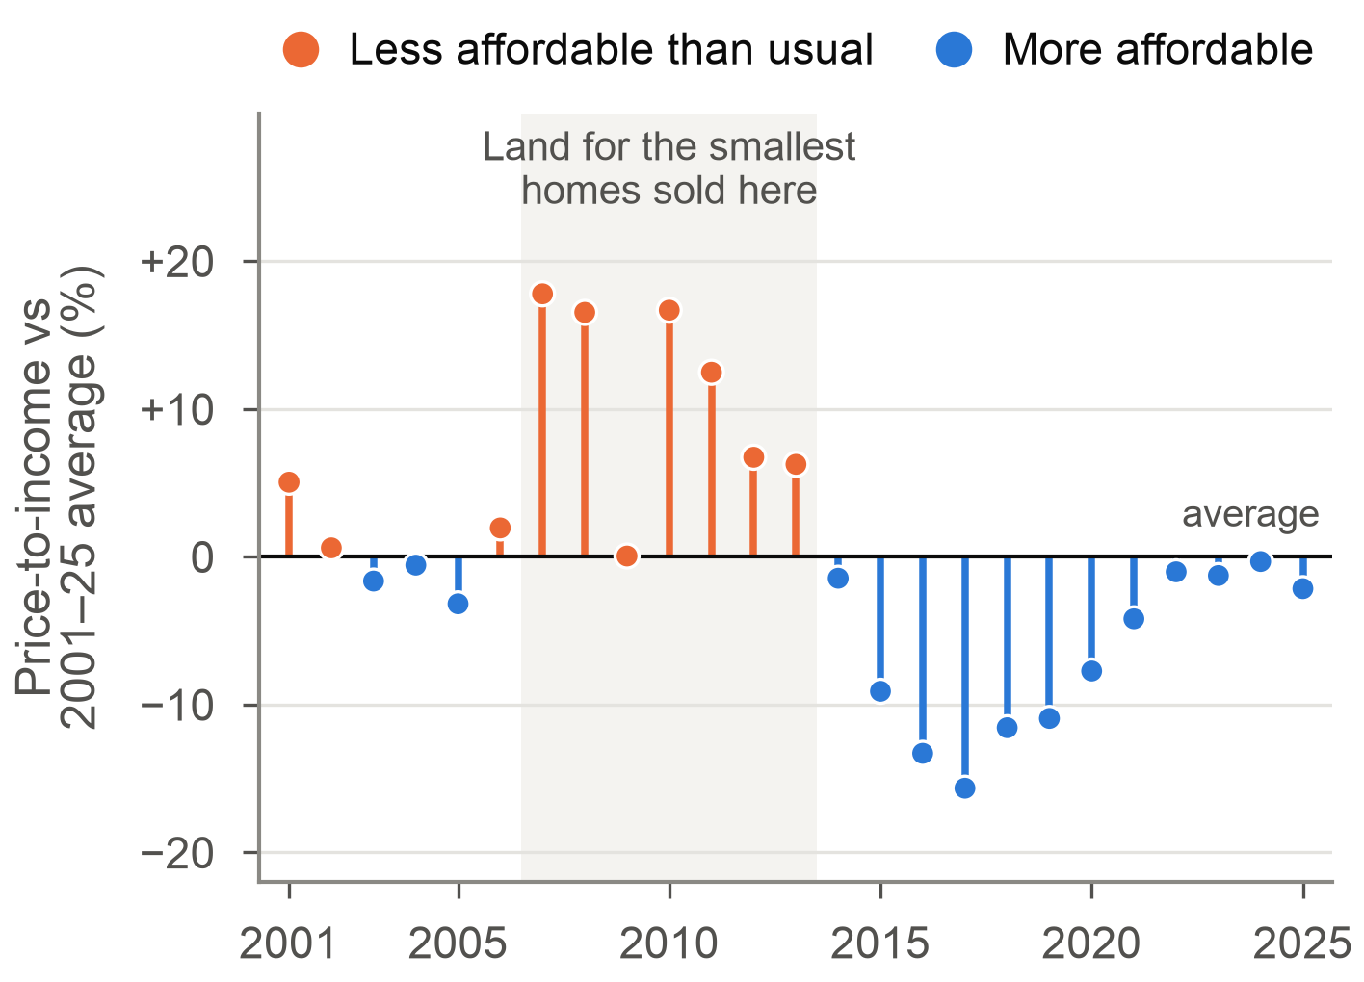
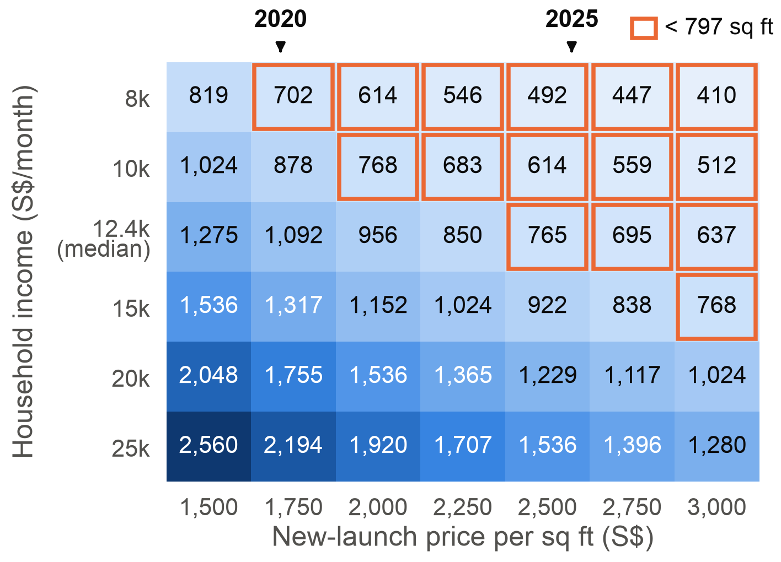
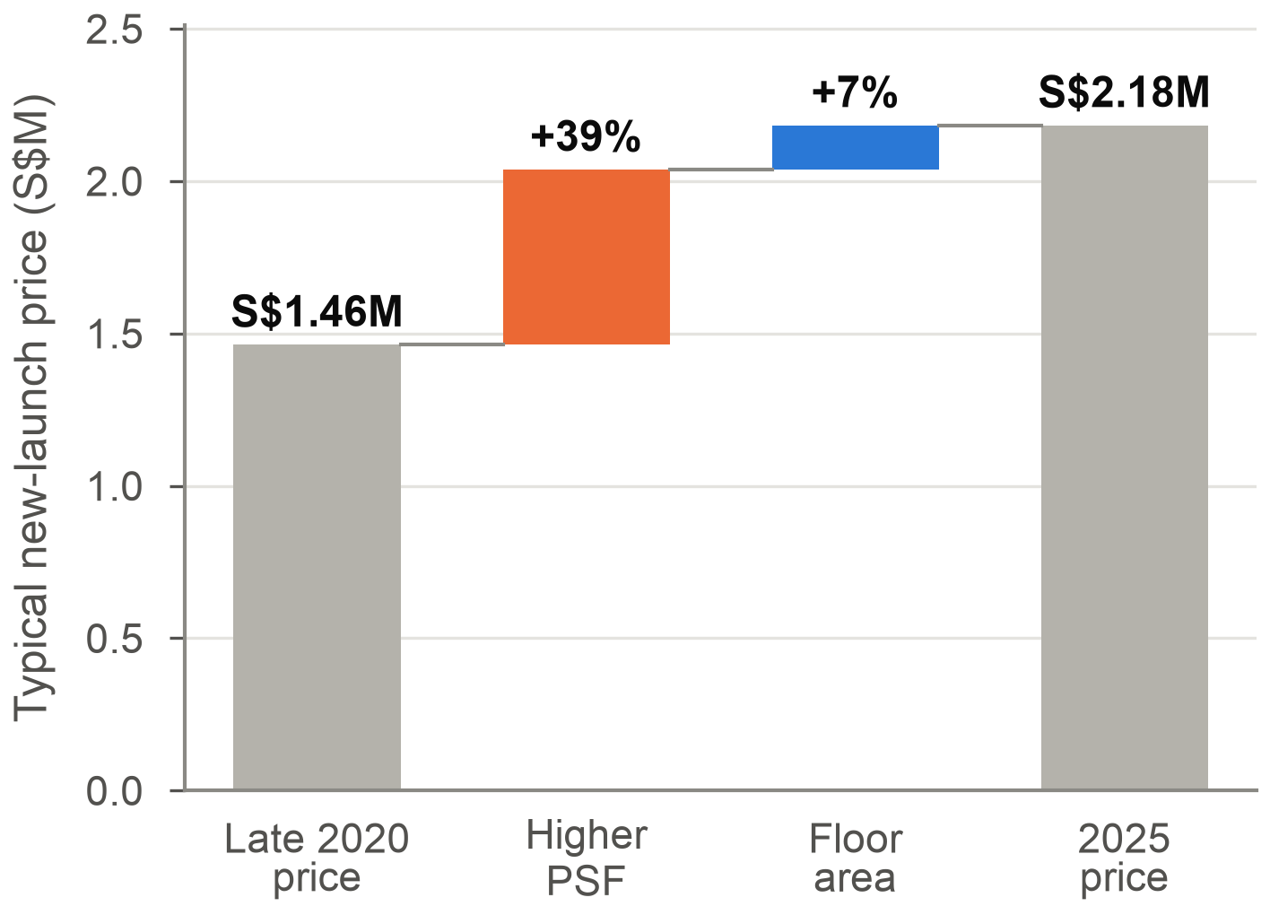
Shrinkflation in Singapore's Private Homes
DAO2702 Group Assignment · Team Jupyter · Martin, Huaitao, Manan, Linda, Midhvan, Hoyoung
Did homes shrink to keep the price tag within reach, and is it still happening in 2025?
Shrinkflation: less product for the same price tag [6] · PSF: price per sq ft, so price tag = floor area × PSF · Lease-start year ≈ year the land was sold
URA unit cap: units ≤ floor area ÷ 70 m² (85 m² from 2019) [5] · MAS limit: loan repayments ≤ 55% of income, tested at 4% [4]
1 WHAT SHRANK
1
New launches are 21% smaller than resale homes
2
Homes shrank 43% for land sold after 2008
3
Shoeboxes rose from 1% to 13%, big homes fell from 34% to 8%
New launches crowd into 500–900 sq ft. A buyer who wants a family-sized home now mostly has to look at resale.
A 43% drop in five years is too fast for slowly changing tastes. It lines up with the least affordable years (chart 7) and stops at URA's line.
The cap cut shoeboxes, yet big homes never returned. Developers moved to compact one- and two-bedders instead.
2 IS IT REAL, AND HOW DOES IT WORK?
4
Within the same district the gap stays at −34%
5
Shrinking cut prices to S$1.45M; after 2019 they jump to S$2.05M
6
Every unit size sells at its project's PSF, within 1.5%
The raw and controlled gaps are almost identical, so units shrank everywhere, in cheap suburbs and prime districts alike.
Smaller homes stayed cheaper despite a higher PSF, the trade shrinkflation relies on. Once the shrink stopped, the price tag rose by S$0.6M.
Small units carry no premium inside a launch, so every sq ft cut comes straight off the price tag. That made shrinking the easiest lever.
3 WHY IT HAPPENED, AND WHAT CHANGED
7
Least affordable in 2007–13, when that land was sold
8
The median household can borrow for under 800 sq ft
9
Price tag S$1.46M → S$2.18M, driven by PSF (+39%)
When prices ran ahead of incomes, developers cut the size of the product instead of its price per sq ft.
The median new unit sits almost exactly at what the median household can borrow, which suggests launches are sized to the loan limit.
With the cap fixing sizes, any further PSF rise reaches buyers in full. Affordability now hinges on land costs and incomes.
Answer: yes, until URA stopped it. Homes shrank about 40% to hold the price tag down. Now that shrinking is capped, the price tag rises instead.
1
Homes on land sold after 2008 are about 40% smaller, and big homes all but disappeared
2
It is not location. It works because a launch is priced per sq ft, so fewer sq ft means a lower price tag
3
Prices outran incomes when that land was sold. Since the 2019 cap the new-launch price tag is up 49%
Data and method: 24,131 URA private home sales in 2025 and 74,436 from Aug 2020 to Dec 2023 [1]; 155 rows outside 200–5,000 sq ft removed. Charts 2–5 use 99-year leaseholds grouped by lease-start year. Chart 7 uses the URA price index [2] and SingStat household income [3]; chart 8 applies MAS loan rules [4]. Limitations: eras are compared at 2025 prices, so older homes also carry age and lease decay; no bedroom count; 2024 missing; associations, not causal effects.
Sources: [1] URA REALIS via DAO2702 (2025; Lecture 6, 2020–23). [2] URA Private Residential Price Index, data.gov.sg. [3] SingStat household income, data.gov.sg. [4] MAS: TDSR 55%, 4% stress rate. [5] URA circular DC18-06 (2018). [6] ONS (2019), shrinkflation and CPIH. Code: shrinkflation.ipynb.

