Slide 1
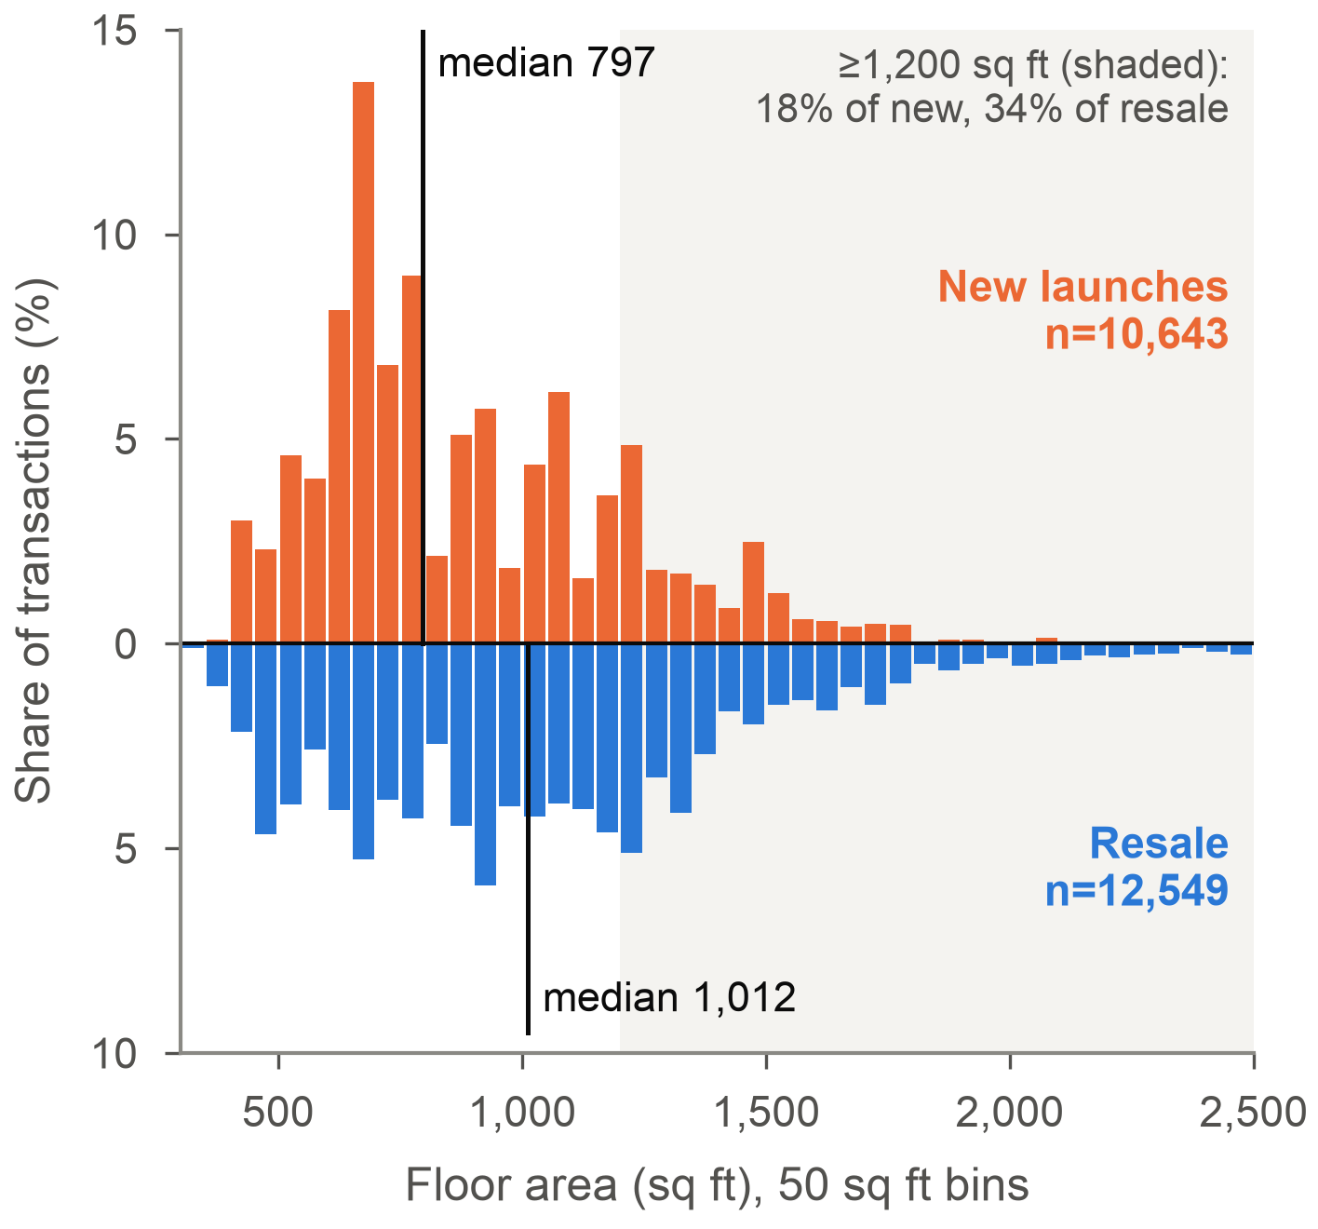
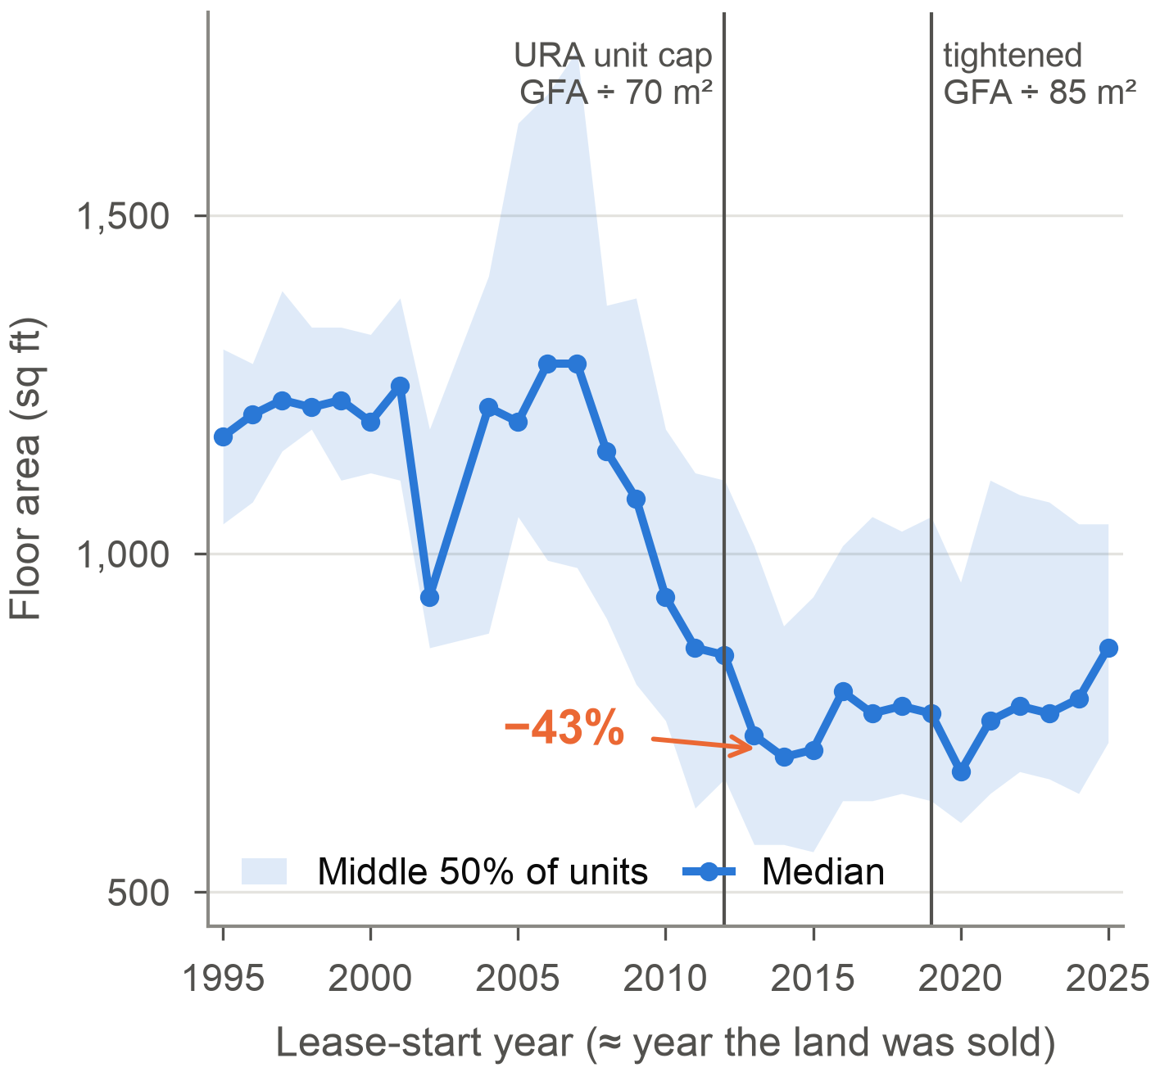
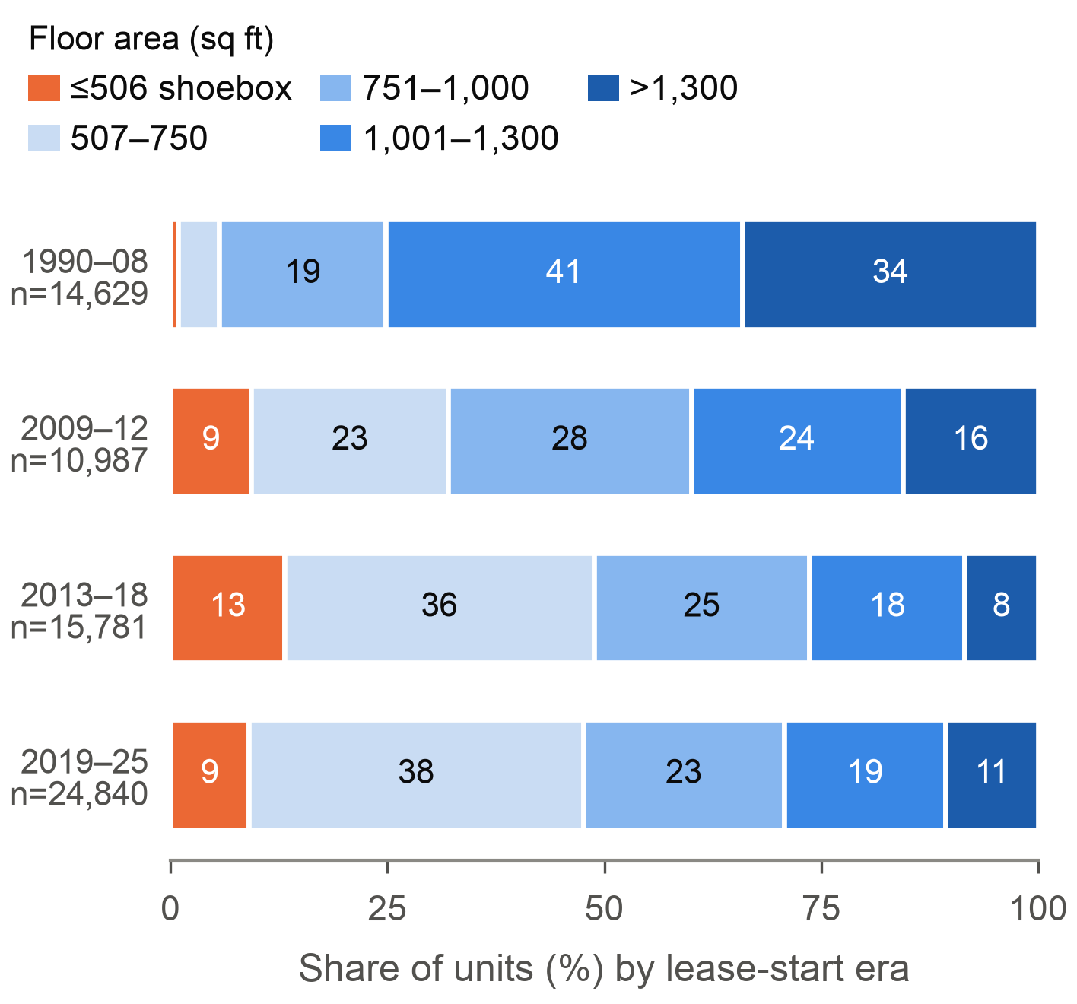
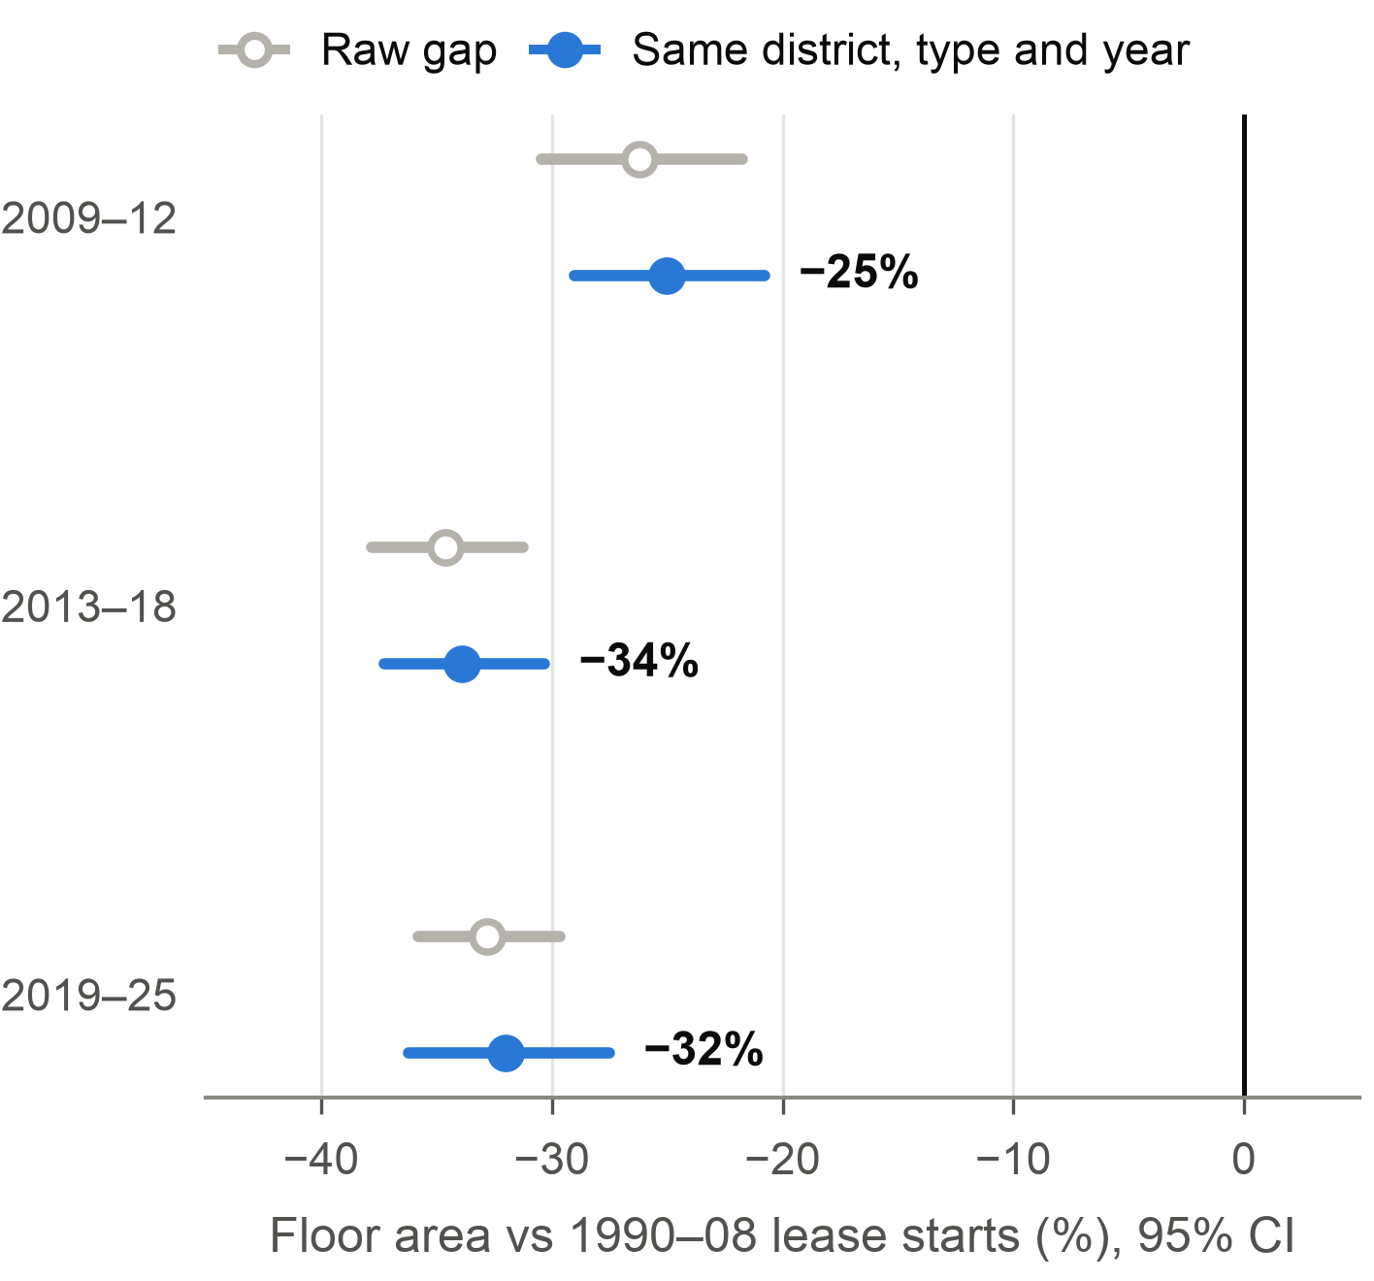
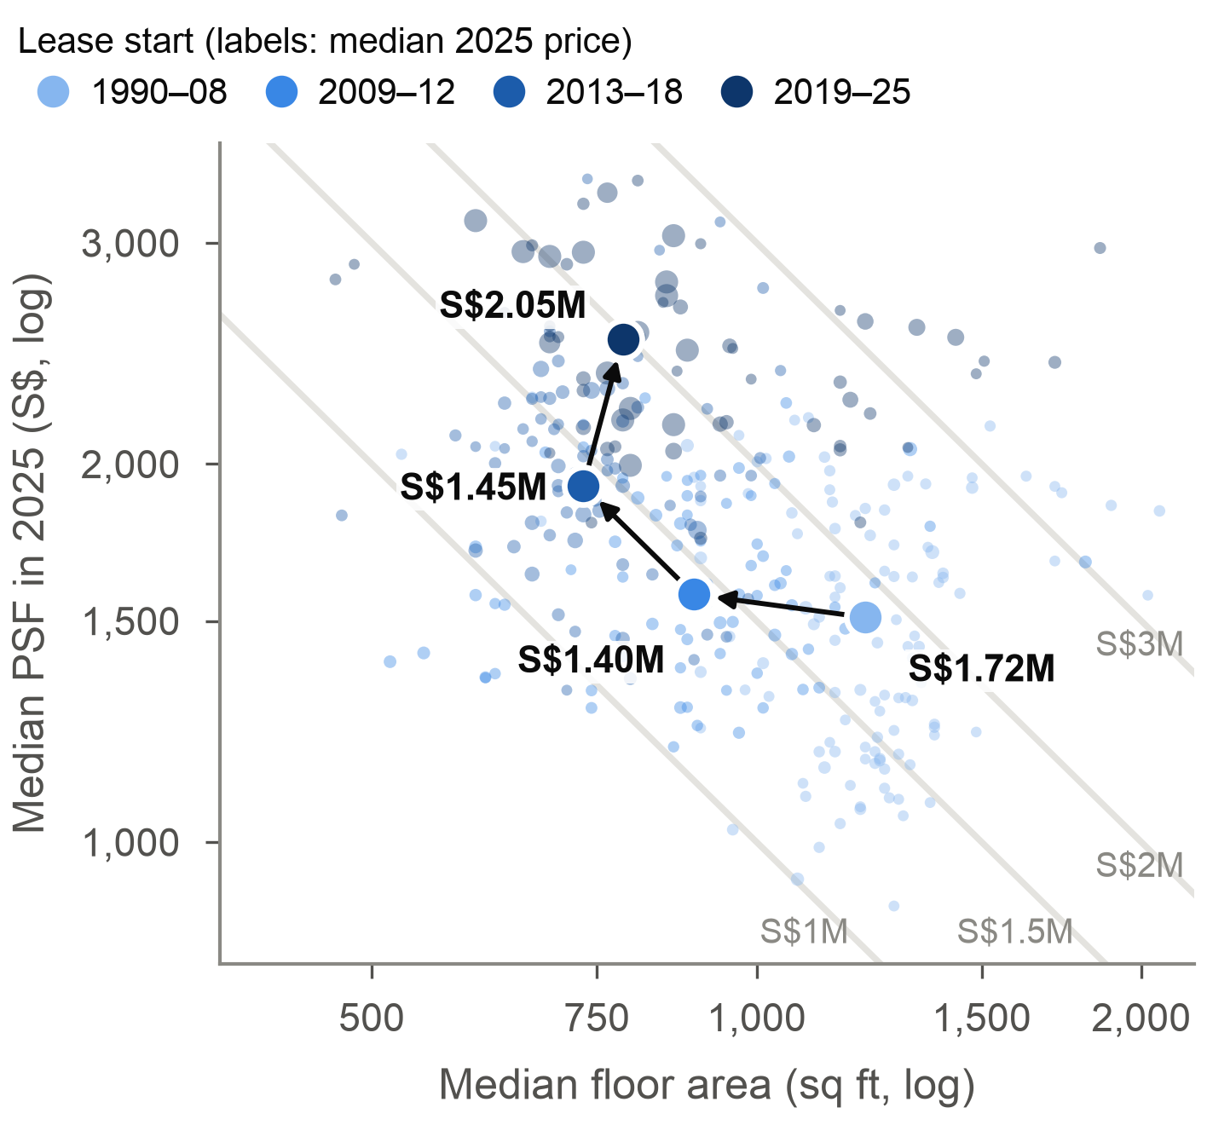
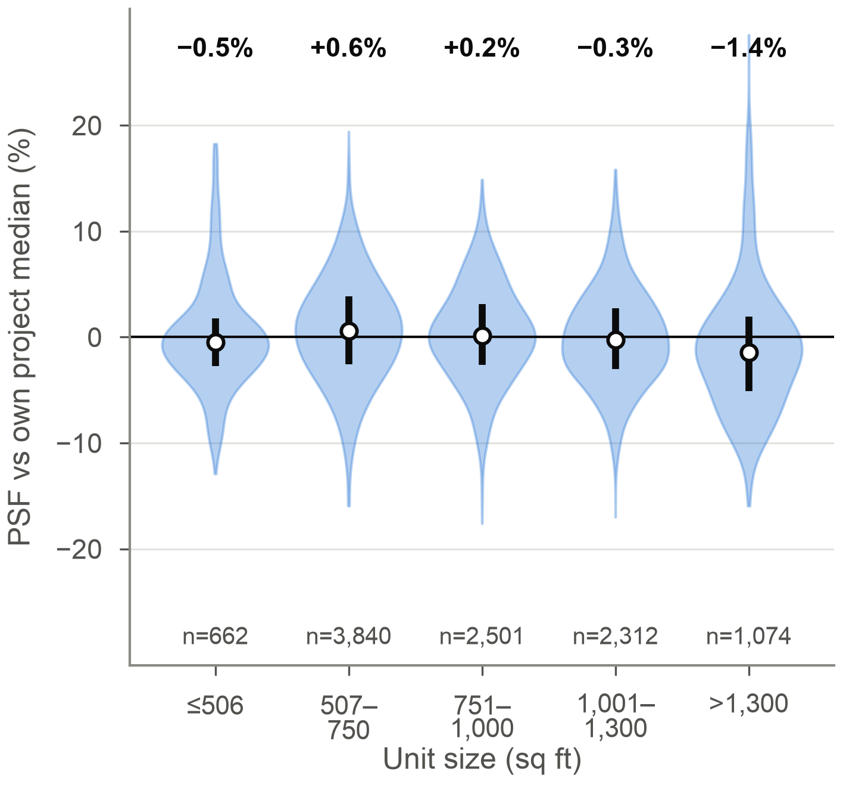
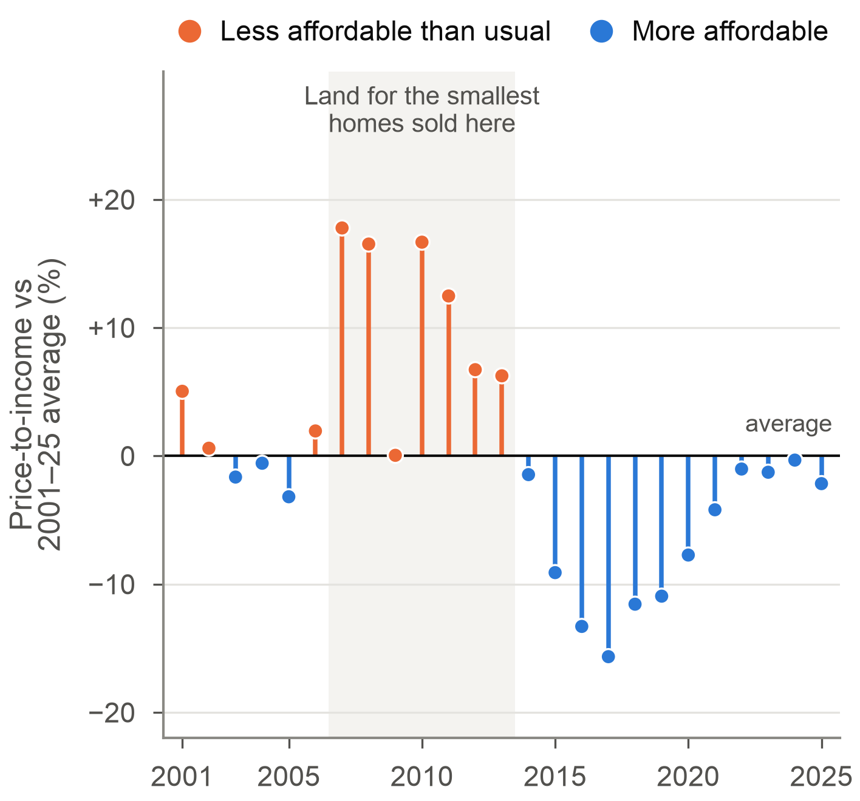
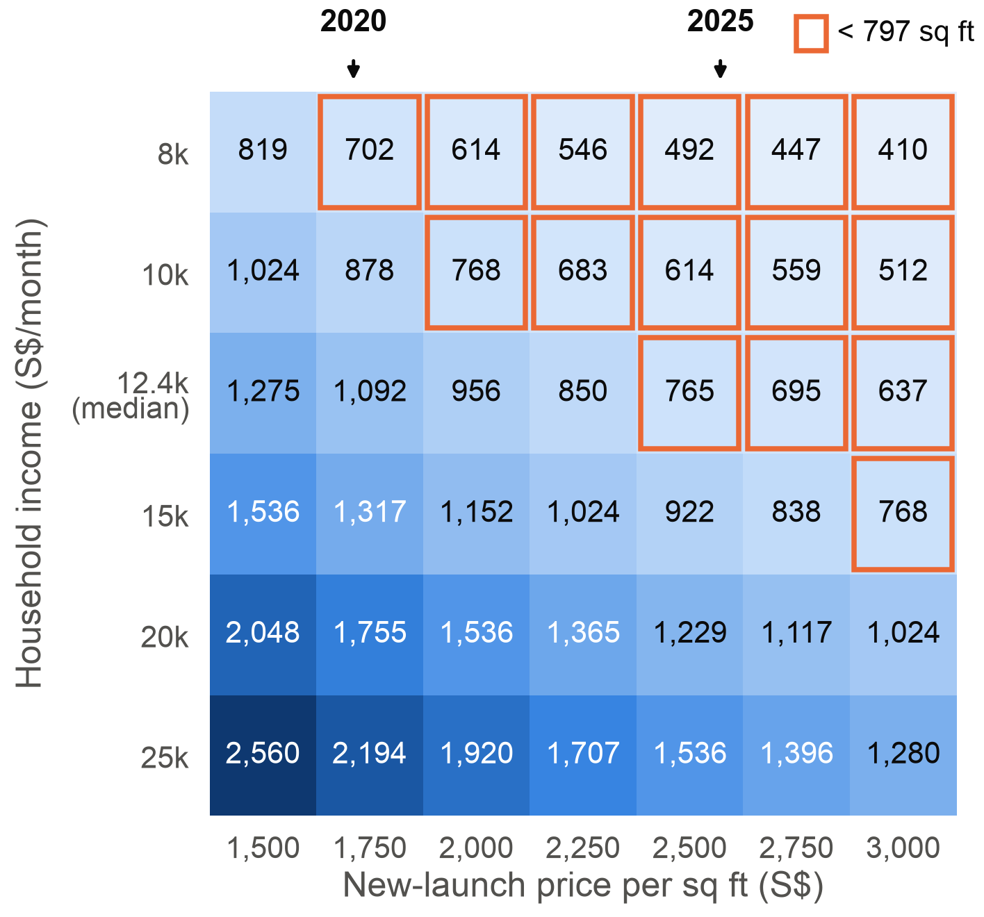
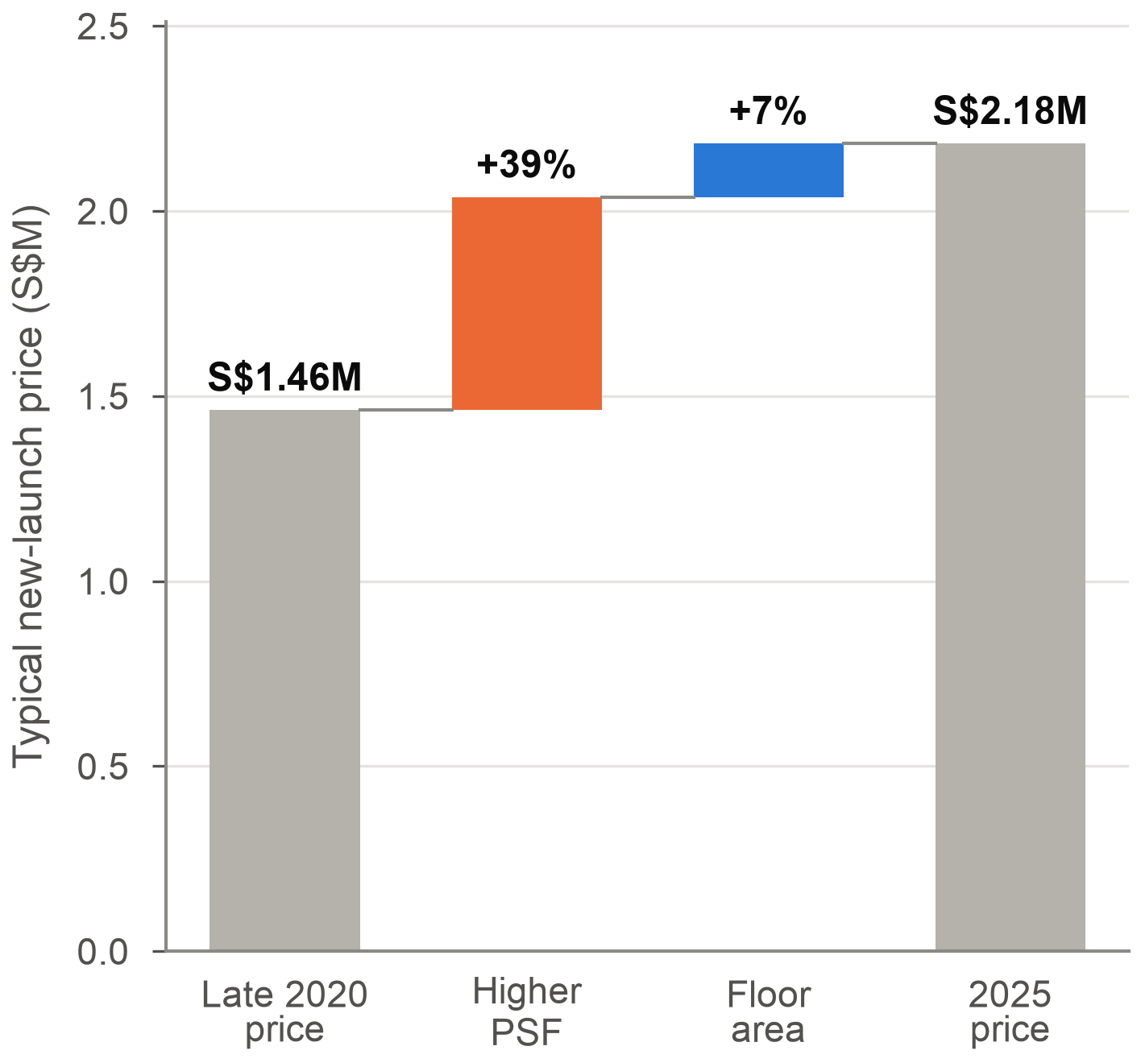
Shrinkflation in Singapore's Private Homes
DAO2702 Group Assignment · Team Jupyter · Martin, Huaitao, Manan, Linda, Midhvan, Hoyoung
Did homes shrink to keep the price tag within reach, and is it still happening in 2025?
Shrinkflation: less product for the same price tag [6] · PSF: price per sq ft, so price tag = floor area × PSF · Lease-start year ≈ year the land was sold
URA unit cap: units ≤ floor area ÷ 70 m² (85 m² from 2019) [5] · MAS limit: loan repayments ≤ 55% of income, tested at 4% [4]
1 WHAT SHRANK
1
New launches are 21% smaller than resale homes
2
Homes shrank 43% for land sold after 2008
3
Shoeboxes rose from 1% to 13%, big homes fell from 34% to 8%
2 IS IT REAL, AND HOW DOES IT WORK?
4
Within the same district the gap stays at −34%
5
Shrinking cut prices to S$1.45M; after 2019 they jump to S$2.05M
6
Every unit size sells at its project's PSF, within 1.5%
3 WHY IT HAPPENED, AND WHAT CHANGED
7
Least affordable in 2007–13, when that land was sold
8
The median household can borrow for under 800 sq ft
9
Price tag S$1.46M → S$2.18M, driven by PSF (+39%)
Answer: yes, until URA stopped it. Homes shrank about 40% to hold the price tag down. Now that shrinking is capped, the price tag rises instead.
1
Homes on land sold after 2008 are about 40% smaller, and big homes all but disappeared
2
It is not location. It works because a launch is priced per sq ft, so fewer sq ft means a lower price tag
3
Prices outran incomes when that land was sold. Since the 2019 cap the new-launch price tag is up 49%
Data and method: 24,131 URA private home sales in 2025 and 74,436 from Aug 2020 to Dec 2023 [1]; 155 rows outside 200–5,000 sq ft removed. Charts 2–5 use 99-year leaseholds grouped by lease-start year. Chart 7 uses the URA price index [2] and SingStat household income [3]; chart 8 applies MAS loan rules [4]. Limitations: eras are compared at 2025 prices, so older homes also carry age and lease decay; no bedroom count; 2024 missing; associations, not causal effects.
Sources: [1] URA REALIS via DAO2702 (2025; Lecture 6, 2020–23). [2] URA Private Residential Price Index, data.gov.sg. [3] SingStat household income, data.gov.sg. [4] MAS: TDSR 55%, 4% stress rate. [5] URA circular DC18-06 (2018). [6] ONS (2019), shrinkflation and CPIH. Code: shrinkflation.ipynb.

