Slide 1
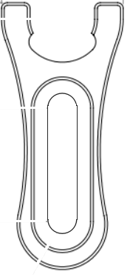

Task 4 - 9
← TO MAINS
Green Laser / LED with Filter
OPTIONAL: DETECTOR 2
DETECTOR 2
GREEN LASER / LED WITH FILTER
x
GAIN ADJUSTMENT
SPLIT BEAM
STATIC
MIRROR
DETECTOR 1
BEAM SPLITTER 2
BEAM SPLITTER 1
x + ^{p}/₂
← TO LINUX
MICRO-CONTROLLER
MOVING
MIRROR
MICROMETER
LIMIT SWITCH
TO MAINS →

Slide 2
Task 10 - 12
← TO MAINS
Mercury Lamp
DETECTOR 2
MERCURY LAMP
x
GAIN ADJUSTMENT
SPLIT BEAM
STATIC
MIRROR
DETECTOR 1
BEAM SPLITTER 2
BEAM SPLITTER 1
x + ^{p}/₂
← TO LINUX
MICRO-CONTROLLER
MOVING
MIRROR
MICROMETER
LIMIT SWITCH
TO MAINS →

Slide 3
Task 13
← TO MAINS
Red He-Ne Laser
MERCURY LAMP
DETECTOR 2
BEAM SPLITTER 3
I
x
O
GAIN ADJUSTMENT
SPLIT BEAM
STATIC
MIRROR
RED HELIUM - NEON LASER
DETECTOR 1
BEAM SPLITTER 2
BEAM SPLITTER 1
x + ^{p}/₂
← TO LINUX
MICRO-CONTROLLER
MOVING
MIRROR
MICROMETER
LIMIT SWITCH
TO MAINS →

