Slide 1
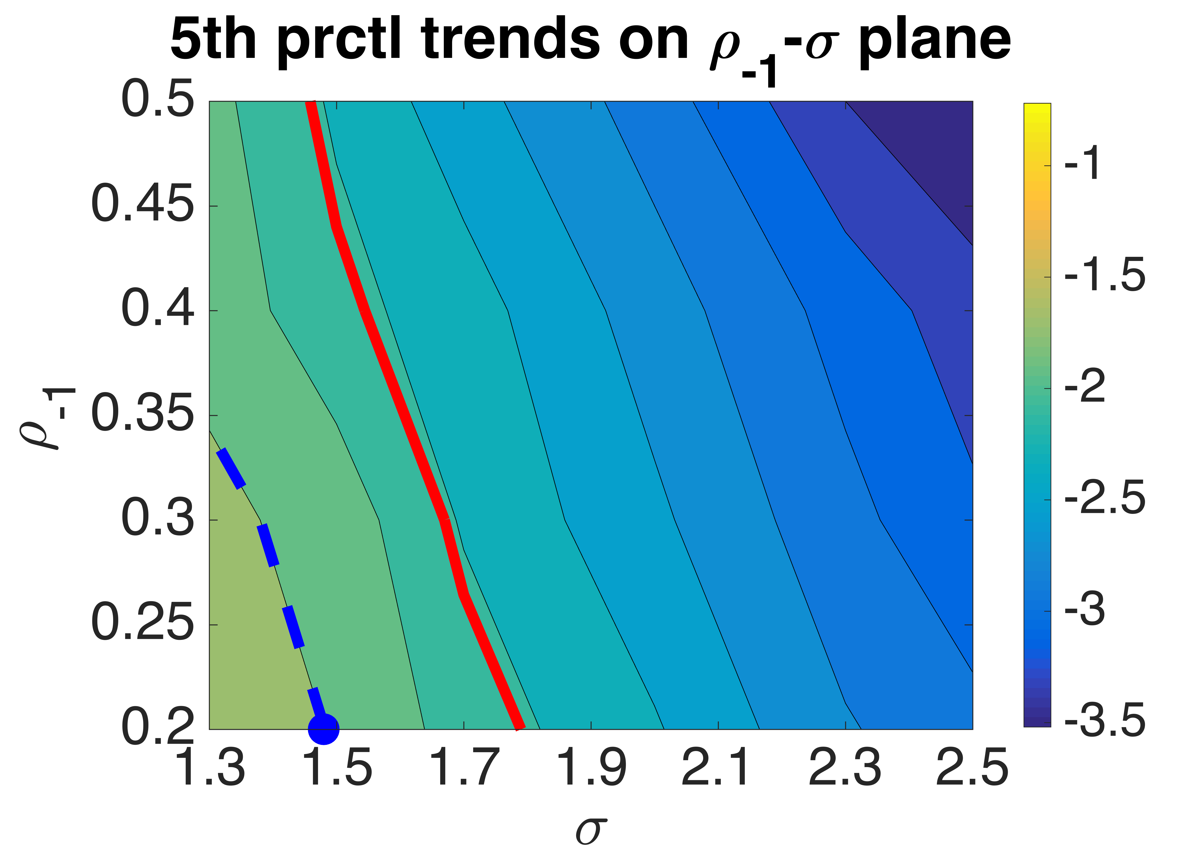
AR1 5th prctl trends stronger than observed trend
AR1 5th prctl trends weaker than observed trend
Observed trend isoline = -2.09K/dec
-1.73K/dec isoline
Observed ρ₋₁ and σ

