Slide 1
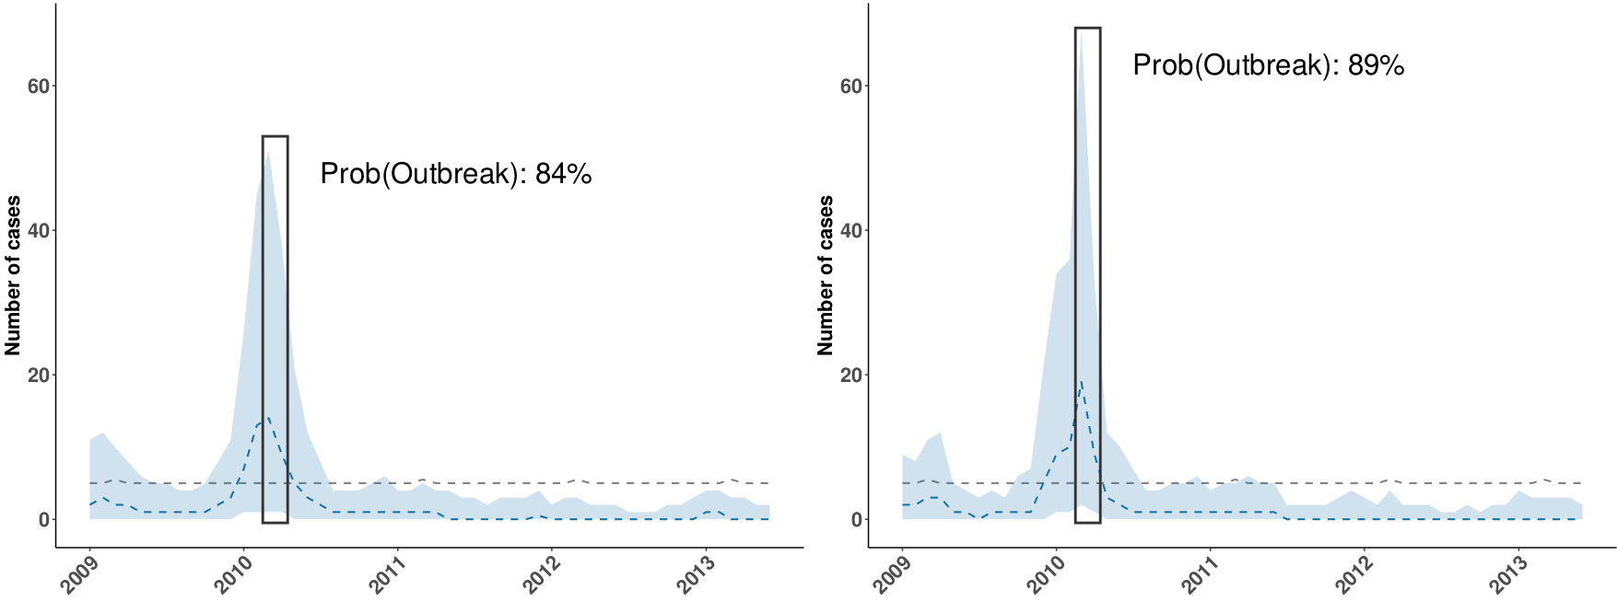
Prediction for March
Aug
Sep
Oct
Nov
Dec
Jan
Feb
Mar
Apr
May
Jun
Jul
a. Initial prediction three months before using SST 3.4 anomalies
b. Update one month before prediction using precipitation and Paraná river height

