Slide 1
R Markdown to PowerPoint Presentation
Martin

Slide 2
Why would you use R Markdown?

Slide 3

Firstly - Why would you use R?
Advantages
Free and Open Source
Provides powerful data analysis and visualization tools
Reproducibility and documentation easy via R Markdown
RStudio logo (R’s IDE)

Slide 4
Lets see R in action!
Lets look at all flights that departed NYC (i.e. JRK, LGA or EWR) in 2013 and do some analysis.
## # A tibble: 336,776 × 8 ## year month day dep_time sched_dep_time dep_delay carrier flight ## <int> <int> <int> <int> <int> <dbl> <chr> <int> ## 1 2013 1 1 517 515 2 UA 1545 ## 2 2013 1 1 533 529 4 UA 1714 ## 3 2013 1 1 542 540 2 AA 1141 ## 4 2013 1 1 544 545 -1 B6 725 ## 5 2013 1 1 554 600 -6 DL 461 ## 6 2013 1 1 554 558 -4 UA 1696 ## 7 2013 1 1 555 600 -5 B6 507 ## 8 2013 1 1 557 600 -3 EV 5708 ## 9 2013 1 1 557 600 -3 B6 79 ## 10 2013 1 1 558 600 -2 AA 301 ## # ℹ 336,766 more rows

Slide 5
Flights overview continued…
## # A tibble: 336,776 × 7 ## origin dest air_time distance hour minute time_hour ## <chr> <chr> <dbl> <dbl> <dbl> <dbl> <dttm> ## 1 EWR IAH 227 1400 5 15 2013-01-01 05:00:00 ## 2 LGA IAH 227 1416 5 29 2013-01-01 05:00:00 ## 3 JFK MIA 160 1089 5 40 2013-01-01 05:00:00 ## 4 JFK BQN 183 1576 5 45 2013-01-01 05:00:00 ## 5 LGA ATL 116 762 6 0 2013-01-01 06:00:00 ## 6 EWR ORD 150 719 5 58 2013-01-01 05:00:00 ## 7 EWR FLL 158 1065 6 0 2013-01-01 06:00:00 ## 8 LGA IAD 53 229 6 0 2013-01-01 06:00:00 ## 9 JFK MCO 140 944 6 0 2013-01-01 06:00:00 ## 10 LGA ORD 138 733 6 0 2013-01-01 06:00:00 ## # ℹ 336,766 more rows

Slide 6
Data cleaning and preprocessing
Number of missing values per column
## dep_time dep_delay arr_time arr_delay tailnum air_time ## 8255 8255 8713 9430 2512 9430
Missing values could be due to:
Cancelled flights
Sadly, some are crashed flights
Legitimate data entry errors (Explicit vs implicit missing values)

Slide 7
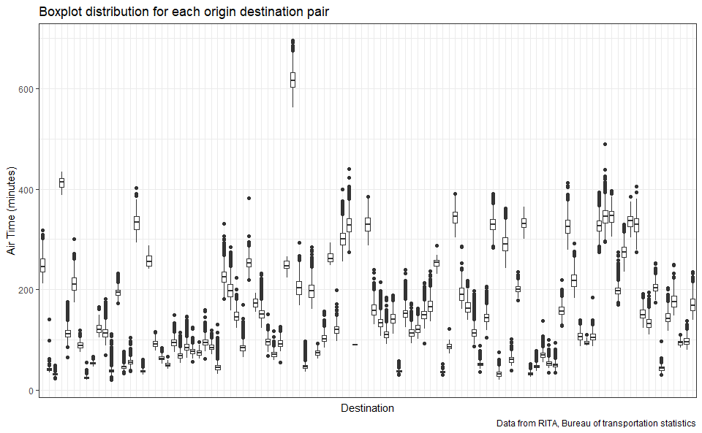
Look out for outliers

Slide 8
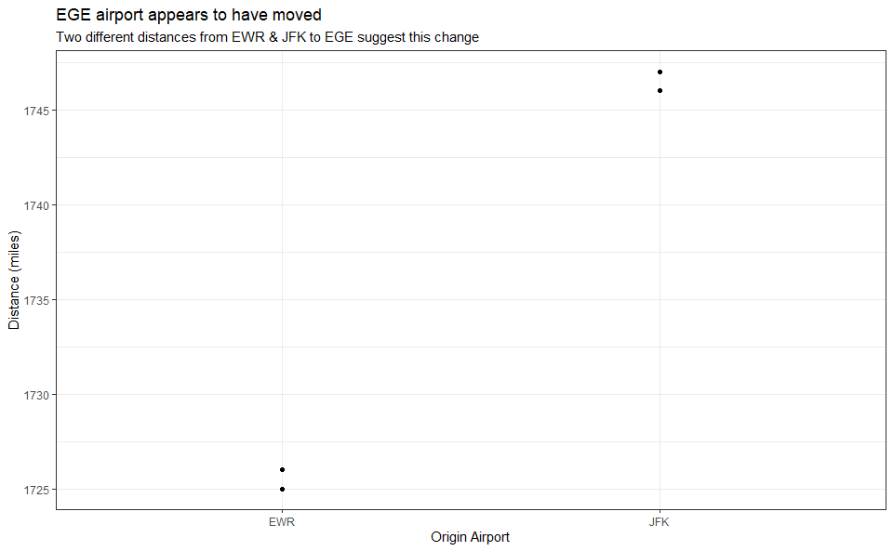
Check for inconsistencies
Other things to check
Are related columns consistent? (e.g. Does departure delay = departure time - scheduled departure time)
Do values make sense (We can’t have a negative distance!)

Slide 9
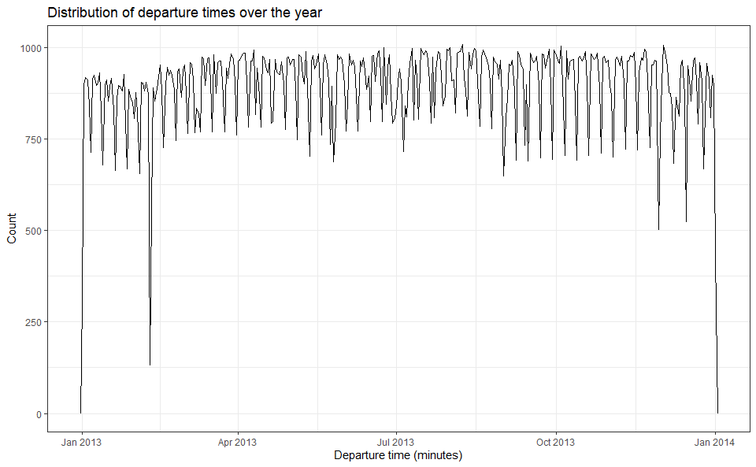
Exploratory Data Analysis
Distribution of departure times across the year
Why was there a drop somewhere around February?

Slide 10
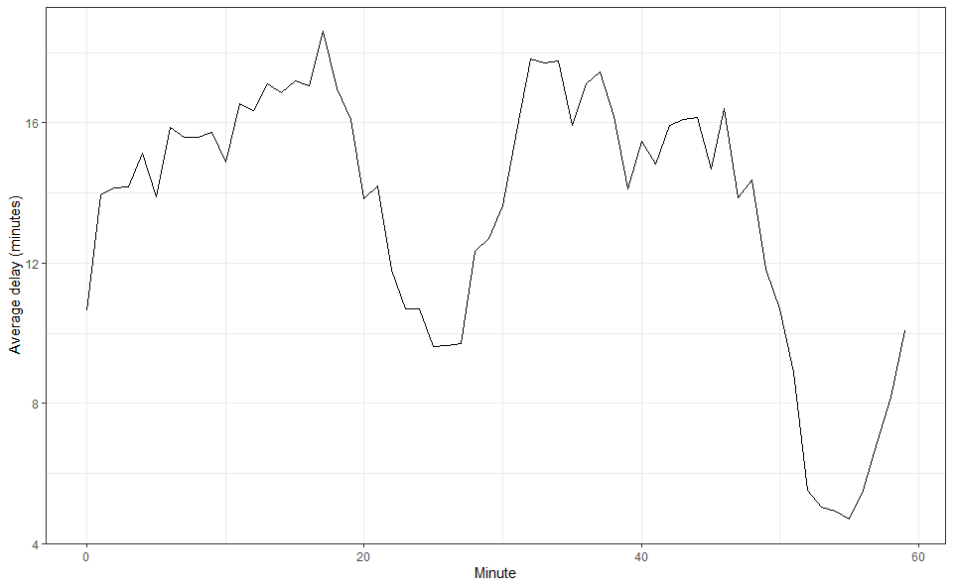
Average delay within the hour (Departure time)
What can we observe?
Lower average delays around 25 and 55 minutes
Peak of about 18 minutes delay around 17 minute hour mark

Slide 11
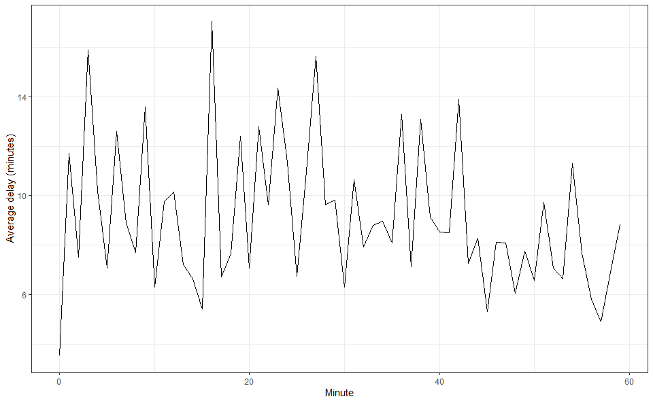
Average delay within the hour (Scheduled departure time)
What do we observe now?
No pattern
Our line is far “Spikier” in its appearance
What does this suggest?
Some sort of manipulation is present
Likely due to human bias around wanting nice looking scheduled departure times
Previous graph is a better representation of average delays

Slide 12
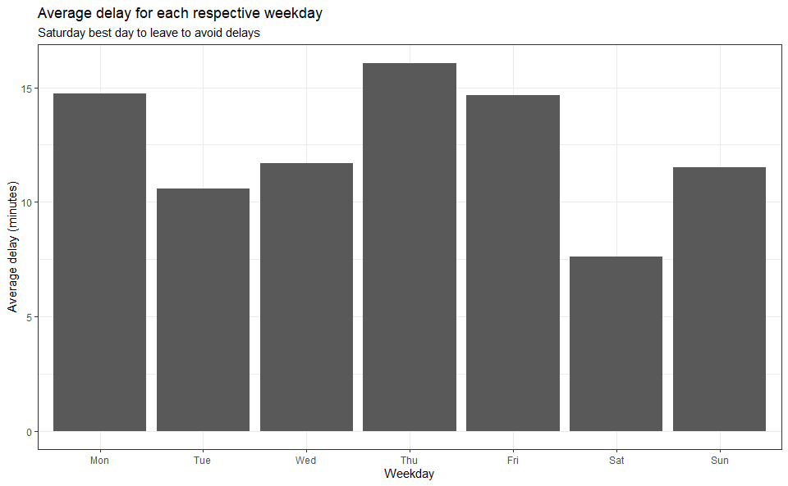
What day of the week should I leave to minimise delay?
Best days of the week
Saturday with only an average delay of 7.5 mins!
Interestingly, Sunday is slightly worse than Tuesday (Weekend vs Workweek)
Worst days of the week
Thursday at about 16 mins!
Monday unsurprisingly, as well as Friday (People wanting to go home or elsewhere)

Slide 13
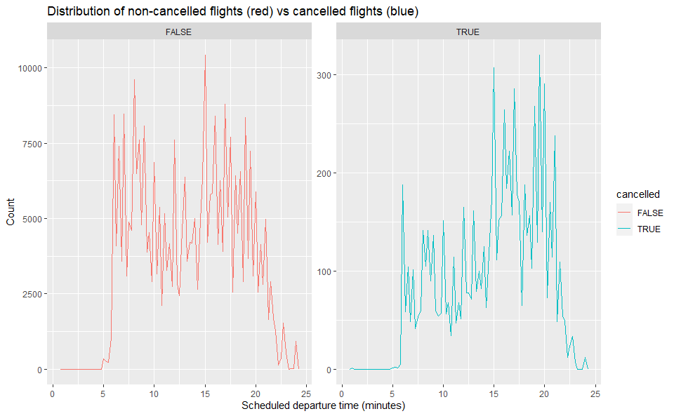
Do non-cancelled flights effect cancelled flights?

Slide 14
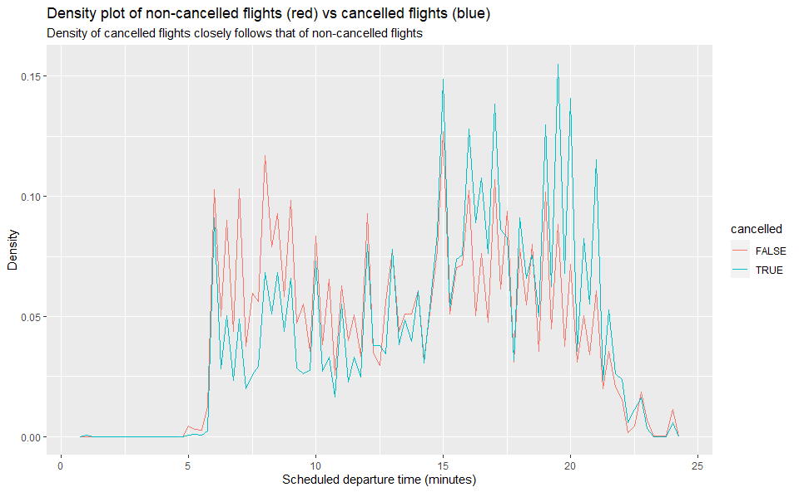
Overlapping density comparison

Slide 15
Joining with other datasets
nycflights13 has other datasets such as one called airports
## # A tibble: 3 × 7 ## faa lat lon alt tz dst tzone ## <chr> <dbl> <dbl> <dbl> <dbl> <chr> <chr> ## 1 04G 41.1 -80.6 1044 -5 A America/New_York ## 2 06A 32.5 -85.7 264 -6 A America/Chicago ## 3 06C 42.0 -88.1 801 -6 A America/Chicago

Slide 16
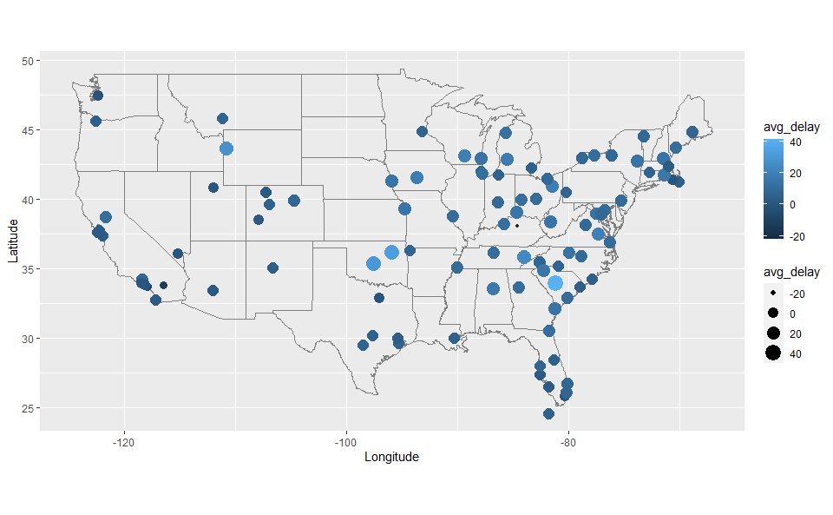
Geospatial visualisation of average delays

Slide 17
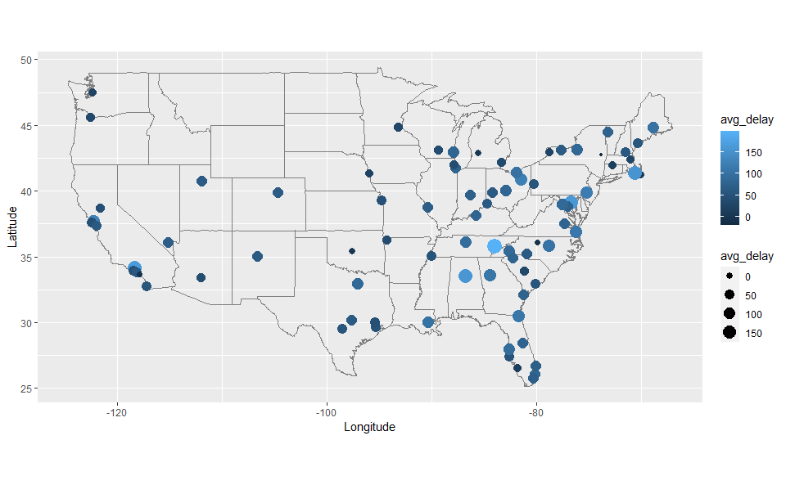
What happened on June 13 2013?
Very high delays in the eastern region of America
Why?

Slide 18

After a bit of Googling…

Slide 19
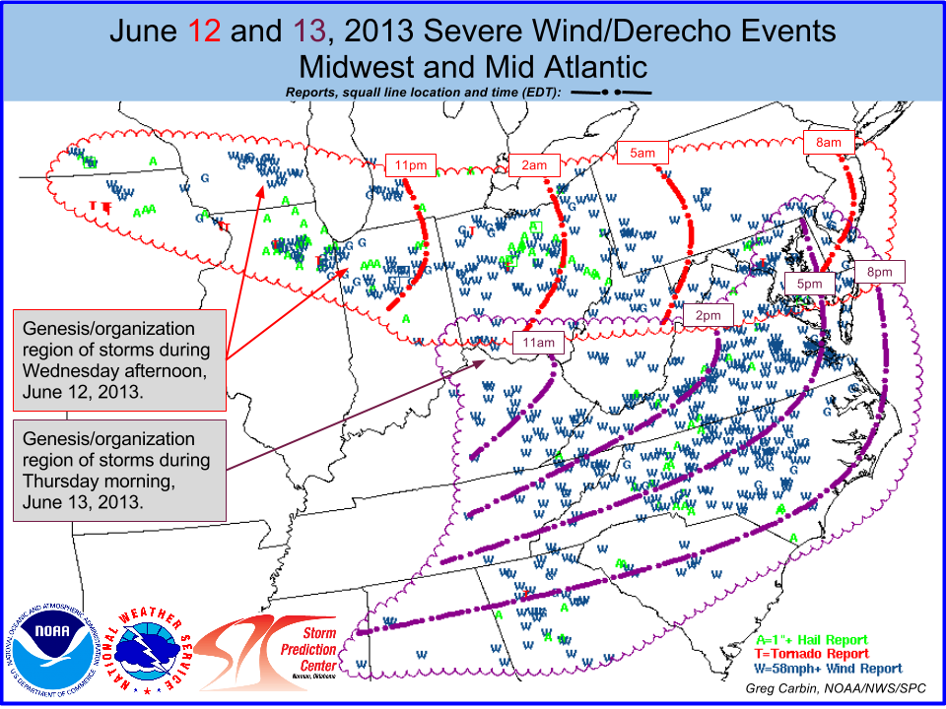
Two derecho series storms occurred

Slide 20
Why would you want to create a PowerPoint Presentation from R Markdown?

Slide 21

PowerPoint is universal
Commonly used communication software
Estimates of 20 million over 16’s in the UK have used PowerPoint before
Very common in business
Anecdotally, I had to use PowerPoint in highschool
Even if you hate PowerPoint
Most people use Windows - It’s Window’s software
Ease of use
It’s not going away anytime soon

Slide 22

Why would you use R Markdown?
Easily reproducible
Seamless integration of code and text (prose) to produce high quality reports
Easy creation of dynamic reports
Multiple formats
Supports various output formats (HTML, PDF, Word)
and of course… PowerPoint!
And more
Supports interactive elements and widgets
Integrates with Git, useful for collaboration

Slide 23
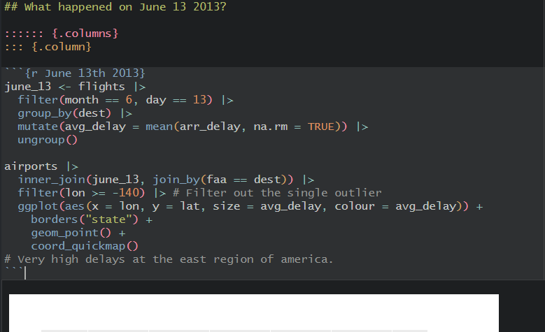
Here’s an example
Combination of prose and code
Can obscure our code for presentation purposes
Allows us to add comments about the “Why?” of our code for future-self/others

Slide 24
Combines two great things

Slide 25

Demo: Creating a PowerPoint Presentation from R Markdown

Slide 26
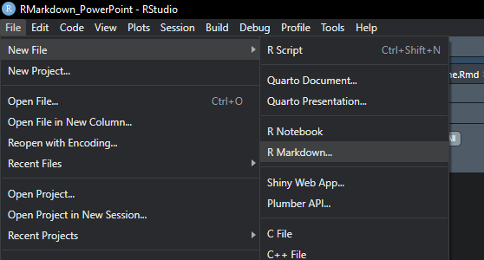

Slide 27
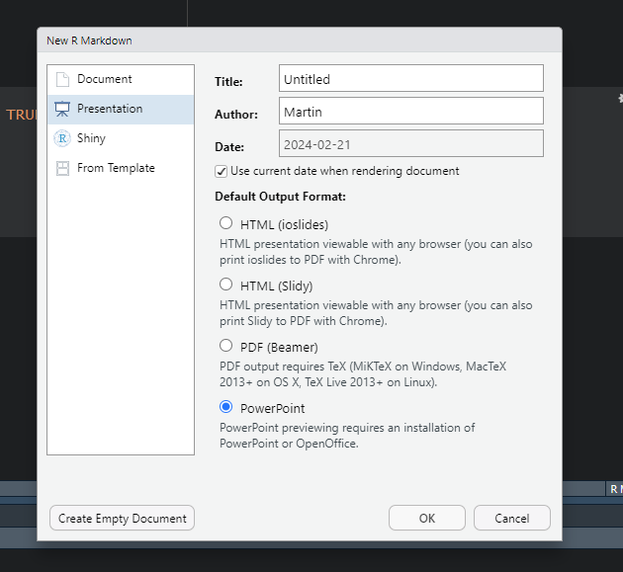

Slide 28
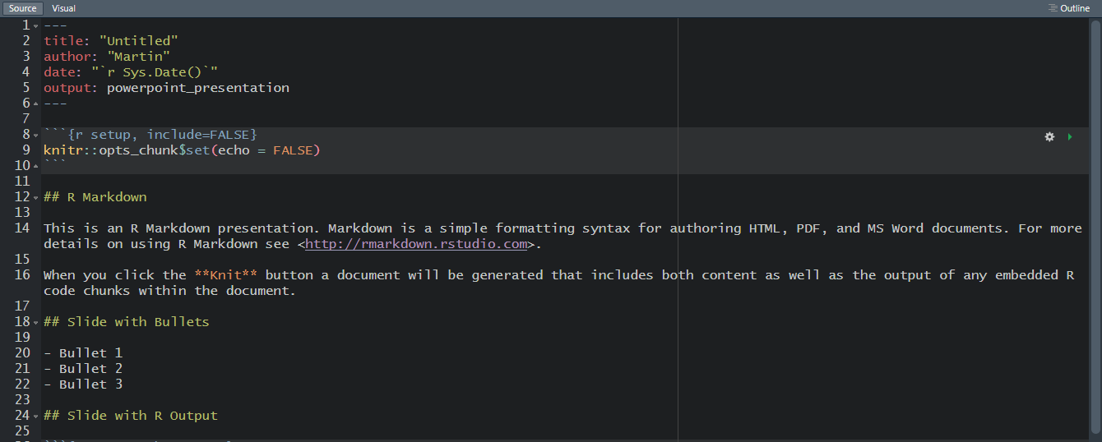

Slide 29
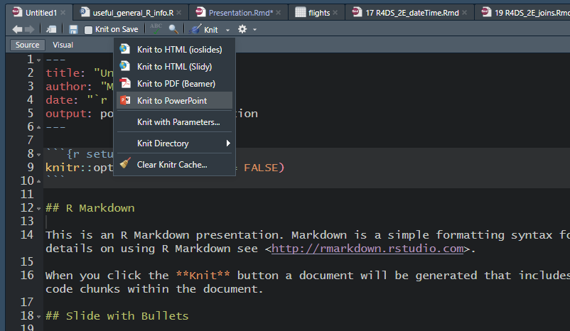

Slide 30
R Markdown
This is an R Markdown presentation. Markdown is a simple formatting syntax for authoring HTML, PDF, and MS Word documents. For more details on using R Markdown see http://rmarkdown.rstudio.com.
When you click the Knit button a document will be generated that includes both content as well as the output of any embedded R code chunks within the document.

Slide 31
Slide with Bullets
Bullet 1
Bullet 2
Bullet 3

Slide 32
Slide with R Output
summary(cars)
## speed dist ## Min. : 4.0 Min. : 2.00 ## 1st Qu.:12.0 1st Qu.: 26.00 ## Median :15.0 Median : 36.00 ## Mean :15.4 Mean : 42.98 ## 3rd Qu.:19.0 3rd Qu.: 56.00 ## Max. :25.0 Max. :120.00

Slide 33
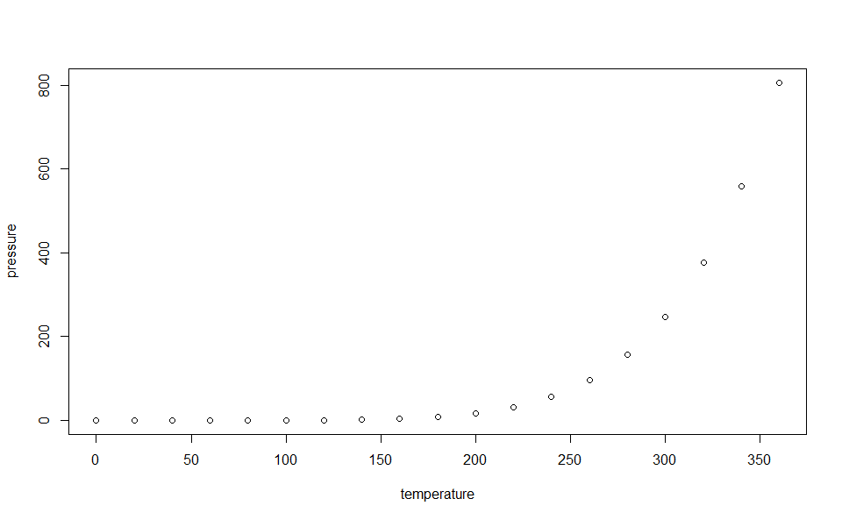
Slide with Plot

Slide 34
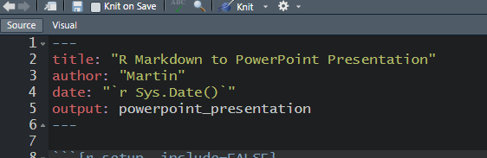
Or simply render from a pre-existing RMarkdown document

Slide 35
How it works

Slide 36
Benefits of Markdown

Slide 37
Basic formatting
*italic*
**bold**
~~strikeout~~
~subscript~
^superscript^
italic
bold
strikeout
_{subscript}
^{superscript}

Slide 38

Images from file or the Web
![](https://…/new-google-favicon-512.png){#fig:Google-logo}
![](C:…Markdown_logo.png){#fig:markdown-logo}

Slide 39
Columns
Supports two column layout by doing the following on the right. Contents are sandwiched between the colons.
:::::: {.columns} ::: {.column}
Column #1 content
:::
::: {.column}
Column #2 content
::: ::::::

Slide 40

Obviously, R code as well
Tables
Plots
Syntax highlighting

Slide 41
Thats how easy it is
For further fine tuning, you may need:
R2PPT
OfficeR
Displayr

Slide 42
Summary
Learnt about R and some examples of what it can do
Why you would want to use R Markdown
How easy it is to make a PowerPoint Presentation from R Markdown

Slide 43
Any questions?

