Slide 1
Testing KumoRFM with temporal user status
Create a synthetic dataset to test KumoRFM dealing with temporal dependency that is not in the transactional history, but instead is in a "user type" variable that changes over time.
Users of 2 types: premium/free. Premium users can do actions that free users cannot.
Testing if/how KumoRFM detects this dependency and uses during inference.

Slide 2
Dataset description
- Two types of users: free tier, premium tier. Users can upload files.
- For simplicity, there are 2 sizes: 5GB and 50GB.
- Premium tier users can upload both sizes.
- Free tier users can only upload files with size of 5GB.
- Users can change their tier no earlier than 24 hours after the last change.
- There are 50 users, covering 5 cohorts:
- Always premium → a single interval that spans the whole window.
- Always free → a single interval that spans the whole window.
- Premium → Free once (≥24h after start).
- Free → Premium once (≥24h).
- Free → Premium → Free (each change ≥24h apart; all within window).
- The history of transactions lasts 10 days from March 1st to March 10th, 2025.
- The prediction task of interest is the likelihood of a user uploading a 50GB in the next k hours.
- Expectations:
- For users that just became free tier this should be 0.
- For users that just became Premium it should be (1 – exp(-lambda*k)), by design.

Slide 3
Tables
Users: 50 users, 10 in each cohort
user_id | name
Items: 45 of 5 GB, 35 of 50 GB
item_id [PK] | size_gb
tiers
tier_status_id | user_id | from_date | until_date | status
uploads
upload_id | user_id | item_id | datetime

Slide 4
Dataset generation
Users: 50 user ids / names
Items: 80 items ids (45 of 5GB, 35 of 50GB)
Tiers: 10 in each cohort: pick random times during from March 1st to March 10 for the status change.
Uploads: generated so that for premium users:
  P[50GB upload with next h hours] ~ 1 - exp(-h*lambda)

Slide 5
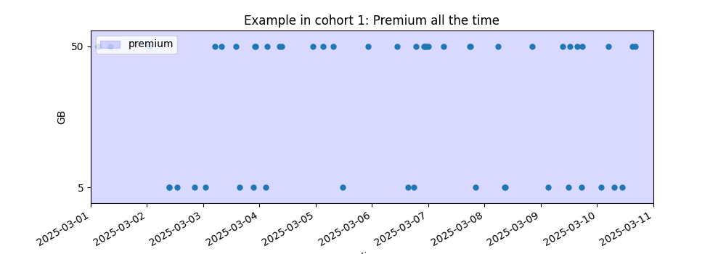
Premium uploads example

Slide 6
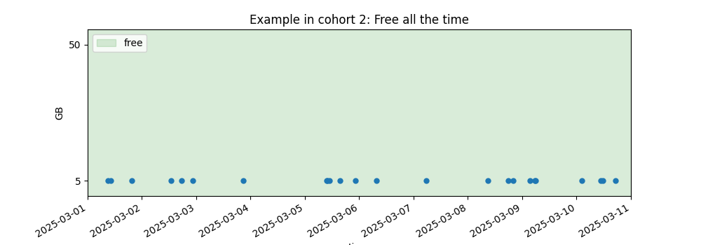
Free uploads example

Slide 7
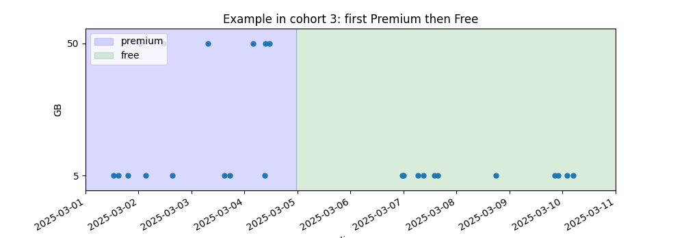
Premium-Free uploads example

Slide 8
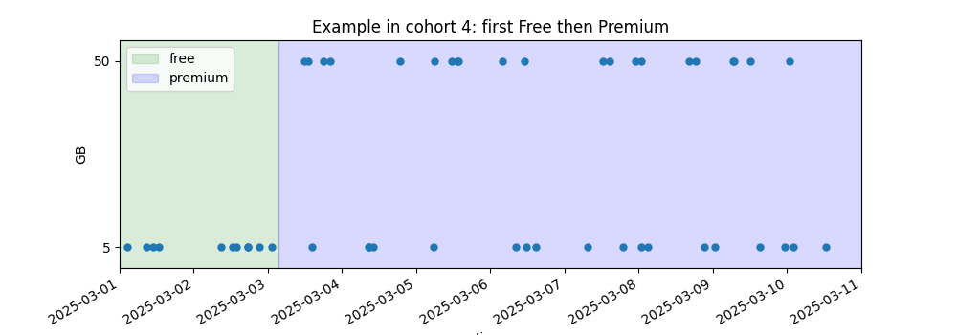
Free-Premium uploads example

Slide 9
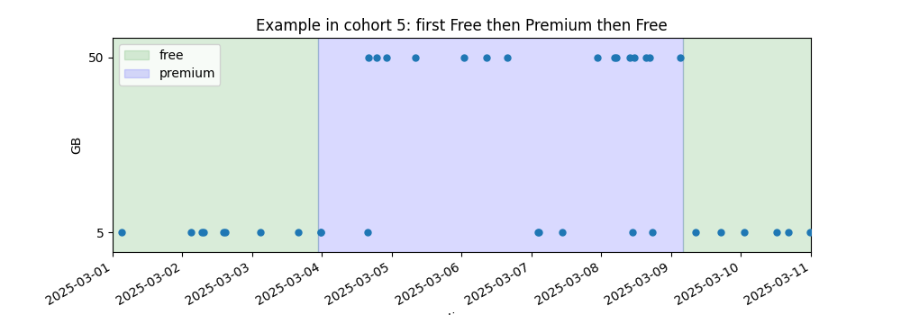
Free-Premium-Free uploads example

Slide 10
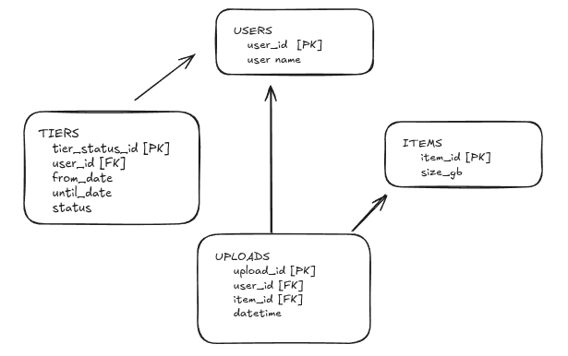
Graph for KumoRFM

Slide 11
First attempt at prediction (failed)
PREDICT
COUNT(uploads.* where items.size_gb=50, 0, 3, hours)>0
FOR users.user_id = 5
Error: Unsupported implicit join.
Static references to columns from other tables that implicitly contain a foreign key to primary key connection are not supported in foundation model queries.
Your query implicitly requires a join uploads.item_id -> items.item_id. Please remove the reference to table items and retry, or train a new model instead of the foundation model.
My solution: add size_gb to uploads by joining with items (then ignore items).

Slide 12
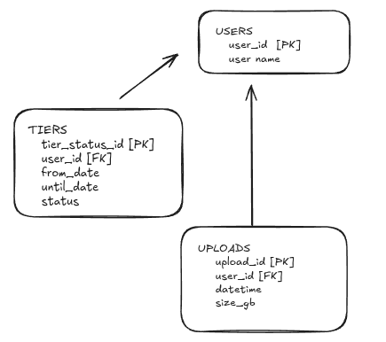
Graph for KumoRFM (after fix)

Slide 13
Predictions
query = f"""
PREDICT
COUNT(uploads.*
where uploads.size_gb=50, 0, {hours}, hours)>0
FOR users.user_id = {uid}
"""
Compare predicted vs actual probabilities.
Premium actuals: 1 – exp(-lambda* hours)
Free actuals: 0

Slide 14
Actual vs Predicted for Free-Premium-Free user
user_id | datetime | status | Hours (prediction window | Actual Probability | Estimated Probability
45 | 2025-03-02 11:15:07 | Free | 1 | 0.0000 | 0.0005
 |  |  | 2 | 0.0000 | 0.0009
 |  |  | 4 | 0.0000 | 0.0088
 | 2025-03-06 13:20:27 | Premium | 1 | 0.0952 | 0.1037
 |  |  | 2 | 0.1813 | 0.1719
 |  |  | 4 | 0.3297 | 0.3336
 | 2025-03-10 02:05:20 | Free | 1 | 0.0000 | 0.0534
 |  |  | 2 | 0.0000 | 0.1665
 |  |  | 4 | 0.0000 | 0.1198

Slide 15
Observations on predicted probabilities
Probability estimation on Premium works well.
For Free, it works well only in the first period.
For Free, in the second period, seems influenced by the stats during the Premium period.
Increasing number of hops did not help.

