Slide 1

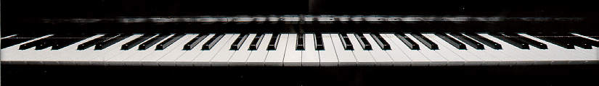
Introduction
to Csound 2

Slide 2
The Csound Score
a group of function tables and list of note statements
  combining score with orchestra creates a soundfile
Csound sorts notes by start time so they can appear in the list in any order
naming convention: .sco file contains Csound score

Slide 3
A Simple Score
; sinewave.sco - use with sinewave.orc
; waveform for oscillator - a sine wave
f1 0 16385 10 1
;p1 p2 p3 p4 p5 p6 p7
; st dur amp freq attck decay
i1 1 2 4000 440 .1 1.4
end

Slide 4
The Note Statement
;p1 p2 p3 p4 p5 p6 p7
; st dur amp freq attck decay
i1 1 2 4000 440 .1 1.4
end
scores specify parameter values for each note such as
  amplitudes
  frequencies
  attack
  decay times

Slide 5
The Note Statement
;p1 p2 p3 p4 p5 p6 p7
; st dur amp freq attck decay
i1 1 2 4000 440 .1 1.4
“i” indicates note statement
p1 always contains the instrument number
  instrument number 1 should play the note
p2 always contains the note start time
  in beats per minute
p3 always contains the note duration
  in beats per minute

Slide 6
The Note Statement
;p1 p2 p3 p4 p5 p6 p7
; st dur amp freq attck decay
i1 1 2 4000 440 .1 1.4
in this example
  p4 contains the maximum amplitude
  p5 contains the frequency of the note in Hertz
  p6 contains the attack duration in seconds
  p7 contains the decay duration in seconds

Slide 7
The Note Statement
;p1 p2 p3 p4 p5 p6 p7
; st dur amp freq attck decay
i1 1 2 4000 440 .1 1.4
end
end indicates the end of the note list
  Csound ignores any events following it
  “e” is shortcut for “end”

Slide 8
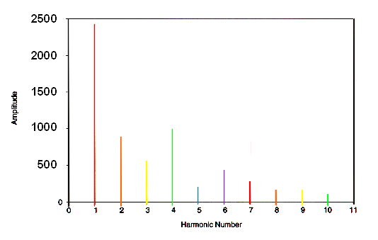
Amplitude (p4)
spectrum of additive synthesis group (10 harmonics)

Slide 9
[i:46] Additive Synthesis Score
; p2 p3 p4 p5 p6 p7
; st dur amp harm attk dec
i1 1 5 2400 1 .25 .05
i1 . 4.5 900 2 .28 .048
i1 . 4 600 3 .03 .047
i1 . 3.5 1000 4 .031 .044
i1 . 3.25 180 5 .032 .043
i1 . 3.1 400 6 .033 .039
i1 . 2.85 250 7 .034 .035
i1 . 2.55 90 8 .035 .031
i1 . 2.17 90 9 .036 .028
i1 . 2.1 55 10 .037 .025

Slide 10
The Csound Score
the dots in p2 are a shortcut that allows Csound to re-use the previous value in those p-fields
in this score, all the notes
  begin at the same time (st=1)
  blend together to create a single sound
  have varying durations so the sound changes

Slide 11
Amplitude (p4)
this score sets the amplitude of the first partial to 2400
total amplitude of all partials is 5965

Slide 12
Amplitude (p4)
Since Csound uses 16-bit integer samples, the largest amplitude possible without distortion is 32,767
two simultaneous notes, each with an amplitude of 4,000 can produce a combined amplitude of 8,000 if their peak amplitudes are together
scores — such as this one — with several simultaneous notes may require scaling down their amplitudes

Slide 13
Avoiding Overflow
Run Csound. The maximum amplitude of the output is:
end of score. overall amps: 35003.6
overall samples out of range: 0
To avoid overflow, in the orchestra scale the output:
out asig * .9
32767/35003.6 = .936
Run Csound again
  check that the maximum amplitude is less than 32767:
end of score. overall amps: 31503.2

Slide 14
Amplitude (p4)
A significant noticeable increase in loudness level (e.g., from mf to f) roughly corresponds to increase by an amplitude factor of 1.5
  example, a note with amplitude of 6,000 will be about one dynamic level louder than a note with amplitude of 4,000

