Slide 1

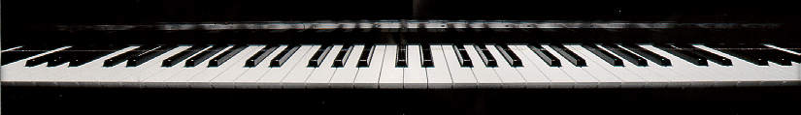
Introduction
to Csound 3

Slide 2
The Csound Orchestra
semi-colon begins a comment
  Csound ignores
    everything on the line after the semi-colon
    blank lines
instr 1 — gives instrument number
  first line of instrument design

Slide 3
Assembly Language-Style Syntax
each line of instrument — one operation
  result variable — left column
    except with operations such as out which do not have a result
  the operation (an "opcode") — second column
    tells Csound which unit generator to use
  one or more arguments — third column
result opcode argument1, argument2, ...
out signal

Slide 4
Initial Variables
begin with the letter "i"
ifreq and iwtnum are initial variables
set their values at the beginning of each note — they are single numbers
remain constant for the note duration — BUT
  additional statements can revise them
  example: multiplying iamp by .5 cuts the amplitude in half
iamp = p4
iamp = iamp * .5

Slide 5
Initial Variables
iamp — constant representing the maximum amplitude of note (value from parameter field 4 in the score)
ifreq — the frequency of the note (p5)
iattack — the attack time in seconds (p6)
idecay — the decay time (p7)
isustain — sustain time — duration between attack and decay
  isustain definition must come after iattack and idecay

Slide 6
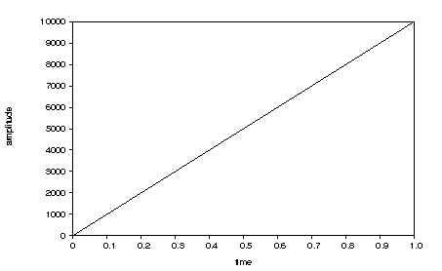
Amplitude Envelopes
ampenv linseg 0,idur,iamp
can fade the waveform in
time-varying scalers that allow waveforms to fade in or out and vary in overall amplitude
amplitude envelope

Slide 7
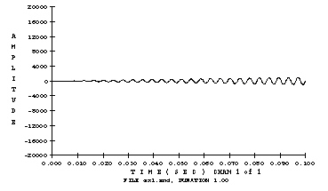
Amplitude Envelopes
Output signal in first .1 seconds:

Slide 8
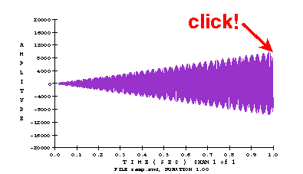
Amplitude Envelopes
[i:80] Output signal over full note duration:

Slide 9
Amplitude Envelopes
ampenv linseg 0,iattack,iamp,idecay,0
[i:81] add decay to the envelope to control how the note fades out
iamp
0
iattack
idecay

Slide 10
Audio Rate Variables
ampenv linseg 0,iattack,iamp,isustain,iamp,idecay,0
[i:82] ampenv — amplitude envelope controlling how the note fades in and out
  linseg arguments — line segment breakpoints
  shaped by attack and decay time values in Csound score
iamp
0
iattack
isustain
idecay

Slide 11
The Csound Orchestra
; amplitude envelope and signal:
ampenv linseg 0,iattack,1,isustain,1,idecay,0,1,0
asig oscili iamp, ifreq, iwave ; generate signal
out asig * ampenv ; output signal
endin ; end of instrument
oscili statement generates the output signal (asig)
  first argument — amplitude (iamp)
  second argument — frequency (ifreq)
  third argument — wavetable number (1)
out writes asig to the soundfile
endin turns off the instrument design

Slide 12
oscili
a basic Csound unit generator which performs wavetable lookup
arguments:
  xamp — the note's maximum amplitude
  xfreq — frequency
  iwtnum — wavetable number
  example:
asig oscili ampenv, ifreq, iwtnum
first letter of each result or argument name
  specifies whether the variable remains constant or varies over time

Slide 13
Audio Rate Variables
change every sampling period
always begin with the letter "a"
made of many numbers — used for time-varying variables such as signals and envelopes
  the result ampenv in the example is an audio rate variable:
ampenv linseg 0, iattack, iamp, isustain, iamp, idecay, 0
iamp
0
iattack
isustain
idecay

Slide 14
Control Rate Variables
change once every control period
always begin with "k"
change more slowly than audio rate variables
  control rate usually about 1/10 of audio rate
not as precise as audio rate variables, but can efficiently represent slowly varying functions such as some amplitude envelopes
Not as common in recent years with improved CPU speeds. Now many Csound user only use audio rate variables for time-varying variables.
kfreq = ifreq + kvib

Slide 15
The Csound Orchestra
;sinewave.orc ; name of orchestra
sr=22050 ; sampling rate
kr=2205 ; control rate
ksmps=10 ; samples/control per.
nchnls=1 ; 1 channel playback
;-----------------------------------------------------
instr 1 ; beginning of instr.
idur = p3 ; duration
iamp = p4 ; maximum amplitude
ifreq = p5 ; frequency in Hertz
iattack = p6 ; attack time dur.
idecay = p7 ; decay time dur.
isustain = idur - iattack - idecay ; remaining dur.
iwave = 1 ; use wavetable 1
continued on following slide ...

Slide 16
The Csound Orchestra
; amplitude envelope and signal:
ampenv linseg 0, iattack, 1, isustain, 1, idecay, 0
asig oscili iamp, ifreq, iwave ; generate signal
out asig * ampenv ; output signal
endin ; end of instrument

