Slide 1

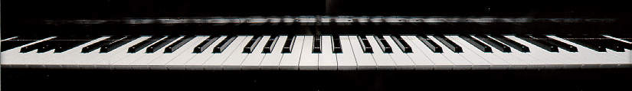
Introduction
to Csound 5

Slide 2
Parameter (p) Variables
contain the score parameter values for each note
allow score to control orchestra
  p1 — always the instrument number
  p2 — always the start time
  p3 — always the duration
    in some effects, such as reverb, lengthening p3 allows the sound to die away before cutting it off
p3 = p3 + iring
user defines the other parameter fields

Slide 3
Labels
signposts directing Csound to the right place in the orchestra
NOT variables
can start with any character - BUT
  don't start labels with "p," "g," "i," "k" and "a" — these reserved letters begin variable names
end with colon
may have their own line or may precede an operation line
label: result opcode argument1, argument2, ...

Slide 4
goto Statements
tell the program to go to one of the labels
usually in if statements.
if ifreq > 300 goto label

Slide 5
The Function Statement
f1 0 16385 10 1
f1 — wavetable number 1
  the "1" used by oscili in sinewave.orc
0 — load at time zero
16385 — load with 16385 points
  number of points in wavetable must be
    a power of 2
      512, 1024, 2048, 4096, 8192, 16384
OR
    (a power of 2) + 1
      513, 1025, 2049, 4097, 8193, 16385

Slide 6
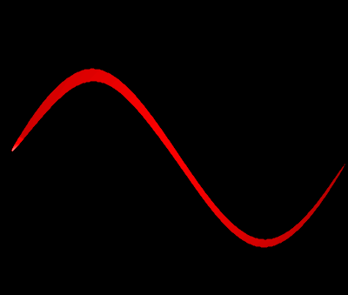
The Function Statement
f1 0 16385 10 1
a lower number of points = faster wavetable loading (draft)
a higher number of points = better sound quality (finished)
10 — fill the table with a (group of) harmonic [ii:18] sine waves

Slide 7
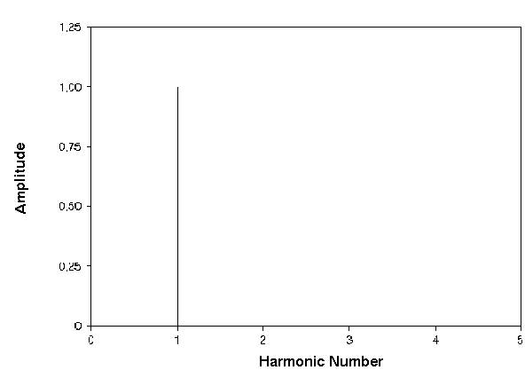
The Function Statement
f1 0 16385 10 1
After the "10," each number indicates the strength of that harmonic number
for example, the single number "1" indicates that this is a sine wave — only the first harmonic partial (fundamental)
Spectral Snapshot
of Wavetable
No. 1

Slide 8
The Function Statement
oscili statement takes values from this waveform
for each tone, oscili repeats this waveform at frequency of the tone
  example: 440 times per second for A4

Slide 9
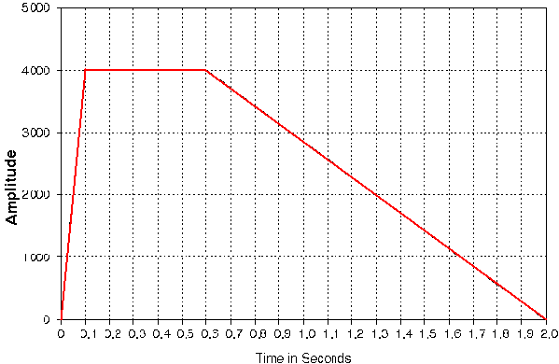
Amplitude Envelope
fades in and out as shown in figure
  note statement sets
    the attack time of each note to .1 seconds
    the decay time to 1.4 seconds

Slide 10

Review Question
f1 0 16385 10 10 9 8 7 6 5 4 3 2 1
The line of code in the box is:
A. a tempo statement
B. a note statement
C. the end of the score file
D. a function statement
E. none of the above

Slide 11
A Global Frequency Factor
; freqfactor.orc ; name of orchestra
sr=22050 ; sampling rate
kr=2205 ; control rate
ksmps=10 ; samples/control per.
nchnls=1 ; 1 channel playback
;-----------------------------------------------------
gifreq = 2 ; make all notes octave higher
;-----------------------------------------------------
instr 1 ; sine wave or whatever
...
ifreq = p5 * gifreq
...
out asig ; output signal
endin ; end of instrument

Slide 12
[ii:80] A Global Frequency Factor
; freqfactor.sco - use with freqfactor.orc
; waveform for oscillator - 10 sine waves
f1 0 16385 10 10 9 8 7 6 5 4 3 2 1
;p1 p2 p3 p4 p5 p6 p7
; st dur amp freq attck dec
i1 1 1 5000 440 .1 .7
end

Slide 13
Function Statement
defines the wavetable
f1 0 16385 10 10 9 8 7 6 5 4 3 2 1
f1 - wavetable number 1 (the "1" used by oscili in sinewave.orc)
0 - load the wavetable at time 0
16385 - load the wavetable with 16385 points

Slide 14
Function Statement
f1 0 16385 10 10 9 8 7 6 5 4 3 2 1
gen 10 - each number indicates the strength of that harmonic number
  wavetable f1 uses the first 10 harmonics
  the harmonics are in consecutive order
    the first harmonic has a strength of 10
    the second harmonic has a strength of 9
  normalization
    all the harmonics are normalized so that the peak amplitude of the waveform is 1
    Use -10 instead of 10 to skip normalization

Slide 15
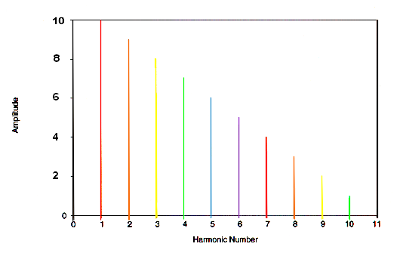
Amplitude (p4)
relative amplitudes of 10 harmonics in function table
f1 0 16385 10 10 9 8 7 6 5 4 3 2 1

Slide 16
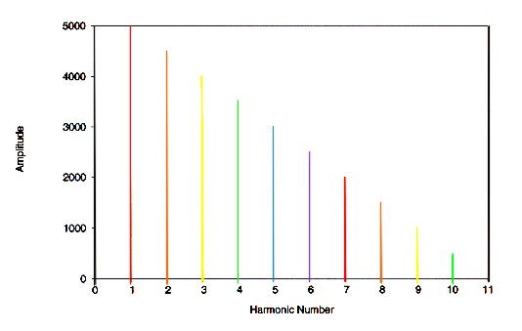
Review Question
Which function statement can represent the spectrum shown in the figure:
A. f1 0 16385 10 1 2 3 4 5 6 7 8 9 10
B. f1 0 16385 10 10 9 8 7 6 5 4 3 2 1
C. f1 0 16385 10 1 1 1 1 1 1 1 1 1 1
D. f1 0 16385 10 1 0 1 0 1 0 1 0 1 0
E. none of the above

