Slide 1
Filters

Slide 2
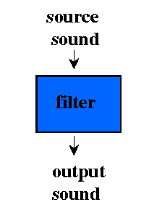
Filtering
Filtering is another name for subtractive synthesis because it subtracts frequencies from a sound
Filtering is the opposite approach of additive synthesis:
  Additive synthesis builds a complex sound out of sine waves.
  Subtractive synthesis starts with a complex source sound and removes some of the frequency components.

Slide 3
Sound Examples
Atlantic Brass Quintet
  Praetorius, "Introduction" from Terpsichore:
    2 trumpets (high)
    horn and trombone (medium)
    tuba (low)
[iv:10] original
[iv:11] low-pass filtered
[iv:12] high-pass filtered
[iv:13] band-pass filtered
[iv:14] notch (band-stop) filtered
[iv:10] original

Slide 4
Csound Filters
Four Main Filter Types:
  Low-pass — tone
  High-pass — atone
  Band-pass — reson
  Notch (Band-stop) — areson

Slide 5
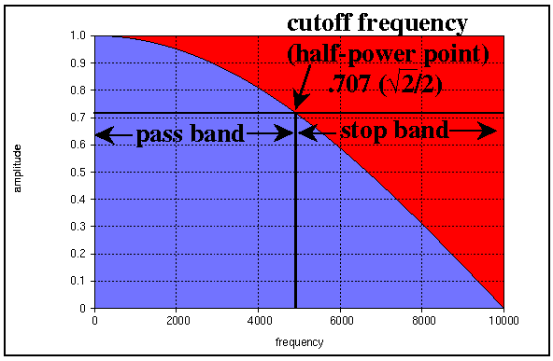
Low-Pass Filter
Very common, probably about 50% of filters used in computer music are low-pass.
Frequency Response Curve
power = amp²; amp = sqrt(power)
1/2 power = sqrt(2)/2 amp = ~71% amp

Slide 6

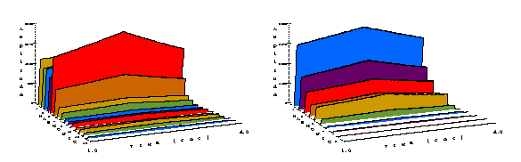
Csound Low-Pass Filter (tone)
synthesized oboe
[iv:15] original tone
261.6 Hertz
[iv:16] low-pass filter
at 523.2 Hz

Slide 7
Csound Low-Pass Filter (tone)
synthesized oboe with low-pass filter
; p2 p3 p4 p5 p6 p7 p8
; start dur amp freq attk dec filtfr
i10 1 3.0 10000 261.6 .045 .15 523.2
;ifiltfr=cps of response
afilt tone asig, ifiltfr ;curve's half amp point
afilt2 tone afilt, ifiltfr ;2nd filter =
;steeper rolloff
abal balance afilt2, asig ;balance amplitude

Slide 8
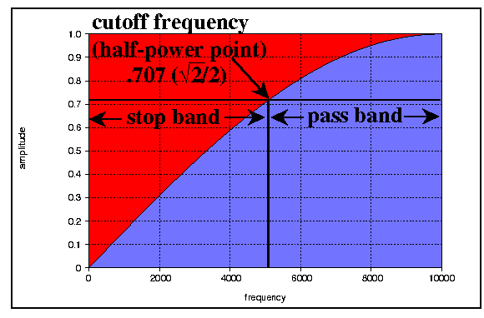
High-Pass Filter
Passes high frequencies, attenuates lows.
Used to brighten a signal
  be careful, can also increase noise
About 20% of filters used in computer music are high-pass.
Frequency Response Curve

Slide 9
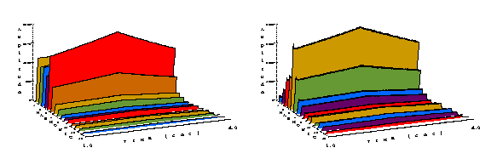
Csound High-Pass Filter (atone)
synthesized oboe
[iv:15] original tone
261.6 Hertz
[iv:17] high-pass filter
at 1046.4 Hz

Slide 10
Csound High-Pass Filter (atone)
synthesized oboe with high-pass filter
; p2 p3 p4 p5 p6 p7 p8
; start dur amp freq attk dec filtfr
i10 1 3.0 10000 261.6 .045 .15 1046.4
;ifiltfr=cps of response
afilt atone asig, ifiltfr ;curve's half amp point
afilt2 atone afilt, ifiltfr ;2nd filter =
;steeper rolloff
abal balance afilt2, asig ;balance amplitude

Slide 11
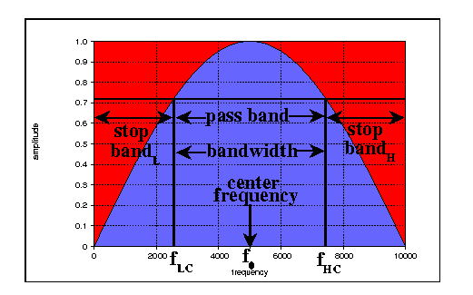
Band-Pass Filter
Passes band of frequencies, attenuates those above and below band.
Most common in implementations of discrete Fourier transform to separate out harmonics.
About 20% of filters used in computer music are band-pass.
Frequency Response Curve

Slide 12
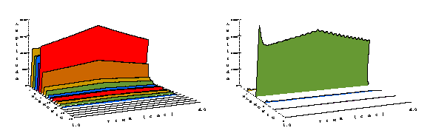
Csound Band-Pass Filter (reson)
Defined by center frequency f₀, and bandwidth of pass-band = f_{highcutoff} - f_{lowcutoff}
synthesized oboe
[iv:15] original tone
261.6 Hertz
[iv:18] b-pass filter
at 523.2 Hz/10 bw

Slide 13
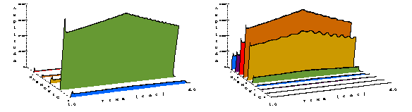
Csound Band-Pass Filter (reson)
synthesized oboe
[iv:19] b-p filter at
1046.4 Hz/100 bw
[iv:20] b-p filter at
1046.4 Hz/500 bw

Slide 14
Csound Band-Pass Filter (reson)
synthesized oboe with band-pass filter
; p2 p3 p4 p5 p6 p7 p8 p9
; start dur amp freq attk dec filtfr bw
i10 1 3.0 10000 261.6 .045 .15 523.2 10
i10 1 3.0 10000 261.6 .045 .15 1046.4 100
i10 1 3.0 10000 261.6 .045 .15 1046.4 500
;ifiltfr=center freq of
afilt reson asig,ifiltfr,ibw,0 ;the passband
afilt2 reson afilt,ifiltfr,ibw,0 ;steeper rolloff
abal balance afilt2, asig ;balance amplitude

Slide 15
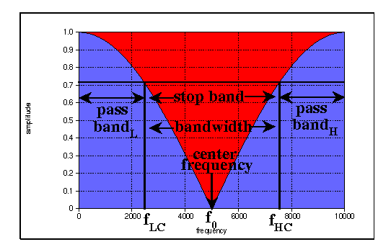
Band-Stop (Notch) Filter
Stops band of frequencies, passes those above and below band.
Most common in removing electric hum (50 Hertz A/C).
About 10% of filters used in computer music are band-stop.
Frequency Response Curve

Slide 16
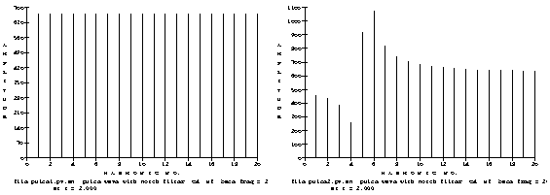
Csound Notch Filter (areson)
Defined by center frequency f₀, and bandwidth of stop-band = f_{highcutoff} - f_{lowcutoff}
pulse wave
[iv:21] original tone
261.6 Hertz
[iv:22] notch filter
at 1046.4 Hz
100 bw

Slide 17
Csound Notch Filter (areson)
synthesized oboe with notch filter
; p2 p3 p4 p5 p6 p7 p8 p9
; start dur amp freq attk dec filtfr bw
i11 1 3.0 10000 261.6 .045 .15 1046.4 100
;ifiltfr=center freq of
afilt areson asig,ifiltfr,ibw,1 ;the stopband
afilt2 areson afilt,ifiltfr,ibw,1 ;steeper rolloff
abal balance afilt2, asig ;balance amplitude
NOTE: The fourth argument in areson is scaling — it must be 1 (0 default in Csound manual doesn't work)

Slide 18
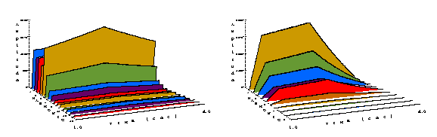
LP Filter
original synthesized oboe tone 261.6 Hertz
[iv:15] 0. unfiltered tone
[iv:26] 1. low-pass filter
523.2 Hz

Slide 19
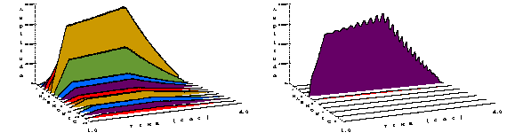
HP and BP Filter
original synthesized oboe tone 261.6 Hertz
[iv:27] 2. high-pass
1046.4 Hz
[iv:28] 3. band-pass
1046.4 Hz

Slide 20
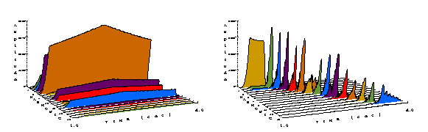
Dynamically Changing the Center Frequency and Bandwidth
original synthesized bassoon tone 69 Hz
b-pass filter — freq from fundamental to harmonic 15
[iv:23] bassoon at 69 Hz
[iv:24] bp filter 69-1035 Hz/bw 15
; p2 p3 p4 p5 p6 p7 p8 p9 p10 p11 p12 p13
; st dur amp frq attk dec flt1 flt2 bw1 bw2 wai gls
i15 1 3 9000 69 .23 .1 69 1035 15 15 .2 .6

Slide 21
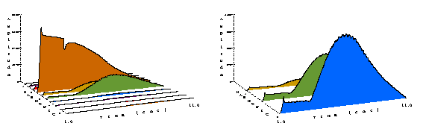
Dynamically Changing the Center Frequency and Bandwidth
original synthesized bassoon tone 69 Hz
band-pass filter — bw moving from 10 to 500
[iv:25] bp filter 276 Hz/bw 10-500
same — first 3 harmonics
; p2 p3 p4 p5 p6 p7 p8 p9 p10 p11 p12 p13
; st dur amp frq attk dec flt1 flt2 bw1 bw2 wai gls
i15 1 10 9000 69 .23 .1 276 276 10 500 .2 .6

Slide 22
Dynamically Changing the Center Frequency and Bandwidth
In the Csound manual:
ar tone asig, khp[,istor] ;l-pass
ar atone asig, khp[,istor] ;h-pass
ar reson asig, kcf,kbw[,iscale,istor] ;b-pass
ar areson asig, kcf,kbw[iscale,istor] ;notch
Default is 0 for iscale and istor
NOTE: Make sure that iscale is 1 if using the areson notch filter, as Csound doesn't work properly with the 0 default

Slide 23
Dynamically Changing the Center Frequency and Bandwidth
We can change the half-power, the center frequency and the bandwidth at the k-rate using linseg statements
original synthesized bassoon tone 69 Hz
b-pass filter — freq from fundamental to harmonic 15
kflfr linseg 69, idur, 1035 ;linseg for center
afilt reson asig,kflfr,ibw,0 ;freq of the passband
band-pass filter — bandwidth moving from 10 to 500
kbw linseg 10, idur, 500 ; linseg for bandwidth
afilt reson asig,iflfr,kbw,0 ; of the passband

Slide 24
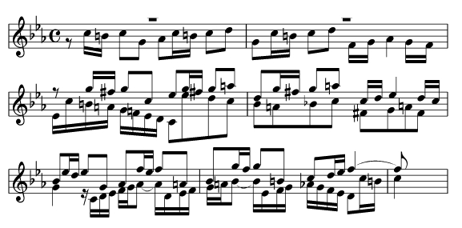
Dynamically Changing the Center Frequency and Bandwidth
a musical example: oboe, Bach, Fugue #2 in C Minor
[iv:29] no filter
[iv:30] lp filter, 55 -> 160 Hertz
[iv:31] bp filter, 220 -> 7040 Hertz, bw 1
[iv:32] bp filter, 220 -> 7040 Hertz, bw 1 -> 100

Slide 25
[iv:33] Hiss and Hum compare with [iv:34] 60 Hertz sine wave
hiss
  high frequency noise you hear on cassette tapes
  unfocused — not just a single frequency
  which kind of filter can you use to get rid of it?
hum
  the noise you hear from machinery (such as lights and computers)
  focused frequency, same as the local electrical power
  which kind of filter can you use to get rid of it?

Slide 26
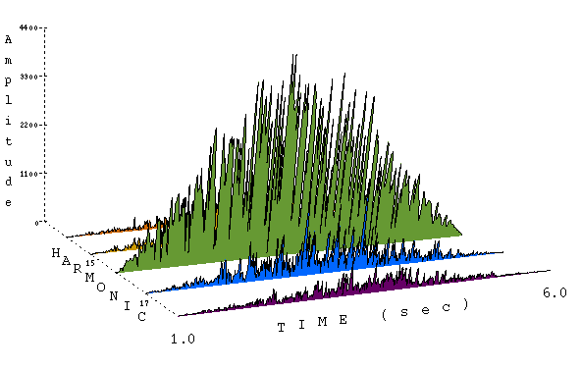
Filtered Noise with Band-Pass Filters
[iv:35] noise with bp filter at 1046.4 Hz/bw 1% of filter freq
; p2 p3 p4 p5 p6 p7 p8
; start dur amp freq attk dec bw
i16 1 5 4000 1046.4 2 2.5 .01

Slide 27
Filtered Noise with Band-Pass Filters
[iv:36] a musical example: Ayers, Companion of Strange Intimacies

Slide 28
Filtered Noise with Band-Pass Filters
;noiseflt.orc
instr 16 ; noise filter
idur = p3
iamp = p4
Ifreq = p5 ;filter frequency
iattack = p6
idecay = p7
ibw = p8 * ifreq ;max bandwidth for filter
isus = idur - iattack - idecay

Slide 29
Filtered Noise with Band-Pass Filters
kenv linseg 0,iattack,1,isus,1,idecay,0,1,0 ;ampenv
knenv = kenv * iamp ;env for noise source
anoise rand knenv ;noise source
;filter the noise source at ifreq
afilt reson anoise,ifreq,ibw*kenv,0,0
abal balance afilt, anoise ;balance amplitude
out abal ;OUTPUT asig here
endin

