Slide 1

Frequency
Modulation

Slide 2
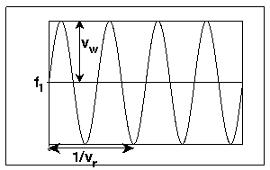
Frequency Modulation
related to musical vibrato
Vibrato - Periodic variation of frequency
A simple signal:
sample(time) = sin(2 freq(time)time)
with vibrato
  freq(time) = freq₁ + vib_{wid}sin(2 vib_{rate}time)
vib_{wid} = vibrato width
  amount of vibrato
vib_{rate} = vibrato rate
  frequency of vibrato

Slide 3
Vibrato
Typical vibrato values:
  vib_{rate} = 5 Hertz
    normal range:
    1-6 Hertz, with slight acceleration during tone
  vib_{wid}
    minimum: 0 (none)
    usual maximum for instruments:
    .01*freq₁ (1%)
    usual maximum for voices:
    .05*freq₁ (5%)
    maximum for special effects:
    SR/2 - highest frequency in signal

Slide 4
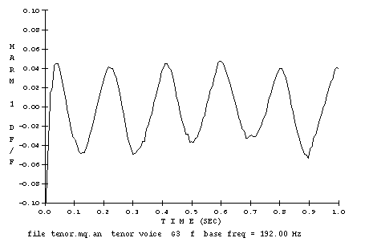
[iii:1] Tenor Voice Vibrato
Tenor voice has 5 Hertz vibrato rate and vibrato width of 4.5%

Slide 5
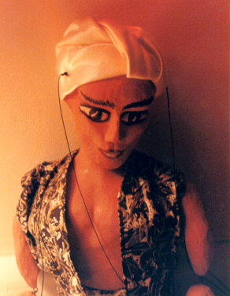
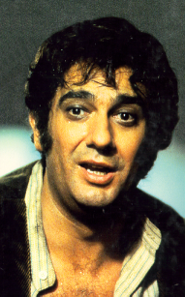
Vibrato in Csound
[iii:2] synthesized tenor without vibrato
[iii:3] synthesized tenor with vibrato
[iii:1] the real tenor

Slide 6
Vibrato in Csound
orchestra:
avib oscili ivibwidth, ivibrate, 1 ; modulator
asig oscili iamp, ifreq+avib, 2 ; carrier
out asig ; output
score:
f1 0 16385 -10 1 ; for modulator
f2 0 16385 -10 1 .9 .8 whatever … ; for carrier

Slide 7
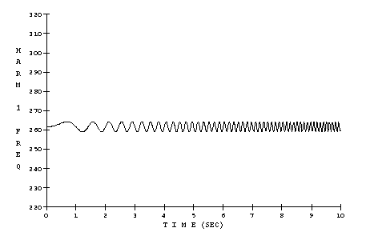
[iii:4] Vibrato Rate
vib_{rate} = 0 -----> 10 Hertz (over 10 seconds)
vib_{wid} = .01 * freq₁ (1%)
slow vibrato fast vibrato

Slide 8
Vibrato Rate
orchestra:
;fmbasic.orc - use with fmbasic.sco
instr 1 ; increase vibrato rate
idur = p3 ; (10)
iamp = p4
ifreq = p5
ivibwidth = .01*ifreq
iwave1 = 1
kvibrate linseg 0, idur, 10
aenv linseg 0, .1, 1, idur-.3, 1, .2, 0
avib oscili ivibwidth, kvibrate, iwave1
asig oscili iamp, ifreq+avib, iwave1
out asig * aenv
endin

Slide 9
Vibrato Rate
score:
; fmbasic.sco – use with fmbasic.orc
f1 0 16385 -10 1 ; sine
; start dur amp freq
i1 0 10 10000 261.6 ; Middle C

Slide 10
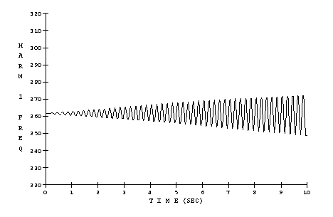
[iii:5] Vibrato Amount
vib_{rate} = 5 Hertz
vib_{wid} = 0 -----> .05 * freq₁ (0-5% over 0:10)
small vibrato large vibrato

Slide 11
Vibrato Amount
orchestra:
;fmbasic.orc - use with fmbasic.sco
instr 2 ; increase vibrato width
idur = p3 ; (10)
iamp = p4
ifreq = p5
ivibrate = 5
iwave1 = 1
kvibwidth linseg 0, idur, .05 * ifreq
aenv linseg 0, .1, 1, idur-.3, 1, .2, 0
avib oscili kvibwidth, ivibrate, iwave1
asig oscili iamp, ifreq+avib, iwave1
out asig * aenv
endin

Slide 12
Vibrato -----> FM
A sine wave with vibrato becomes a full spectrum when vib_{rate} is in the audio range (above 20 Hz), especially as vib_{rate} approaches freq₁.
Since it is no longer vibrato, we use the term modulation frequency instead of vibrato rate.
When vib_{rate} is above 20 Hz:
  freq_{mod} = vib_{rate}

Slide 13
Vibrato -----> FM
With FM, we may not get the frequency out that we put in.
  We call the base frequency of the outer sine wave the carrier frequency freq_{car}:
  sample(time) = sin(2 freq(time)time)
  with:
  freq(time) = freq_{car} + vib_{wid}sin(2 freq_{mod}time)

Slide 14
Vibrato -----> FM
FM uses a modulation index as well as the vibrato width to describe the amount of modulation. The relationship between them is:
  vib_{wid} = Index * freq_{mod}
  or:
  Index = vib_{wid} / freq_{mod}
Typical values for modulation index:
  0 <= Index <= 10

Slide 15
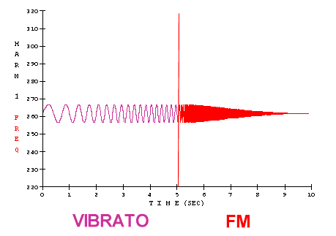

[iii:6] Vibrato -----> FM
freq_{mod} = 1 ---> 6 Hz ---> 261.6 Hz (= vib_{rate})
  (vib) (FM)
Index = .02
  (vib_{wid} = .02 * freq_{mod})
When the frequency of the modulator reaches 6 Hertz (at 5 seconds), the effect changes from vibrato to FM.

Slide 16
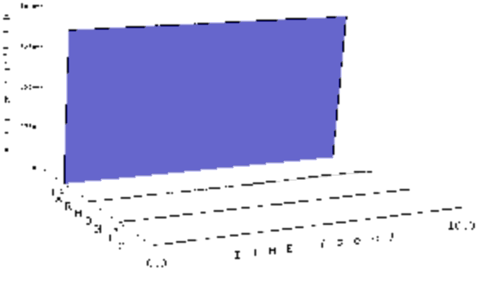
Vibrato -----> FM
The amplitude of the first harmonic remains the same ...
Harmonic 1 Amplitude

Slide 17
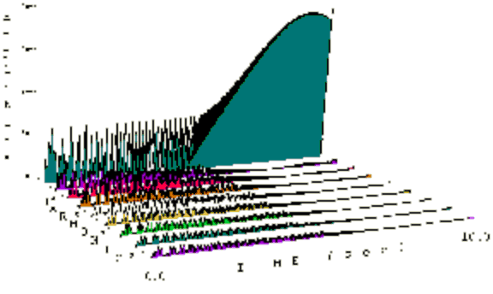
Vibrato -----> FM
… but the amplitudes of the other harmonics change.
Amplitudes of the Other Harmonics

Slide 18
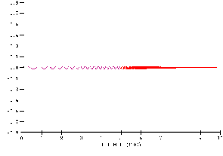
Vibrato -----> FM
The frequency changes of all the harmonics get much faster during FM.
Harmonic 1 Frequency

Slide 19
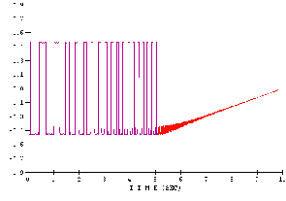
Vibrato -----> FM
The frequency changes of all the harmonics get much faster during FM.
Harmonic 2 Frequency

Slide 20
Vibrato -----> FM
orchestra:
;fmbasic.orc - use with fmbasic.sco
instr 3 ; vibrato --> fm
idur = p3 ; (10)
iamp = p4
ifreq = p5
ivibwidth = .02 * ifreq ; (~5.2 Hertz)
iwave1 = 1
kvibrate linseg 1, idur * .5, 6, idur * .5, ifreq
aenv linseg 0, .1, 1, idur-.3, 1, .2, 0
amod oscili ivibwidth, kvibrate, iwave1
acar oscili iamp, ifreq+amod, iwave1
out acar * aenv
endin

Slide 21
Modulation Index
Index = 0 (no modulation)
Index = .01 - .05 (vibrato range)
As modulation index increases, the spectrum bandwidth increases (and gets brighter).

Slide 22
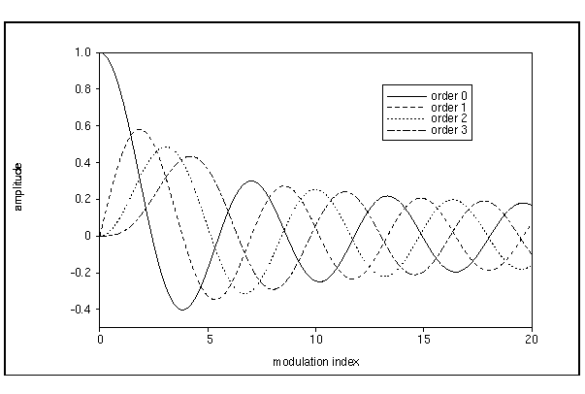
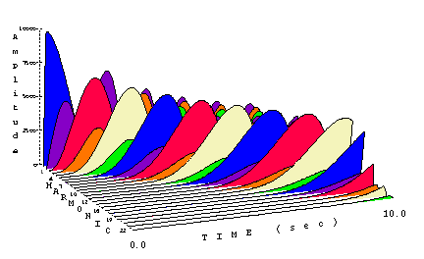
[iii:7] Modulation Index
freq_{mod} = 261.6 Hertz
index = 0 -----> 20 (over 0:10)
Bessel Function,
orders 0 - 3
Harmonic Amplitude vs. Time

Slide 23
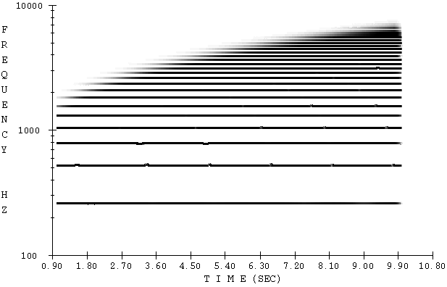
Modulation Index
freq_{mod} = 261.6 Hertz
index = 0 -----> 20 (over 10 seconds)
Frequency vs. Time

Slide 24
Modulation Index
orchestra:
;fmbasic.orc - use with fmbasic.sco
instr 4 ; vibrato --> fm
idur = p3 ; (10)
iamp = p4
ifreq = p5
imodfr = ifreq
icarfr = ifreq
iwave1 = 1
kindex linseg 0, idur, 20
aenv linseg 0, .1, 1, idur-.3, 1, .2, 0
amod oscili kindex*imodfr, imodfr, iwave1
acar oscili iamp, icarfreq+amod, iwave1
out acar * aenv
endin

Slide 25
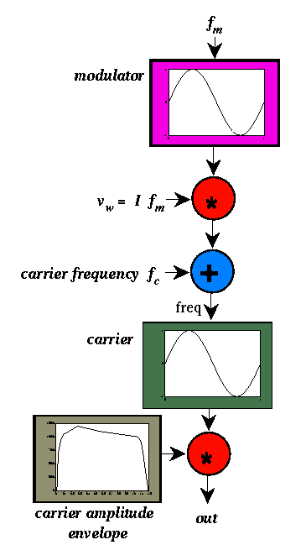
Frequency Modulation Block Diagram

Slide 26
Add Noise
Random Noise Variation
anoise randi .3, 15, giseed
giseed = frac(giseed*105.947)
anoise = anoise + 1
avrate linseg 1, idur, 10
avrate = avrate * anoise
avibwid = ivibwid * anoise
Try different combinations of the parameters to find one that really suits your sound

