Slide 1
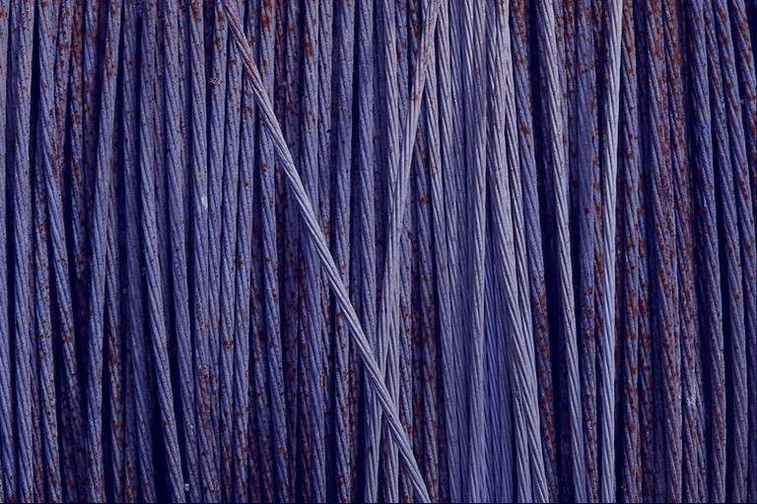
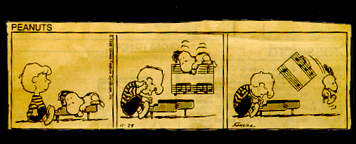
Rhythm

Slide 2
What is Music?
4 main properties of musical sounds:
  rhythm/duration — when to play the notes
  amplitude/loudness — how loud to play the notes
  pitch — which notes to play
  timbre/tone color — sound quality
    which instruments are playing?

Slide 3
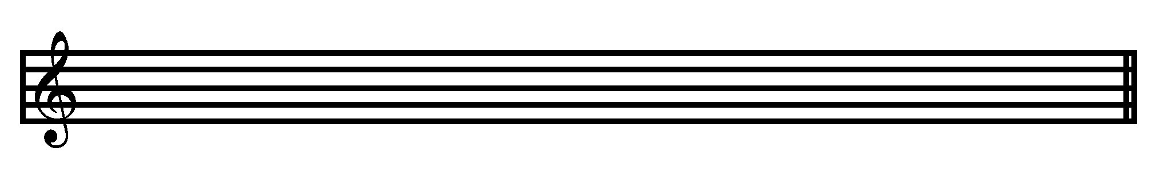
Rhythm
Rhythmic Notation
  Sound (notes) vs. Silence (rests)
  Specifies starting times and durations for individual notes
Staff
  a graph of five horizontal lines for writing musical notes (x = time, y = pitch)
PITCH
TIME

Slide 4


Rhythm
Duration
  how long a sound lasts
Note
  a written symbol that shows the duration (and pitch) of a sound
flag
stem
head

Slide 5
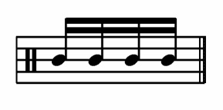
Rhythm
Beam
  the line connecting a group of flagged notes
  beam group = 1 beat
beam

Slide 6
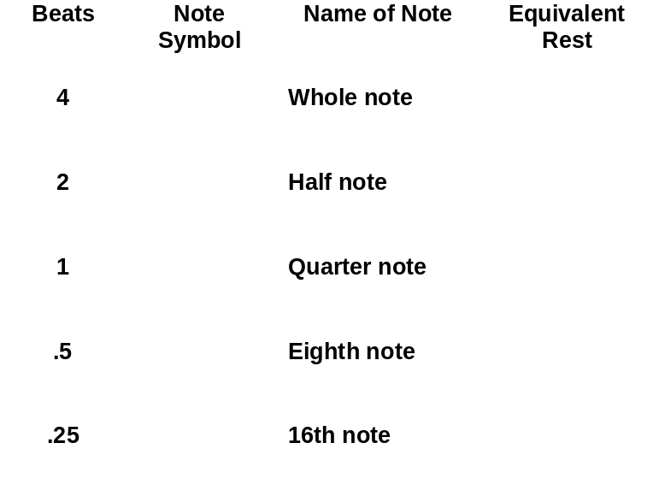
Notation of Equal Subdivisions

Slide 7
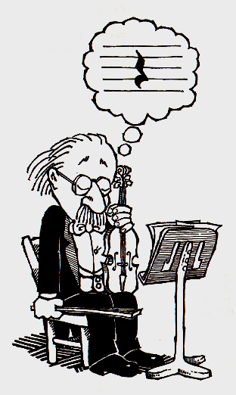

Rest
A short period of silence
  useful for turning pages, breathing, coughing, etc.

Slide 8
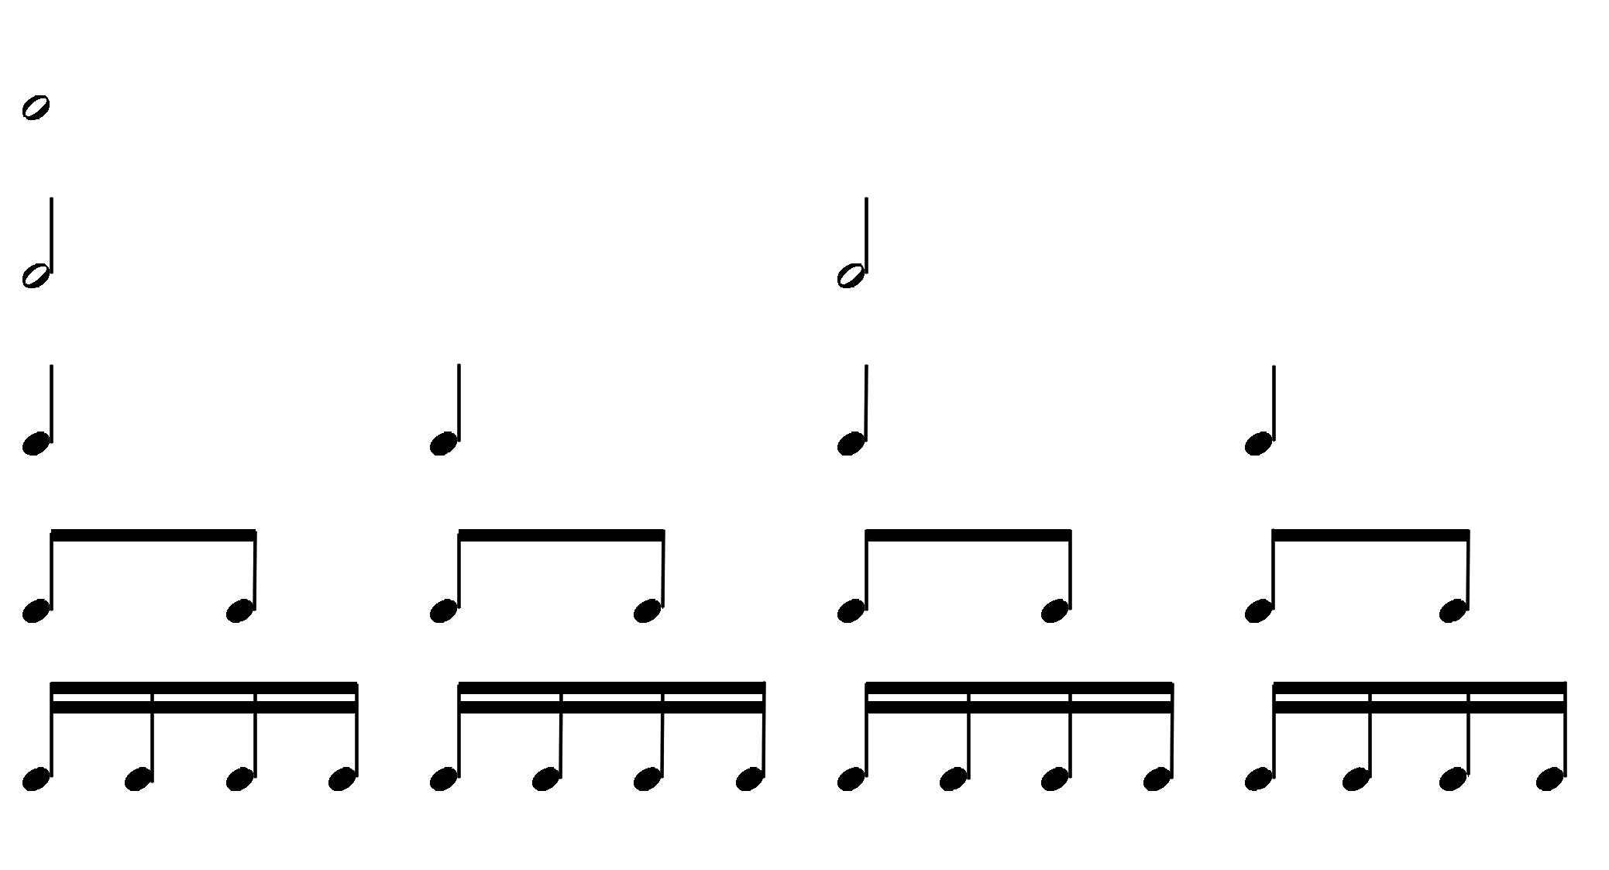

Equal Subdivisions
1 whole note
= 2 half notes
= 4 quarter notes
= 8 eighth notes
= 16 sixteenth notes
Exercise: clap the following rhythm:

Slide 9
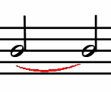
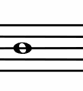
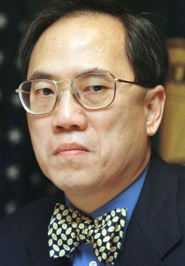
Tie
Linking one note to another.
=
An strange article of clothing worn by Donald Tsang.
Donald Tsang

Slide 10


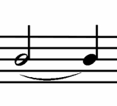

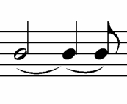
Dots
A dot increases the duration of a note by half its value
=
a second dot adds half the value of the first dot
=

Slide 11
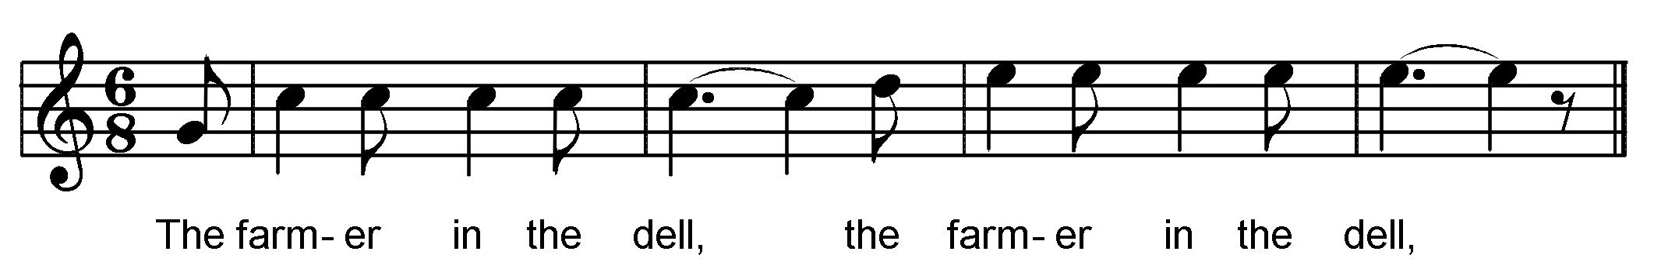
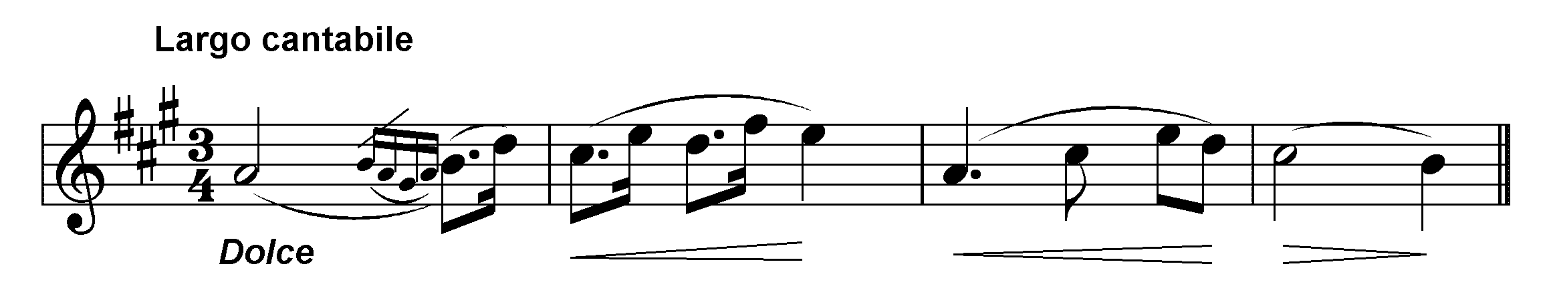
Example
Tie
Tie
[i:50]
Dotted Quarter Note
Dotted Rhythm
  a dotted note followed by a shorter note
  often used in marches
[i:51]

Slide 12
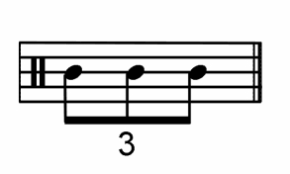
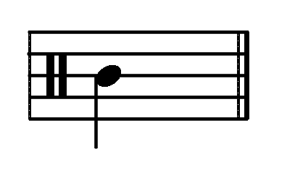
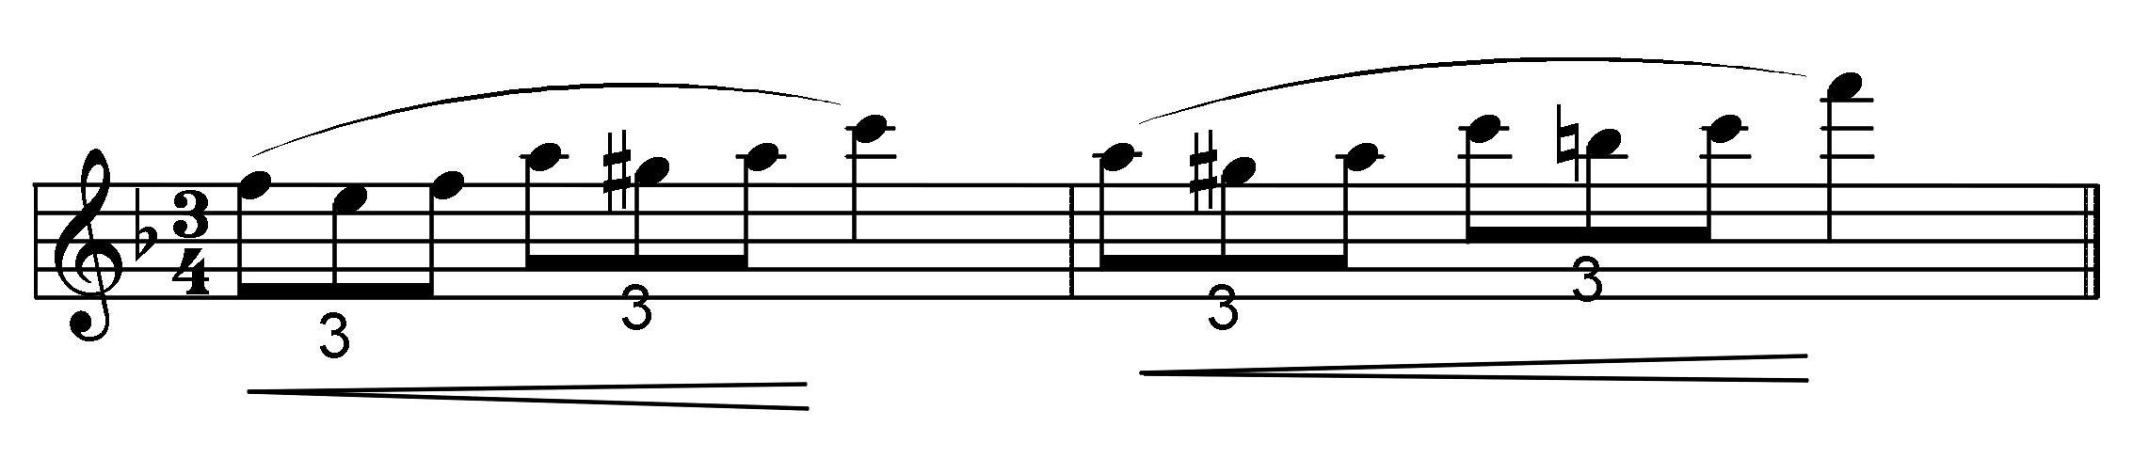
Rhythm
Triplets
  divide a note into thirds
  the notated unit is one unit smaller than the divided beat unit
  in an eighth-note triplet, 3 eighth notes = the duration of 1 quarter note
=
[i:52]

Slide 13
Start and Duration in Csound
usually give the quarter note one beat
  start each note at the correct number of quarter notes
  the duration is also the correct number of quarter notes
what is the start time for the 1st note in the excerpt? what is the duration?
what is the start time for the 8th note in the excerpt? what is the duration?
[i:51]

Slide 14
Two Csound Parameters
;simple.sco - use with simple.orc ; name of score
;function table for waveform for sinewave oscillator
f1 0 4096 10 1
;p1 p2 p3 p4 p5
; start dur amp Hertz
i1 0 2 4000 440 ; note statement
e ; end of score

Slide 15
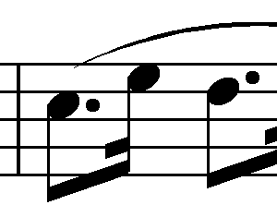
Csound Score for Previous Excerpt
;simple.sco - use with simple.orc ; name of score
;function table for waveform for sinewave oscillator
f1 0 4096 10 1
;p1 p2 p3 p4 p5
; start dur amp Hertz
...
i1 3 .75 . .
i1 3.75 .25 . .
i1 4 .75 . .
...

Slide 16

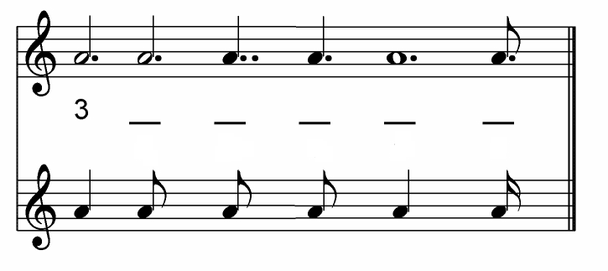
Rhythm Exercise
[i:53] clap the following rhythm:
For each note value on the upper staff, write the number of the note values on the lower staff required for an equivalent duration

