Slide 1

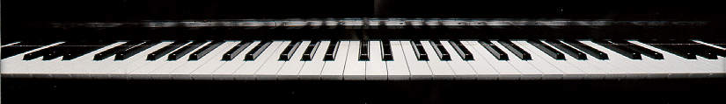
Waveforms,
Sampling and
Aliasing

Slide 2
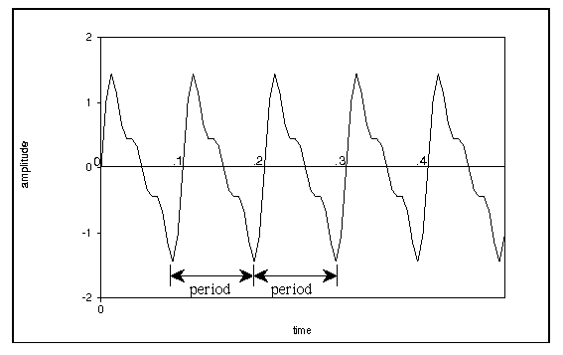
Introduction
For periodic waveforms, the duration of the waveform before it repeats is called the period of the waveform

Slide 3
Frequency
the rate at which a regular vibration pattern repeats itself (frequency = 1/period)

Slide 4
Frequency of a Waveform
The unit for frequency is cycles/second, also called Hertz (Hz).
The frequency of a waveform is equal to the reciprocal of the period.
frequency = 1/period

Slide 5
Frequency of a Waveform
Examples:
  frequency = 10 Hz
  period = .1 (1/10) seconds
  frequency = 100 Hz
  period = .01 (1/100) seconds
  frequency = 261.6 Hz (middle C)
  period = .0038226 (1/ 261.6) seconds

Slide 6
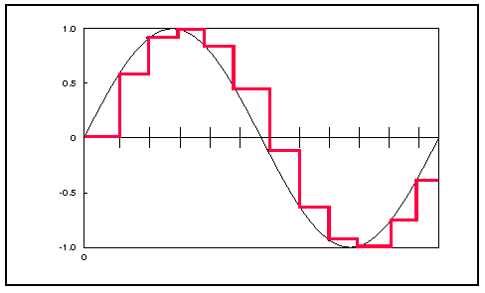
Waveform Sampling
To represent waveforms on digital computers, we need to digitize or sample the waveform.
side effects of digitization:
  introduces some noise
  limits the maximum upper frequency range

Slide 7
Sampling Rate
The sampling rate (SR) is the rate at which amplitude values are digitized from the original waveform.
  CD sampling rate (high-quality):
  SR = 44,100 samples/second
  medium-quality sampling rate:
  SR = 22,050 samples/second
  phone sampling rate (low-quality):
  SR = 8,192 samples/second

Slide 8
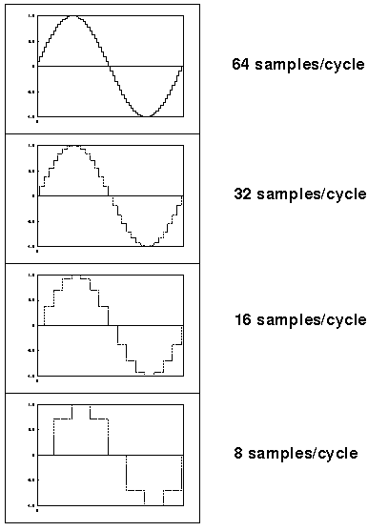
Sampling Rate
Higher sampling rates allow the waveform to be more accurately represented

Slide 9
Nyquist Theorem and Aliasing
Nyquist Theorem:
We can digitally represent only frequencies up to half the sampling rate.
  Example:
  CD: SR=44,100 Hz
  Nyquist Frequency = SR/2 = 22,050 Hz
  Example:
  SR=22,050 Hz
  Nyquist Frequency = SR/2 = 11,025 Hz

Slide 10
Nyquist Theorem and Aliasing
Frequencies above Nyquist frequency "fold over" to sound like lower frequencies.
  This foldover is called aliasing.
Aliased frequency f in range [SR/2, SR] becomes f':
f' = |f - SR|

Slide 11
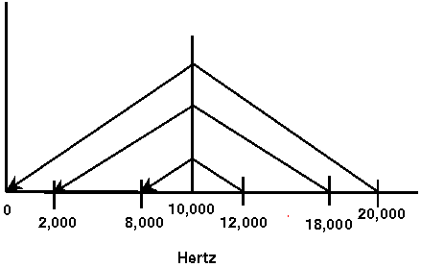
Nyquist Theorem and Aliasing
f' = |f - SR|
Example:
  SR = 20,000 Hz
  Nyquist Frequency = 10,000 Hz
  f = 12,000 Hz --> f' = 8,000 Hz
  f = 18,000 Hz --> f' = 2,000 Hz
  f = 20,000 Hz --> f' = 0 Hz

Slide 12
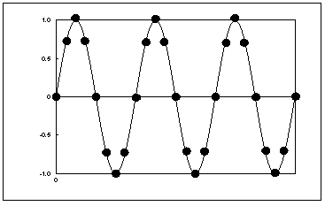
Nyquist Theorem and Aliasing
Graphical Example 1a:
  SR = 20,000 Hz
  Nyquist Frequency = 10,000 Hz
  f = 2,500 Hz (no aliasing)

Slide 13
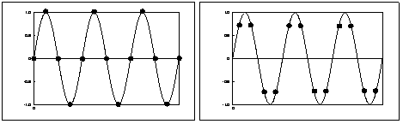
Nyquist Theorem and Aliasing
Graphical Example 1b:
  SR = 20,000 Hz
  Nyquist Frequency = 10,000 Hz
  f = 5,000 Hz (no aliasing)
(left and right figures have same frequency, but have different sampling points)

Slide 14
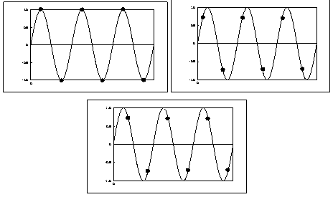
Nyquist Theorem and Aliasing
Graphical Example 2:
  SR = 20,000 Hz
  Nyquist Frequency = 10,000 Hz
  f = 10,000 Hz (no aliasing)

Slide 15
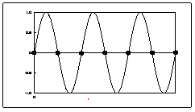
Nyquist Theorem and Aliasing
Graphical Example 2:
  BUT, if sample points fall on zero-crossings the sound is completely cancelled out

Slide 16
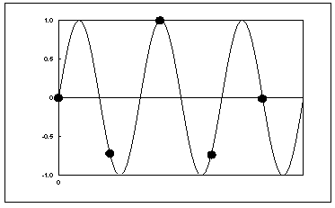
Nyquist Theorem and Aliasing
Graphical Example 3:
  SR = 20,000 Hz
  Nyquist Frequency = 10,000 Hz
  f = 12,500 Hz, f' = 7,500

Slide 17
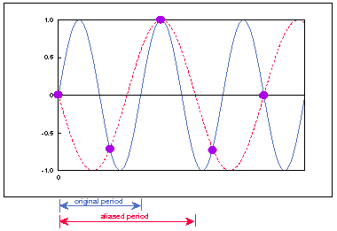
Nyquist Theorem and Aliasing
Graphical Example 3:
  Fitting the simplest sine wave to the sampled points gives an aliased waveform (dotted line below):

Slide 18
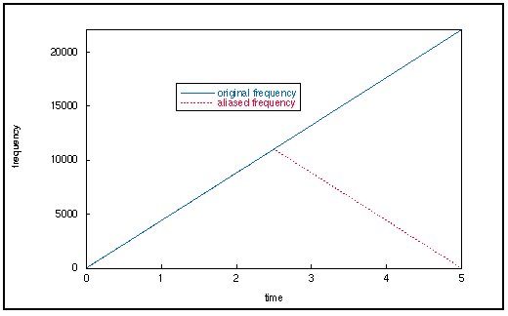
Aliasing — Sound Examples
[i:33] sine wave with variable frequency, SR = 22050

Slide 19
Aliasing — Sound Examples
Musical examples on the Bach trumpet:
  [i:34] SR=22050, highest frequency in music is about 7000 Hz. (no aliasing)
  [i:35] SR=11025 (some aliasing; adds a little metallic quality)
  [i:36] SR=4410 (lots of aliasing; sounds like bad video game)

