Slide 1
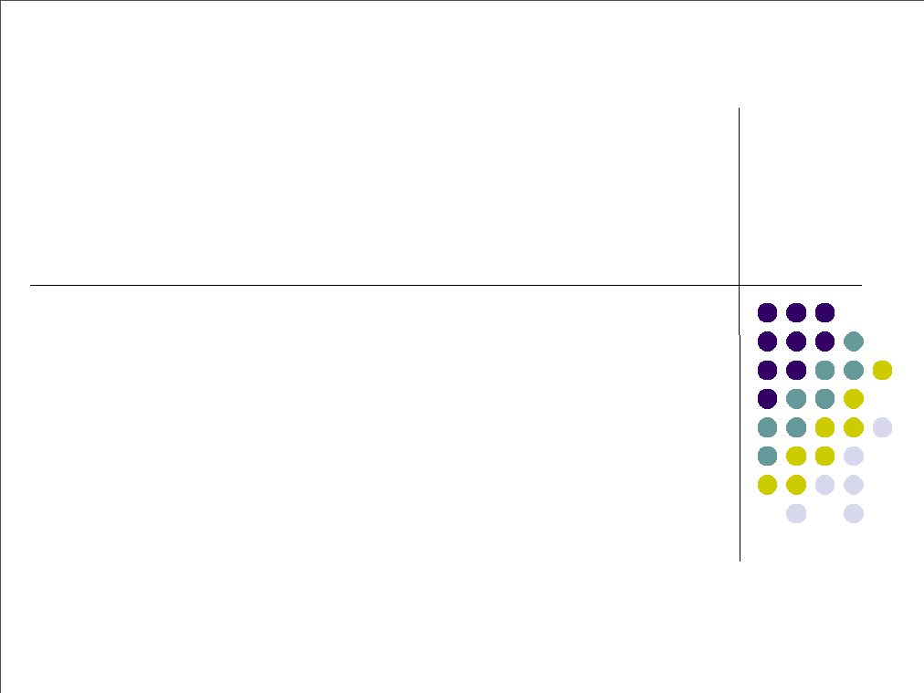
Tutorial 1 for COMP4621
Spring 2015

Slide 2

Outline
●
●
●
●
Concepts Review
Socket Programming
Practices
Discussion

Slide 3
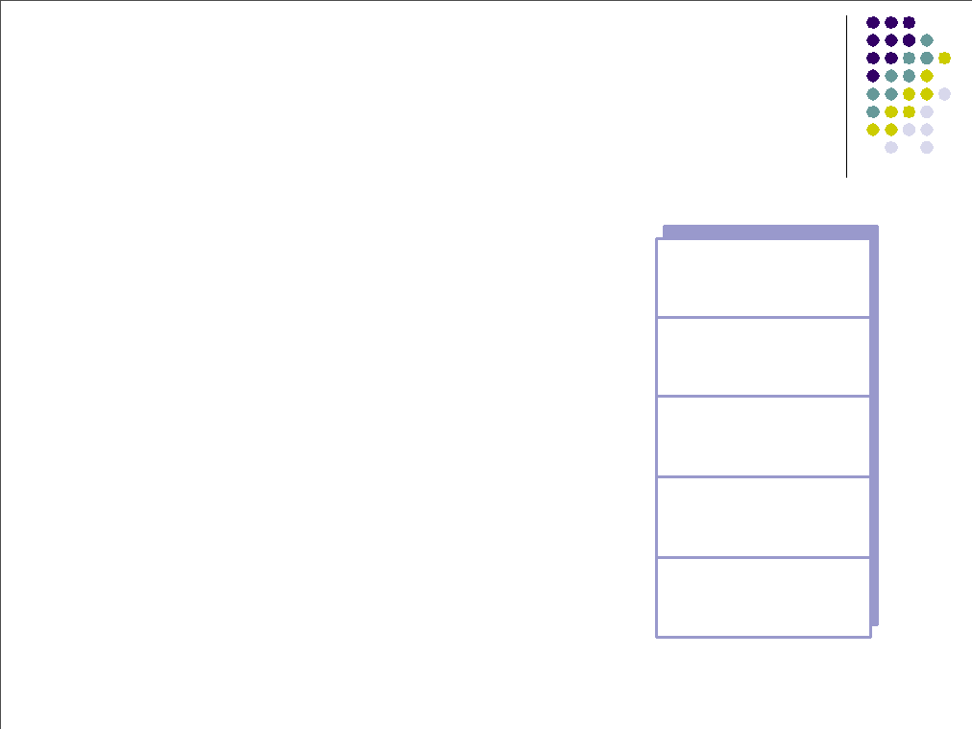
Internet Protocol Stack
●
Application: supporting network app.
 FTP, SMTP, EMAIL
Transport: process-process
 TCP, UDP
Network: routing of datagrams from
source to destination, host-host
 IP, routing protocols
Link: data transfer between
neighboring network elements
 PPP, Ethernet
Physical: bits “on the wire”
application
transport
network
link
physical
●
●
●
●

Slide 4
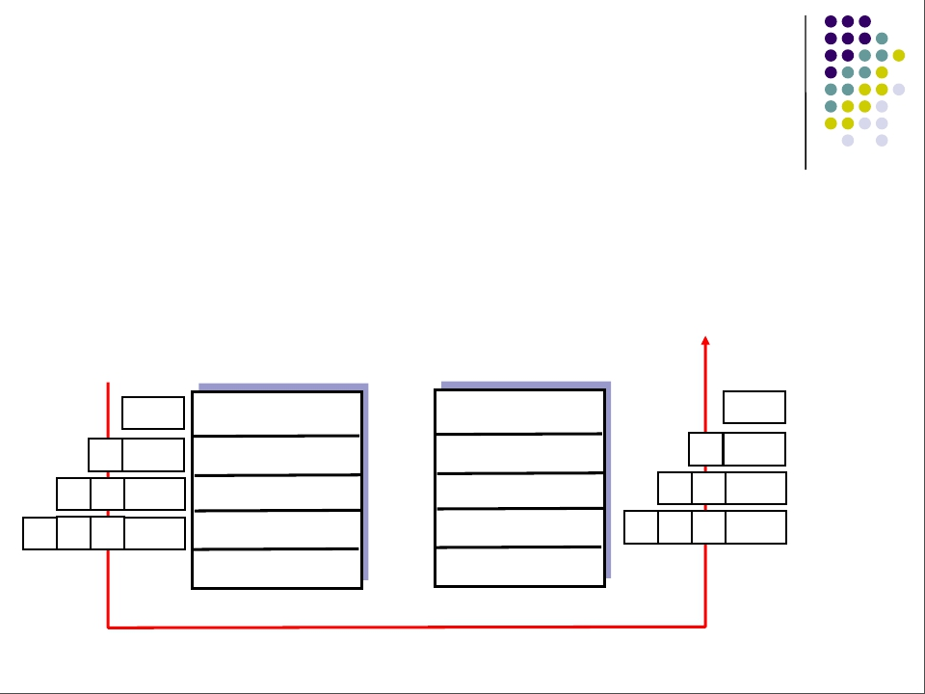
Protocol Layering and Data
●
Each layer takes data from above
●
●
adds header information to create new data unit
passes new data unit to layer below
source
destination
M
Ht M
Hn Ht M
Hl Hn Ht M
application
transport
network
link
physical
application
transport
network
link
physical
M
M
M
M
message
segment
datagram
frame
Ht
Hn Ht
Hl Hn Ht

Slide 5
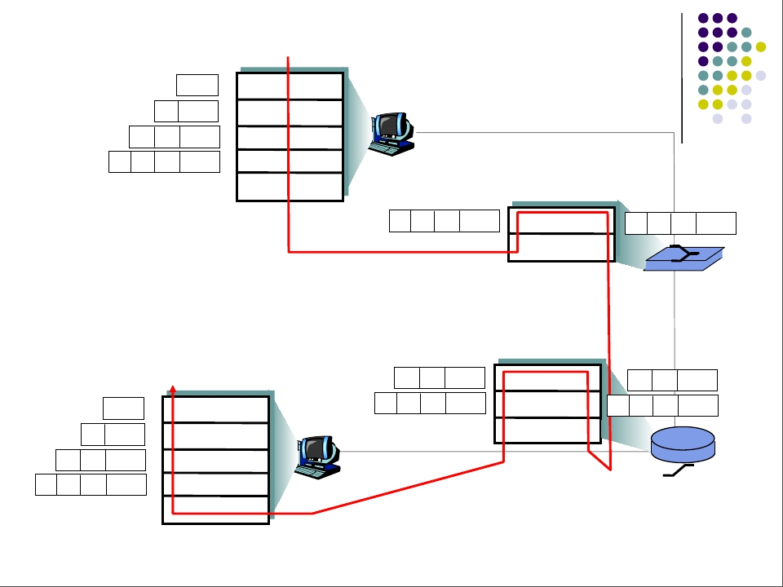
source
application
transport
network
link
physical
Encapsulation
message
segment
datagram Hn Ht
frame Hl Hn Ht
M
M
M
M
Ht
Hl Hn Ht
M
link
physical
Hl Hn Ht
M
switch
destination
application
transport
network
link
physical
Hn Ht
H’l Hn Ht
M
M
network
link
physical
Hn Ht
Hl Hn Ht
M
M
router
M
M
M
M
Ht
Hn Ht
H’l Hn Ht

Slide 6
What is Socket
●
●
●
Just like in real life we use telephone to
connect to others, in internet world, we use
socket to connect to others
We use telephone to send and receive
sounds, we use socket to send and receive
messages
To connect to somebody using telephone,
you need his telephone number, to connect
to somebody using socket, you need his IP
address and port number

Slide 7
Socket programming
Goal: learn how to build client/server applications that communicate using sockets
Socket API
introduced in BSD4.1 UNIX, 1981
explicitly created, used, released by apps
client/server paradigm
two types of transport service via socket API:
  Unreliable datagram: UDP
  Reliable, byte-stream oriented : TCP
socket
An application-created,
OS-controlled interface (a “door”) into which
application process can both send and
receive messages to/from another application process

Slide 8
Socket programming basics
Server must be running before client can send anything to it.
Server must have a socket (door) through which it receives and sends segments
Similarly client needs a socket
Socket is locally identified with a port number
  Analogous to the apt # in a building
Client needs to know server IP address and socket port number.

Slide 9
Socket programming with UDP
UDP: no “connection” between client and server
no handshaking
sender explicitly attaches IP address and port of destination to each segment
OS attaches IP address and port of sending socket to each segment
Server can extract IP address, port of sender from received segment
application viewpoint
UDP provides unreliable transfer
of groups of bytes (“datagrams”)
between client and server
Note: the official terminology
for a UDP packet is “datagram”.
In this class, we instead use “UDP
segment”.

Slide 10
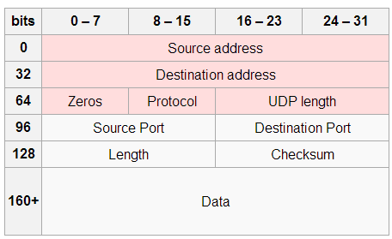
UDP
●
Often used for streaming
multimedia apps.
 loss tolerant
 rate sensitive
other UDP uses
 DNS
SNMP
●
●
●
Reliable transmission over
UDP
●
add reliability at app. layer

Slide 11
Our First Example in Java
●
A simple client-server application to
demonstrate socket programming for UDP
●
●
●
●
●
A client reads a line from its standard input and
sends out the line through its socket to the server
The server reads a line from its socket
The server converts the line to uppercase
The server sends out the modified line through its socket
to the client
The client reads the modified line from socket and
prints the line on its standard output

Slide 12
Our First Example in Java
Client:
  User types line of text
  Client program sends line to server
Server:
  Server receives line of text
  Capitalizes all the letters
  Sends modified line to client
Client:
  Receives line of text
  Displays

Slide 13
Client/server socket interaction: UDP
Server (running on hostid)
Client
create socket,
port= x.
create socket,
clientSocket =
DatagramSocket()
serverSocket =
DatagramSocket()
Create datagram with server IP and
port=x; send datagram via
clientSocket
read datagram from
serverSocket
write reply to
serverSocket
specifying
client address,
port number
read datagram from
clientSocket
close
clientSocket

Slide 14
Implementation: Java server (UDP)
import java.io.*;
import java.net.*;
class UDPServer {
public static void main(String args[]) throws Exception
{
DatagramSocket serverSocket = new DatagramSocket(9876);
byte[] receiveData = new byte[1024];
byte[] sendData = new byte[1024];
while(true)
{
DatagramPacket receivePacket =
new DatagramPacket(receiveData, receiveData.length);
serverSocket.receive(receivePacket);
Create
datagram socket
at port 9876
Create space for
received datagram
Receive
datagram

Slide 15
Implementation: Java server (UDP)
String sentence = new String(receivePacket.getData());
InetAddress IPAddress = receivePacket.getAddress();
int port = receivePacket.getPort();
String capitalizedSentence = sentence.toUpperCase();
sendData = capitalizedSentence.getBytes();
DatagramPacket sendPacket =
new DatagramPacket(sendData, sendData.length, IPAddress,
port);
serverSocket.send(sendPacket);
}
}
}
Get IP addr
port #, of
sender
Create datagram
to send to client
Write out
datagram
to socket
End of while loop,
loop back and wait for
another datagram

Slide 16
Implementation: Java client (UDP)
import java.io.*;
import java.net.*;
class UDPClient {
public static void main(String args[]) throws Exception
{
BufferedReader inFromUser =
new BufferedReader(new InputStreamReader(System.in));
DatagramSocket clientSocket = new DatagramSocket();
InetAddress IPAddress = InetAddress.getByName(“localhost");
byte[] sendData = new byte[1024];
byte[] receiveData = new byte[1024];
String sentence = inFromUser.readLine();
sendData = sentence.getBytes();
Create
input stream
Create
client socket
Translate
hostname to IP
address using DNS

Slide 17
Implementation: Java client (UDP)
Create datagram with data-to-send,
length, IP addr, port
DatagramPacket sendPacket =
new DatagramPacket(sendData, sendData.length, IPAddress, 9876);
clientSocket.send(sendPacket);
DatagramPacket receivePacket =
new DatagramPacket(receiveData, receiveData.length);
clientSocket.receive(receivePacket);
String modifiedSentence =
new String(receivePacket.getData());
System.out.println("FROM SERVER:" + modifiedSentence);
clientSocket.close();
}
}
Send datagram
to server
Read datagram
from server

Slide 18
Practice 1
●
●
Modify the UDP server. The server converts the
strings to upper cases. For each string obtained
by the server, the server add sits reception order
at the beginning of this string; then returns the
modified string back to the client.
For example, if the server receives “hello”, it
will return “1 HELLO” back to the client

Slide 19
Practice 1
●
Add
...
byte[] sendData = new byte[1024];
int seq = 0;
while(true)
...
String capitalizedSentence = sentence.toUpperCase();
seq++;
capitalizedSentence = seq + “ ” + capitalizedSentence;
sendData = capitalizedSentence.getBytes();
...

Slide 20
Practice 2
●
●
Modify the UDP client. Let it send the
numbers from 0 to 50 to the server.
Hint: use loop

Slide 21
Practice 2
●
Add
for(int i = 0; i < 50; i++){
...
String sentence = Integer.toString(i);
...
}

Slide 22
Question
●
●
Can we use UDP to transmit a file?
How?

Slide 23
File Download:
https://www.dropbox.com/s/9q20jndcrqpb5mw/lab1_2015week5.ppt?dl=0
https://www.dropbox.com/s/viqivyhr02hf38z/UDPClient.java?dl=0
https://www.dropbox.com/s/kwsncjk8l01mvm0/UDPSvr.java?dl=0

