Slide 1
COMP 4622
Computer Communication Networks II
Fall 2013 HKUST
Qian Zhang
Department of Computer Science and Engineering

Slide 2
Who’s Who
Instructor:
Prof. Qian Zhang, qianzh AT ust domain
  Rm. 3533, Tel: 2358-7688
  Office hours: by appointment
TAs:
Wei Wang, gswwang AT ust domain
Course web site:
  http://course.cs.ust.hk/comp4622/index.html
No lab for comp4622

Slide 3


Conduct in the Classroom
1. Be on-time to class.
When you come in late, you disrupt your class. Respect your fellow students, and be on-time to class!

Slide 4


Conduct in the Classroom
No talking in class except to raise or answer questions.
During class, you should not do anything that disrupts the class or distracts your classmates. If you have a pager or cellular phone, turn it off when you are in class.
And please pay attention to the signs that tell you not to eat or drink in the classrooms.

Slide 5

Conduct in the Classroom
Anti-cheating
Unless otherwise stated, all work submitted by you should be your own. If there is any doubt about the appropriateness of your actions, please contact the instructor for explicit clarification. Cheating is a serious offense and will result in appropriate disciplinary actions against those involved.

Slide 6
Grading
Project 5%
Homeworks (2) 20%
Midterm 35%
Final 40%
The detailed instruction for course project will be given 2-3 weeks later

Slide 7
Overview
Introduction: course description & calendar
Prerequisites
What we have learnt, and what we will learn

Slide 8
Introduction
What you have learnt
  COMP 361/4621 or ELEC 315/4120 has already laid the foundation of computer networks
  We will review the concepts and techniques discussed in these prerequisite courses
In this course we concentrate on advanced topics in computer networks beyond what you learnt

Slide 9
What you Learnt!: Overview
Goal:
broader coverage of networking
approach:
  descriptive
  use Internet as example
Overview:
what’s the Internet
what’s a protocol?
network edge
network core
access net, physical media
Internet/ISP structure
performance: loss, delay
protocol layers, service models
history

Slide 10
What’s the Internet: “Nuts and Bolts” View
tens of millions of connected computing devices: hosts = end systems
  New members – pervasive wireless devices
running network apps
communication links
  fiber, copper, radio, satellite
  transmission rate = bandwidth
routers: forward packets (chunks of data)
router
workstation
server
mobile
local ISP
regional ISP
company
network

Slide 11
What’s the Internet: a Service View
communication infrastructure enables distributed applications:
  Popular applications: Web, email, games, e-commerce, file sharing, blogging, twitter, …
communication services provided to apps:
  Connectionless unreliable
  connection-oriented reliable

Slide 12
What’s a Protocol?
human protocols:
“what’s the time?”
“I have a question”
introductions
… specific msgs sent
… specific actions taken when msgs received, or other events
network protocols:
machines rather than humans
all communication activity in Internet governed by protocols
protocols define the format, and the order of msgs sent and received among network entities, and actions taken on msg transmission and receipt

Slide 13
The Network Edge:
end systems (hosts):
  run application programs
  e.g. Web, email
  at “edge of network”
client/server model
  client host requests, receives service from always-on server
  e.g. Web browser/server; email client/server
peer-peer model:
  minimal (or no) use of dedicated servers
  e.g. Gnutella, KaZaA

Slide 14
Network Core: Circuit Switching
End-end resources reserved for “call”
link bandwidth, switch capacity
dedicated resources: no sharing
circuit-like (guaranteed) performance
call setup required

Slide 15
Network Core: Packet Switching
each end-end data stream divided into packets
packets share network resources
each packet usually uses full link bandwidth
resources used as needed
resource contention:
aggregate resource demand can exceed amount available
congestion: packets queue, wait for link use
store and forward: packets move one hop at a time
  Node receives complete packet before forwarding
Bandwidth division into “pieces”
Dedicated allocation
Resource reservation

Slide 16
Packet Switching vs. Circuit Switching
Packet switching allows more users to use network!
1 Mbps link
each user:
  100 kbps when “active”
  active 10% of time
circuit-switching:
  10 users
packet switching:
  with 35 users, probability > 10 simultaneous active uses less than .0004
N users
1 Mbps link

Slide 17
Access Networks and Physical Media
Q: How to connect end systems to edge router?
residential access nets
institutional access networks (school, company)
mobile access networks
Keep in mind:
bandwidth (bits per second) of access network?
shared or dedicated?

Slide 18
Residential Access: Point to Point Access
Dialup via modem
  up to 56Kbps direct access to router (often less)
  Can’t surf and phone at same time: can’t be “always on”
ADSL: asymmetric digital subscriber line
  up to 1 Mbps upstream (today typically < 256 kbps)
  up to 8 Mbps downstream (today typically < 1 Mbps)
  FDM: 50 kHz - 1 MHz for downstream
  4 kHz - 50 kHz for upstream
  0 kHz - 4 kHz for ordinary telephone

Slide 19
Company Access: Local Area Networks
company/univ local area network (LAN) connects end system to edge router
Ethernet:
  shared or dedicated link connects end system and router
  10 Mbps, 100Mbps, Gigabit Ethernet

Slide 20
Wireless Access Networks
shared wireless access network connects end system to router
  via base station a.k.a. “access point”
wireless LANs:
  802.11b (WiFi): 11 Mbps
wider-area wireless access
  provided by telecom operators
  2G, 3G, 4G, …
  WAP/GPRS
router
base
station
mobile
hosts

Slide 21
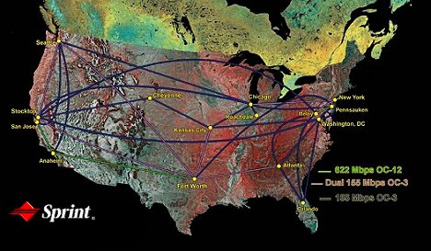
Tier-1 ISP: e.g., Sprint
Sprint US backbone network

Slide 22
Internet Structure: Network of Networks
“Tier-2” ISPs: smaller (often regional) ISPs
  Connect to one or more tier-1 ISPs, possibly other tier-2 ISPs
  NAP: Network Access Point
Tier-2 ISPs also peer privately with each other, interconnect at NAP
Tier-2 ISP pays tier-1 ISP for connectivity to rest of Internet
tier-2 ISP is customer of
tier-1 provider
Tier-2 ISP
Tier-2 ISP
Tier 1 ISP
NAP
Tier 1 ISP
Tier 1 ISP
Tier-2 ISP
Tier-2 ISP
Tier-2 ISP

Slide 23
Internet Structure: Network of Networks
“Tier-3” ISPs and local ISPs
  last hop (“access”) network (closest to end systems)
local
ISP
Tier 3
ISP
local
ISP
local
ISP
local
ISP
Local and tier- 3 ISPs are customers of
higher tier ISPs
connecting them to rest of Internet
Tier-2 ISP
Tier-2 ISP
Tier 1 ISP
NAP
Tier 1 ISP
Tier 1 ISP
Tier-2 ISP
Tier-2 ISP
Tier-2 ISP
local
ISP
local
ISP
local
ISP
local
ISP

Slide 24
Internet Structure: Network of Networks
a packet passes through many networks!
local
ISP
Tier 3
ISP
local
ISP
local
ISP
local
ISP
Tier-2 ISP
Tier-2 ISP
Tier 1 ISP
NAP
Tier 1 ISP
Tier 1 ISP
Tier-2 ISP
Tier-2 ISP
Tier-2 ISP
local
ISP
local
ISP
local
ISP
local
ISP

Slide 25
Four Sources of Packet Delay
1. nodal processing:
  check bit errors
  determine output link
2. queueing
  time waiting at output link for transmission
  depends on congestion level of router
transmission
A
propagation
B
nodal
processing
queueing

Slide 26
Delay in Packet-Switched Networks
3. Transmission delay:
R=link bandwidth (bps)
L=packet length (bits)
time to send bits into link = L/R
4. Propagation delay:
d = length of physical link
s = propagation speed in medium (~2x10⁸ m/sec)
propagation delay = d/s
Note: s and R are very different quantities!
transmission
A
propagation
B
nodal
processing
queueing

Slide 27
Packet Loss
A queue (a.k.a. buffer) preceding a link has finite capacity
when packets arrive to a full queue, some packets have to be dropped (a.k.a. lost)
lost packets may be retransmitted by the previous node, by source end system, or not retransmitted at all

Slide 28
Internet Protocol Stack
application: supporting network applications
  FTP, SMTP, HTTP
transport: host-host data transfer
  TCP, UDP
network: routing of datagrams from source to destination
  IP, routing protocols
link: data transfer between neighboring network elements
  PPP, Ethernet
physical: bits “on the wire”
application
transport
network
link
physical

Slide 29
Encapsulation
source
M
application
transport
network
link
physical
H_{t}
M
H_{n}
H_{t}
M
H_{l}
H_{n}
H_{t}
M
H_{l}
H_{n}
H_{t}
M
link
physical
H_{l}
H_{n}
H_{t}
M
switch
destination
H_{n}
H_{t}
M
network
link
physical
H_{n}
H_{t}
M
M
application
transport
network
link
physical
H_{l}
H_{n}
H_{t}
M
H_{l}
H_{n}
H_{t}
M
H_{t}
M
H_{n}
H_{t}
M
H_{l}
H_{n}
H_{t}
M
router

Slide 30
What you Learnt!: Application Layer
Goals:
conceptual, implementation aspects of network application protocols
  transport-layer service models
  client-server paradigm
  peer-to-peer paradigm
learnt about protocols by examining popular application-level protocols
  HTTP
  FTP
  SMTP / POP3 / IMAP
  DNS
programming network applications
  socket API

Slide 31
Creating a Network App
Write programs that
  run on different end systems and
  communicate over a network.
  e.g., Web: Web server software communicates with browser software
Almost NO app software written for devices in network core
  Network core devices do not function at app layer
  This design allows for rapid app development
application
transport
network
data link
physical
application
transport
network
data link
physical
application
transport
network
data link
physical

Slide 32
Application Architectures
Client-server
Peer-to-peer (P2P)
Hybrid of client-server and P2P

Slide 33
Client-Server Archicture
server:
  always-on host
  permanent IP address
  server farms for scaling
clients:
  communicate with server
  may be intermittently connected
  may have dynamic IP addresses
  do not communicate directly with each other

Slide 34
Pure P2P Architecture
no (or very few) always-on servers
arbitrary end systems directly communicate
peers are intermittently connected and change IP addresses
example: Gnutella
Highly scalable
But difficult to manage
Hard to be made reliable

Slide 35
Hybrid of Client-Server and P2P
Napster
  File transfer P2P
  File search centralized:
    Peers register content at central server
    Peers query same central server to locate content
Instant messaging
  Chatting between two users is often P2P
  Presence detection/location centralized:
    User registers its IP address with central server when it comes online
    User contacts central server to find IP addresses of buddies

Slide 36
DNS: Domain Name System
People: many identifiers:
  SSN, name, passport #
Internet hosts, routers:
  IP address (32 bit) - used for addressing datagrams
  “name”, e.g., ww.yahoo.com - used by humans
Q: map between IP addresses and name ?
Domain Name System:
distributed database implemented in hierarchy of many name servers
application-layer protocol host, routers, name servers to communicate to resolve names (address/name translation)
  note: DNS is a core Internet function implemented as application-layer protocol
  complexity at network’s “edge”

Slide 37
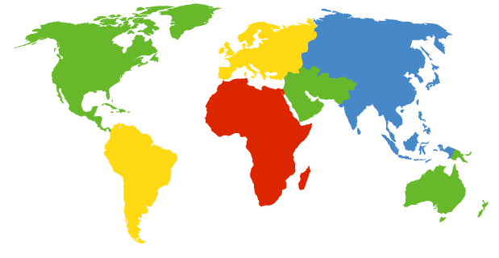
DNS: Root Name Servers
contacted by local name server that cannot resolve name
root name server:
  contacts authoritative name server if name mapping not known
  gets mapping
  returns mapping to local name server
a Verisign, Dulles, VA
c Cogent, Herndon, VA (also Los Angeles)
d U Maryland College Park, MD
g US DoD Vienna, VA
h ARL Aberdeen, MD
j Verisign, ( 11 locations)
k RIPE London (also Amsterdam, Frankfurt)
i Autonomica, Stockholm (plus 3 other locations)
m WIDE Tokyo
e NASA Mt View, CA
f Internet Software C. Palo Alto, CA (and 17 other locations)
13 root name servers worldwide
b USC-ISI Marina del Rey, CA
l ICANN Los Angeles, CA

Slide 38
What you Learnt!: Transport Layer
Goals:
understand principles behind transport layer services:
  Multiplexing and demultiplexing
  reliable data transfer
  flow control
  congestion control
learnt about transport layer protocols in the Internet:
  UDP: connectionless transport
  TCP: connection-oriented transport
  TCP congestion control

Slide 39
Transport Services and Protocols
provide logical communication between app processes running on different hosts
transport protocols run in end systems
  send side: breaks app messages into segments, passes to network layer
  rcv side: reassembles segments into messages, passes to app layer
more than one transport protocol available to apps
  Internet: TCP and UDP
application
transport
network
data link
physical
network
data link
physical
network
data link
physical
network
data link
physical
logical end-end transport
network
data link
physical
network
data link
physical
application
transport
network
data link
physical

Slide 40
Internet Transport Protocols Services
TCP service:
connection-oriented: setup required between client and server processes
reliable transport between sending and receiving processes
flow control: sender won’t overwhelm receiver
congestion control: throttle sender when network overloaded
does not provide: timing, minimum bandwidth guarantees
UDP service:
unreliable data transfer between sending and receiving processes
does not provide: connection setup, reliability, flow control, congestion control, timing, or bandwidth guarantee
Q: why bother? Why is there a UDP?

Slide 41
UDP: User Datagram Protocol [RFC 768]
Why is there a UDP?
no connection establishment (which can add delay)
simple: no connection state at sender, receiver
small segment header
no congestion control: UDP can blast away as fast as desired
Attractive to applications requiring high bandwidth, low latency, and a best-effort service
“no frills,” “bare bones” Internet transport protocol
“best effort” service, UDP segments may be:
  lost
  delivered out of order to app
connectionless:
  no handshaking between UDP sender, receiver
  each UDP segment handled independently of others

Slide 42
TCP: Overview RFCs: 793, 1122, 1323, 2018, 2581
point-to-point:
  one sender, one receiver
reliable, in-order byte steam:
  no “message boundaries”
pipelined:
  TCP congestion and flow control set window size
send & receive buffers
full duplex data:
  bi-directional data flow in same connection
  MSS: maximum segment size
connection-oriented:
  handshaking (exchange of control msgs) initiates sender, receiver state before data exchange
flow controlled:
  sender will not overwhelm receiver

Slide 43
TCP Reliable Data Transfer
On top of IP’s unreliable service
Pipelined segments
Cumulative acks
TCP uses single retransmission timer
Retransmissions are triggered by:
  timeout events
  duplicate acks

Slide 44
TCP Sender Events:
data rcvd from app:
Create segment with seq #
seq # is byte-stream number of first data byte in segment
start timer if not already running (think of timer as for oldest unacked segment)
expiration interval: TimeOutInterval
timeout:
retransmit segment that caused timeout
restart timer
Ack rcvd:
If acknowledges previously unacked segments
  update what is known to be acked
  start timer if there are outstanding segments

Slide 45
TCP: Retransmission Scenarios
Host A
Host B
Host A
Host B
Seq=92, 8 bytes data
Seq=92, 8 bytes data
Seq=100, 20 bytes data
timeout
ACK=100
Seq=92 timeout
X
ACK=100
loss
ACK=120
Seq=92, 8 bytes data
SendBase
= 100
Seq=92, 8 bytes data
SendBase
= 120
Seq=92 timeout
ACK=120
ACK=100
SendBase
= 100
SendBase
= 120
premature timeout
time
time
lost ACK scenario

Slide 46
TCP Retransmission Scenarios (more)
Host A
Host B
Seq=92, 8 bytes data
ACK=100
timeout
Seq=100, 20 bytes data
X
loss
SendBase
= 120
ACK=120
time
Cumulative ACK scenario

Slide 47
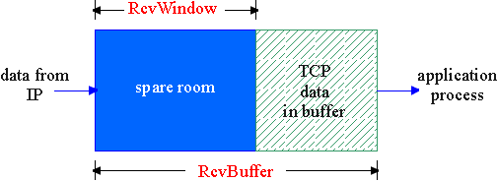
TCP Flow Control
flow control
sender won’t overflow
receiver’s buffer by
transmitting too much,
too fast
receive side of TCP connection has a receive buffer:
speed-matching service: matching the send rate to the receiving app’s drain rate
app process may be slow at reading from buffer

Slide 48
Principles of Congestion Control
Congestion:
informally: “too many sources sending too much data too fast for network to handle”
different from flow control!
manifestations:
  lost packets (buffer overflow at routers)
  long delays (queueing in router buffers)

Slide 49
What you Learnt!: Network Layer
Goals:
understand principles behind network layer services:
  routing (path selection)
  dealing with scale
  how a router works
  advanced topics: IPv6
instantiation and implementation in the Internet
Overview:
network layer services
routing principles: path selection
hierarchical routing
IP
Internet routing protocols
  intra-domain
  inter-domain
what’s inside a router?
IPv6

Slide 50
Network Layer
transport segment from sending to receiving host
on sending side encapsulates segments into datagrams
on rcving side, delivers segments to transport layer
network layer protocols in every host, router
Router examines header fields in all IP datagrams passing through it
application
transport
network
data link
physical
network
data link
physical
network
data link
physical
network
data link
physical
network
data link
physical
network
data link
physical
network
data link
physical
network
data link
physical
network
data link
physical
application
transport
network
data link
physical

Slide 51
Key Network-Layer Functions
forwarding: move packets from router’s input to appropriate router output
routing: determine route taken by packets from source to dest.
  Routing algorithms
analogy:
routing: process of planning trip from source to dest
forwarding: process of getting through single interchange

Slide 52
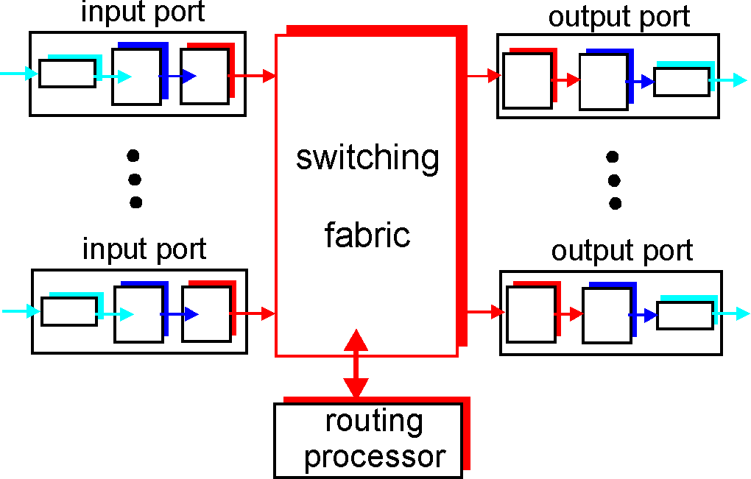
Router Architecture Overview
Two key router functions:
run routing algorithms/protocol (RIP, OSPF, BGP)
forwarding datagrams from incoming to outgoing link

Slide 53
The Internet Network layer
Host, router network layer functions:
Transport layer: TCP, UDP
Routing protocols
path selection
RIP, OSPF, BGP
IP protocol
addressing conventions
datagram format
packet handling conventions
Network
layer
forwarding
table
ICMP protocol
error reporting
router “signaling”
Link layer
physical layer

Slide 54
IP Datagram Format
IP protocol version
number
32 bits
total datagram
length (bytes)
header length
(bytes)
head.
len
type of
service
ver
length
for
fragmentation/
reassembly
“type” of data
flgs
fragment
offset
16-bit identifier
max number
remaining hops
(decremented at
each router)
time to
live
upper
layer
Internet
checksum
32 bit source IP address
upper layer protocol
to deliver payload to
32 bit destination IP address
Options (if any)
E.g. timestamp,
record route
taken, specify
list of routers
to visit.
how much overhead with TCP?
20 bytes of TCP
20 bytes of IP
= 40 bytes + app layer overhead
data
(variable length,
typically a TCP
or UDP segment)

Slide 55
IP Fragmentation & Reassembly
network links have MTU (Maximum Transmission Unit) - largest possible link-level frame.
  different link types, different MTUs
large IP datagram divided (“fragmented”) within net
  one datagram becomes several datagrams
  “reassembled” only at final destination
  IP header bits used to identify, order related fragments
fragmentation:
in: one large datagram
out: 3 smaller datagrams
reassembly

Slide 56
IP Addressing: Introduction
IP address: 32-bit identifier for host, router interface
interface: connection between host/router and physical link
  router’s typically have multiple interfaces
  host may have multiple interfaces
  IP addresses associated with each interface
223.1.1.1
223.1.2.1
223.1.1.2
223.1.1.4
223.1.2.9
223.1.2.2
223.1.1.3
223.1.3.27
223.1.3.1
223.1.3.2
223.1.1.1 = 11011111 00000001 00000001 00000001
223
1
1
1

Slide 57
Subnets
IP address:
  subnet part (high order bits)
  host part (low order bits)
What’s a subnet ?
  device interfaces with same subnet part of IP address
  can physically reach each other without intervening router
223.1.1.1
223.1.2.1
223.1.1.2
223.1.1.4
223.1.2.9
223.1.1.3
223.1.2.2
223.1.3.27
LAN
223.1.3.1
223.1.3.2
network consisting of 3 subnets

Slide 58
IP Addresses: How to Get One?
Q: How does host get IP address?
hard-coded by system admin in a file
  Windows: control-panel->network->configuration->TCP/IP->properties
  UNIX: /etc/rc.config
DHCP: Dynamic Host Configuration Protocol: dynamically get address from as server
  “plug-and-play”
(more in next chapter)

Slide 59
IP Addresses: How to Get One?
Q: How does network get a “subnet” of IP addr?
A: gets allocated portion of its provider ISP’s address space
ISP's block 11001000 00010111 00010000 00000000 200.23.16.0/20
Organization 0 11001000 00010111 00010000 00000000 200.23.16.0/23
Organization 1 11001000 00010111 00010010 00000000 200.23.18.0/23
Organization 2 11001000 00010111 00010100 00000000 200.23.20.0/23
... ….. …. ….
Organization 7 11001000 00010111 00011110 00000000 200.23.30.0/23

Slide 60
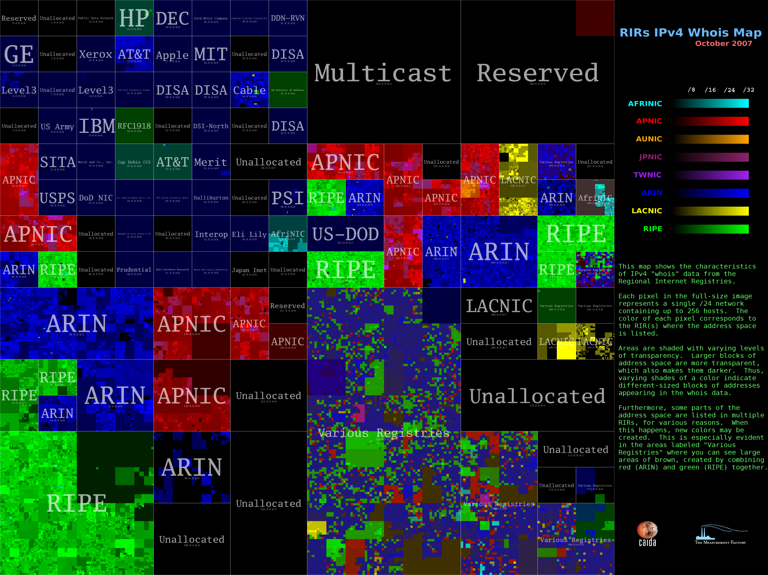
IP addresses: how to get one?

Slide 61
Hierarchical Addressing: Route Aggregation
Hierarchical addressing allows efficient advertisement of routing
information:
Organization 0
200.23.16.0/23
Organization 1
200.23.18.0/23
“Send me anything
with addresses
beginning
200.23.16.0/20”
Organization 2
200.23.20.0/23
.
Fly-By-Night-ISP
.
.
.
.
Internet
Organization 7
.
200.23.30.0/23
ISPs-R-Us
“Send me anything
with addresses
beginning
199.31.0.0/16”

Slide 62
Routing Algorithm Classification
Global or decentralized information?
Global:
all routers have complete topology, link cost info
“link state” algorithms
Decentralized:
router knows physically-connected neighbors, link costs to neighbors
iterative process of computation, exchange of info with neighbors
“distance vector” algorithms
Static or dynamic?
Static:
routes change slowly over time
Dynamic:
routes change more quickly
  periodic update
  in response to link cost changes

Slide 63
Graph Abstraction
5
v
3
w
2
5
u
2
1
z
3
1
2
x
y
1
Graph: G = (N,E)
N = set of routers = { u, v, w, x, y, z }
E = set of links ={ (u,v), (u,x), (v,x), (v,w), (x,w), (x,y), (w,y), (w,z), (y,z) }
Remark: Graph abstraction is useful in other network contexts
Example: P2P, where N is set of peers and E is set of TCP connections

Slide 64
Graph Abstraction: Costs
5
c(x,x’) = cost of link (x,x’)
- e.g., c(w,z) = 5
cost could always be 1, or
inversely related to bandwidth,
or inversely related to
congestion
v
3
w
2
5
u
2
1
z
3
1
2
x
y
1
Cost of path (x₁, x₂, x₃,…, x_{p}) = c(x₁,x₂) + c(x₂,x₃) + … + c(x_{p-1},x_{p})
Question: What’s the least-cost path between u and z ?
Routing algorithm: algorithm that finds least-cost path

Slide 65
Virtual Circuits
“source-to-dest path behaves much like telephone circuit”
  performance-wise
  network actions along source-to-dest path
call setup/teardown for each call before/after the data flow
each packet carries VC identifier (not destination host address)
every router on source-dest path maintains “state” for each passing connection
link, router resources (bandwidth, buffers) may be allocated to VC

Slide 66
What you Learnt!: The Data Link Layer
Goals:
understand principles behind data link layer services:
  error detection, correction
  sharing a broadcast channel: multiple access
  link layer addressing
  reliable data transfer, flow control: done!
instantiation and implementation of various link layer technologies

Slide 67
Link Layer: Introduction
“link”
Some terminology:
hosts and routers are nodes
communication channels that connect adjacent nodes along communication path are links
  wired links
  wireless links
  LANs
layer-2 packet is a frame, encapsulates datagram
data-link layer has responsibility of
transferring datagram from one node
to adjacent node over a link

Slide 68
Link Layer Services
Framing, link access:
  encapsulate datagram into frame, adding header, trailer
  channel access if shared medium
  “MAC” addresses used in frame headers to identify source, dest
    different from IP address!
Reliable delivery between adjacent nodes
  we learned how to do this already (chapter 3)!
  seldom used on low bit error link (fiber, some twisted pair)
  wireless links: high error rates
    Q: why both link-level and end-end reliability?

Slide 69
Link Layer Services (more)
Flow Control:
  pacing between adjacent sending and receiving nodes
Error Detection:
  errors caused by signal attenuation, noise.
  receiver detects presence of errors:
    signals sender for retransmission or drops frame
Error Correction:
  receiver identifies and corrects bit error(s) without resorting to retransmission
Half-duplex and full-duplex
  with half duplex, nodes at both ends of link can transmit, but not at same time

Slide 70
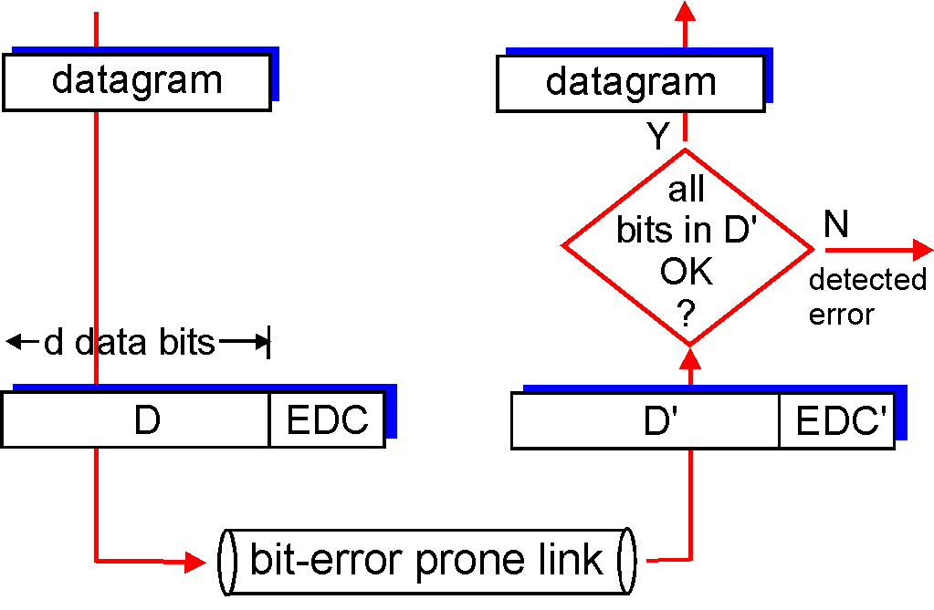
Error Detection
EDC= Error Detection and Correction bits (redundancy)
D = Data protected by error checking, may include header fields
Error detection not 100% reliable!
  protocol may miss some errors, but rarely
  larger EDC field yields better detection and correction

Slide 71
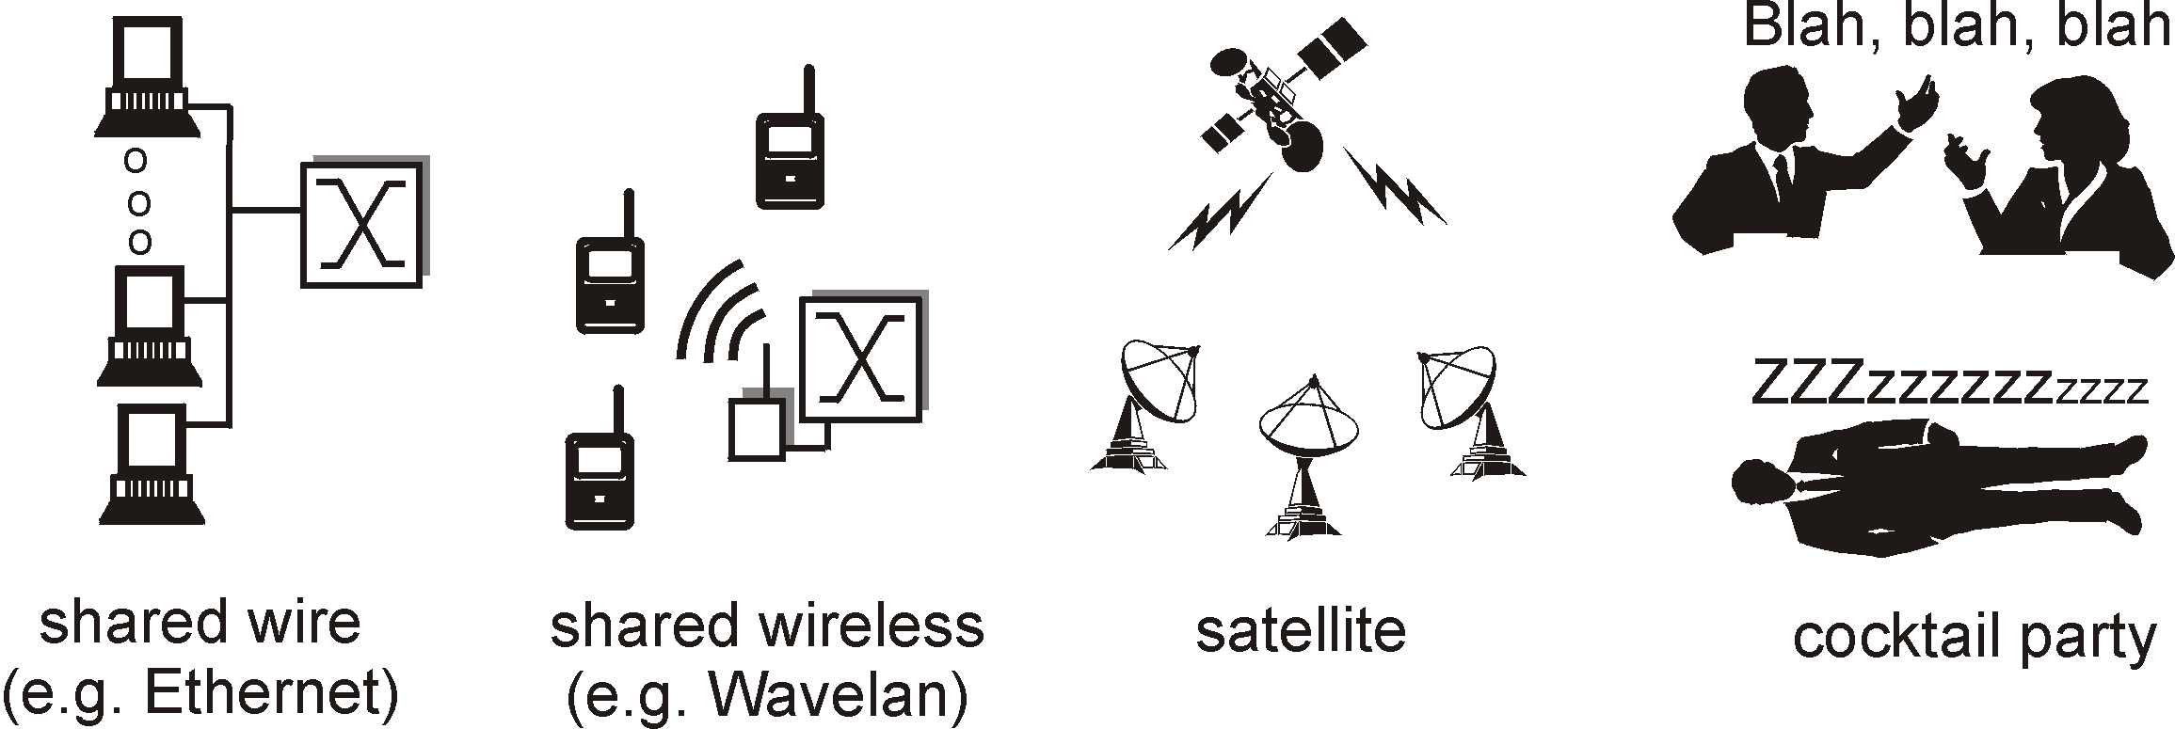
Multiple Access Links and Protocols
Two types of “links”:
point-to-point
  PPP for dial-up access
  point-to-point link between Ethernet switch and host
broadcast (shared wire or medium)
  traditional Ethernet
  upstream HFC
  802.11 wireless LAN

Slide 72
Multiple Access Protocols
single shared broadcast channel
two or more simultaneous transmissions by nodes: interference
  collision if node receives two or more signals at the same time
multiple access protocol
distributed algorithm that determines how nodes share channel, i.e., determine when node can transmit
communication about channel sharing must use channel itself!
  no out-of-band channel for coordination

Slide 73
Ideal Mulitple Access Protocol
Broadcast channel of rate R bps
1. When one node wants to transmit, it can send at rate R.
2. When M nodes want to transmit, each can send at average rate R/M
3. Fully decentralized:
  no special node to coordinate transmissions
  no synchronization of clocks, slots
4. Simple

Slide 74
CSMA (Carrier Sense Multiple Access)
CSMA: listen before transmit:
If channel sensed idle: transmit entire frame
If channel sensed busy, defer transmission
Human analogy: don’t interrupt others!

Slide 75
CSMA/CD (Collision Detection)
CSMA/CD: carrier sensing, deferral as in CSMA
  collisions detected within short time
  colliding transmissions aborted, reducing channel wastage
collision detection:
  easy in wired LANs: measure signal strengths, compare transmitted, received signals
  difficult in wireless LANs
    The transmitting node cannot “listen” during a transmission
    Collision occurs at the receive side

Slide 76
“Taking Turns” MAC protocols
channel partitioning MAC protocols:
  share channel efficiently and fairly at high load
  inefficient at low load: delay in channel access, 1/N bandwidth allocated even if only 1 active node!
Random access MAC protocols
  efficient at low load: single node can fully utilize channel
  high load: collision overhead
“taking turns” protocols
  look for best of both worlds!

Slide 77
LAN Technologies
Data link layer so far:
  services, error detection/correction, multiple access
Next: LAN technologies
  addressing
  Ethernet
  hubs, switches
  PPP

Slide 78
LAN Addresses and ARP
Each adapter on LAN has unique LAN address
1A-2F-BB-76-09-AD
Broadcast address =
FF-FF-FF-FF-FF-FF
LAN
(wired or
wireless)
= adapter
71-65-F7-2B-08-53
58-23-D7-FA-20-B0
0C-C4-11-6F-E3-98

Slide 79
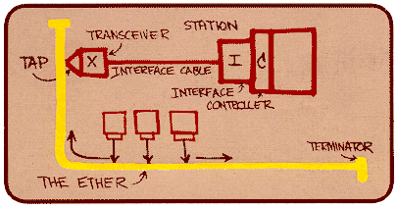
Ethernet
“dominant” wired LAN technology:
cheap $20 for 100Mbs!
first widely used LAN technology
Simpler, cheaper than token ring LANs and ATM
Kept up with speed race: 10 Mbps – 10 Gbps
Metcalfe’s Ethernet
sketch

Slide 80
Star Topology
Bus topology popular through mid 90s
Now star topology prevails
Connection choices: hub or switch (more later)
hub or
switch

Slide 81

Ethernet Frame Structure
Sending adapter encapsulates IP datagram (or other network layer protocol packet) in Ethernet frame
Preamble:
7 bytes with pattern 10101010 followed by one byte with pattern 10101011
used to synchronize receiver, sender clock rates

Slide 82
Ethernet Frame Structure (more)
Addresses: 6 bytes
  if adapter receives frame with matching destination address, or with broadcast address (eg ARP packet), it passes data in frame to net-layer protocol
  otherwise, adapter discards frame
Type: indicates the higher layer protocol (mostly IP but others may be supported such as Novell IPX and AppleTalk)
CRC: checked at receiver, if error is detected, the frame is simply dropped

Slide 83
Hubs
Hubs are essentially physical-layer repeaters:
  bits coming from one link go out all other links
  at the same rate
  no frame buffering
  no CSMA/CD at hub: adapters detect collisions
  provides net management functionality
twisted pair
hub

Slide 84
Interconnecting with Hubs
Backbone hub interconnects LAN segments
Extends max distance between nodes
But individual segment collision domains become one large collision domain
Can’t interconnect 10BaseT & 100BaseT
hub
hub
hub
hub

Slide 85
Switch
Link layer device
  stores and forwards Ethernet frames
  examines frame header and selectively forwards frame based on MAC dest address
  when frame is to be forwarded on segment, uses CSMA/CD to access segment
transparent
  hosts are unaware of presence of switches
plug-and-play, self-learning
  switches do not need to be configured

Slide 86
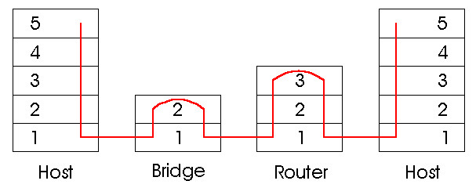
Switches vs. Routers
both store-and-forward devices
  routers: network layer devices (examine network layer headers)
  switches are link layer devices
routers maintain routing tables, implement routing algorithms
switches maintain switch tables, implement filtering, learning algorithms

Slide 87
ATM and MPLS
ATM, MPLS separate networks in their own right
  different service models, addressing, routing from Internet
viewed by Internet as logical link connecting IP routers
  just like dialup link is really part of separate network (telephone network)
ATM, MPSL: of technical interest in their own right

Slide 88
Asynchronous Transfer Mode: ATM
1990’s/00 standard for high-speed (155Mbps to 622 Mbps and higher) Broadband Integrated Service Digital Network architecture
Goal: integrated, end-end transport of carry voice, video, data
  meeting timing/QoS requirements of voice, video (versus Internet best-effort model)
  “next generation” telephony: technical roots in telephone world
  packet-switching (fixed length packets, called “cells”) using virtual circuits

Slide 89
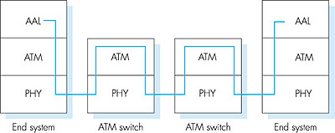
ATM Architecture
adaptation layer: only at edge of ATM network
  data segmentation/reassembly
  roughly analagous to Internet transport layer
ATM layer: “network” layer
  cell switching, routing
physical layer

Slide 90
ATM: Network or Link Layer?
Vision: end-to-end transport: “ATM from desktop to desktop”
  ATM is a network technology
Reality: used to connect IP backbone routers
  “IP over ATM”
  ATM as switched link layer, connecting IP routers
IP
network
ATM
network

Slide 91
ATM Layer
Service: transport cells across ATM network
analogous to IP network layer
very different services than IP network layer
Network
Architecture
Internet
ATM
ATM
ATM
ATM
Service
Model
best effort
CBR
VBR
ABR
UBR
Guarantees ?
Congestion
feedback
no (inferred
via loss)
no
congestion
no
congestion
yes
no
Bandwidth
none
constant
rate
guaranteed
rate
guaranteed
minimum
none
Loss
no
yes
yes
no
no
Order
no
yes
yes
yes
yes
Timing
no
yes
yes
no
no

Slide 92
ATM Layer: Virtual Circuits
VC transport: cells carried on VC from source to dest
  call setup, teardown for each call
  each packet carries VC identifier (not destination ID)
  every switch on source-dest path maintain “state” for each passing connection
  link,switch resources (bandwidth, buffers) may be allocated to VC: to get circuit-like performance
Permanent VCs (PVCs)
  long lasting connections
  typically: “permanent” route between to IP routers
Switched VCs (SVC):
  dynamically set up on per-call basis

Slide 93
What Else is Left to Learn?
Why am I taking this course? I know everything already!
Not quite yet!

Slide 94
What Else is Left to Learn?
Multicast (1 week)
Peer-to-Peer networking (1.5 weeks)
Wireless and Mobile Networks (2.5 weeks)
Mid-term
Multimedia Networking (2 weeks)
Network Security and Wireless Security (2.5 weeks)
Sensor and Senor Networks (1.5 weeks)

