Slide 1
Sensors and Wireless Sensor Networks

Slide 2
Roadmap
Motivation for a Network of Wireless Sensor Nodes
  Definitions and background
  Challenges and constraints
  Overview of topics covered

Slide 3
Sensing and Sensors
Sensing: technique to gather information about physical objects or areas
Sensor (transducer): object performing a sensing task; converting one form of energy in the physical world into electrical energy
Examples of sensors from biology: the human body
  eyes: capture optical information (light)
  ears: capture acoustic information (sound)
  nose: captures olfactory information (smell)
  skin: captures tactile information (shape, texture)

Slide 4
Sensing (Data Acquisition)
Sensors capture phenomena in the physical world (process, system, plant)
Signal conditioning prepare captured signals for further use (amplification, attenuation, filtering of unwanted frequencies, etc.)
Analog-to-digital conversion (ADC) translates analog signal into digital signal
Digital signal is processed and output is often given (via digital-analog converter and signal conditioner) to an actuator (device able to control the physical world)

Slide 5
Sensor Classifications
Physical property to be monitored determines type of required sensor
Type | Examples
Temperature | Thermistors, thermocouples
Pressure | Pressure gauges, barometers, ionization gauges
Optical | Photodiodes, phototransistors, infrared sensors, CCD sensors
Acoustic | Piezoelectric resonators, microphones
Mechanical | Strain gauges, tactile sensors, capacitive diaphragms, piezoresistive cells
Motion, vibration | Accelerometers, mass air flow sensors
Position | GPS, ultrasound-based sensors, infrared-based sensors, inclinometers
Electromagnetic | Hall-effect sensors, magnetometers
Chemical | pH sensors, electrochemical sensors, infrared gas sensors
Humidity | Capacitive and resistive sensors, hygrometers, MEMS-based humidity sensors
Radiation | Ionization detectors, Geiger-Mueller counters

Slide 6
Sensors
Enabled by recent advances in MEMS technology
Integrated Wireless Transceiver
Limited in
  Energy
  Computation
  Storage
  Transmission range
  Bandwidth
CPU
Battery
Wireless
Transceiver
Memory
Sensing Hardware
Notes:
Micro-Electro-Mechanical Systems

Slide 7
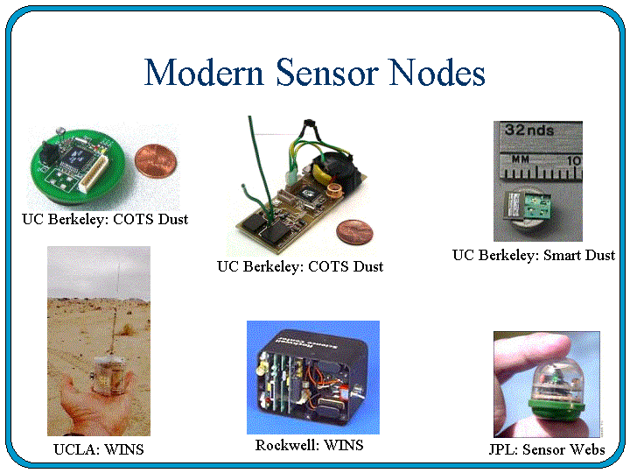
Sensors

Slide 8
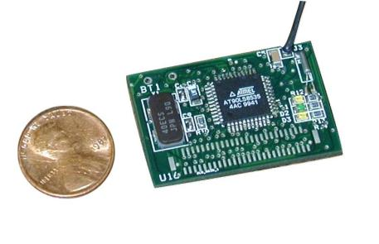
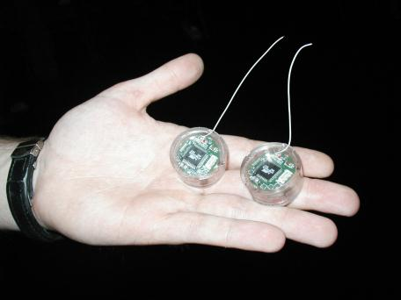
Sensor Nodes

Slide 9
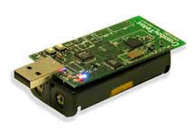
Sensors (contd.)
The overall architecture of a sensor node consists of:
  The sensor node processing subsystem running on sensor node main CPU
  The sensor subsystem and
  The communication subsystem
The processor and radio board includes:
  TI MSP430 microcontroller with 10kB RAM
  16-bit RISC with 48K Program Flash
  IEEE 802.15.4 compliant radio at 250 Mbps
  1MB external data flash
  Runs TinyOS 1.1.10 or higher
  Two AA batteries or USB
  1.8 mA (active); 5.1uA (sleep)
Crossbow Mote
TPR2400CA-TelosB

Slide 10
Overall Architecture of a Sensor Node

Slide 11
Wireless Sensor Network (WSN)
Multiple sensors (often hundreds or thousands) form a network to cooperatively monitor large or complex physical environments
Acquired information is wirelessly communicated to a base station (BS), which propagates the information to remote devices for storage, analysis, and processing

Slide 12
Networked vs. Individual Sensors
Extended range of sensing:
  Cover a wider area of operation
Redundancy:
  Multiple nodes close to each other increase fault tolerance
Improved accuracy:
  Sensor nodes collaborate and combine their data to increase the accuracy of sensed data
Extended functionality:
  Sensor nodes can not only perform sensing functionality, but also provide forwarding service.

Slide 13
History of Wireless Sensor Networks
DARPA:
  Distributed Sensor Nets Workshop (1978)
  Distributed Sensor Networks (DSN) program (early 1980s)
  Sensor Information Technology (SensIT) program
UCLA and Rockwell Science Center
  Wireless Integrated Network Sensors (WINS)
  Low Power Wireless Integrated Microsensor (LWIM) (1996)
UC-Berkeley
  Smart Dust project (1999)
  Concept of “motes”: extremely small sensor nodes
Berkeley Wireless Research Center (BWRC)
  PicoRadio project (2000)
MIT
  μAMPS (micro-Adaptive Multidomain Power-aware Sensors) (2005)

Slide 14
History of Wireless Sensor Networks
Recent commercial efforts
  Crossbow (www.xbow.com)
  Sensoria (www.sensoria.com)
  Worldsens (worldsens.citi.insa-lyon.fr)
  Dust Networks (www.dustnetworks.com)
  Ember Corporation (www.ember.com)

Slide 15
WSN Communication
Characteristics of typical WSN:
  Low data rates (comparable to dial-up modems)
  Energy-constrained sensors
IEEE 802.11 family of standards
  Most widely used WLAN protocols for wireless communications in general
  Can be found in early sensor networks or sensors networks without stringent energy constraints
IEEE 802.15.4 is an example for a protocol that has been designed specifically for short-range communications in WSNs
  Low data rates
  Low power consumption
  Widely used in academic and commercial WSN solutions

Slide 16
Single-Hop vs. Multi-Hop
Star topology
  Every sensor communicates directly (single-hop) with the base station
  May require large transmit powers and may be infeasible in large geographic areas
Mesh topology
  Sensors serve as relays (forwarders) for other sensor nodes (multi-hop)
  May reduce power consumption and allows for larger coverage
  Introduces the problem of routing

Slide 17
Challenges in WSNs: Energy
Sensors typically powered through batteries
  replace battery when depleted
  recharge battery, e.g., using solar power
  discard sensor node when battery depleted
For batteries that cannot be recharged, sensor node should be able to operate during its entire mission time or until battery can be replaced
Energy efficiency is affected by various aspects of sensor node/network design
Physical layer:
  switching and leakage energy of CMOS-based processors

Slide 18
Challenges in WSNs: Energy
Medium access control layer:
  contention-based strategies lead to energy-costly collisions
  problem of idle listening
Network layer:
  responsible for finding energy-efficient routes
Operating system:
  small memory footprint and efficient task switching
Security:
  fast and simple algorithms for encryption, authentication, etc.
Middleware:
  in-network processing of sensor data can eliminate redundant data or aggregate sensor readings

Slide 19
Challenges in WSNs: Self-Management
Ad-hoc deployment
  many sensor networks are deployed “without design”
    sensors dropped from airplanes (battlefield assessment)
    sensors placed wherever currently needed (tracking patients in disaster zone)
    moving sensors (robot teams exploring unknown terrain)
  sensor node must have some or all of the following abilities
    determine its location
    determine identity of neighboring nodes
    configure node parameters
    discover route(s) to base station
    initiate sensing responsibility

Slide 20
Challenges in WSNs: Self-Management
Unattended operation
  Once deployed, WSN must operate without human intervention
  Device adapts to changes in topology, density, and traffic load
  Device adapts in response to failures
Other terminology
  Self-organization is the ability to adapt configuration parameters based on system and environmental state
  Self-optimization is the ability to monitor and optimize the use of the limited system resources
  Self-protection is the ability recognize and protect from intrusions and attacks
  Self-healing is the ability to discover, identify, and react to network disruptions

Slide 21
Challenges in WSNs: Wireless Networks
Wireless communication faces a variety of challenges
Attenuation:
  limits radio range
Multi-hop communication:
  increased latency
  increased failure/error probability
  complicated by use of duty cycles

Slide 22
Challenges in WSNs: Decentralization
Centralized management (e.g., at the base station) of the network often not feasible to due large scale of network and energy constraints
Therefore, decentralized (or distributed) solutions often preferred, though they may perform worse than their centralized counterparts
Example: routing
Centralized:
  BS collects information from all sensor nodes
  BS establishes “optimal” routes (e.g., in terms of energy)
  BS informs all sensor nodes of routes
  Can be expensive, especially when the topology changes frequently
Decentralized:
  Each sensors makes routing decisions based on limited local information
  Routes may be nonoptimal, but route establishment/management can be much cheaper

Slide 23
Challenges in WSNs: Design Constraints
Many hardware and software limitations affect the overall system design
Examples include:
  Low processing speeds (to save energy)
  Low storage capacities (to allow for small form factor and to save energy)
  Lack of I/O components such as GPS receivers (reduce cost, size, energy)
  Lack of software features such as multi-threading (reduce software complexity)

Slide 24
Challenges in WSNs: Security
Sensor networks often monitor critical infrastructure or carry sensitive information, making them desirable targets for attacks
Attacks may be facilitated by:
  Remote and unattended operation
  Wireless communication
  Lack of advanced security features due to cost, form factor, or energy
Conventional security techniques often not feasible due to their computational, communication, and storage requirements
As a consequence, sensor networks require new solutions for intrusion detection, encryption, key establishment and distribution, node authentication, and secrecy

Slide 25
Comparison
Traditional Networks | Wireless Sensor Networks
General-purpose design; serving many applications | Single-purpose design; serving one specific application
Typical primary design concerns are network performance and latencies; energy is not a primary concern | Energy is the main constraint in the design of all node and network components
Networks are designed and engineered according to plans | Deployment, network structure, and resource use are often ad-hoc (without planning)
Devices and networks operate in controlled and mild environments | Sensor networks often operate in environments with harsh conditions
Maintenance and repair are common and networks are typically easy to access | Physical access to sensor nodes is often difficult or even impossible
Component failure is addressed through maintenance and repair | Component failure is expected and addressed in the design of the network
Obtaining global network knowledge is typically feasible and centralized management is possible | Most decisions are made localized without the support of a central manager

Slide 26
Roadmap
Motivation for a Network of Wireless Sensor Nodes
Applications
  Structural Health Monitoring
  Traffic Control
  Health Care
  Pipeline Monitoring
  Precision Agriculture

Slide 27

Structural Health Monitoring
Motivation
  Events:
    On August 2, 2007, a highway bridge unexpectedly collapsed in Minnesota
    Nine people were killed in the event
    Potential causes: wear and tear, weather, and the weight of a nearby construction project
    In fact, the BBC reported (August 14, 2007) that China had identified more than 6,000 bridges that were damaged or considered to be dangerous
  These accidents motivate wireless sensor
  networks for monitoring bridges and
  similar structures

Slide 28
Structural Health Monitoring
Motivation:
  Traditional inspections:
    Visual inspection ➔ everyday
      Labor-intensive, tedious, inconsistent, and subjective
    Basic inspections ➔ at least once a year
    Detailed inspection ➔ at least every five years on selected bridges
    Special inspections ➔ according to technical needs
      The rest require sophisticated tools ➔ expensive, bulky, and power consuming

Slide 29
Local and Global Inspections
Local inspection techniques focus on detecting highly localized, imperceptible fractures in a structure
  Requires:
    a significant amount of time
    the disruption of the normal operation of the structure
Global inspection techniques aim to detect a damage or defect that is large enough to affect the entire structure
  Researcher have been developing and testing wireless sensor networks as global inspection techniques

Slide 30
Wisden
http://enl.usc.edu/projects/wisden/
First prototype to employ WSN for monitoring structural health
  Installing a large scale wired data acquisition system may take several weeks and is quite expensive
  First deployment - for conducting seismic experiments
    on an imitation of a full-scale 28×28 square foot hospital ceiling
    the overall weight which the ceiling supports is approximately 12,000 pounds
  Second deployment
    25 nodes (a tree topology) and a 16 bit vibration card
    a high-sensitive triaxial accelerometer is attached to the vibration card
    designed for high-quality, low-power vibration sensing
    the task of the network was to reliably send time-synchronized vibration data to a remote sink over a multi-hop route
    NACK
    hop-by-hop scheme

Slide 31
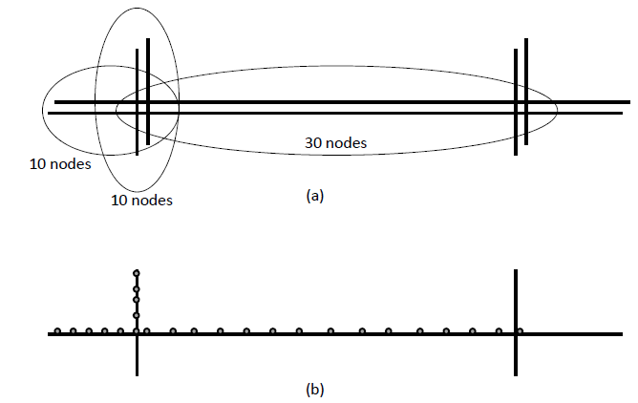
Golden Gate Bridge
(University of California)
http://www.cs.berkeley.edu/~binetude/ggb/
Figure: The deployment scenario on the Golden Gate Bridge

Slide 32
Golden Gate Bridge
64 wireless sensor nodes deployed on this bridge
The network monitors ambient vibrations synchronously
  1 KHz rate, ≤10µs jitter, accuracy=30µG, over a 46 hop network
The goal of the deployment:
  determine the response of the structure to both ambient and extreme conditions
  compare actual performance to design predictions
  measure ambient structural accelerations from wind load
  measure strong shaking from a potential earthquake
  the installation and the monitoring was conducted without the disruption of the bridge’s operation
Notes:
'æmbi:ənt

Slide 33
Roadmap
Motivation for a Network of Wireless Sensor Nodes
Applications
  Structural Health Monitoring
  Traffic Control
  Health Care
  Pipeline Monitoring
  Precision Agriculture
  Underground Mining

Slide 34
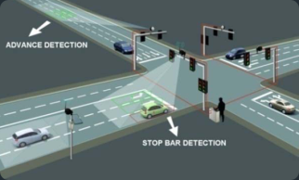
Traffic Control
Motivation:
  Ground transportation is a vital and a complex socio-economic infrastructure
  It is linked with and provides support for a variety of systems, such as supply-chain, emergency response, and public health
  The 2009 Urban Mobility Report reveals that in 2007, congestion caused urban Americans to
    travel 4.2 billion hours more
    purchase an extra 2.8 billion gallons of fuel
  Congestion cost is very high - $87.2 billion; an increase of more than 50% over the previous decade

Slide 35
Traffic Control
Motivation:
  Building new roads is not a feasible solution for many cities
    lack of free space
    high cost of demolition of old roads
  One approach: put in place distributed systems that reduce congestions
    Gather information about the density, sizes, and speed of vehicles on roads
    Infer congestions
    Suggest alternative routes and emergency exits

Slide 36
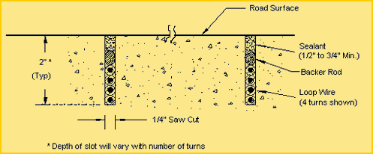
The Sensing Task
Inductive loops (in-road sensing devices)
  Advantages:
    Unaffected by weather
    Provide direct information (few ambiguity)
  How does it work: using Faraday’s induction law
    A coil of wire (several meters in diameter, passes an electric current through the coil)
    Buried under the road and connected to a roadside control box
    Magnetic field strength can be induced as a result of a current and the speed and the size of passing vehicles

Slide 37
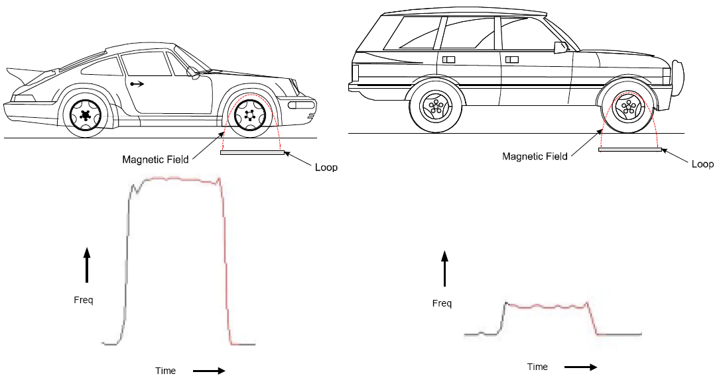
Magnetic Sensors
Magnetic sensors can determine the direction and speed of a vehicle
  A moving vehicle can disturb the distribution of the magnetic field
    by producing its own magnetic field
    by cutting across it
The magnitude and direction of the disturbance depends on
  The speed, size, density
  and permeability of
  the vehicle

Slide 38
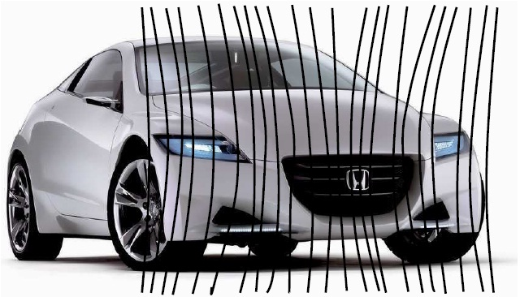
Magnetic Sensors
Figure: Detection of a moving vehicle with an ARM magnetic sensor (Caruso and Withanawasam 1999)

Slide 39
Magnetic Sensors
Almost all road vehicles contain a large mass of steel
The magnetic permeability of steel is much higher than the surrounding air
Steel has the capacity to concentrate the flux lines of the Earth’s magnetic field
The concentration of magnetic flux varies as the vehicle moves; it can be detected from a distance of up to 15m
The field variation reveals a detailed magnetic signature
It is possible to distinguish between different types of vehicles
Notes:
pə:miə'biliti]

Slide 40
Roadmap
Motivation for a Network of Wireless Sensor Nodes
Applications
  Structural Health Monitoring
  Traffic Control
  Health Care
  Pipeline Monitoring
  Precision Agriculture
  Underground Mining

Slide 41
Health Care
  A wide range of health care applications have been proposed for WSN, including monitoring patients with:
  Parkinson’s Disease and epilepsy
  heart patients
  patients rehabilitating from stroke or heart attack
  elderly people
  Health care applications do not function as standalone systems
  They are integral parts of a comprehensive and complex health and rescue system

Slide 42
Health Care
Motivation:
  cost is very high
    according to the US Centers for Medicare and Medicaid Services (CMS):
      the national health spending of the country in 2008 was estimated to be $2.4 trillion USD
      the costs caused by heart disease and stroke are around $394 billion
    this is a concern for policy makers, health care providers, hospitals, insurance companies, and patients
  higher spending does not imply quality service or prolonged lifetime (Kulkarni and Öztürk 2007)
    for example, in 2000, the US spent more on health care than any other country in the world – an average of $4,500 USD per person - but ranked 27th in average life expectancy
    many countries achieve higher life expectancy rates at a lower cost

Slide 43
Health Care
Motivation:
  preventive health care - to reduce health spending and mortality rate
    but some patients find certain practices inconvenient, complicated, and interfering with their daily life (Morris 2007)
    many miss checkup visits or therapy sessions because of a clash of schedules with established living and working habits, fear of overexertion, or transportation cost

Slide 44
Health Care
To deal with these problems, researchers proposed comprehensible solutions that involve the following tasks:
  building pervasive systems that provide patients with rich information about diseases and their prevention mechanisms
  seamless integration of health infrastructures with emergency and rescue operations as well as transportation systems
  developing reliable and unobtrusive health monitoring systems that can be worn by patients to reduce the task and presence of medical personnel
  alarming nurses and doctors when medical intervention is necessary
  reducing inconvenient and costly check-up visits by creating reliable links between autonomous health monitoring systems and health institutions

Slide 45



Commercially Available Sensors
Pulse oxygen saturation sensors
Blood pressure sensors
Electrocardiogram (ECG)
Electromyogram (EMG) for measuring muscle activities
Temperature sensors (core body temperature and skin temperature)
Respiration sensors
Blood flow sensors
Blood oxygen level sensor

Slide 46
Roadmap
Motivation for a Network of Wireless Sensor Nodes
Applications
  Structural Health Monitoring
  Traffic Control
  Health Care
  Pipeline Monitoring
  Precision Agriculture
  Underground Mining

Slide 47
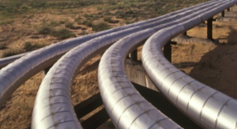
Pipeline Monitoring
Objective: monitoring gas, water and oil pipelines
Motivation:
  management of pipelines presents a formidable challenge
    long length, high value, high risk
    difficult access conditions
    requires continuous and unobtrusive monitoring
  leakages can occur due to excessive deformations
    earthquakes
    landslides or collisions with an external force
    corrosion, wear, material flaws
    intentional damage to the structure

Slide 48
Pipeline Monitoring
To detect leakages, it is vital to understand the characteristics of the substance the pipelines transport
  fluid pipelines generate a hot-spot at the location of the leak
  gas pipelines generate a cold-spot due to the gas pressure relaxation
  fluid travels at a higher propagation velocity in metal pipelines than in a Polyvinyl Chloride (PVC)
  a large number of commercially available sensors to detect and localize thermal anomalies
    fiber optics sensors
    temperature sensors and
    acoustic sensors

Slide 49
PipeNet
Motivation:
  sewerage systems convey domestic sewage, rainwater runoff, and industrial wastewater to sewerage treatment plants
  historically, these systems are designed to discharge their content to nearby streams and rivers
  subsequently, combined sewer overflows are among the major sources of water quality impairment
  nearly 770 large cities in the US, mainly older communities, have combined sewer systems (Stoianov et al. 2007)
Notes:
'su:ɪdʒ]

Slide 50
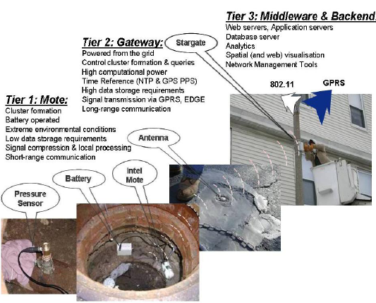
PipeNet
The PipeNet prototype has been developed to monitor water pipelines in urban areas
The task is to monitor:
  hydraulic and water
  quality by measuring
  pressure and pH
  the water level in
  combined sewer
  systems
    sewer collectors
    and combined
    sewer outflows

Slide 51
Roadmap
Motivation for a Network of Wireless Sensor Nodes
Applications
  Structural Health Monitoring
  Traffic Control
  Health Care
  Pipeline Monitoring
  Precision Agriculture
  Underground Mining

Slide 52
Precision Agriculture
Motivation:
  traditionally, a large farm is taken as homogeneous field in terms of resource distribution and its response to climate change, weeds, and pests
  accordingly, farmers administer
    fertilizers, pesticides, herbicides, and water resources
  in reality, wide spatial diversity in soil types, nutrient content, and other important factors
  therefore, treating it as a uniform field can cause
    inefficient use of resources
    loss of productivity
Precision agriculture is a method of farm management that enables farmers to produce more efficiently through a frugal use of resources

Slide 53
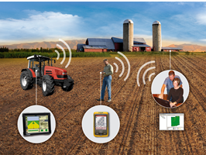
Precision Agriculture
Precision agriculture technologies:
  yield monitors
  yield mapping
  variable rate fertilizer
  weed mapping
  variable spraying
  topography and boundaries
  salinity mapping
  guidance systems
Requirements of precision agriculture technologies:
  collect a large amount of data
  over several days

Slide 54

Wine Vineyard (2004)
Motivation:
  in a vineyard, temperature is the predominant parameter that affects the quality as well as the quantity of the harvest
  grapes see no real growth until the temperature goes above 10°C
  different grapes have different requirements for heat units
  subsequently, the deployment aims to
    measure the temperature over a 10°C baseline that a site accumulates over the growing season

Slide 55
Wine Vineyard (2004)
Beckwith et al. deploy a WSN to monitor and characterize variation in temperature of a wine vineyard
  heat summation and periods of freezing temperatures
65 nodes in a grid like pattern 10 to 20 meters apart, covering about two acres
Easy to develop the network (1 person day)
  due to the self-configuration nature of the network
  inherent structured layout of vineyard fields
Two essential constraints of the network topology
  placement of nodes in an area of viticulture interest
  the support for multi-hop communication

Slide 56
Wine Vineyard (2004)
The data were used to investigate several aspects:
  the existence of co-variance between the temperature data collected by the network
  growing degree day differences
  potential frost damage
The mean data enabled to observe the relative differences between heat units accumulation during that period
  according to the authors’ report, the extent of variation in this vineyard – there was a measured difference of over 35% of heat summation units (HSUs) in as little as 100 meters

Slide 57
Roadmap
Motivation for a Network of Wireless Sensor Nodes
Applications
Coverage and Connectivity Issues in Sensor Networks
  Coverage
  Connectivity

Slide 58
A Sensor Node
Memory
(Application)
Processor
Transmission range
Sensing
range
Sensor
Actuator
Network
Interface

Slide 59
Sensor Deployment
How to deploy sensors over a field?
  Deterministic, planned deployment
  Random deployment
Desired properties of deployments?
  Depends on applications
  Connectivity
  Coverage

Slide 60
Coverage, Connectivity
Every point is covered by 1 or K sensors
  1-covered, K-covered
The sensor network is connected
  K-connected
Others
1
8
R
2
7
6
3
4
5

Slide 61
Coverage & Connectivity: not independent, not identical
If region is continuous & Rt > 2Rs
Region is covered sensors are connected
Rt
Rs

Slide 62
Connectivity Issues

Slide 63
Power Control for Connectivity
Adjust transmission range (power)
  Resulting network is connected
  Power consumption is minimum
Transmission range
  Homogeneous
  Node-based

Slide 64
Power Control for K-Connectivity
For fault tolerance, k-connectivity is desirable
K-connected graph:
  K paths between every two nodes
  with k-1 nodes removed, graph is still connected
1-connected 2-connected 3-connected

Slide 65
Two Types of Approaches
Probabilistic
  How many neighbors are needed?
Algorithmic
  Gmax connected
  Construct a connected subgraph
  with desired properties

Slide 66
Probabilistic Approach
How many neighbors are necessary and/or sufficient to ensure connectivity?

Slide 67
How Many Neighbors are Needed?
Regular deployment of nodes – easy
Random deployment (Poisson distribution)
N: number of nodes in a unit square
Each node connects to its k nearest neighbors
For what values of k, is network almost sure connected?
  P( network connected ) → 1, as N →
∞

Slide 68
An Alternative View
A square of area N
Poisson distribution of a fixed density λ
Each node connects to its k nearest neighbors
For what values of k, is the network almost sure connected?
  P( network connected ) → 1, as N →
N
∞

Slide 69
A Related Old Problem
Packet radio networks (1970s/80s)
Larger transmission radius
  Good: more progress toward destination
  Bad: more interference
Optimum transmission radius?

Slide 70
Magic Number
Kleinrock and Silvester (1978)
  Model:
    slotted Aloha
    homogeneous radius R
    Poisson distribution
    maximize one hop progress toward destination
  Set R so that every station has 6 neighbors on average
  6 is the magic number

Slide 71
More Magic Numbers
Tobagi and Kleinrock (1984)
  Eight is the magic number
Other magic numbers for various protocols and models:
  5, 6, 7, 8

Slide 72
Are Magic Numbers Magic?
Xue & Kumar (2002)
For the network to be almost sure connected, Θ(log n) neighbors are necessary and sufficient
Heterogeneous radius
8, 7, 6, 5
(Magic numbers)

Slide 73
Coverage Issues

Slide 74
Simple Coverage Problem
Given an area and a sensor deployment
Question: Is the entire area covered?
1
8
R
2
7
6
3
4
5

Slide 75
K-Covered
1-covered
2-covered
3-covered

Slide 76
K-Coverage Problem
Given: region, sensor deployment, integer k
Question: Is the entire region k-covered?
1
8
R
2
7
6
3
4
5

Slide 77
Reference
C. Huang and Y. Tseng, “The coverage problem in a wireless sensor network,”
  In WSNA, 2003.
  Also MONET 2005.

Slide 78
Density (or Topology) Control
Given: an area and a sensor deployment
Problem: turn on/off sensors to maximize the sensor network’s life time

Slide 79
PEAS and OGDC
PEAS: A robust energy conserving protocol for long-lived sensor networks
  Fan Ye, et al (UCLA), ICNP 2002
“Maintaining Sensing Coverage and Connectivity in Large Sensor Networks”
  H. Zhang and J. Hou (UIUC), MobiCom 2003

Slide 80
PEAS: Basic Ideas
How often to wake up?
How to determine whether to work or not?
Wake-up rate?
Sleep
Wake up
Go to
Work?
yes
work
no

Slide 81
How Often to Wake Up?
Desired: the total wake-up rate around a node equals some given value

Slide 82
Inter Wake-up Time
f(t) = λ exp(- λt)
exponential distribution
λ = average # of wake-ups per unit time

Slide 83
Wake-Up Rates
A
f(t) = λ exp(- λt)
B
f(t) = λ’ exp(- λ’t)
A + B: f(t) = (λ + λ’) exp(- (λ + λ’) t)

Slide 84
Adjust Wake-Up Rates
Working node knows
  Desired total wake-up rate λd
  Measured total wake-up rate λm
When a node wakes up, adjusts its λ by
λ := λ (λd / λm)

Slide 85
Go to Work or Return to Sleep?
Depends on whether there is a working node nearby
Rp
Go back to sleep go to work

Slide 86
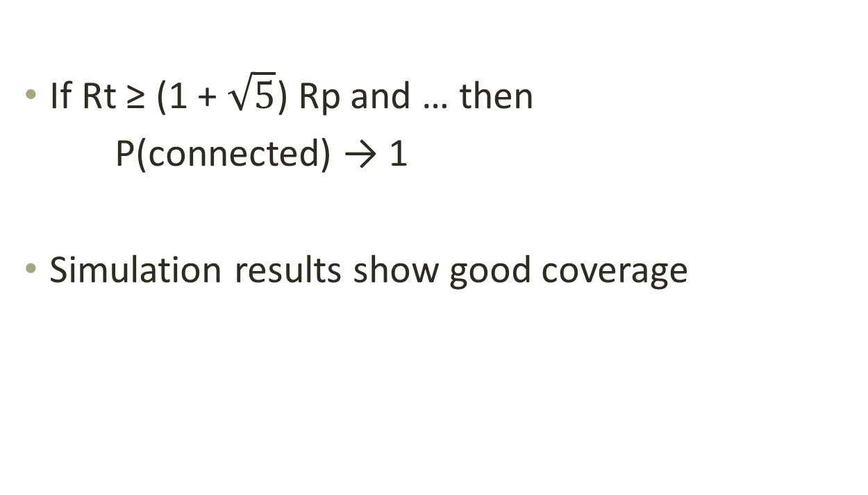
Is the Resulting Network Covered or Connected?
If Rt ≥ (1 + $\sqrt{5}$) Rp and … then
P(connected) → 1
Simulation results show good coverage

Slide 87
Roadmap
Motivation for a Network of Wireless Sensor Nodes
Applications
Coverage and Connectivity Issues in Sensor Networks
Routing Protocols for Wireless Sensor Networks

Slide 88
Usage and Constraints
Gather data locally (Temperature, Humidity, Motion Detection, etc.)
Send them to a command center (sink)
Limitations
  Energy Constrains
  Bandwidth
  All layers must be energy aware
  Need for energy efficient and reliable network routing
  Maximize the lifetime of the network

Slide 89
Differences of Routing in WSN and Traditional Networks
No global addressing
  Classical IP-based protocols cannot be applied to sensor networks
Redundant data traffic
  Multiple sensors may generate same data within the vicinity of a phenomenon
  Such redundancy needs to be exploited by the routing protocols to improve energy and bandwidth utilization
Multiple-source single-destination network
  Almost all applications of sensor networks require the flow of sensed data from multiple regions (sources) to a particular sink
Careful resource management
  Sensor nodes are tightly constrained in terms of:
    Transmission power
    On-board energy
    Processing capacity
    Storage

Slide 90
Classification of Routing Protocols
Data Centric:
  Data-centric protocols are query-based
Hierarchical:
  Aim at clustering the nodes so that cluster heads can do some aggregation and reduction of data in order to save energy
Location-based:
  Utilize the position information to relay the data to the desired regions rather than the whole network.
Network Flow & QoS Aware:
  Are based on general network-flow modeling and protocols that strive for meeting some QoS requirements along with the routing function

Slide 91
Hierarchical Routing Protocols
Scalability is one of the major design attributes of sensor networks
A single-tier network can cause the gateway to overload with the increase in sensors density
  Such overload might cause latency in communication and inadequate tracking of events
The single-gateway architecture is not scalable for a larger set of sensors covering a wider area of interest

Slide 92
Hierarchical Protocols
Maintain energy consumption of sensor nodes
  By multi-hop communication within a particular cluster
  By data aggregation and fusion → decrease the number of the total transmitted packets
LEACH: Low-Energy Adaptive Clustering Hierarchy
PEGASIS: Power-Efficient GAthering in Sensor Information Systems
  Hierarchical PEGASIS
TEEN: Threshold sensitive Energy Efficient sensor Network protocol
  Adaptive Threshold TEEN (APTEEN)
Energy-aware routing for cluster-based sensor networks
Self-organizing protocol

Slide 93
LEACH : Low-Energy Adaptive Clustering Hierarchy
One of the first hierarchical routing protocols
Forms clusters of the sensor nodes based on received signal strength
Self-organizing, adaptive clustering protocol
Dynamic cluster formation
Local cluster heads route the information of the cluster to the sink
Data processing & aggregation done by cluster head
Cluster heads change randomly over time balance energy dissipation

Slide 94
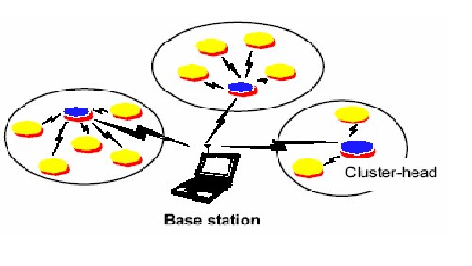
LEACH – Architecture

Slide 95
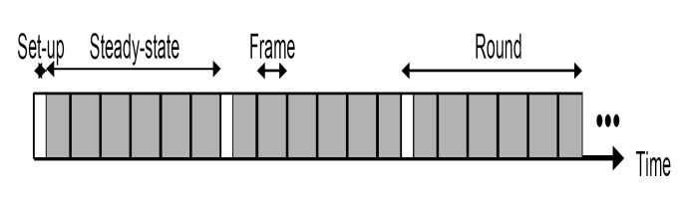
LEACH’s Two Phases
The LEACH network has two phases: the set-up phase and the steady-state
  The set-up phase
    Where cluster-heads are chosen
    Cluster formation
  The steady-state
    The cluster-head is maintained
    When data is transmitted between nodes
Timeline showing LEACH operation

Slide 96
Setup Phase
At the beginning of each round, each node advertises it probability, (depending upon its current energy level) to be the Cluster Head, to all other nodes
  Nodes (k for each round) with higher probabilities are chosen as the Cluster Heads
Cluster Heads broadcasts an advertisement message (ADV) using CSMA MAC protocol
Based on the received signal strength, each non-Cluster Head node determines its Cluster Head for this round (random selection with obstacle)
Each non-Cluster Head transmits a join-request message (Join-REQ) back to its chosen Cluster Head using a CSMA MAC protocol
Cluster Head node sets up a TDMA schedule for data transmission coordination within the cluster

Slide 97
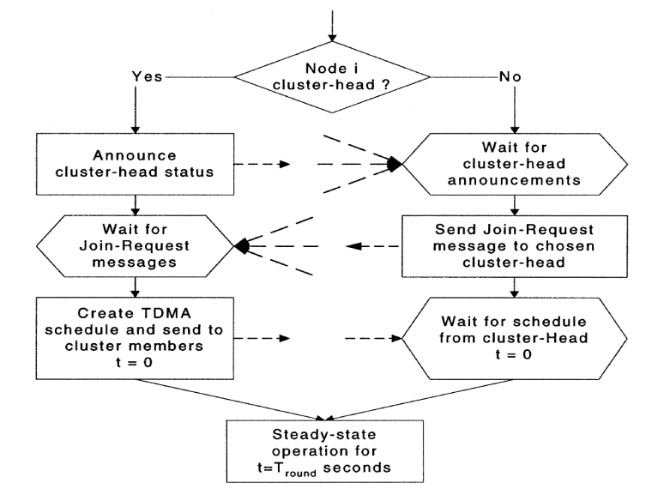
Flow Graph for Setup Phase

Slide 98
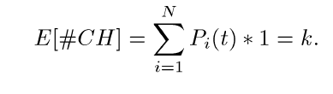
Cluster Head Selection Algorithm
P_{i}(t) is the probability with which node i elects itself to be Cluster Head at the beginning of the round r+1 (which starts at time t) such that expected number of cluster-head nodes for this round is k
  (1)
  k = number of clusters during each round
  N = number of nodes in the network

Slide 99

Cluster Head Selection Algorithm
Each node will be Cluster Head once in N/k rounds
Probability for each node i to be a cluster-head at time t
  (2)
  C_{i}(t) = it determines whether node i has been a Cluster
  Head in most recent (r mod(N/k)) rounds

Slide 100
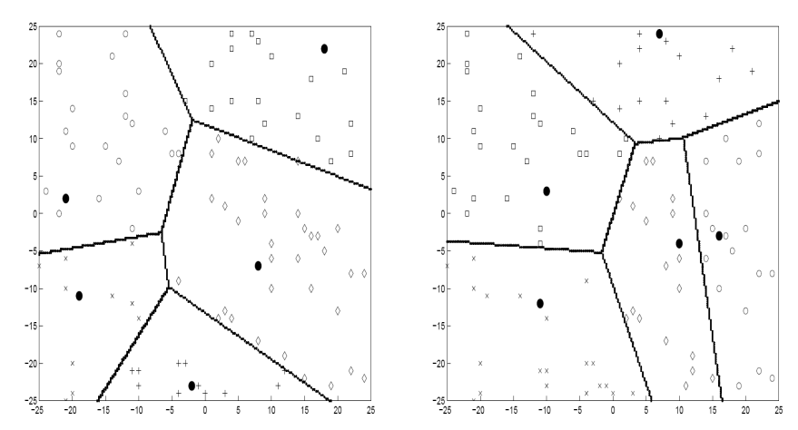
Dynamic Cluster Formation
Clusters at time t
Clusters at time t+d

Slide 101
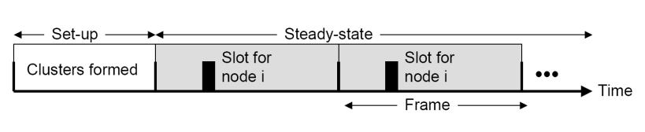
Steady-State Phase
Timeline showing LEACH operation
TDMA schedule is used to send data from node to head cluster
Head Cluster aggregates the data received from node cluster’s
Communication is via direct-sequence spread spectrum (DSSS) and each cluster uses a unique spreading code to reduce inter-cluster interference
Data is sent from the cluster head nodes to the BS using a fixed spreading code and CSMA

Slide 102
Steady-State Phase
Timeline showing LEACH operation
Assumptions
  Nodes are all time synchronized and start the setup phase at same time
    BS sends out synchronized pulses to the nodes
  Cluster Head must be awake all the time
To reduce inter-cluster interference, each cluster in LEACH communicates using direct-sequence spread spectrum (DSSS)
Data is sent from the cluster head nodes to the BS using a fixed spreading code and CSMA

Slide 103
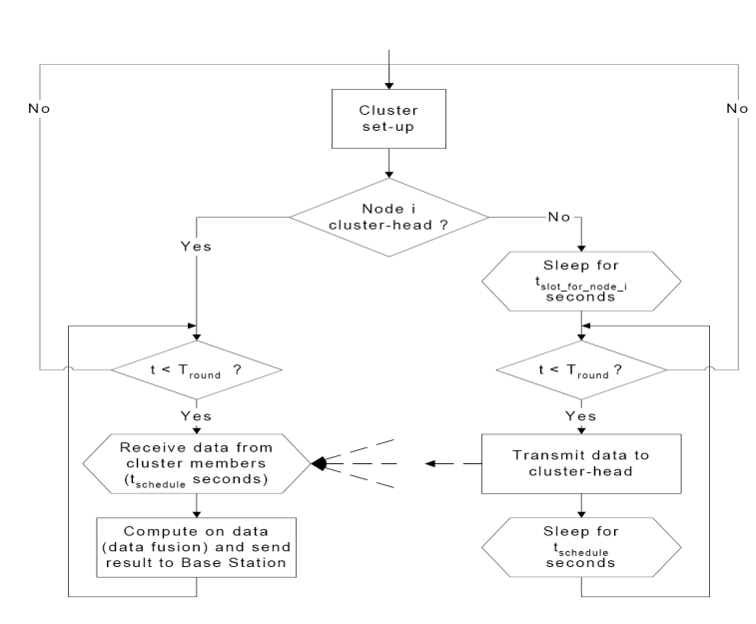
Flow Chart for Steady Phase

Slide 104
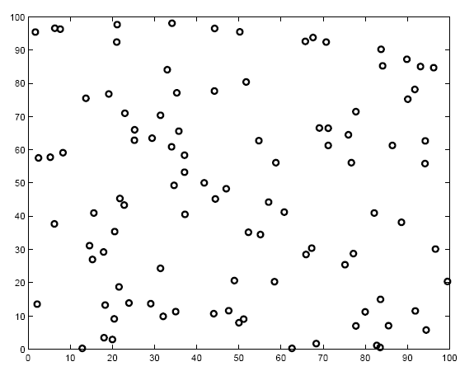
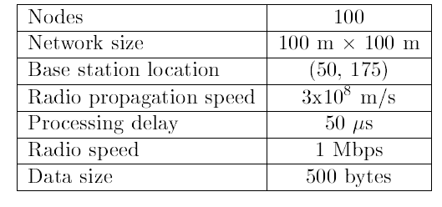
LEACH Simulation
100 node random test network

Slide 105
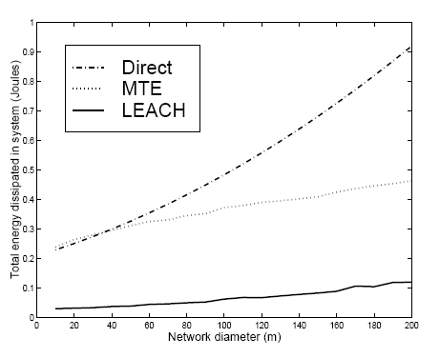
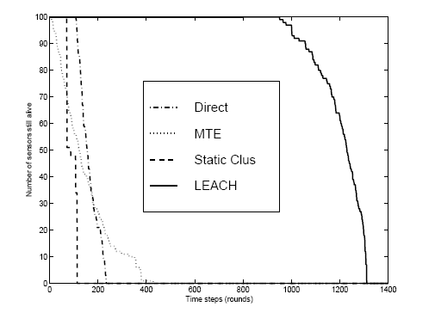
LEACH – Simulation Result
Energy dissipation
System Lifetime

Slide 106
LEACH Conclusion
Advantages
  Completely distributed
  No global knowledge of the network
  Increases the lifetime of the network
Disadvantages
  Uses single-hop routing within cluster → not applicable to networks in large regions
  Dynamic clustering brings extra overhead (advertisements, etc.)
  The paper assumes all the nodes begin with same energy – this assumption may not be realistic

