Slide 1
ONLINE AGRI-MARKETING SYSTEM
Supervisor: P. Njuguna

Slide 2
Problem Statement
Farmers are not willing to invest cash crops due to extortion from the middlemen
This project will create a link between farmers and potential buyers.

Slide 3
General objectives
To develop an online agri-marketing system which aims at improving the marketing strategies
of farmers.
Specific objectives
To review current systems where farmers are using to sell their produce.
To design online agri-marketing system.
To implement online agri-marketing system.
To test online agri-marketing system.
To deploy online agri-marketing system

Slide 4
Scope
The project will provide a platform where farmers and potential buyers get a chance to interact and sell their produce without a go between.

Slide 5
Justification
The project will improve relationship between sellers and buyers by eliminating middlemen . hence improved profit to the clients and buyers will get quality and fresh products of their choice

Slide 6
LITERATURE REVIEW
marketing is a collective medium with which individuals or group of individuals can collectively exchange goods and services based on their needs and wants
Marketing activities in the 1980’s have been dominated by traditional marketing mix offline,
with the advent of the internet, the focus of marketing has shifted to online marketing.

Slide 7
Similar work in Kenya
M-farm
charges a transaction fee for every deal made in the platform
Zalisha app
involved in marketing of fruits in Kenya and Tanzania
Mkulima bora

Slide 8
Proposed system
The project is a web based application. Online agri-marketing system will provide a marketplace for various sellers.
The seller will manage their marketpalce independently . The transaction carried on the system will be absolutely free, there will be no commission on the transactions.

Slide 9
The system will comprise of
Sign up/log in page
Administrator section
Payment section
Marketplace
Chat section(blog)

Slide 10
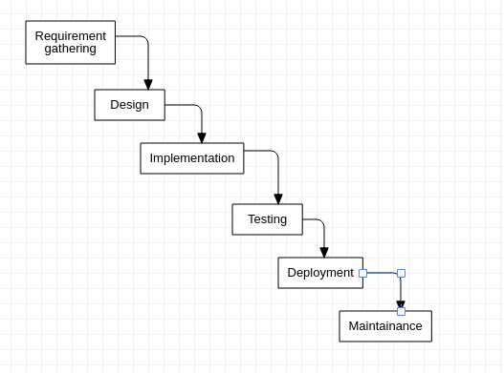
METHODOLOGY

Slide 11
Requirement gathering
Interviews and narratives,
Journals and other printed media,
Survey,
Questionnaires

Slide 12
end

