Slide 1
TrackIn
A Location Finder

Slide 2
Developed by
IODroid
TEAM:
1.Ajin Thomas
2.James George
3.Joel Jolly
4.Martin Siby Mathew
5.Rajat Jaic Mendus

Slide 3
INTRODUCTION
A user authorized app to track location as soon as the user clicks on the track location button on the map , the system will zoom into the users current location and show the coordinates of the user . A 5 mile/KM radius distance is demarcated by a circular ring on the map . This system provides the user to conver a geo-location coordinartes to address and vice-versa. As the user clicks on a location anywhere on the map the geo-location of the map is displayed .

Slide 4
FUNCTIONS
Track the User Location
The application allows the user to locate the position of the user on the map .
Convert a Geo Location to Geo Address
The user is asked to enter a geo-location .ie Coordinates of a particular location which the user wishes to find.The address of the specific location is given to the user.
Convert a Geo-Address to Geo-Location
The user is asked to enter a locational Address of which the coordinates he wishes to find .The user is given the longitude values and latitude values of the entered address.

Slide 5
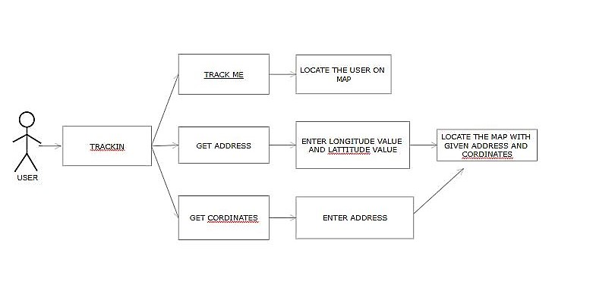
WORK FLOW

Slide 6
BASIC REQUIREMENT
Android Mobile phone with Android 5.1 or higher
Global Positioning System
Internet

Slide 7
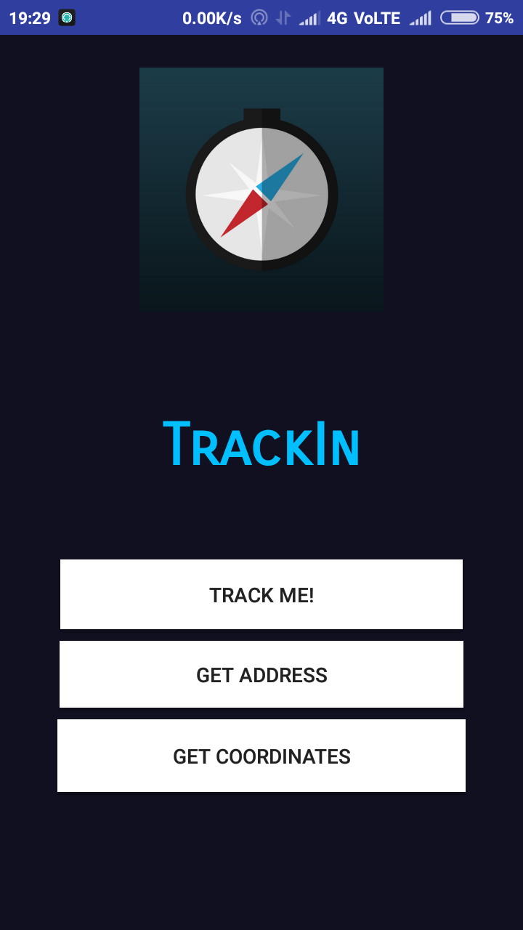
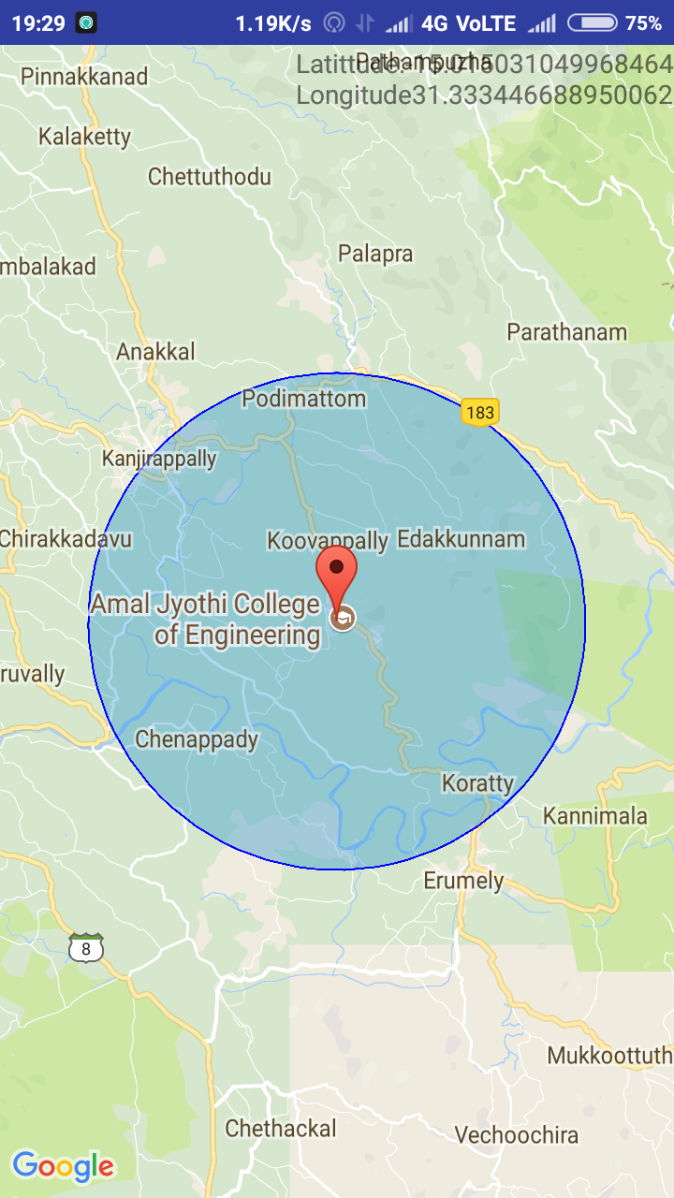
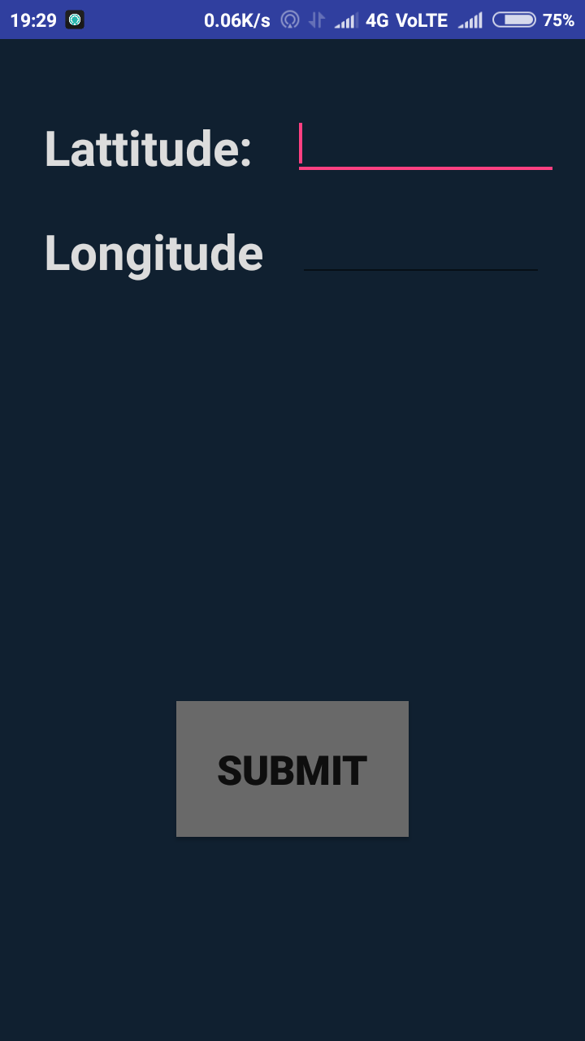
SCREENSHOTS

Slide 8
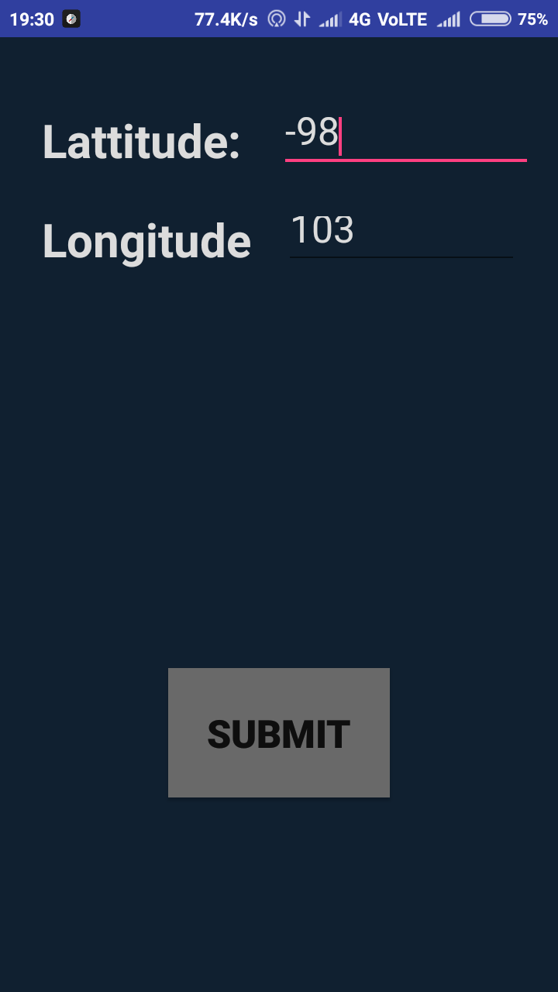
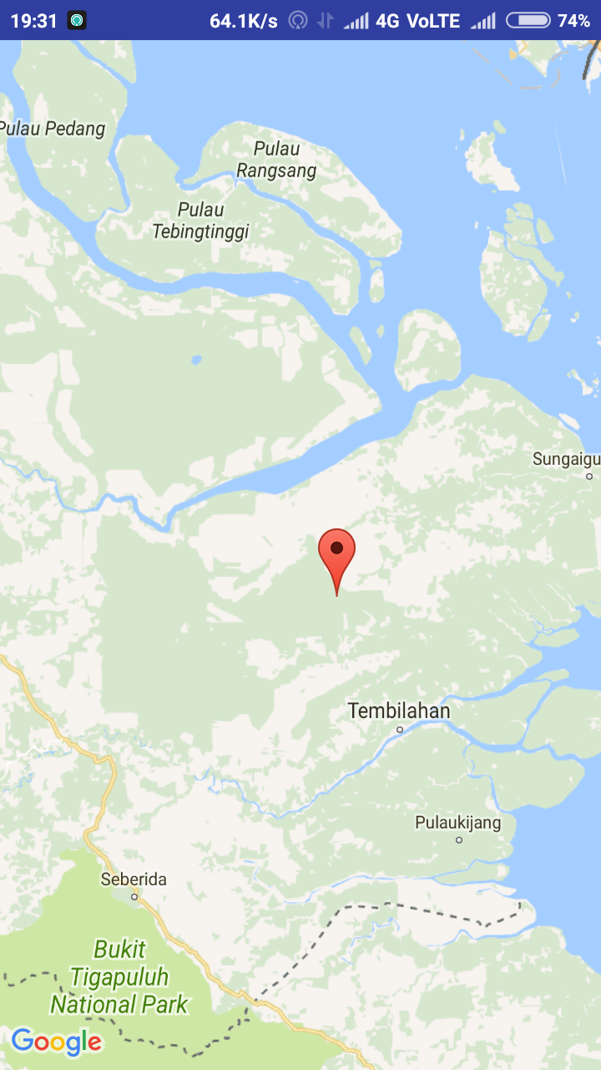
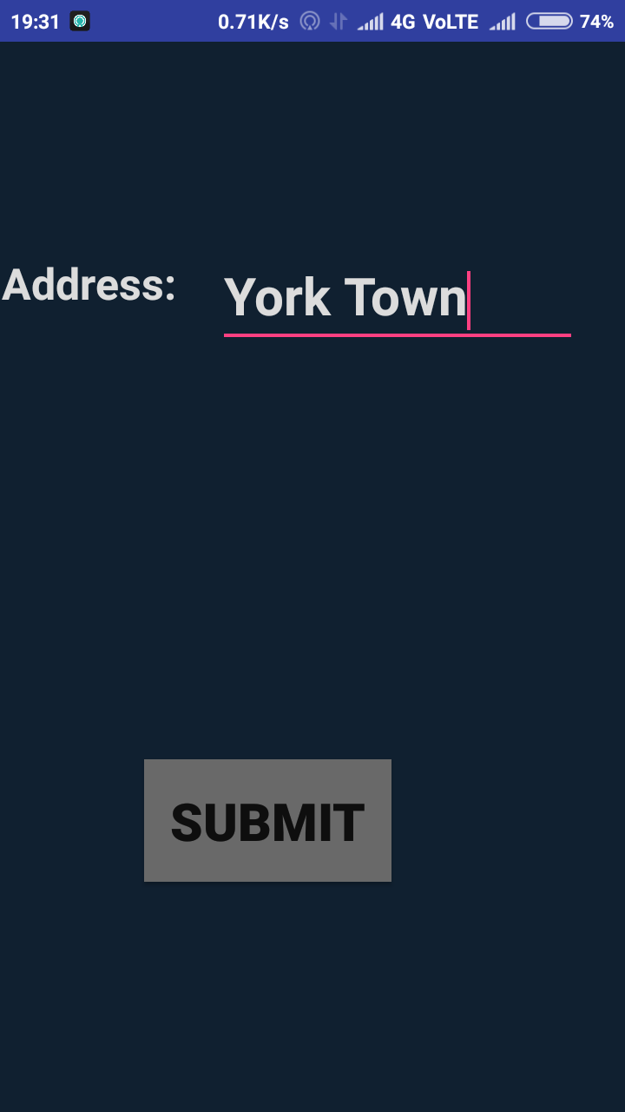

Slide 9
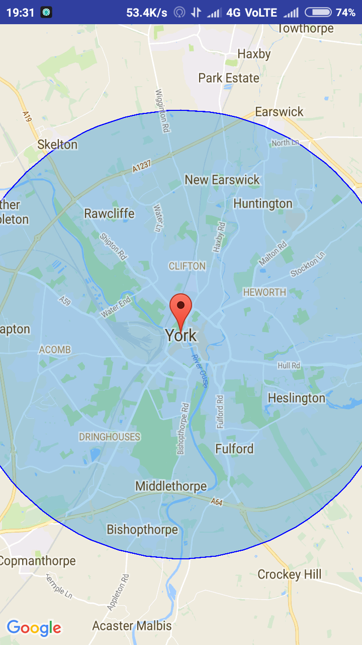

Slide 10
CONCLUSION
The application helps the user to find his/her location exactly with the longitude values and latitude values .
The user get the specific location of the address entered .
The user gets the specific address of the coordinated entered.

Slide 11
THANKYOU

