Slide 1
Impacts of the HTTP/2 protocol for large scale web environments
Martin Leucht <martin.leucht@os3.nl>
James Gratchoff <james.gratchoff@os3.nl>
Large Infrastructure Administration
Jaap van Ginkel
Master System and Network Engineering 2015
UvA

Slide 2



Introduction
HTTP/2 specifications accepted by IESG
on the 18th of February 2015
On the way to become an RFC
16 years of HTTP/1.1 (June 1999)

Slide 3
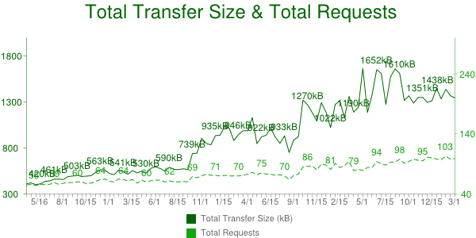
Why change?
The web has changed
Index.html
Css
Style1.css
Style2.css
Javascript
Java.js
Java2.js
Images
img1.jpg
Img2.jpg
Img3.jpg
…
Source: http://httparchive.org

Slide 4
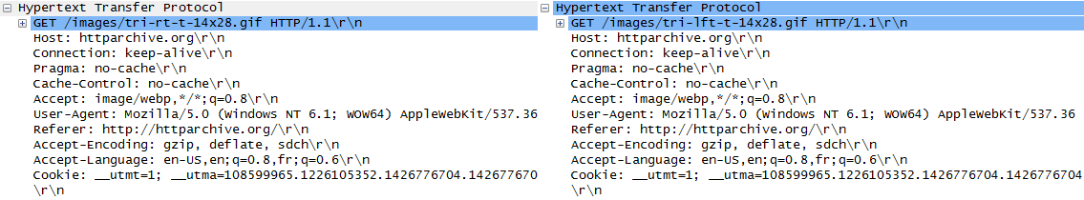
Problems
client
server
Bad usage of TCP:
Head of line blocking
Headers size:
Repetition of header
GET big.png
GET style.css
Waiting to fetch
the png file
200 ok
200 ok

Slide 5
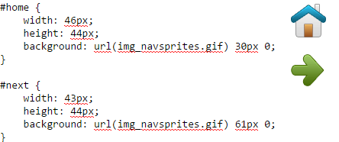



Workarounds
Spriting
TCP works better for larger files. Use one single image for different one.
Domain sharding
GET image1.img
GET image2.img
GET image3.img
GET image4.img
Concatenation, Inlining (base 64)…

Slide 6
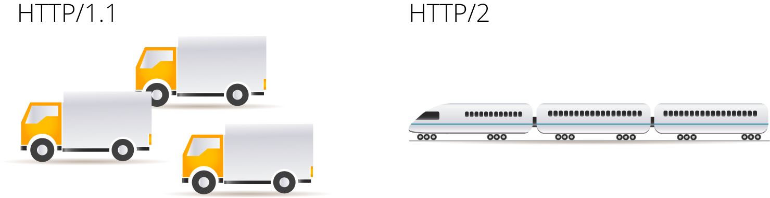
HTTP/2
Advantages:
Binary protocol
one TCP connection
Streams
Header compression (HPACK)
Multiplexing with prioritization and flow control
Server push
TLS mandatory (Google Chrome, Firefox)

Slide 7
Research questions
How do the new features of the HTTP/2 protocol improve the performance for frequently visited webpages/webserver?
What are possible drawbacks that can occur for large web service providers when switching from HTTP/1.1 to HTTP/2? And what is the impact on the infrastructure?
What is the difference between HTTP/1.1 and HTTP/2 in terms of:
- Bandwidth and CPU utilization
- Header size
- mean time taken for request and response (per location/RTT)

Slide 8

Benchmark setup
Webserver:
Ubuntu 14 (8CPUx1,8GHz, 8GB RAM)
Servers:
HTTP/2 Nghttp2
HTTP/1.1 Apache2
Reverse Proxy Nghttpx
4-Clients:
Ubuntu 14 (ec2-Amazon)
4vCPU, 2GB
Benchmark Tool:
H2load
 | California | Local | Frankfurt | Tokyo
RTT(ms) | 150 | 0,3 | 6.8 | 280

Slide 9
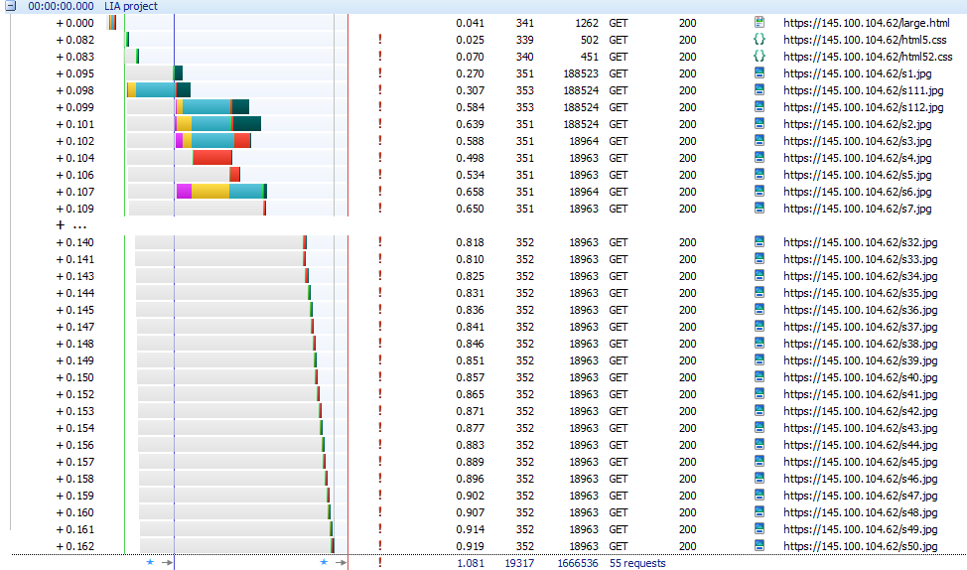
Httpwatch screenshot

Slide 10
Methods - Measurements
Test Parameters:
HTTP/1.1 and/or HTTP/2 protocol used
different locations/distances (RTT)
2 different webpages (size, number of URLs included)
increment number of clients/requests in parallel (1…750)
recursion depth/repetitions 20

Slide 11
Methods – Data
Mean of request + response time seen from clients (in ms)
Header sizes (bytes)
Failed requests
Resource Monitoring of web server/reverse proxy:
traffic (bps) inbound/outbound
CPU utilization
number of TCP sockets/connections

Slide 12
Results (HTTP/1.1 vs. HTTP/2 Header Traffic)
measured ca. 33% less header traffic in HTTP/2 (header compression)

Slide 13
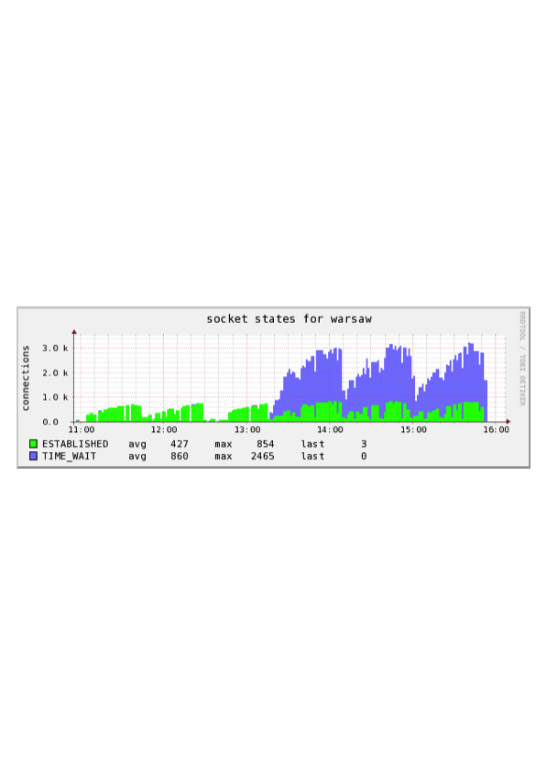
Results (Frankfurt/Germany – RTT ~7ms)
HTTP/2 RTT
significantly
faster
HTTP/2
HTTP/1.1
TCP TIME_WAIT
connections HTTP/1.1

Slide 14
Results (North Carolina/US – RTT ~150ms)
HTTP/2 RTT
HTTP/2 mean RTT constant (no jitter/packet delay variation)

Slide 15
Results (request time – difference HTTP/2 – HTTP/1.1)
HTTP/2 is in almost all measurements significantly faster
than HTTP/1.1

Slide 16
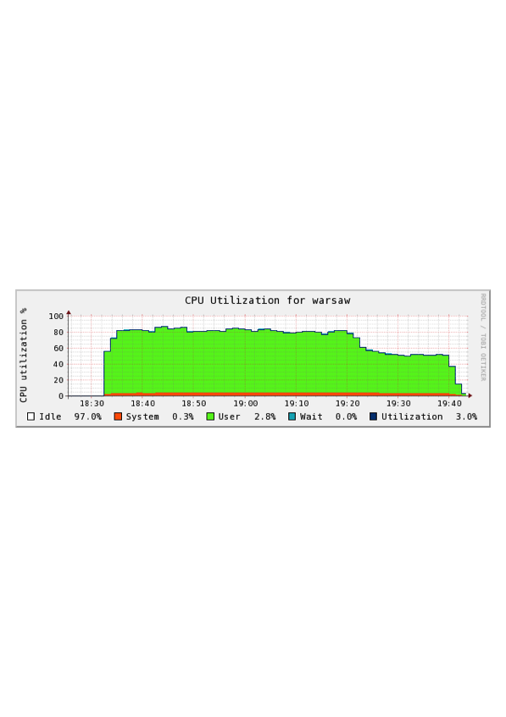
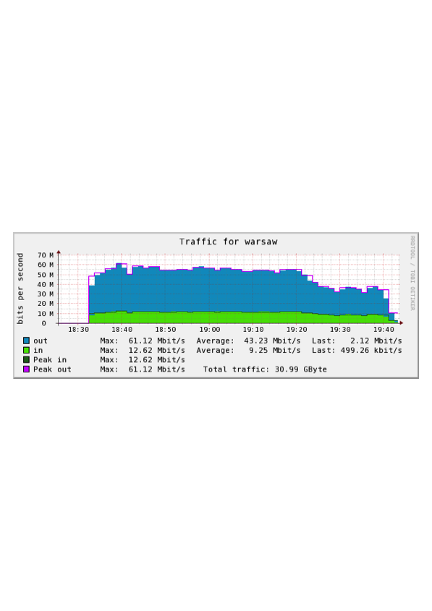
Results (HTTP/1.1 and HTTP/2 simultaneous - local)
HTTP/2 tests
finished –

Slide 17
Conclusion
Performance improvements HTTP/2 (compared to HTTP/1.1)
significantly less amount header traffic (ca. 33%)
significantly faster request/response time – only one TCP session per page request
significantly less TCP TIME_WAIT connections on server
endpoint (server) blocks current connection before it closes it

Slide 18
Conclusion
Performance improvements HTTP/2 (compared to HTTP/1.1)
significantly less amount header traffic (ca. 33%)
significantly faster request/response time – only one TCP session per page request
significantly less TCP TIME_WAIT connections on server
endpoint (server) blocks current connection before it closes it
Large Scale Webcontent provider should consider when switching to HTTP/2:
Use no longer tweaks like ‘Spriting’ or ‘Sharding’ for HTTP/2
Adapt deep packet inspection firewalls rules (data now binary) in order to allow HTTP/2 requests to path through

Slide 19
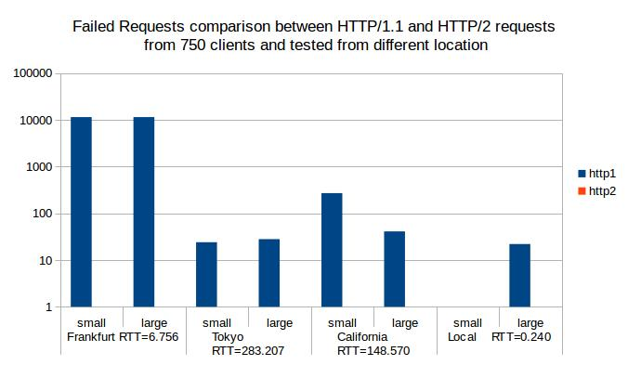
Results (Request failures)

