Slide 1
Monitoring DNSSEC
Martin Leucht <martin.leucht@os3.nl>
Julien Nyczak <julien.nyczak@os3.nl>
Supervisor: Rick van Rein
System and Network Engineering 2015

Slide 2
Introduction
DNSSEC becomes more and more popular
Expired RRSIG RR might result that zone not available
Need for monitoring
Monitoring systems exist but are too specific to be widely deployed
Solution: Monitoring DNSSEC through SNMP

Slide 3
SNMP
standard application protocol to manage and monitor devices running on IP network
can be implemented for applications as well
agent-manager architecture
structure of the management information and SNMP variables defined in a Management Information Base (MIB)
SNMP variables are assigned to Object Identifiers (OID) in a hierarchical manner

Slide 4
Research Questions
What are vital life signs for monitoring DNSSEC?
How to construct a MIB module for DNSSEC?
How to conduct monitoring based on such a MIB?
How do architectures for monitoring DNSSEC compare?

Slide 5
Approach (1/2)
To be independent on other software components (only AXFR and authoritative queries)
Vital life signs for DNSSEC
Availability of a zone from a resolver point of view (initial check)
Verify DNSKEY RRSIG against published KSK
DS record count = delegation count (in a parent zone)
TTL checks
List of name servers for a zone
Expiration date of RRSIG for SOA, NS, DNSKEY
Discrepancies in serial numbers between slave and master (slave serving expired data)

Slide 6
Approach (2/2)
Construct the MIB based on vital life signs
Write the SNMP subagent (python-netsnmpagent)
How data is retrieved from zones?
From a central repository: XML
DNSSEC data collected via AXFR requests, DNS queries to authorities and resolvers

Slide 7
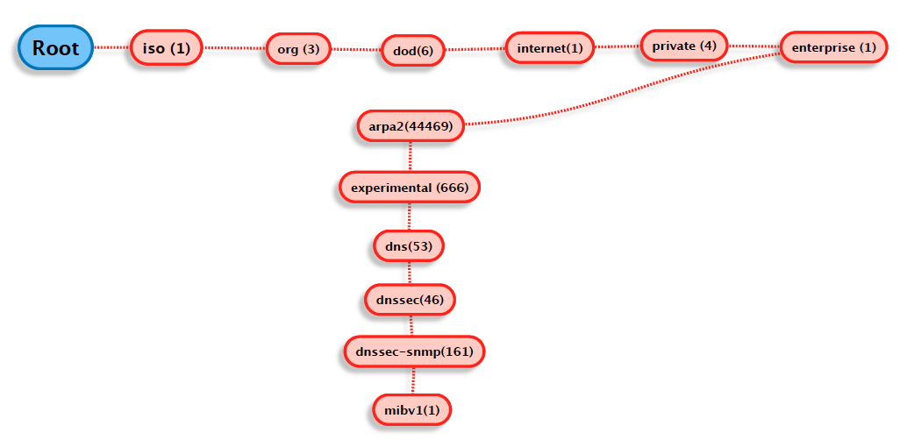
DNSSEC MIB implementation (1/4)
OID entry point inside ARPA2 OID tree (enterprise OID 44469):
ARPA2-Experimental-DNSSEC-MIBv1
.1.3.6.1.4.1.44469.666.53.46.161.1

Slide 8
DNSSEC MIB implementation (2/4)
Objects are defined using a subset of Abstract Syntax Notation One (ASN.1) called "Structure of Management Information Version 2 (SMIv2)" RFC 2578
Objects organized in columnar (conceptual tables) or scalar objects.
Four tables indexed by domain name (OCTET-STRING)
dnssecZoneGlobalTable, dnssecZoneAuthNSTable, dnssecZoneSigTable, dnssecZoneDiffTable
Datatype INTEGER to represent boolean and numeric values, OCTET-STRING to represent strings (e.g domain names)
Usage of Textual conventions to customize object-types

Slide 9
DNSSEC MIB implementation (3/4)
+--arpa2experimentaldnssecMIBv1(1)
|
+--dnssecObjects(1)
| |
| +--dnssecGeneral(1)
| | |
| +--dnssecZoneGlobal(2)
| | |
| | +--dnssecZoneGlobalTable(2)
| | |
| | +--dnssecZoneGlobalEntry(1)
| | | Index: dnssecZoneGlobalIndex
| |
| +--dnssecZoneAuthNS(3)
| | |
| | +--dnssecZoneAuthNSTable(3)
| | |
| | +--dnssecZoneAuthNSEntry(1)
| | | Index: dnssecZoneGlobalIndex
| | |
| +--dnssecZoneSig(4)
| | |
| | +--dnssecZoneSigTable(4)
| | |
| | +--dnssecZoneSigEntry(1)
| | | Index: dnssecZoneGlobalIndex
| | |
| +--dnssecZoneDiff(5)
| |
| +--dnssecZoneDiffTable(5)
| |
| +--dnssecZoneDiffEntry(1)
| | Index: dnssecZoneGlobalIndex
| |
+--dnssecMIBConformance(2)
|
+--dnssecMIBGroups(1)
| |
| +--dnssecMIBScalarGroup(1)
| +--dnssecMIBTableGroup(2)
|
+--dnssecMIBCompliances(2)

Slide 10
DNSSEC MIB implementation (3/4)
+--arpa2experimentaldnssecMIBv1(1)
|
+--dnssecObjects(1)
| |
| +--dnssecGeneral(1)
| | |
| +--dnssecZoneGlobal(2)
| | |
| | +--dnssecZoneGlobalTable(2)
| | |
| | +--dnssecZoneGlobalEntry(1)
| | | Index: dnssecZoneGlobalIndex
| |
| +--dnssecZoneAuthNS(3)
| | |
| | +--dnssecZoneAuthNSTable(3)
| | |
| | +--dnssecZoneAuthNSEntry(1)
| | | Index: dnssecZoneGlobalIndex
| | |
| +--dnssecZoneSig(4)
| | |
| | +--dnssecZoneSigTable(4)
| | |
| | +--dnssecZoneSigEntry(1)
| | | Index: dnssecZoneGlobalIndex
| | |
| +--dnssecZoneDiff(5)
| |
| +--dnssecZoneDiffTable(5)
| |
| +--dnssecZoneDiffEntry(1)
| | Index: dnssecZoneGlobalIndex
| |
+--dnssecMIBConformance(2)
|
+--dnssecMIBGroups(1)
| |
| +--dnssecMIBScalarGroup(1)
| +--dnssecMIBTableGroup(2)
|
+--dnssecMIBCompliances(2)

Slide 11
DNSSEC MIB implementation (4/4)
ARPA2-Experimental-DNSSEC-MIBv1::dnssecZoneGlobalServFail."derby.practicum.os3.nl" = INTEGER: noerror(1)
dnssecZoneGlobalServFail OBJECT-TYPE
SYNTAX CustomInteger
MAX-ACCESS read-only
STATUS current
DESCRIPTION "Indicates that ..."
::= { dnssecZoneGlobalEntry 2 }

Slide 12
DNSSEC MIB implementation (4/4)
DomainOctetString ::= TEXTUAL-CONVENTION
DISPLAY-HINT "255t"
STATUS current
DESCRIPTION "An octet string containing characters in UTF-8 encoding."
SYNTAX OCTET STRING (SIZE (1..255))
ARPA2-Experimental-DNSSEC-MIBv1::dnssecZoneGlobalServFail."derby.practicum.os3.nl" = INTEGER: noerror(1)
dnssecZoneGlobalServFail OBJECT-TYPE
SYNTAX CustomInteger
MAX-ACCESS read-only
STATUS current
DESCRIPTION "Indicates that ..."
::= { dnssecZoneGlobalEntry 2 }

Slide 13
DNSSEC MIB implementation (4/4)
dnssecZoneGlobalIndex OBJECT-TYPE
SYNTAX DomainOctetString
MAX-ACCESS not-accessible
STATUS current
DESCRIPTION "Reference index for each observed zone"
::= { dnssecZoneGlobalEntry 1 }
DomainOctetString ::= TEXTUAL-CONVENTION
DISPLAY-HINT "255t"
STATUS current
DESCRIPTION "An octet string containing characters in UTF-8 encoding."
SYNTAX OCTET STRING (SIZE (1..255))
ARPA2-Experimental-DNSSEC-MIBv1::dnssecZoneGlobalServFail."derby.practicum.os3.nl" = INTEGER: noerror(1)
dnssecZoneGlobalServFail OBJECT-TYPE
SYNTAX CustomInteger
MAX-ACCESS read-only
STATUS current
DESCRIPTION "Indicates that ..."
::= { dnssecZoneGlobalEntry 2 }

Slide 14
DNSSEC MIB implementation (4/4)
dnssecZoneGlobalIndex OBJECT-TYPE
SYNTAX DomainOctetString
MAX-ACCESS not-accessible
STATUS current
DESCRIPTION "Reference index for each observed zone"
::= { dnssecZoneGlobalEntry 1 }
DomainOctetString ::= TEXTUAL-CONVENTION
DISPLAY-HINT "255t"
STATUS current
DESCRIPTION "An octet string containing characters in UTF-8 encoding."
SYNTAX OCTET STRING (SIZE (1..255))
ARPA2-Experimental-DNSSEC-MIBv1::dnssecZoneGlobalServFail."derby.practicum.os3.nl" = INTEGER: noerror(1)
dnssecZoneGlobalServFail OBJECT-TYPE
SYNTAX CustomInteger
MAX-ACCESS read-only
STATUS current
DESCRIPTION "Indicates that ..."
::= { dnssecZoneGlobalEntry 2 }
CustomInteger ::= TEXTUAL-CONVENTION
STATUS current
DESCRIPTION "Convention for return values of Integer variables."
SYNTAX INTEGER { noerror(1), error(2), unknown(3) }

Slide 15
DNSSEC MIB implementation (4/4)
dnssecZoneGlobalIndex OBJECT-TYPE
SYNTAX DomainOctetString
MAX-ACCESS not-accessible
STATUS current
DESCRIPTION "Reference index for each observed zone"
::= { dnssecZoneGlobalEntry 1 }
DomainOctetString ::= TEXTUAL-CONVENTION
DISPLAY-HINT "255t"
STATUS current
DESCRIPTION "An octet string containing characters in UTF-8 encoding."
SYNTAX OCTET STRING (SIZE (1..255))
ARPA2-Experimental-DNSSEC-MIBv1::dnssecZoneGlobalServFail."derby.practicum.os3.nl" = INTEGER: noerror(1)
dnssecZoneGlobalServFail OBJECT-TYPE
SYNTAX CustomInteger
MAX-ACCESS read-only
STATUS current
DESCRIPTION "Indicates that ..."
::= { dnssecZoneGlobalEntry 2 }
CustomInteger ::= TEXTUAL-CONVENTION
STATUS current
DESCRIPTION "Convention for return values of Integer variables."
SYNTAX INTEGER { noerror(1), error(2), unknown(3) }
.1.3.6.1.4.1.44469.666.53.46.161.1.1.2.2.1.2.22.100.101.114.98.121.46.112.114.97.99.116.105.99.117.109.46.111.115.51.46.110.108 = INTEGER: 1

Slide 16
DNSSEC MIB implementation (4/4)
dnssecZoneGlobalIndex OBJECT-TYPE
SYNTAX DomainOctetString
MAX-ACCESS not-accessible
STATUS current
DESCRIPTION "Reference index for each observed zone"
::= { dnssecZoneGlobalEntry 1 }
DomainOctetString ::= TEXTUAL-CONVENTION
DISPLAY-HINT "255t"
STATUS current
DESCRIPTION "An octet string containing characters in UTF-8 encoding."
SYNTAX OCTET STRING (SIZE (1..255))
ARPA2-Experimental-DNSSEC-MIBv1::dnssecZoneGlobalServFail."derby.practicum.os3.nl" = INTEGER: noerror(1)
dnssecZoneGlobalServFail OBJECT-TYPE
SYNTAX CustomInteger
MAX-ACCESS read-only
STATUS current
DESCRIPTION "Indicates that ..."
::= { dnssecZoneGlobalEntry 2 }
CustomInteger ::= TEXTUAL-CONVENTION
STATUS current
DESCRIPTION "Convention for return values of Integer variables."
SYNTAX INTEGER { noerror(1), error(2), unknown(3) }
.1.3.6.1.4.1.44469.666.53.46.161.1.1.2.2.1.2.22.100.101.114.98.121.46.112.114.97.99.116.105.99.117.109.46.111.115.51.46.110.108 = INTEGER: 1
22 = number of characters

Slide 17
DNSSEC MIB implementation (4/4)
dnssecZoneGlobalIndex OBJECT-TYPE
SYNTAX DomainOctetString
MAX-ACCESS not-accessible
STATUS current
DESCRIPTION "Reference index for each observed zone"
::= { dnssecZoneGlobalEntry 1 }
DomainOctetString ::= TEXTUAL-CONVENTION
DISPLAY-HINT "255t"
STATUS current
DESCRIPTION "An octet string containing characters in UTF-8 encoding."
SYNTAX OCTET STRING (SIZE (1..255))
ARPA2-Experimental-DNSSEC-MIBv1::dnssecZoneGlobalServFail."derby.practicum.os3.nl" = INTEGER: noerror(1)
dnssecZoneGlobalServFail OBJECT-TYPE
SYNTAX CustomInteger
MAX-ACCESS read-only
STATUS current
DESCRIPTION "Indicates that ..."
::= { dnssecZoneGlobalEntry 2 }
CustomInteger ::= TEXTUAL-CONVENTION
STATUS current
DESCRIPTION "Convention for return values of Integer variables."
SYNTAX INTEGER { noerror(1), error(2), unknown(3) }
.1.3.6.1.4.1.44469.666.53.46.161.1.1.2.2.1.2.22.100.101.114.98.121.46.112.114.97.99.116.105.99.117.109.46.111.115.51.46.110.108 = INTEGER: 1
22 = number of characters
ASCII values (decimal) for "derby.practicum.os3.nl"

Slide 18
SNMP subagent implementation (1/4)
NET-SNMP toolkit → de-facto standard for SNMP implementations on most OS
Includes applications (snmpget, snmpwalk, etc.) and libraries
Includes C API to write own AgentX subagents RFC 2741
Subagents register to snmpd master agent via Unix socket

Slide 19
SNMP subagent implementation (2/4)
AgentX SNMP subagent based on Python NET-SNMP API module “netsnmpagent” written by Pieter Hollants licensed under GPLv3
Warning: Consider this when using our prototype !
UpdateSNMPObject() function is self written
Subagent is capable of most SNMP data types
Handles requests for our DNSSEC MIB
Allows to register, update and clear table rows and scalar values
Subagent works asynchronously, data update thread is decoupled from data providing thread
Data for subagent is provided by two main wrapper scripts (dnspython)

Slide 20
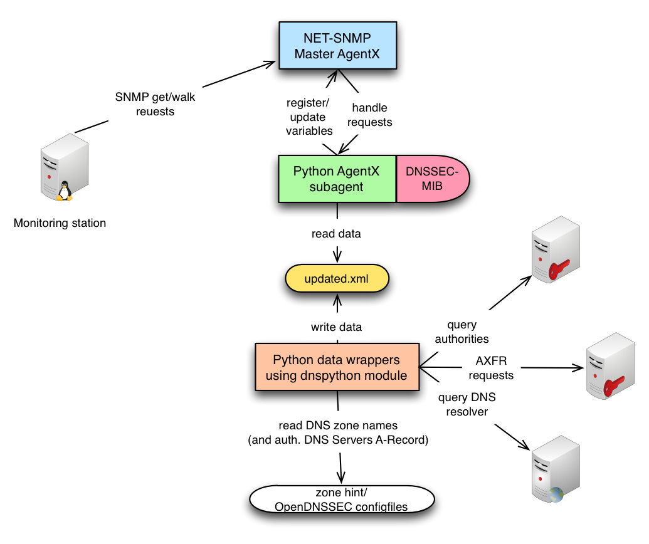
SNMP subagent implementation (3/4)

Slide 21
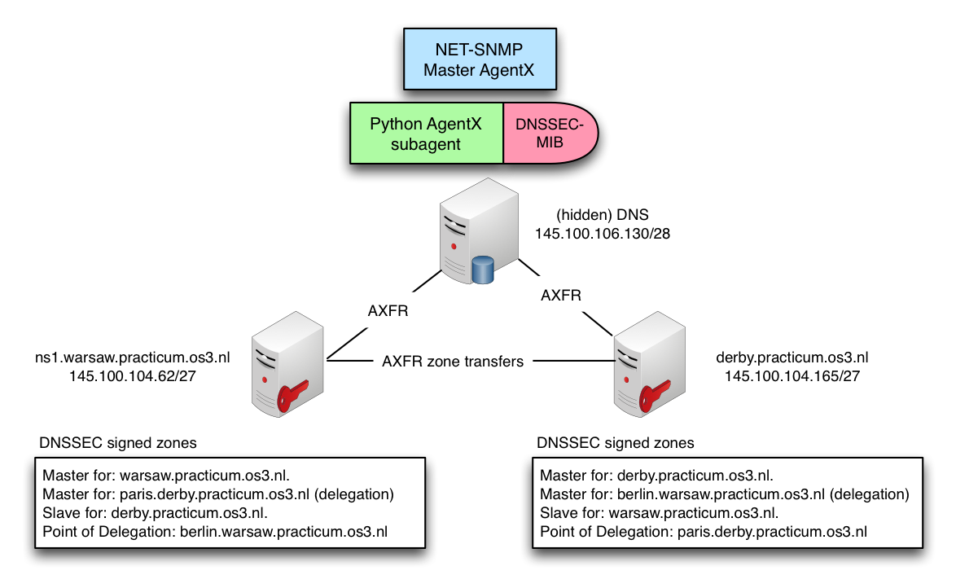
SNMP subagent implementation (4/4)

Slide 22
Conclusion / Future Work
Proof of concept based on SNMP to cover critical data of DNSSEC signed zones
Conduct monitoring based on proof of concept
SNMP Notifications/Traps
Expand MIB to cover more DNSSEC related data
Validation of all RRSIG RR (expired/non validated)
Check for broken NSEC3 chain
…

Slide 23

Demo

