Slide 1
Monitoring DNSSEC
Martin Leucht <martin.leucht@os3.nl>
Julien Nyczak <julien.nyczak@os3.nl>
Supervisor: Rick van Rein
System and Network Engineering 2015

Slide 2
Table of contents
Introduction
Background
Research Questions
Approaches and Methods
DNSSEC MIB implementation
SNMP subagent implementation
Conclusion
Demo

Slide 3
Introduction
DNSSEC becomes more and more popular
Expired signature = Resource Record not available anymore
Need for monitoring
Monitoring systems exist but are too specific to be widely deployed
Solution: Monitoring DNSSEC through SNMP

Slide 4
Background: SNMP
standard application protocol to manage and monitor devices running on IP network
can be implemented for applications as well
agent-manager architecture
structure of the management information and SNMP variables defined in a Management Information Base (MIB)
SNMP variables are assigned to Object Identiers (OID) in a hierarchical manner

Slide 5
Background: DNSSEC
Provides authentication and integrity for DNS data
Makes use of public key cryptography
Builds a chain of trust from root down
Chain can be broken if zones misconfigured
Vital life signs of DNSSEC must be monitored

Slide 6
Research Questions
What are vital life signs for monitoring DNSSEC?
How to construct a MIB module for DNSSEC?
How to conduct monitoring based on such a MIB?
How do architectures for monitoring DNSSEC compare?

Slide 7
Approach and Methods (1/2)
To be as independent on other software programs as possible
Vital life signs for DNSSEC
Availability of a zone
Verify DNSKEY RRSIG against published KSK
DS record count = delegation count (in a parent zone)
TTL
List of name servers for a zone
Expiration date of RRSIG for SOA, NS, DNSKEY
Discrepancies in serial numbers between slave and master (slave serving expired data)

Slide 8
Approach and Methods (2/2)
Construct the MIB based on vital life signs
Write the SNMP subagent (python-netsnmpagent)
How data is retrieved from zones?
From a central repository: XML
Repository is fed by wrapper scripts (dnspython) that collects DNS and DNSSEC data via AXFR requests, DNS queries to authorities and resolvers

Slide 9
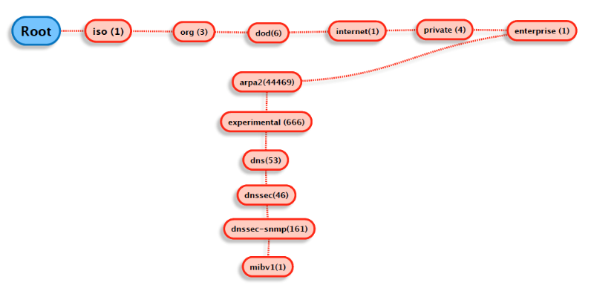
DNSSEC MIB implementation (1/4)
OID entry point inside ARPA2 OID tree (enterprise OID 44469):
ARPA2-Experimental-DNSSEC-MIBv1
.1.3.6.1.4.1.44469.666.53.46.161.1

Slide 10
DNSSEC MIB implementation (2/4)
Objects are defined using a subset of Abstract Syntax Notation One (ASN.1) called "Structure of Management Information Version 2 (SMIv2)" RFC 2578
Objects organized in columnar (conceptual tables) or scalar objects.
Four tables indexed by domain name (OCTET-STRING)
dnssecZoneGlobalTable, dnssecZoneAuthNSTable, dnssecZoneSigTable, dnssecZoneDiffTable
Datatype INTEGER to represent boolean and numeric values, OCTET-STRING to represent strings (e.g domain names)
Usage of Textual conventions to customize object-types

Slide 11
DNSSEC MIB implementation (3/4)
+--arpa2experimentaldnssecMIBv1(1)
|
+--dnssecObjects(1)
| |
| +--dnssecGeneral(1)
| | |
| +--dnssecZoneGlobal(2)
| | |
| | +--dnssecZoneGlobalTable(2)
| | |
| | +--dnssecZoneGlobalEntry(1)
| | | Index: dnssecZoneGlobalIndex
| |
| +--dnssecZoneAuthNS(3)
| | |
| | +--dnssecZoneAuthNSTable(3)
| | |
| | +--dnssecZoneAuthNSEntry(1)
| | | Index: dnssecZoneGlobalIndex
| | |
| +--dnssecZoneSig(4)
| | |
| | +--dnssecZoneSigTable(4)
| | |
| | +--dnssecZoneSigEntry(1)
| | | Index: dnssecZoneGlobalIndex
| | |
| +--dnssecZoneDiff(5)
| |
| +--dnssecZoneDiffTable(5)
| |
| +--dnssecZoneDiffEntry(1)
| | Index: dnssecZoneGlobalIndex
| |
+--dnssecMIBConformance(2)
|
+--dnssecMIBGroups(1)
| |
| +--dnssecMIBScalarGroup(1)
| +--dnssecMIBTableGroup(2)
|
+--dnssecMIBCompliances(2)

Slide 12
DNSSEC MIB implementation (3/4)
+--arpa2experimentaldnssecMIBv1(1)
|
+--dnssecObjects(1)
| |
| +--dnssecGeneral(1)
| | |
| +--dnssecZoneGlobal(2)
| | |
| | +--dnssecZoneGlobalTable(2)
| | |
| | +--dnssecZoneGlobalEntry(1)
| | | Index: dnssecZoneGlobalIndex
| |
| +--dnssecZoneAuthNS(3)
| | |
| | +--dnssecZoneAuthNSTable(3)
| | |
| | +--dnssecZoneAuthNSEntry(1)
| | | Index: dnssecZoneGlobalIndex
| | |
| +--dnssecZoneSig(4)
| | |
| | +--dnssecZoneSigTable(4)
| | |
| | +--dnssecZoneSigEntry(1)
| | | Index: dnssecZoneGlobalIndex
| | |
| +--dnssecZoneDiff(5)
| |
| +--dnssecZoneDiffTable(5)
| |
| +--dnssecZoneDiffEntry(1)
| | Index: dnssecZoneGlobalIndex
| |
+--dnssecMIBConformance(2)
|
+--dnssecMIBGroups(1)
| |
| +--dnssecMIBScalarGroup(1)
| +--dnssecMIBTableGroup(2)
|
+--dnssecMIBCompliances(2)

Slide 13
DNSSEC MIB implementation (4/4)
.1.3.6.1.4.1.44469.666.53.46.161.1.1.2.2.1.2.22.100.101.114.98.121.46.112.114.97.99.116.105.99.117.109.46.111.115.51.46.110.108 = INTEGER: noerror(1)

Slide 14
DNSSEC MIB implementation (4/4)
.1.3.6.1.4.1.44469.666.53.46.161.1.1.2.2.1.2.22.100.101.114.98.121.46.112.114.97.99.116.105.99.117.109.46.111.115.51.46.110.108 = INTEGER: noerror(1)
dnssecZoneGlobalServFail OBJECT-TYPE
SYNTAX CustomInteger
MAX-ACCESS read-only
STATUS current
DESCRIPTION "Indicates that ..."
::= { dnssecZoneGlobalEntry 2 }

Slide 15
DNSSEC MIB implementation (4/4)
22 = number of characters
.1.3.6.1.4.1.44469.666.53.46.161.1.1.2.2.1.2.22.100.101.114.98.121.46.112.114.97.99.116.105.99.117.109.46.111.115.51.46.110.108 = INTEGER: noerror(1)
dnssecZoneGlobalServFail OBJECT-TYPE
SYNTAX CustomInteger
MAX-ACCESS read-only
STATUS current
DESCRIPTION "Indicates that ..."
::= { dnssecZoneGlobalEntry 2 }

Slide 16
DNSSEC MIB implementation (4/4)
22 = number of characters
ASCII values (decimal) for "derby.practicum.os3.nl"
.1.3.6.1.4.1.44469.666.53.46.161.1.1.2.2.1.2.22.100.101.114.98.121.46.112.114.97.99.116.105.99.117.109.46.111.115.51.46.110.108 = INTEGER: noerror(1)
dnssecZoneGlobalServFail OBJECT-TYPE
SYNTAX CustomInteger
MAX-ACCESS read-only
STATUS current
DESCRIPTION "Indicates that ..."
::= { dnssecZoneGlobalEntry 2 }

Slide 17
DNSSEC MIB implementation (4/4)
22 = number of characters
ASCII values (decimal) for "derby.practicum.os3.nl"
.1.3.6.1.4.1.44469.666.53.46.161.1.1.2.2.1.2.22.100.101.114.98.121.46.112.114.97.99.116.105.99.117.109.46.111.115.51.46.110.108 = INTEGER: noerror(1)
dnssecZoneGlobalServFail OBJECT-TYPE
SYNTAX CustomInteger
MAX-ACCESS read-only
STATUS current
DESCRIPTION "Indicates that ..."
::= { dnssecZoneGlobalEntry 2 }
CustomInteger ::= TEXTUAL-CONVENTION
STATUS current
DESCRIPTION "Convention for return values of Integer variables."
SYNTAX INTEGER { noerror(1), error(2), unknown(3) }

Slide 18
DNSSEC MIB implementation (4/4)
22 = number of characters
ASCII values (decimal) for "derby.practicum.os3.nl"
.1.3.6.1.4.1.44469.666.53.46.161.1.1.2.2.1.2.22.100.101.114.98.121.46.112.114.97.99.116.105.99.117.109.46.111.115.51.46.110.108 = INTEGER: noerror(1)
dnssecZoneGlobalServFail OBJECT-TYPE
SYNTAX CustomInteger
MAX-ACCESS read-only
STATUS current
DESCRIPTION "Indicates that ..."
::= { dnssecZoneGlobalEntry 2 }
CustomInteger ::= TEXTUAL-CONVENTION
STATUS current
DESCRIPTION "Convention for return values of Integer variables."
SYNTAX INTEGER { noerror(1), error(2), unknown(3) }
ARPA2-Experimental-DNSSEC-MIBv1::dnssecZoneGlobalServFail."derby.practicum.os3.nl" = INTEGER: noerror(1)

Slide 19
DNSSEC MIB implementation (4/4)
22 = number of characters
ASCII values (decimal) for "derby.practicum.os3.nl"
.1.3.6.1.4.1.44469.666.53.46.161.1.1.2.2.1.2.22.100.101.114.98.121.46.112.114.97.99.116.105.99.117.109.46.111.115.51.46.110.108 = INTEGER: noerror(1)
dnssecZoneGlobalServFail OBJECT-TYPE
SYNTAX CustomInteger
MAX-ACCESS read-only
STATUS current
DESCRIPTION "Indicates that ..."
::= { dnssecZoneGlobalEntry 2 }
CustomInteger ::= TEXTUAL-CONVENTION
STATUS current
DESCRIPTION "Convention for return values of Integer variables."
SYNTAX INTEGER { noerror(1), error(2), unknown(3) }
ARPA2-Experimental-DNSSEC-MIBv1::dnssecZoneGlobalServFail."derby.practicum.os3.nl" = INTEGER: noerror(1)
DomainOctetString ::= TEXTUAL-CONVENTION
DISPLAY-HINT "255t"
STATUS current
DESCRIPTION "An octet string containing characters in UTF-8 encoding."
SYNTAX OCTET STRING (SIZE (1..255))

Slide 20
DNSSEC MIB implementation (4/4)
22 = number of characters
ASCII values (decimal) for "derby.practicum.os3.nl"
.1.3.6.1.4.1.44469.666.53.46.161.1.1.2.2.1.2.22.100.101.114.98.121.46.112.114.97.99.116.105.99.117.109.46.111.115.51.46.110.108 = INTEGER: noerror(1)
dnssecZoneGlobalServFail OBJECT-TYPE
SYNTAX CustomInteger
MAX-ACCESS read-only
STATUS current
DESCRIPTION "Indicates that ..."
::= { dnssecZoneGlobalEntry 2 }
CustomInteger ::= TEXTUAL-CONVENTION
STATUS current
DESCRIPTION "Convention for return values of Integer variables."
SYNTAX INTEGER { noerror(1), error(2), unknown(3) }
ARPA2-Experimental-DNSSEC-MIBv1::dnssecZoneGlobalServFail."derby.practicum.os3.nl" = INTEGER: noerror(1)
DomainOctetString ::= TEXTUAL-CONVENTION
DISPLAY-HINT "255t"
STATUS current
DESCRIPTION "An octet string containing characters in UTF-8 encoding."
SYNTAX OCTET STRING (SIZE (1..255))
dnssecZoneGlobalIndex OBJECT-TYPE
SYNTAX DomainOctetString
MAX-ACCESS not-accessible
STATUS current
DESCRIPTION "Reference index for each observed zone"
::= { dnssecZoneGlobalEntry 1 }

Slide 21
SNMP subagent implementation (1/5)
NET-SNMP toolkit → de-facto standard for SNMP implementations on most OS
Includes applications (snmpget, snmpwalk, etc.) and libraries
Includes C API to write own AgentX subagents RFC 2741
Subagents register to snmpd master agent via Unix socket

Slide 22
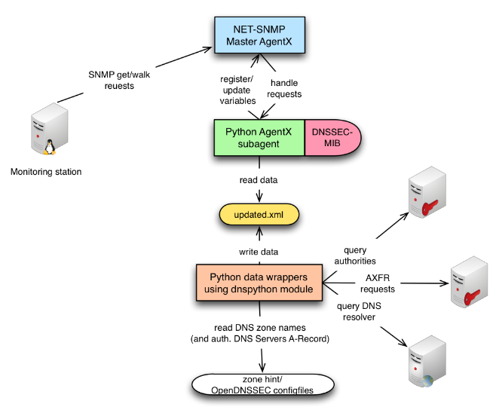
SNMP subagent implementation (2/5)

Slide 23
SNMP subagent implementation (3/5)
SNMP subagent is based on Python NET-SNMP API module “netsnmpagent”
https://github.com/pief/python-netsnmpagent/
Can access NET-SNMP C-API, imitating AgentX subagents written in C
Is capable of most SNMP data types (Gauge, Counter32, Counter64, Integer32, Unsigned32, OCTET-STRING, DisplayString, IpAddress)
Handles requests for DNSSEC MIB OIDs initiated from master agent
Allows to register, update and clear table rows and scalar values
Subagent works asynchron, data update thread is decoupled form data providing thread
Threading subgent itself is Copyright by Pieter Hollants, we added UpdateSNMPObject() function
Data for subagent is provided by two wrapper scripts (dnspython)

Slide 24
SNMP subagent implementation (4/5)
Registering a scalar value
Registering a table
Adding a table row
Clearing a table row
Setting a value in a table row cell
dnssecZoneCount = agent.Unsigned32(
oidstr = "ARPA2-Experimental-DNSSEC-MIBv1::arpa2experimentaldnssecMIBv1",
initval = 0,
writable = False)
dnssecZoneAuthNSTable = agent.Table(
oidstr = "ARPA2-Experimental-DNSSEC-MIBv1::dnssecZoneAuthNSTable",
indexes = [
agent.OctetString(),
agent.Unsigned32() ],
columns = [
(2, agent.DisplayString("")) ] )
dnssecGlobalTable.addRow([agent.OctetString("os3.nl")])
dnssecGlobalTable.clear()
dnssecZoneSigTableRow1.setRowCell(4, agent.DisplayString(”20150228002606"))

Slide 25
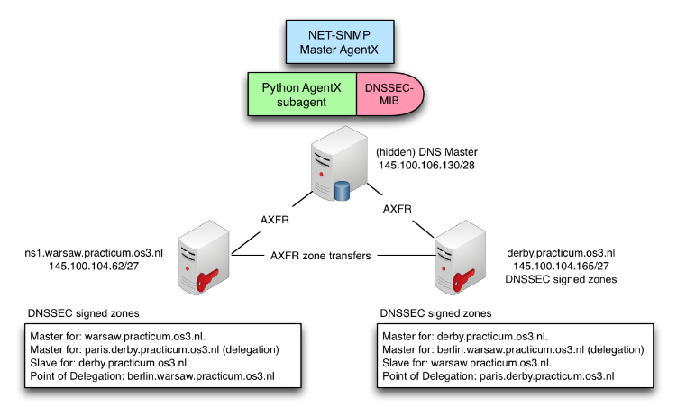
SNMP subagent implementation (5/5)

Slide 26

Demo

