Slide 1
KDE HGI

Slide 2

KDE
Founded in 14.10.1996
Used for high-performance PCs
Written in C++ and Qt

Slide 3
Main concepts
simple
powerful

Slide 4
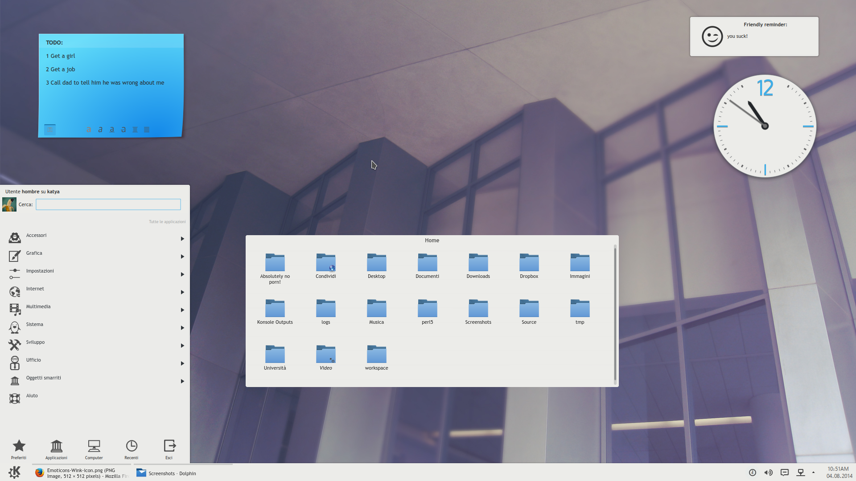
Flat content structure

Slide 5
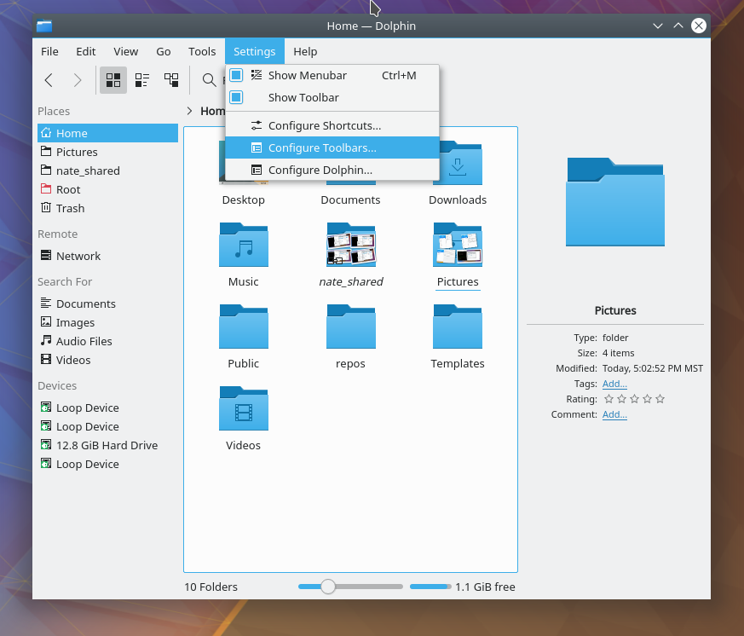
2-deep content structure

Slide 6
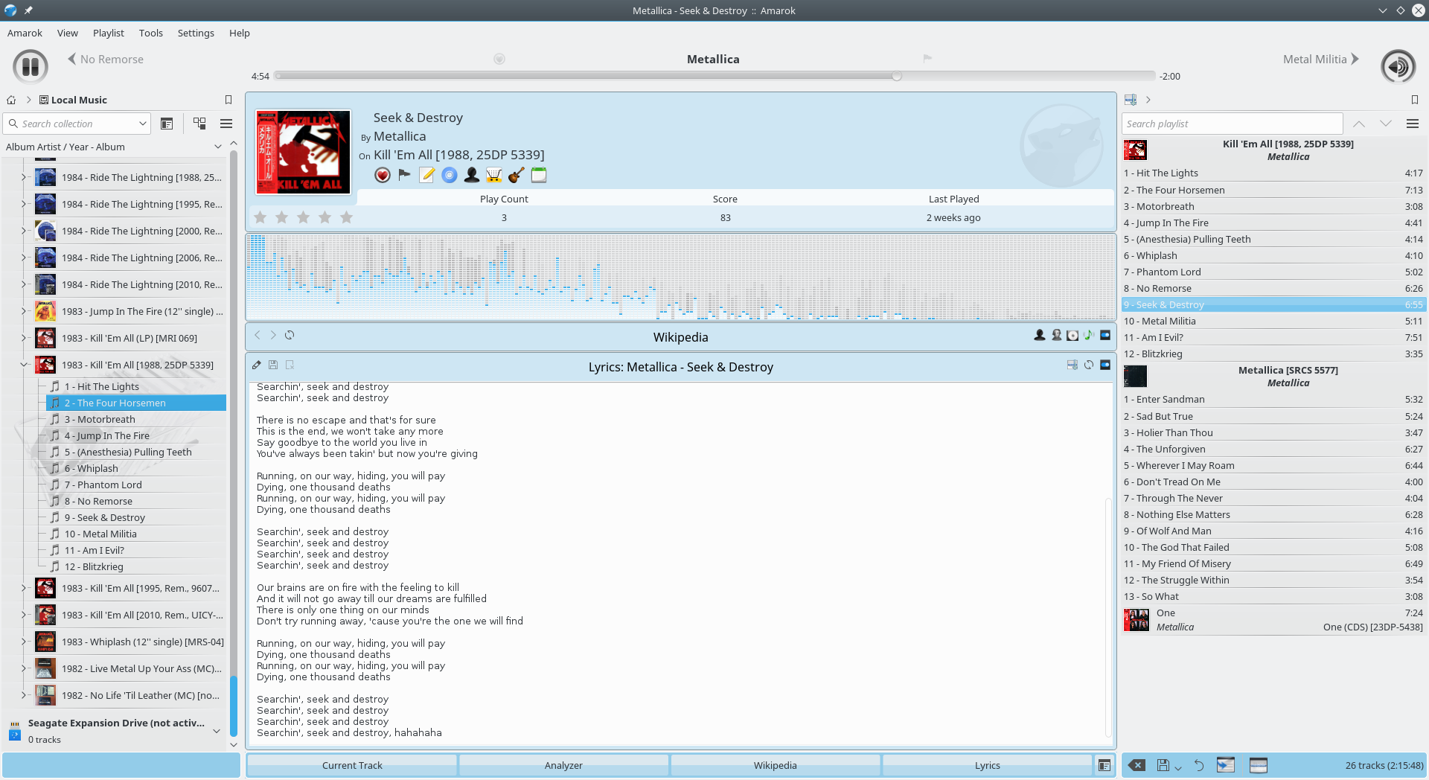
3-deep content structure

Slide 7


Slide 8
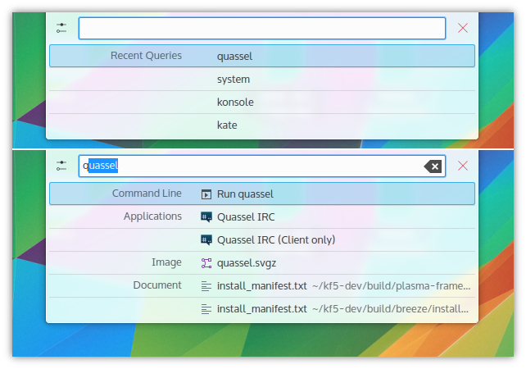

Slide 9
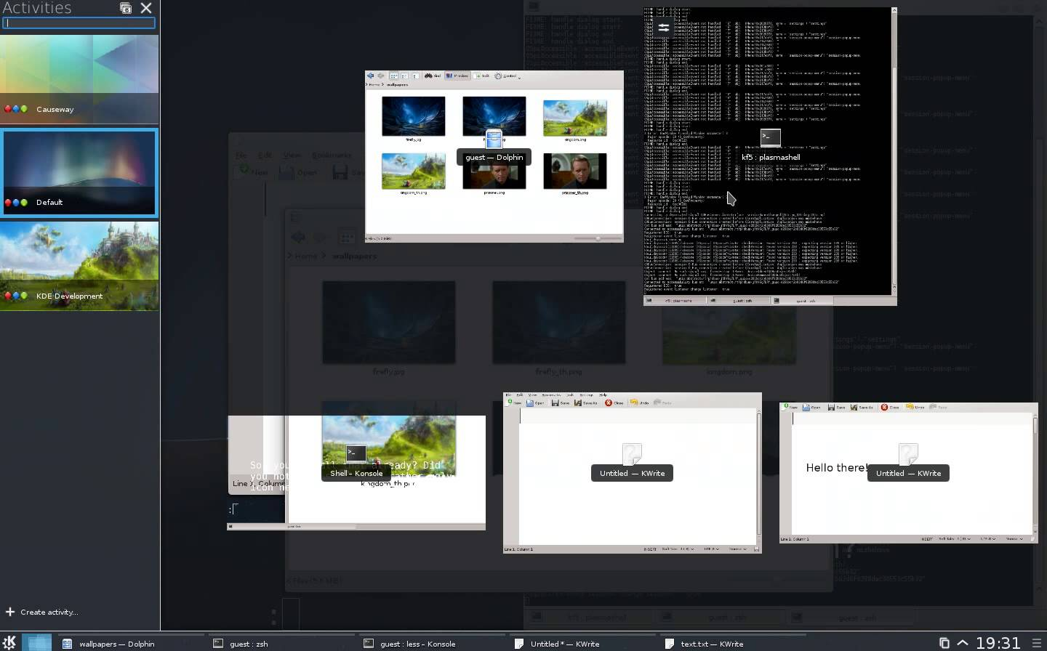

Slide 10
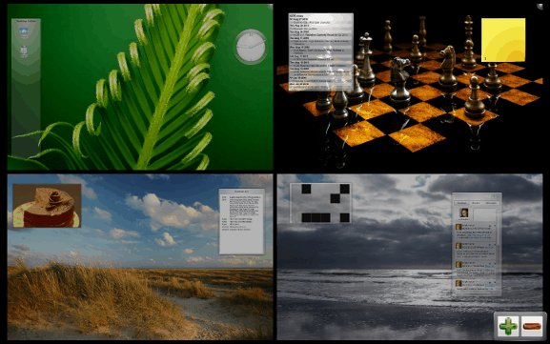

Slide 11
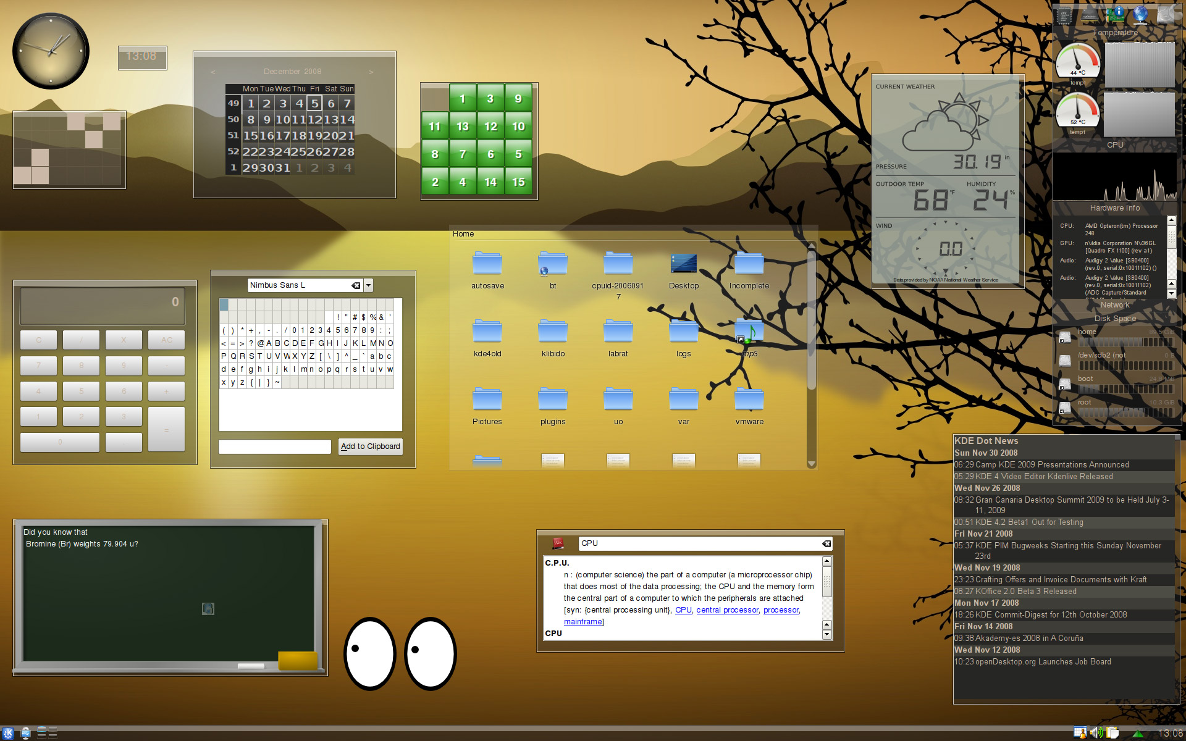

Slide 12
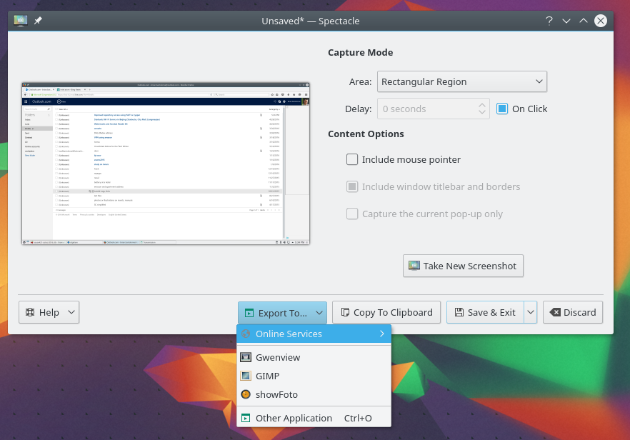

Slide 13
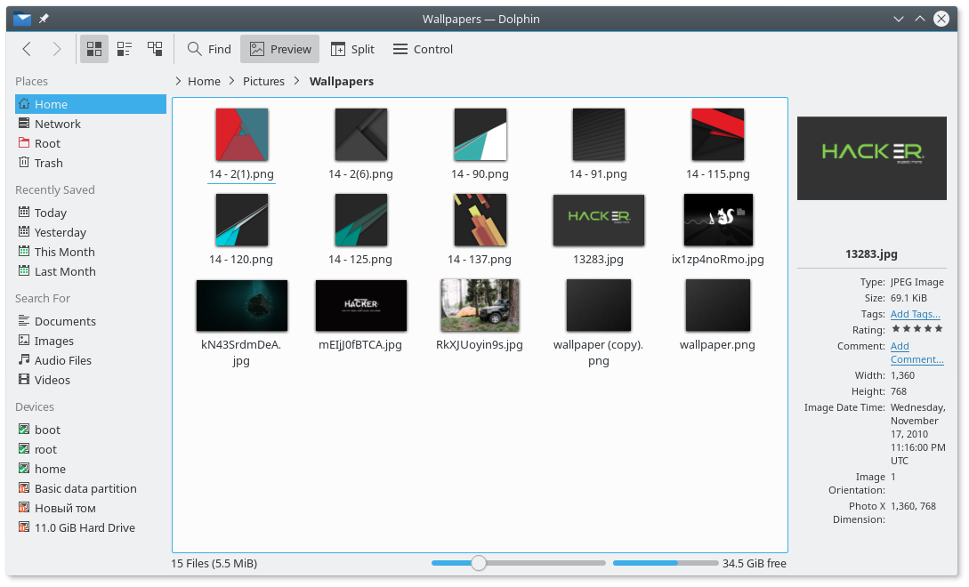

Slide 14
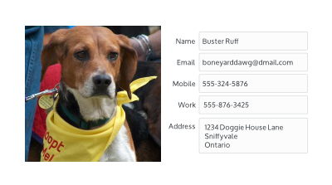
Wrong

Slide 15



Slide 17
Filtering

