Slide 1
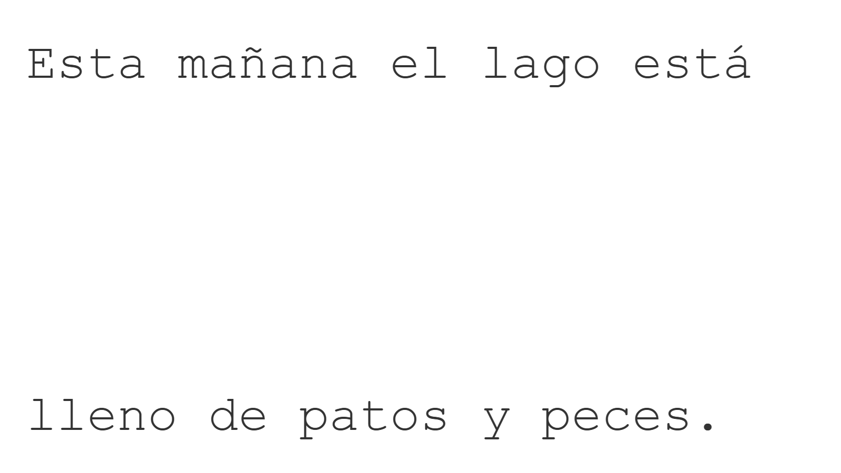
Left
Centre
Right
Top
Middle
Y position
Bottom
X position

Slide 2
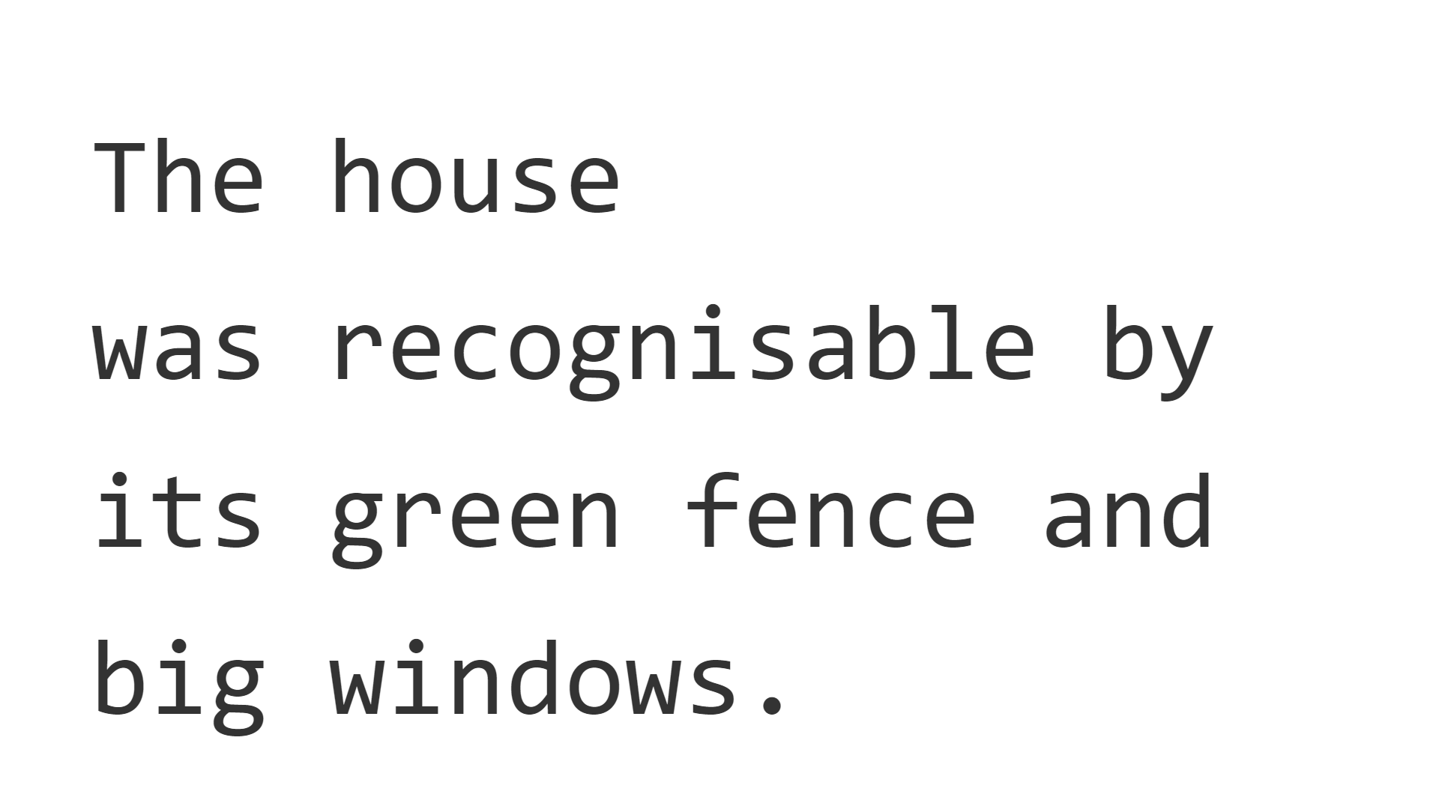
Left
Centre
Right
Top
Middle
Y position
Bottom
X position

