Slide 1
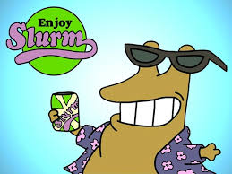
Slurm Beverages expanding into beer market

Slide 2
Time to expand
Slurm cola sales have matured and by expanding into the growing beer industry we can continue to grow
Consumers taste are changing and drinking less cola
Beer sales are on the rise

Slide 3
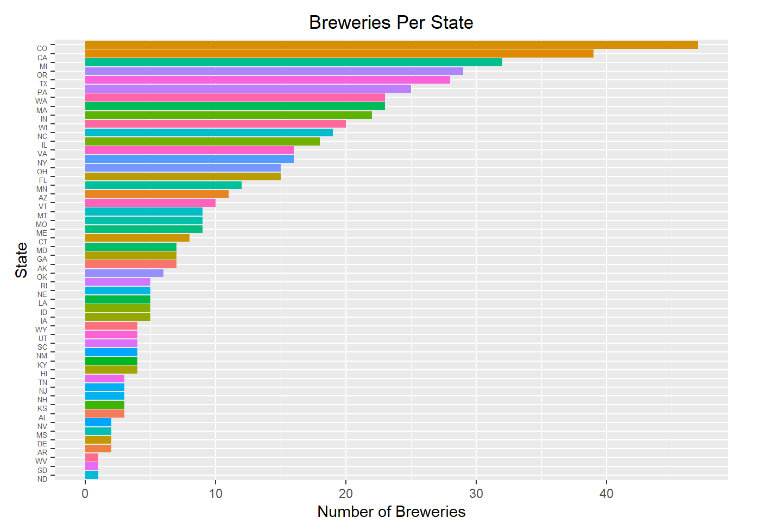
Current State of the Market
There are 558 breweries national wide
Most are located in Colorado
Most of our potential competitors are located on the west coast

Slide 4
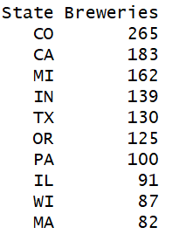
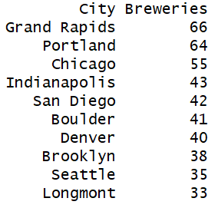
Current State
The most popular beer type in terms of number of type manufactured are ales
Average ounce for beer sold is 13.6
Top beer manufacturing states Top beer manufacturing cities

Slide 5
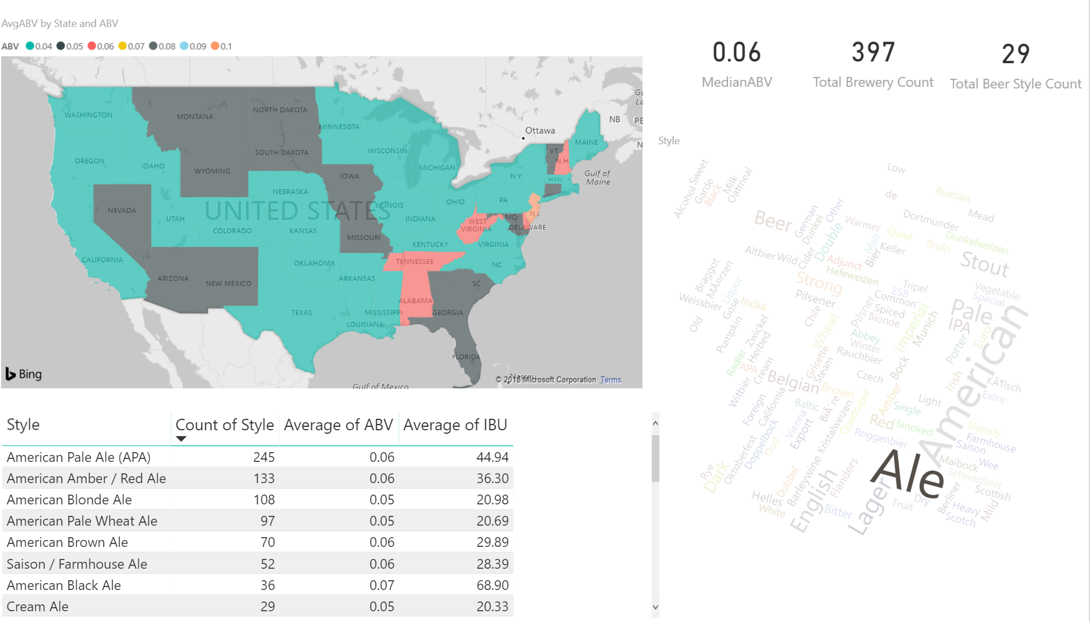
Data Exploration
What markets should we target for an Ale?
By filtering all the data around only styles that contain the word Ale. We see that the American Pale Ale most popular with 16 different variations that we can select.
In terms of popularity, it would seem the American Pale Ale is leader in the clubhouse with 245 different breweries producing a version of an American Pale Ale. Perhaps that’s a safe market to invest in!

Slide 6
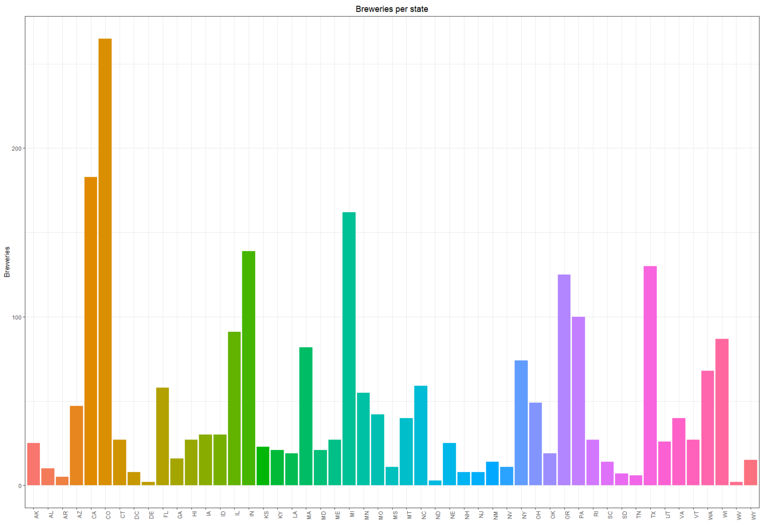
Breweries per state

Slide 7
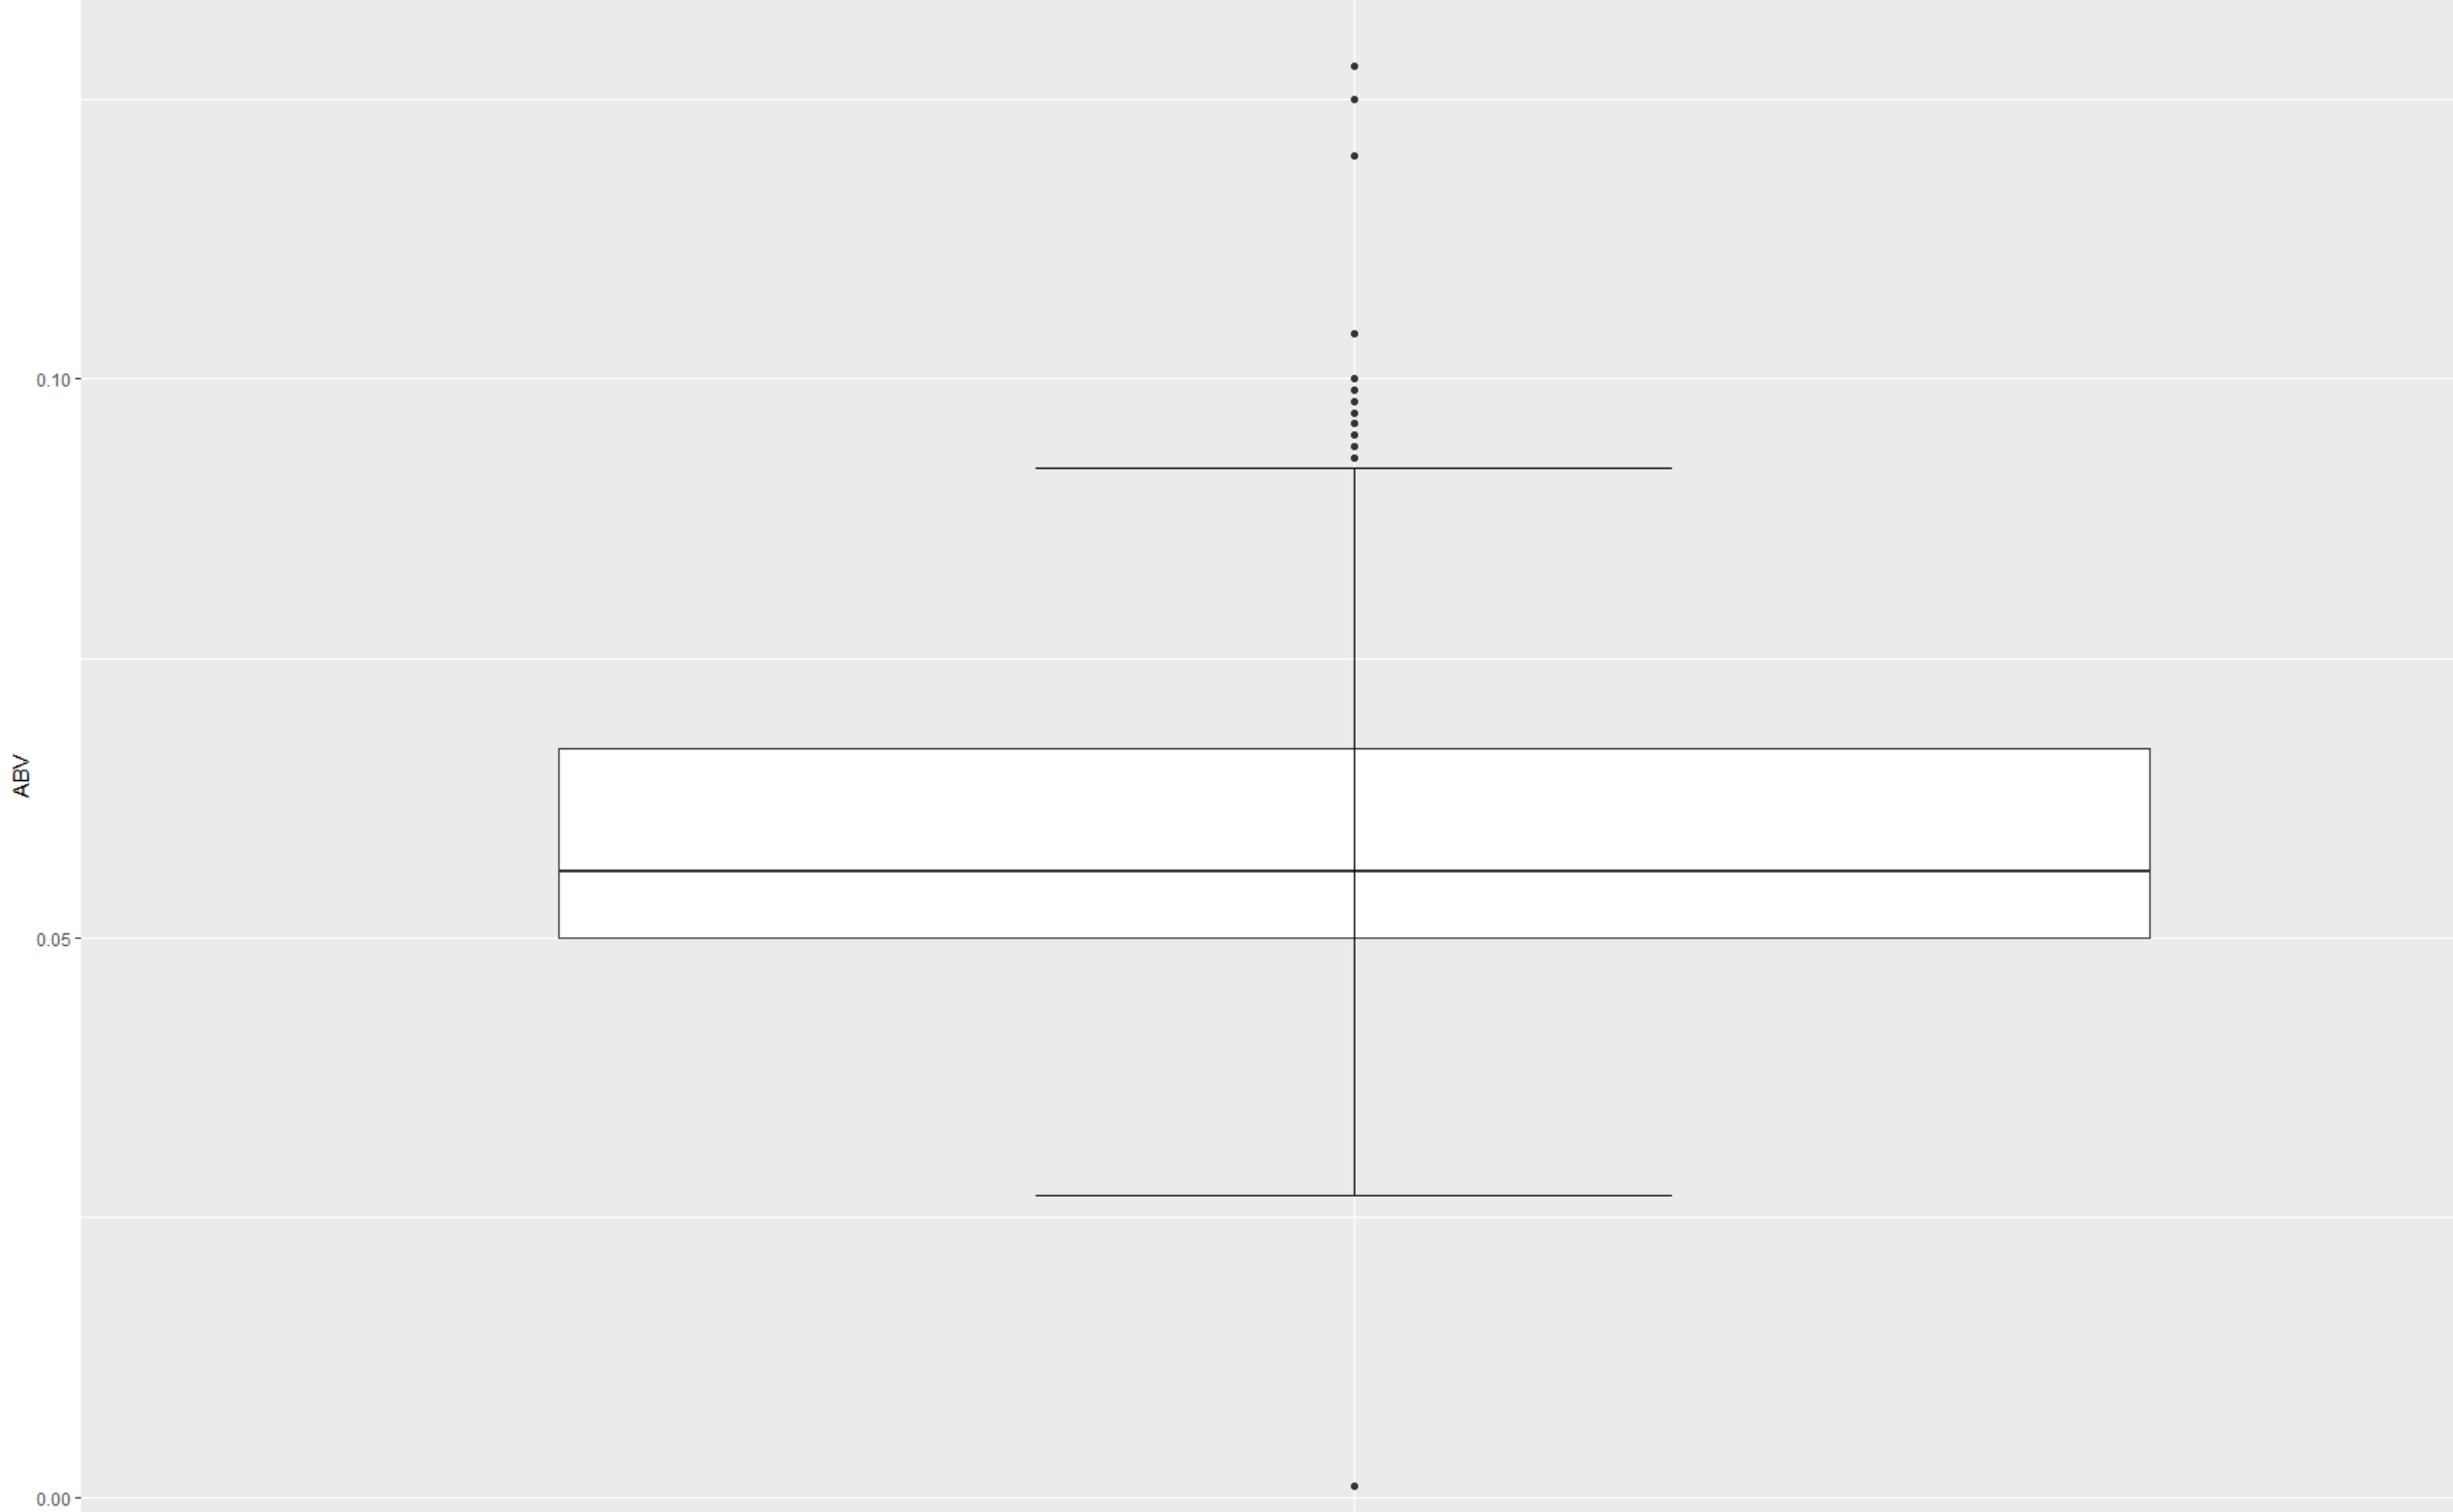
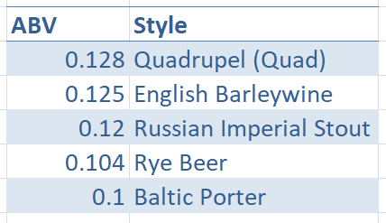
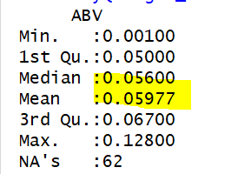
Where we will start
We will start with the average alcohol content rounded at 6% for all beers
Customers prefer a middle of the ground alcohol content
Our highest alcohol content sits at 12.8% and lowest at less .1%
None of the top selling beers had an ABV of over 10%, so we will not be entering this niche market

Slide 8
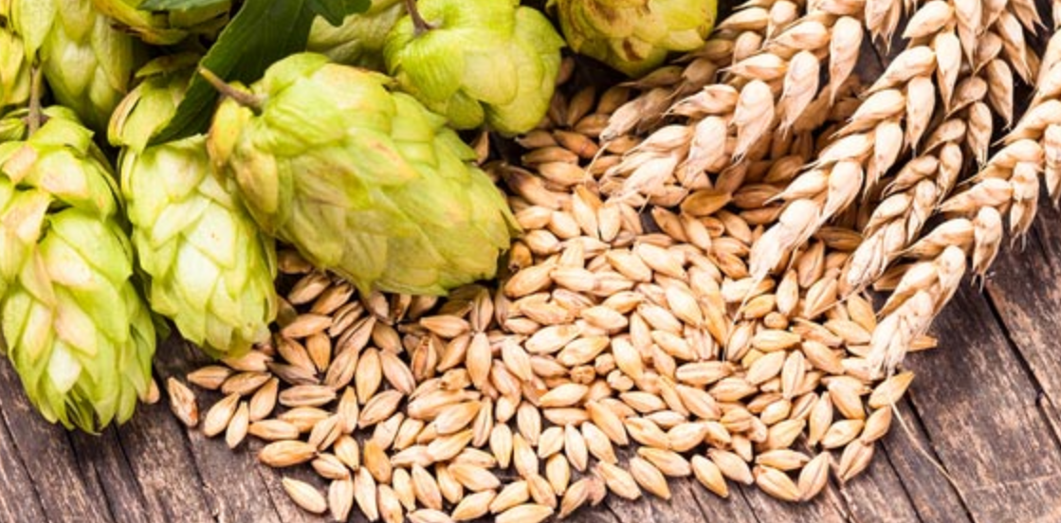
Ales and IPAs
Originally brewed without hops
Modern ales have a fruitier taste
Been around since medieval times
Also known as India Pale Ale
Originated when London was shipping beers to soldiers stationed in India
The manufacturers in London emphasized adding hops, this accounts for the bitterness in this brew
Traditionally brewed with English malt, hops and yeast
Beer taste ranges even amongst IPAS, however they are known for being more bitter

Slide 9
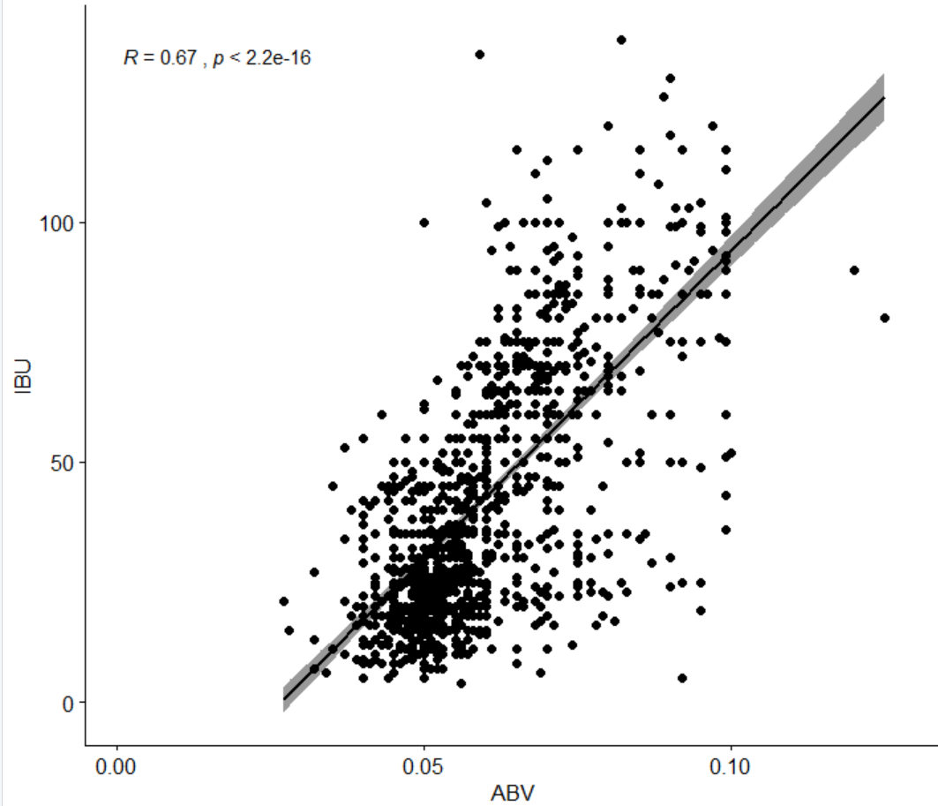
Flavor Profile
We identified positive correlation between ABV and IBU, meaning we have to focus on IBU in relationship to ABV
A low p-value supports our correlation value of .67, at a significiance level of .05, meaning we have enough evidence to suggest that the data is linearly correlated. What does this mean? ABV explains 67% of the variation in bitterness levels of our beer.
At .06 ABV we are looking to create a mildy bitter beer

Slide 10
CHEERS!

