Slide 1

Post-Mortem- Presentation

Slide 2
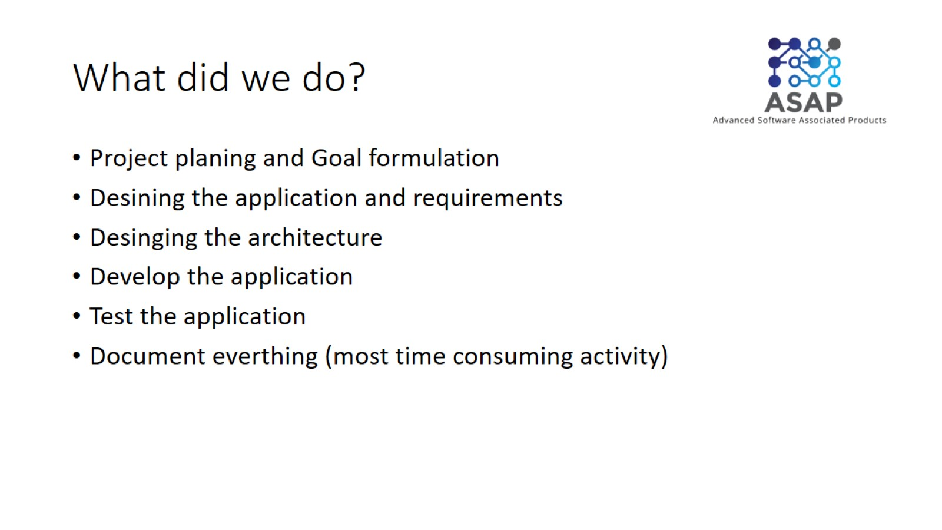
What did we do?

Slide 3
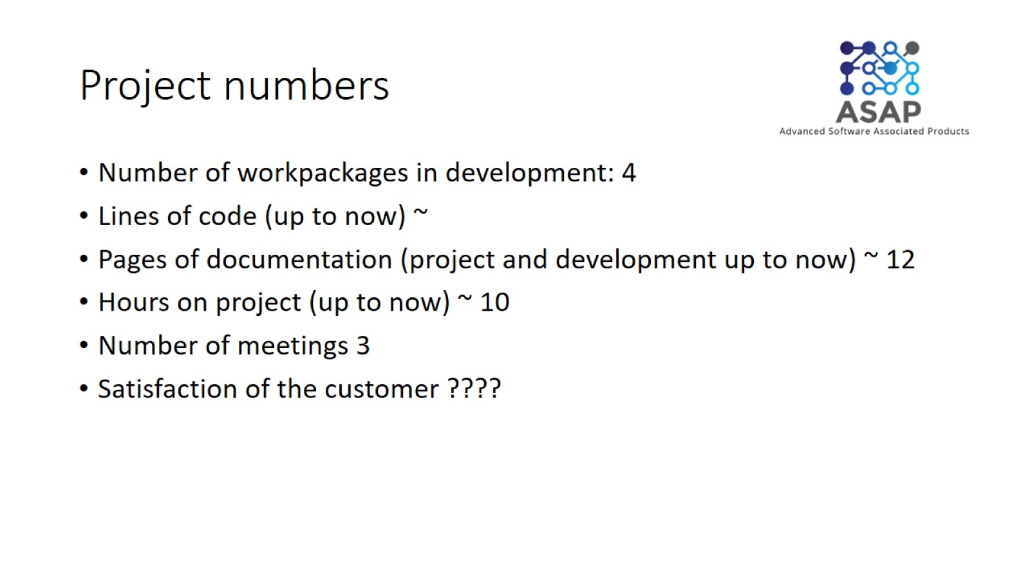
Project numbers

Slide 4
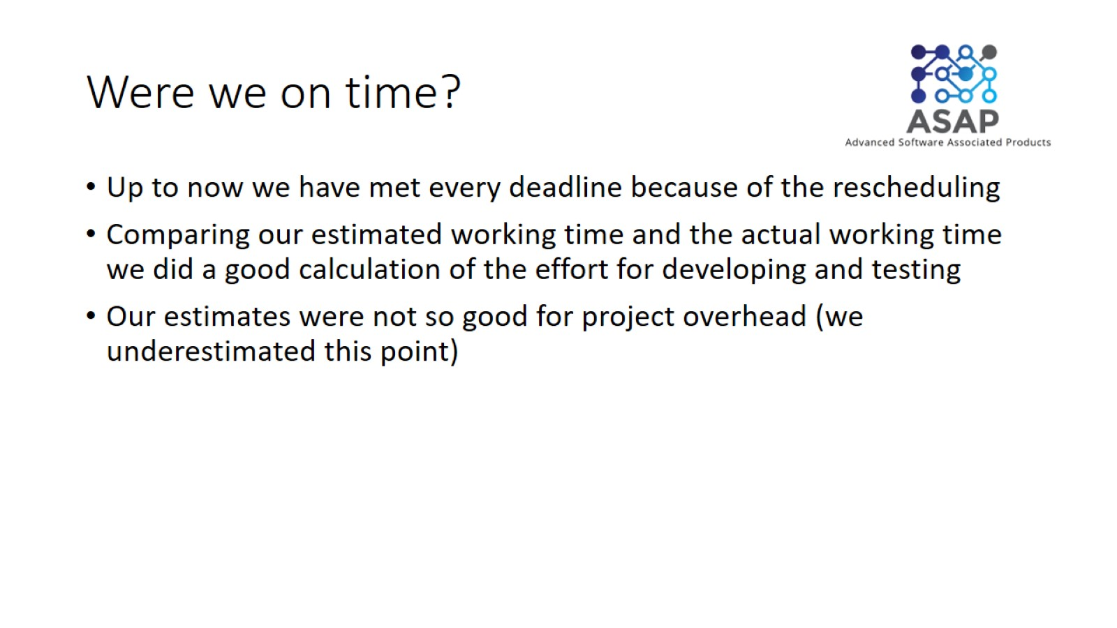
Were we on time?

Slide 5
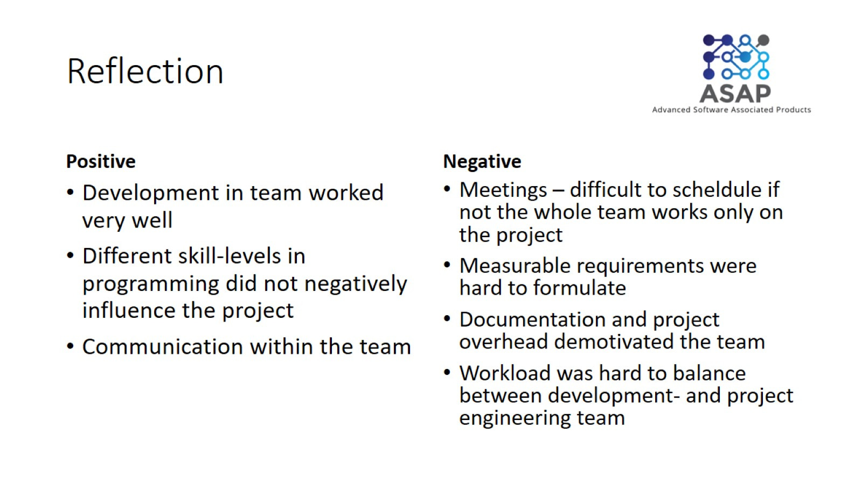
Reflection

Slide 6
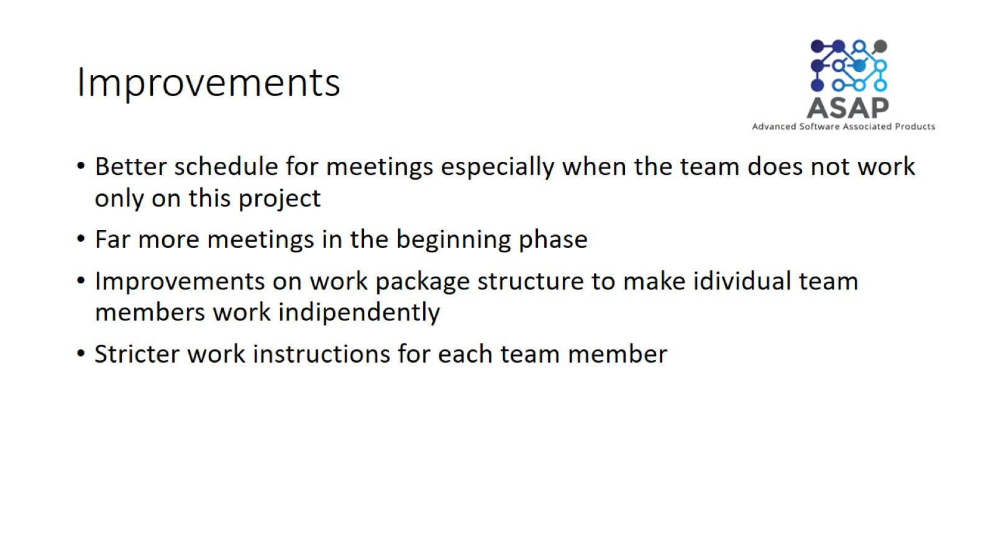
Improvements

