Slide 1

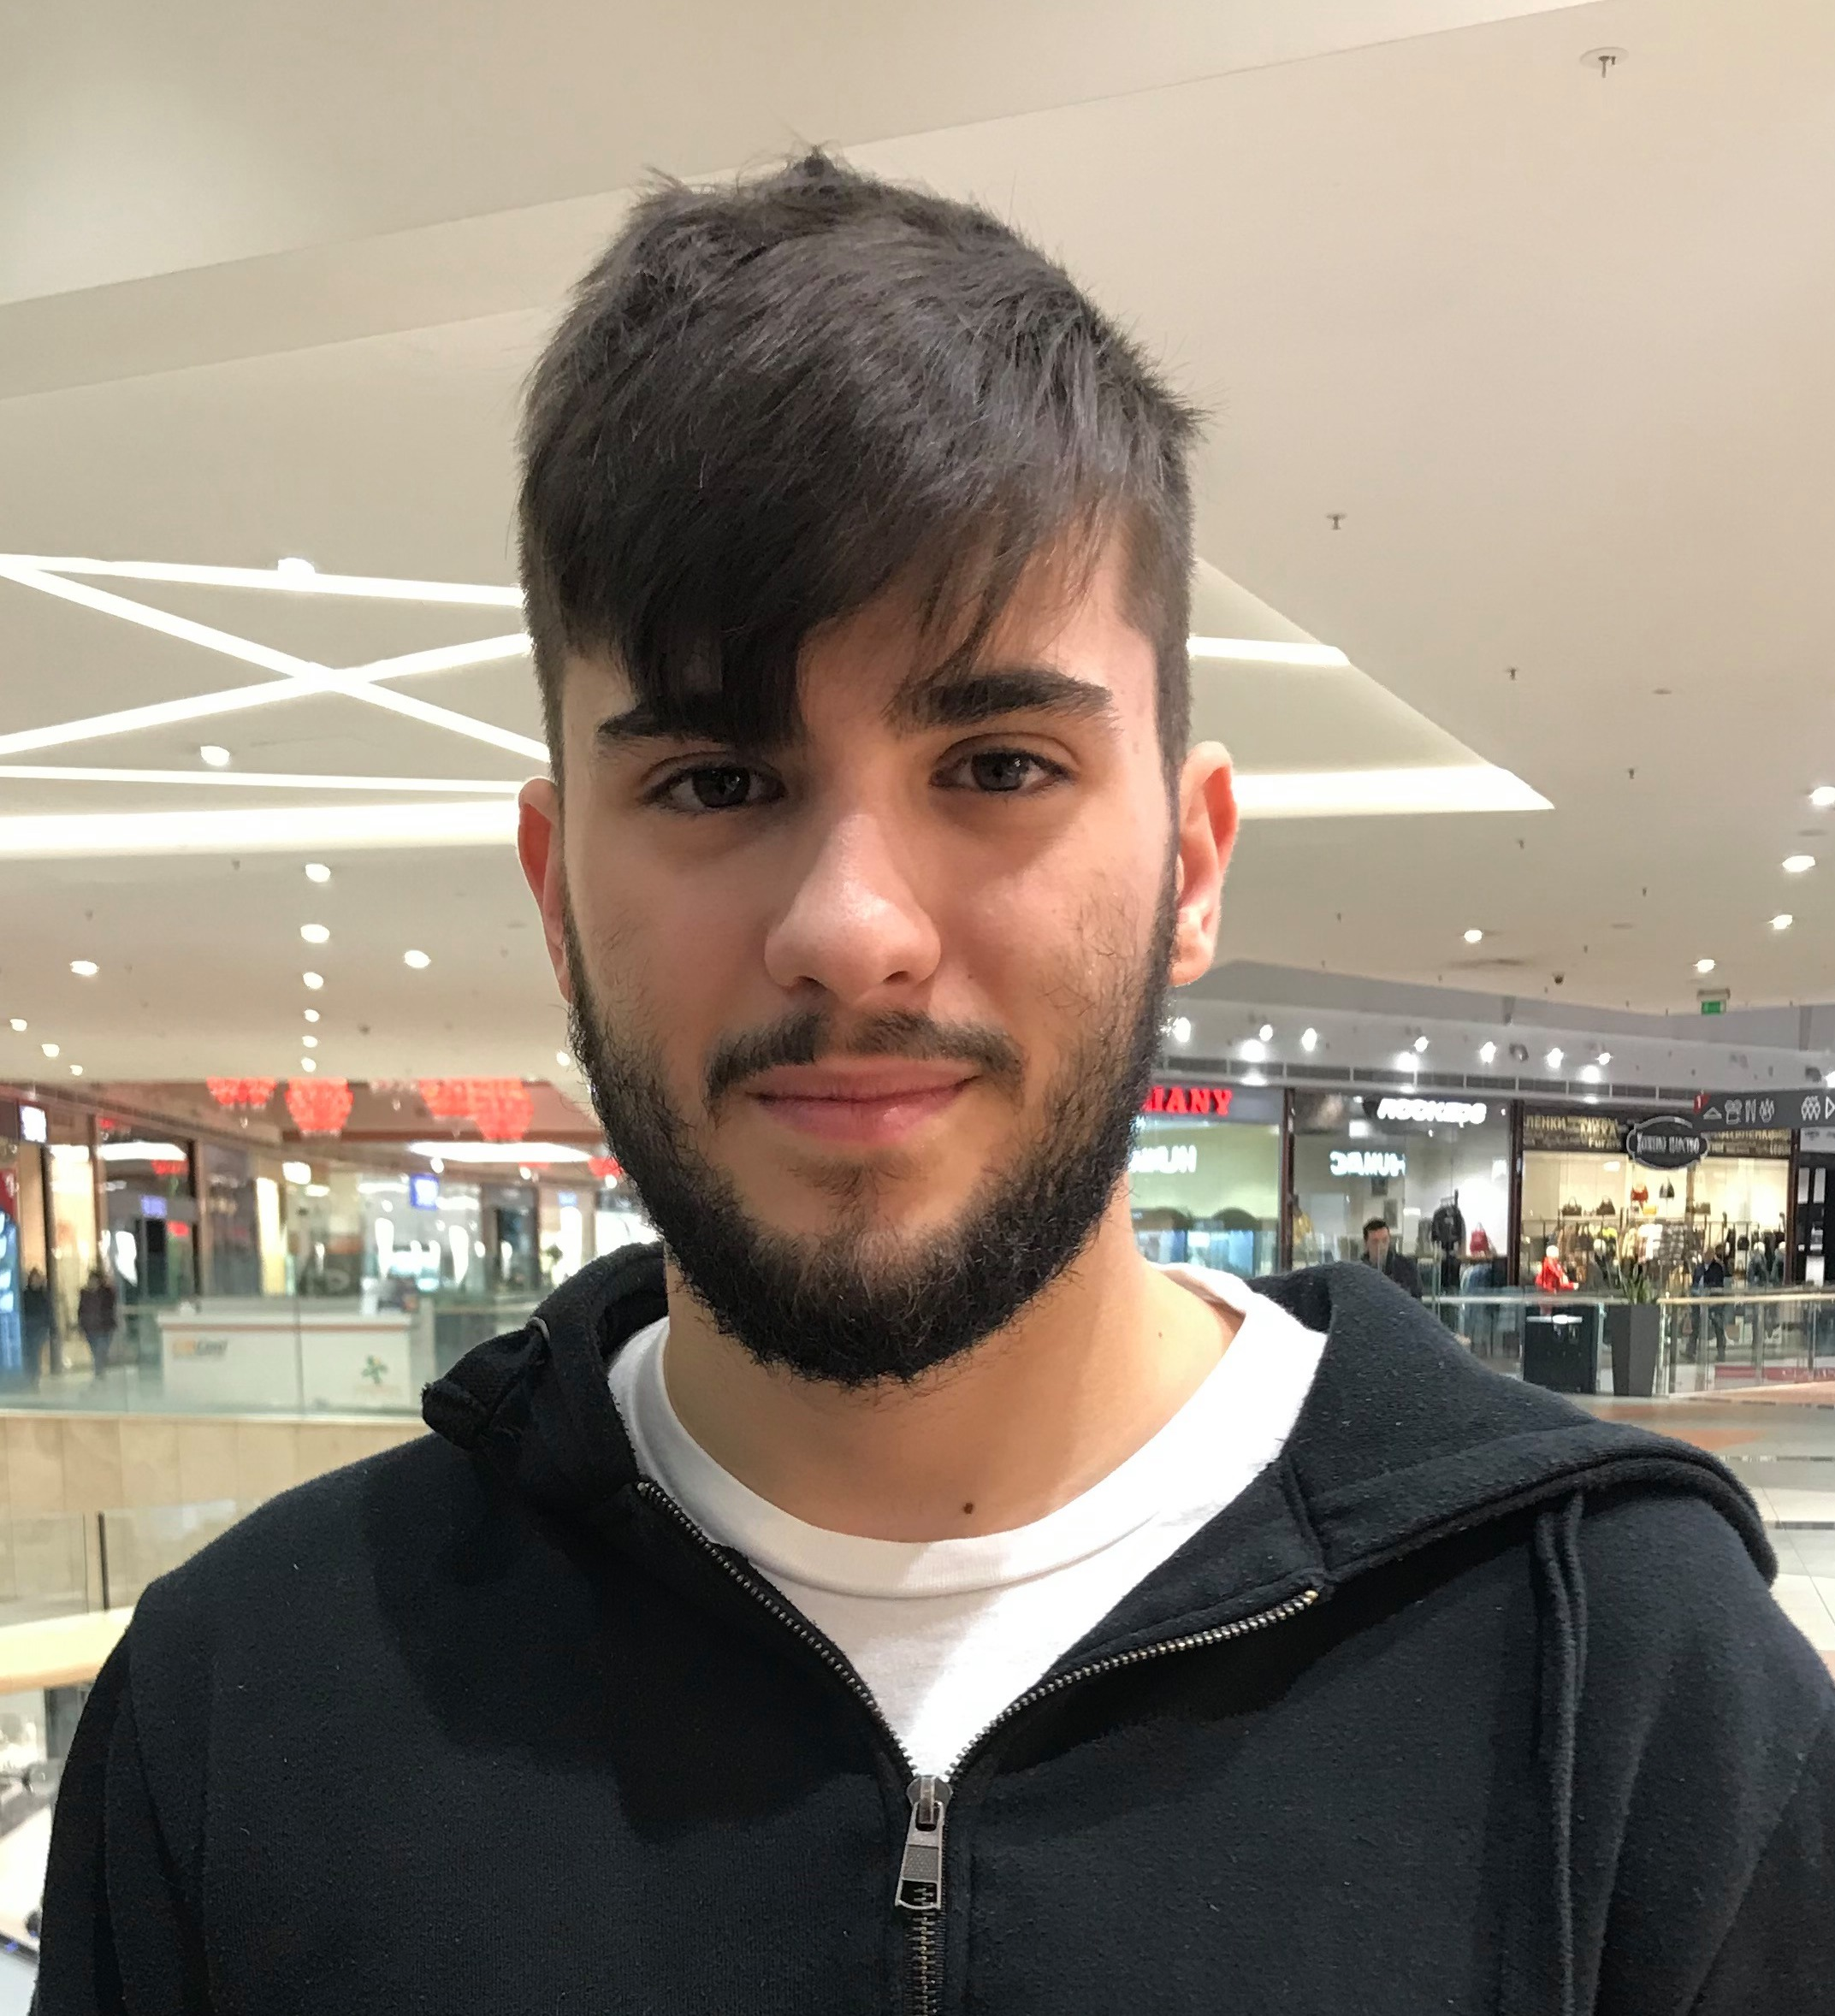
Duo application
Dimitar Ivanov
“Averi”
Martin Grigorov

Slide 2
Introduction about our project
Steps:
Understanding the problem that is fixing
Trying different designs and techniques
Testing
Application for student parties:
Creating parties
Joining parties
Meeting new people
Having good time
Organizing with ease
Key values:
Usability
UX
Plan for the future

Slide 3
Party
Creating
Joining
Choosing a banner, name, date, time and bio for the party
You choose if you want to have an entry limit or entry cost
Choose on the map where the party will be or search for the exact place
Adding the party to your calendar
See who joins your party
App shows only parties near you
You can’t see the location until you join the party
After joining, the party is added in your calendar and you know the location of it
You can see who is going to that party

Slide 4
Why our application
One application used by all students who party
Tested to be as efficient and user-friendly as possible
Intuitively understandable interface
Making new friends is not hard
Makes organization look easy
Very expandable
Designed to continue developing in the future

Slide 5
Personal impression: Martin
Overall good experience with first iOS project
Our team experienced some difficulties with decision making
Great experience with Apple environment
Looking forward for future projects

Slide 6
Personal impression: Dimitar
Good first try in IOS projects
It was like creating a real app
Looking positive for future projects
Had difficulties but never stopped trying

