Slide 1




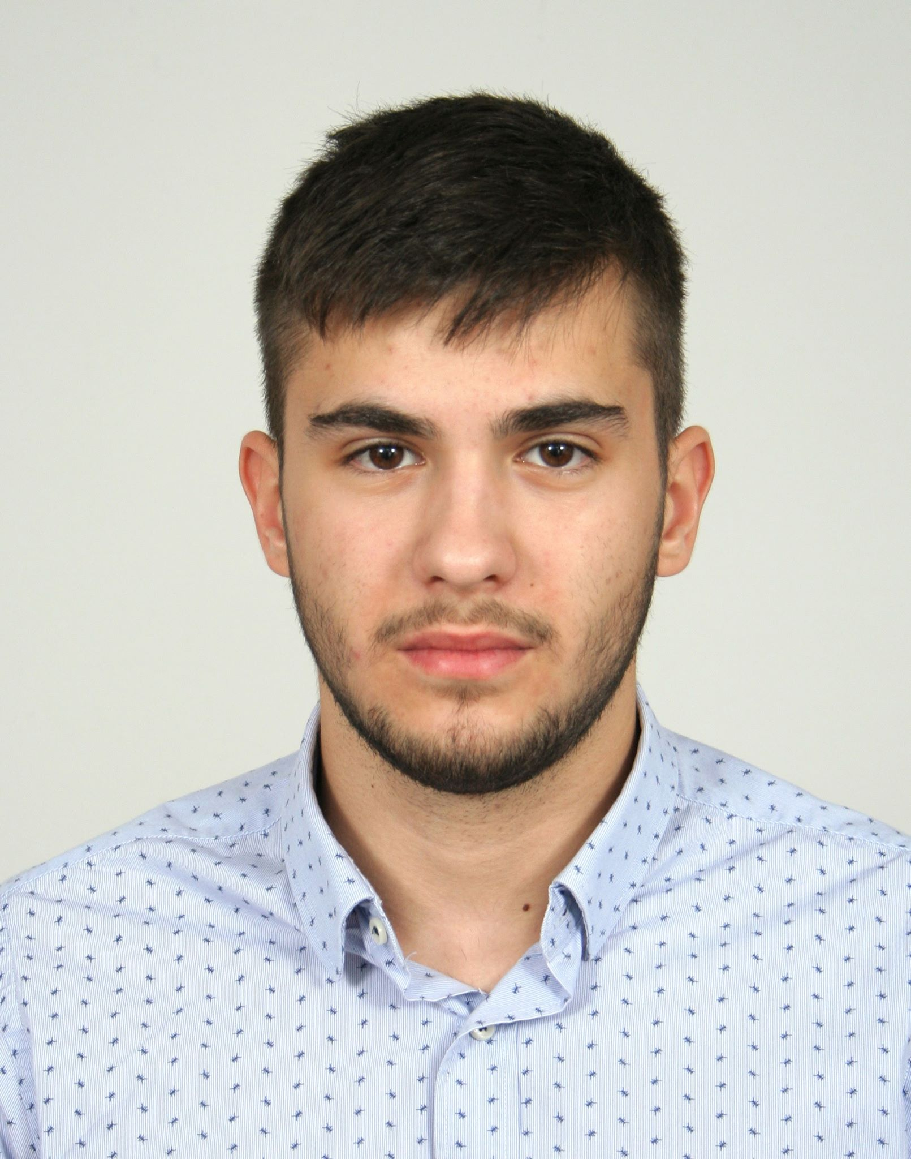
Team introduction
Maria Khovanskaya
e-b21
Dimitr Ivanov
e-s26
“Mad projects”
David Hooi
e-t21
Martin Grigorov
e-s22

Slide 2
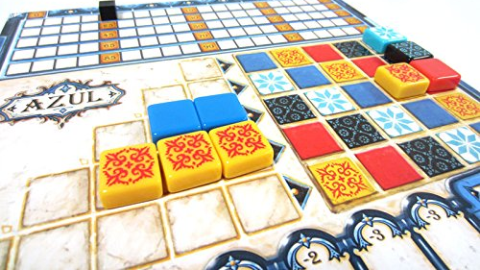
Introduction about the project

Slide 3
Deliverables of block 1 (what we designed)

Slide 4
Deliverables of block 2 (what we delivered)

Slide 5
Presentation of product (through use-cases or somehow)

