Slide 1
Rules of the game
You are a talent scout of volleyball players. For the next season, so you are contacted by the 30 teams of the national tournament to assess the impact of new players.
Each of them would like to have your opinion in order to decided whether to buy a new player.
In order to give a better assessment, you have the possibility to observe, during a series of trial matches, how a given team performs (ie whether it wins or loses) depending on whether the new player takes part in that match.
Premi il tasto -> per passare alla schermata successiva.

Slide 2
Regole del gioco
For every trial match, it will be you who will decide whether the new player will take part in the game or not.
Remember that your goal is not that of making a given team win the highest number ot matches, but rather to evaluate the impact of the player – that is, to evaluate whether he is useful for the team you are examinating.
Premi il tasto -> per passare alla schermata successiva o il tasto <- per tornare a quella precedente.

Slide 3
Regole del gioco
For every player, you will be able to simulate a certain number of games by using the arrow key on the keyboard.
By choosing «With» (left arrow key), you will simulate a game of the team you are currently examinating WITH the participation of that player.
By choosing «Without» (right arrow key), you will simulate a game of the team you are currently examinating WITHOUT the participation of that player.
Premi il tasto -> per passare alla schermata successiva o il tasto <- per tornare a quella precedente.
Con
Senza

Slide 4


Regole del gioco
Afterwards, a smiley face will appear if the team (in which the player has played or not, depending on your choice) has won the game, while a sad face will appear if the team has lost.
Con
Senza
Premi il tasto -> per passare alla schermata successiva o il tasto <- per tornare a quella precedente.
Con
Senza

Slide 5
Regole del gioco
If you don’t make your choice fast enough, a question mark will appear.
?
Con
Senza
Premi il tasto -> per passare alla schermata successiva o il tasto <- per tornare a quella precedente.

Slide 6
Regole del gioco
Important
The position of the buttons «With» or «Without» may vary while testing different players
It can be this
Con
Senza
Premi il tasto -> per passare alla schermata successiva o il tasto <- per tornare a quella precedente.
Senza
Con
Or this

Slide 7
Regole del gioco
After you will have simulate a certain number of games, you will be asked to judge the value of the player with a score between -10 and 10.
For example:
10 : «The player always makes the team win»
0 : «The player has no impact on the team»
-10 : «The player always makes the team lose»
Afterwards, you will be asked whether you’d advise to buy the player.
Premi il tasto -> per passare alla schermata successiva o il tasto <- per tornare a quella precedente.

Slide 8
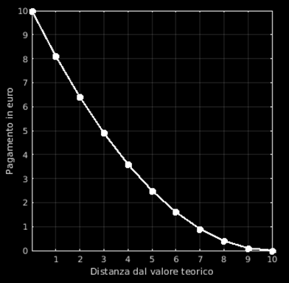
Payment
After you will have evaluated the 30 players and teams, we will calculate your payment according to the accuracy of your assessment.
We will randomly extract your assessment about ONE of the players you tested. If the value you estimated is identical to the real value of the player, you will win 10€.
The further you are from the real value, the less you will be payed (according to the graph on the left.) This sum will be added to the 5€ show-up fee.
Premi il tasto -> per passare alla schermata successiva o il tasto <- per tornare a quella precedente.

Slide 9
END OF THE INSTRUCTIONS
Premi il tasto <- per tornare alla schermata precedente
o il tasto SPAZIO per cominciare con una fase di prova.

