Slide 1
Enterprise IT -TCO over 5 years
Simplified Case Study
Martina De Maio 0296447

Slide 2
Description of the UC & Non-Functional Requirements
Non-Functional Requirements (NFR):
The average number of transactions per second (TPS) is 2.000. 90% of the time the peak is below double of the average (4.000). The maximum peak that the system must handle is the double of the 90% peak (8.000).
The system must ensure a HA at 99.999%.
In case of a disaster, such as Earthquake or flooding in the Data Center site area, the system functionality must be restored and be able to provide Production and Non-Production capabilities and at least 50% of the Dev and Test Capabilities.
The Development team has available an environment that is half the size of the full Production environment.
Before putting in production any new release of software a complete round of functional test must be completed. The Test environment is the same size of the development environment.
Before putting in production any new release of software a complete round of performance test must be completed stressing the system at TPS peaks.
The Software is written in Java and run on the selected Application Server (See Assignment request).
The DB used by the system is the selected DB (See Assignment request).
Description of the UC: Credit Card (CC) Transaction for a Bank
Every CC transaction requires:
Checking the CC is valid
Checking the POS is valid
Checking the money amount is valid
for single transaction and for other limits such as monthly or daily limits
Checking if the transaction is suspect
If the POS requires a second identification step, perform that step and check complete successfully,
At the end of the transaction, issue OK or abort
Store all the information about the transaction whatever is the exit status
Martina De Maio 04/04/2021

Slide 3
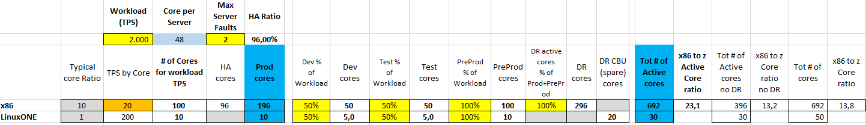
Sizing
The input provided is that the systems must support an average value of 2.000 TPS.
Our input is that a x86 core is able to process 20 TPS
Based on literature, a LinuxONE core (aka IFL) is able to perform 10x TPS, therefore 200 TPS
Martina De Maio 04/04/2021

Slide 4
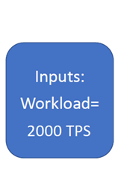
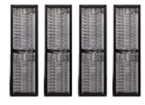
Technical Architectures for the two cases
Case 1:
X86 Server:
Lenovo Rack server ThinkSystem 2U SR665 24C 2.3GHz
(2 Chips, 48 Cores)
22 servers
692 allocated cores
364 spare cores
DR for 100%Prod, 100%PreProd, 50%Test&Dev.
Site 1
Site 2
Prod
5 server (2 HA)
196 cores allocated
44 spare cores
PreProd
3 server
100 cores allocated
44 spare cores
Dev
2 server
50 cores allocated
46 spare cores
Test
2 server
50 cores allocated
46 spare cores
DR
10 server
296 cores allocated
184 spare cores
Site 1
Site 2
Case 2:
LinuxONE Server
2 servers
30 cores
20 spares (CBU)
Prod
10 cores
Dev
5 cores
Spare
10 cores
PreProd
10 cores
Test
5 cores
Spare
10 cores
Martina De Maio 04/04/2021

Slide 5
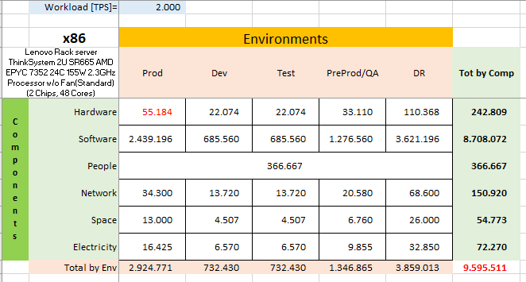
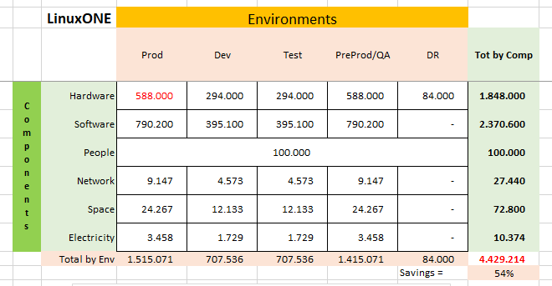
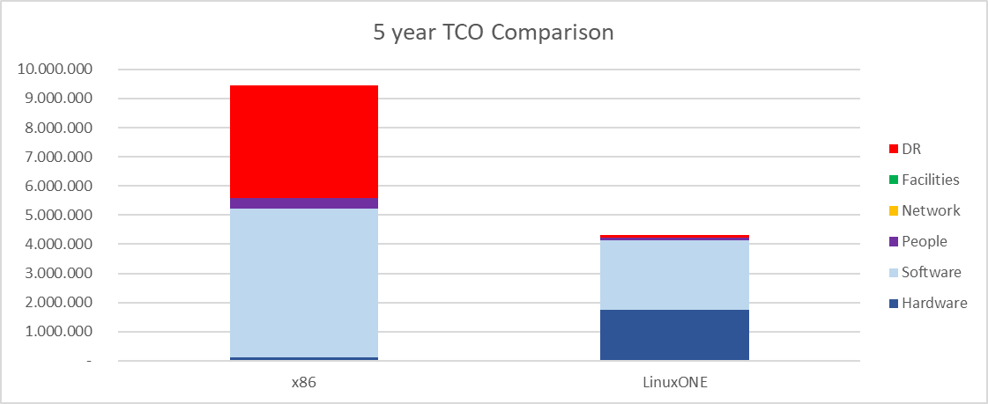
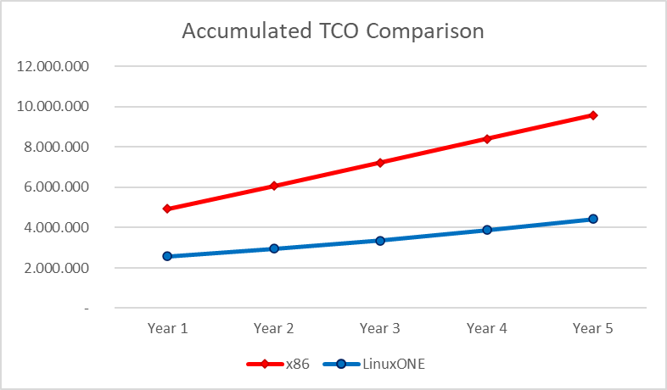
TCO Comparison on 5 years
Above schemas summarize the TCO for the different environments on 5 years, for each cost component. The savings with the LinuxONE platform is 54% vs the x86 equivalent platform.
Below diagrams highlights the component contribution to total cost and cost per year that make the accumulated TCO.

Slide 6
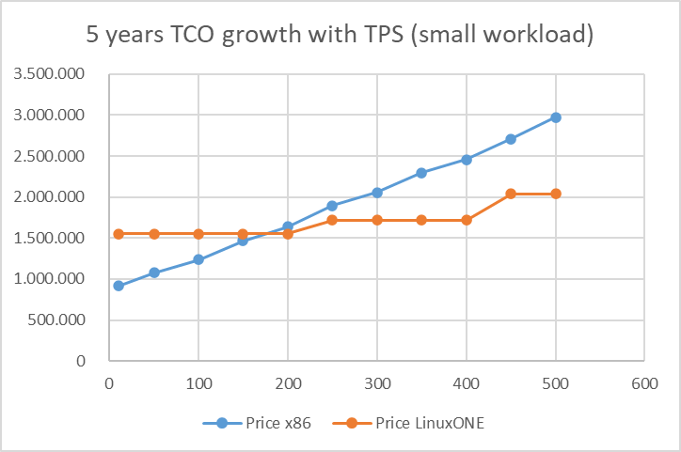
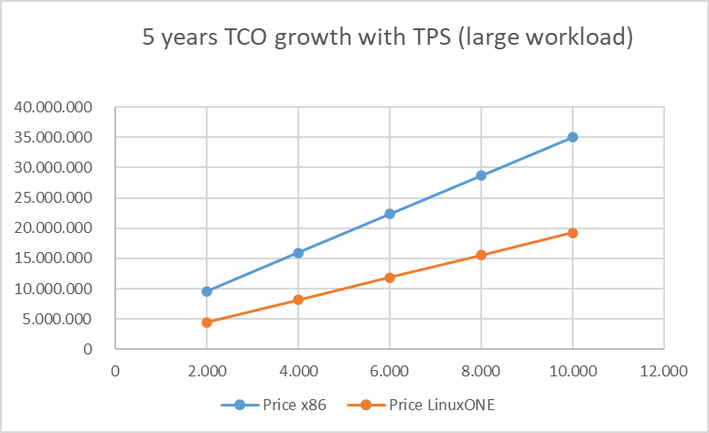
How TCO changes with TPS
Has shown in the left picture, the two platforms have a similar cost for a value of TPS of approx 175.
For small workloads the TCO of x86 platform is lower than the LinuxONE one, up to the intersection of the two curves, from which x86 has always a higher cost.
Martina De Maio 04/04/2021

Slide 7
x86 TCO Assumptions
Software
OS: Linux subscription @2000€/year - 20% discount per socket
VM: kvm embedded in Linux subscription
Application Server: JBoss license @1200€/16core -75% discount, Maintenance @ 20% of purchase price from y2
DB: Oracle Database Enterprise Edition license @47.500€-75% discount, Maintenance @10.450€/year from y2 -75% discount
Data Replication Tools: Zerto Virtual Replication Enterprise Cloud Edition - 25 VM Pack license @24000/25VM € -75% discount, Maintenance @ 20% of purchase price from y2 (Assume we have 50VM).
Monitoring Tools: Nagios XI Enterprise Edition 100 nodes license @ 3400€ - 10% discount, Maintenance @ 2575€ from y2
Security Tools: FortiGate-200E appliance @17.775€ - 20% discount.
Hardware
Lenovo Rack server ThinkSystem 2U SR665 AMD EPYC 7352 24C 155W 2.3GHz Processor w/o Fan(Standard) (2 Chips, 48 Cores)
Acquisition cost: 11K€ - 30% discount including 3 years Support
Support for following years is 20% of purchase price (PP)
Network
7000€ per Server - 30% discount, Maintenance @ 10% of PP from y2
People
One Full Time Equivalent (FTE) covers 30 servers
Average yearly fully loaded costs=100K€
Space
Fully loaded cost of Sq. meter=2.600€
Electricity
Cost per kWh=0,10€
Martina De Maio 04/04/2021

Slide 8
LinuxONE TCO Assumptions
Hardware
LinuxONE servers configured as the example @1.540K€ for 3 years –30% discount
Maintenance @ 10% PP from y4
Network
14000€ per LinuxONE Server -30% discount
Maintenance @ 10% of PP from y2
People
One FTE covers 10 servers
Average yearly fully loaded costs=100K€
Space
Fully loaded cost of Sq. meter=2.800€
Electricity
Cost per kWh=0,10€
Software
OS: subscription 6000€/year –20% discount per socket
VM: included in HW
Application Server: license @100€/PVU -50% discount (120 PVU per core) Maintenance @ 20% of purchase price from y2
DB: license @40.000€ per cores -50% discount, Maintenance @ 20% of purchase price from y2
Data Replication Tools: subscription 3000€/year –50% discount per core
Monitoring Tools: license @5.000€/server -40% discount, Maintenance @ 20% of PP from y2
Security Tools: license @5.000€/server -40% discount. Maintenance @ 20% of from y2
Martina De Maio 04/04/2021

Slide 9
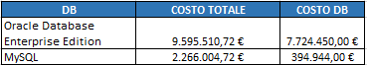
Personal Considerations
The x86 production environment has been sized with 3 servers + 2 to ensure HA, with an HA Ratio of 96%.
For DR environment the systems are able to provide 100% Production, 100% Pre-Production and 50% of the Dev/Test capabilities.
For each technological area of x86 platform has been identified a market solution, preferring, where possible, open source solutions, as reported in the dedicated sheet in the Excel file.
For Monitoring Tools I identified Nagios XI Enterprise solution, one for the primary site (which includes Prod, PreProd and Dev environments), and one for the secondary site (which includes Test and DR environments), each able to manage up to 100 nodes.
For Security Tools I selected Fortigate-200E solution, one on each of the 2 sites.
The most impacting costs element for the x86 solution is the DB software, for which, passing from a commercial solution (Oracle) to an open source (MySQL), we could have a cost reduction of more than 7 million, as shown below, and in this case the TCO for x86 is much lower than the LinuxONE. For simulation has been used the Oracle software.
Martina De Maio 04/04/2021

Slide 10
Personal Considerations
Setting the simulation on an average value of 2000 TPS, the production environment has been sized with 3 servers + 2 for HA, for a total of 240 cores, which allows to manage up to 240x20 = 4800 TPS, in case of normal operation, respecting the requirement of “90% of the time the peak is below double of the average”.
Setting, instead, the calculation with an input value equal to the maximum peak (8000 TPS), I should have foreseen at least 400 cores in production, for a total cost of more than 32 million euros. According to non-functional requirements, this maximum peak must be managed only for 10% of the time, so this solution is not convenient in terms of cost/benefits.
So, selecting the solution with 3 servers + 2 HA (input 2000 TPS), I could manage the maximum peak (8000TPS/400 cores) as follows:
Predictable peaks: I plan to add the Pre-Production cores (144) and part of the Test cores (at least 16) to the Production environment, just for the maximum peak period;
Unpredictable peaks: I start up a pay-per-use contract with a Cloud Provider for a Cloud production environment (no acquisition cost, but just variable operational cost).
Martina De Maio 04/04/2021

