Slide 1
DSS 680: FINAL PROJECT
Martina Carrazzoni

Slide 2


OUTLINE
Purpose
Data Prep
Model
Model Comparison
Score
Forecast
Insights and Recommendation
Notes:
Image1 : https://www.g2.com/products/sas-enterprise-miner/reviews
Image 2: https://www.logo.wine/logo/Microsoft_Excel

Slide 3
PURPOSE
Evaluate two CNS prescription products: Schizophrenia vs. Alzheimer’s disease
Determine which product Joseph’s Pharmaceuticals should license
Build predictive models to estimate market share based on product attributes
Forecast 5-year sales performance for each product
Incorporate assumptions (pricing, treatment length, market penetration)
Provide a data-driven recommendation on the more commercially promising product

Slide 4
OVERVIEW OF DATA
Respondent-level dataset capturing perceptions of product attributes
Variables measured on a 1–10 scale (higher = better performance)
Key predictors: Efficacy1, Efficacy2, Pricing, Safety, Convenience, Packaging, Marketing, Conferences, Targeting
Outcome variable: Market Share
Data used to identify drivers of demand and support predictive modeling
Dataset was cleaned by addressing missing values and out-of-range entries using mean imputation

Slide 5
DATA PREP

Slide 6
CLEANING ALZHEIMER’S DATA
Averages
Data Quality Issues Identified
Variables affected: Efficacy2, Convenience, Marketing, Targeting
All variables measured on a 1–10 scale
Missing values and values outside this range were treated as invalid
Errors Detected
Efficacy2: C11 (40 – outlier)
Convenience: F85 (missing), F261 (60 – outlier)
Marketing: H30 (70 – outlier)
Targeting: J124 (missing)
Data Cleaning Approach (Mean Imputation)
Replaced all invalid values with missing
Calculated mean for each variable using only valid observations
Imputed missing/outlier values with corresponding variable mean
Imputed Values Used
Efficacy2 = 5.07
Convenience = 4.80
Marketing = 5.31
Targeting = 4.97
Column | Error | Average
C11 | 40 | 5.07
F85 | Missing | 4.80
F261 | 60 | 4.80
H30 | 70 | 5.31
J124 | Missing | 4.97

Slide 7
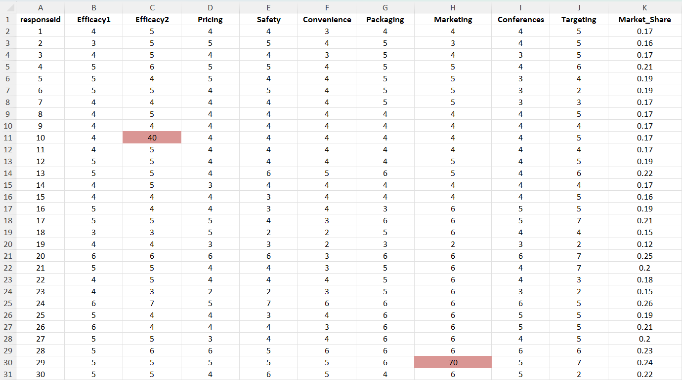
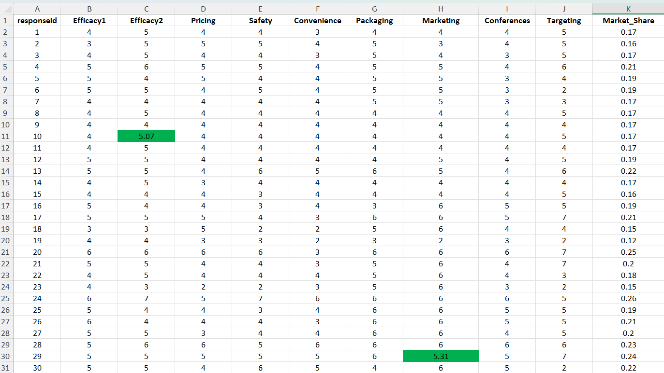
CLEANING ALZHEIMER DATA
ERRORS:
CORRECTIONS:

Slide 8
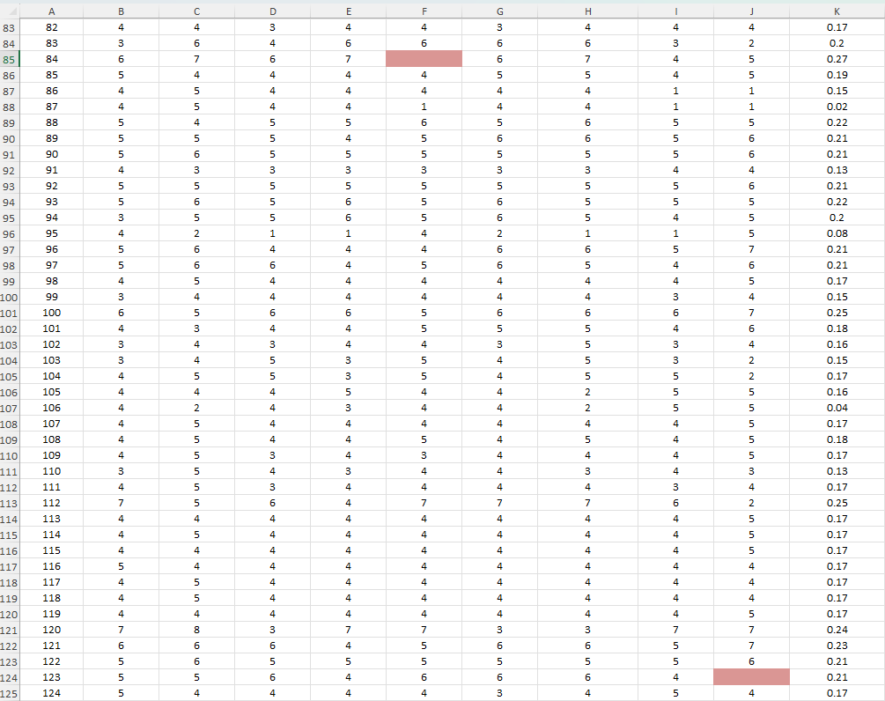
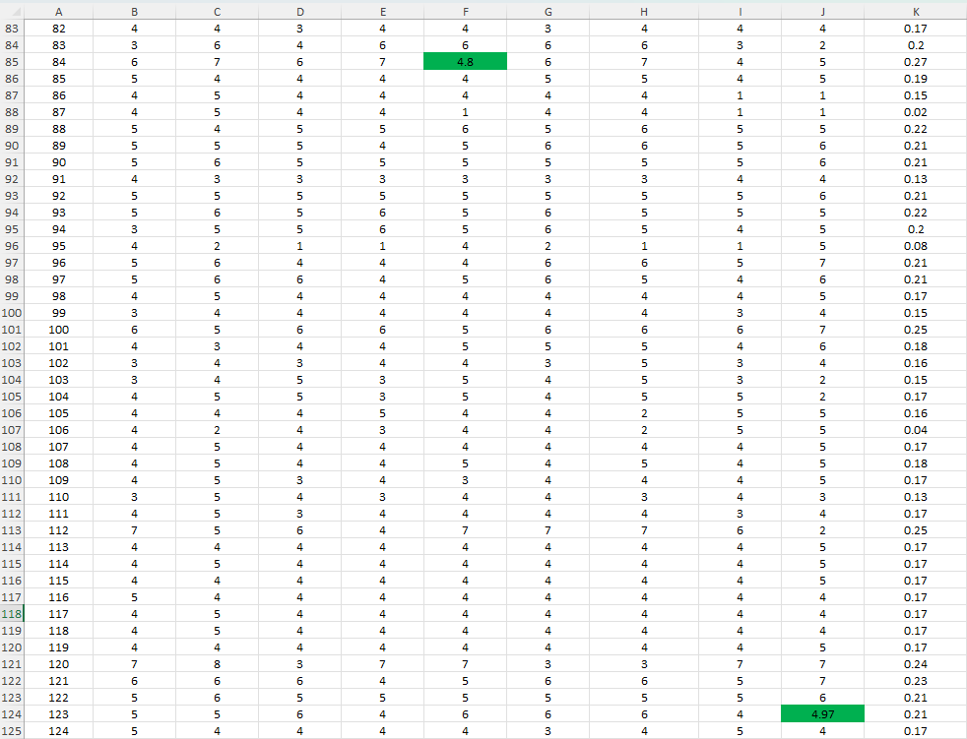
CLEANING ALZHEIMER DATA
ERRORS:
CORRECTIONS:

Slide 9
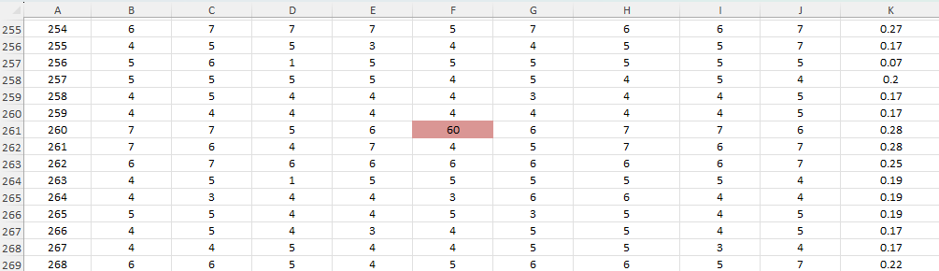
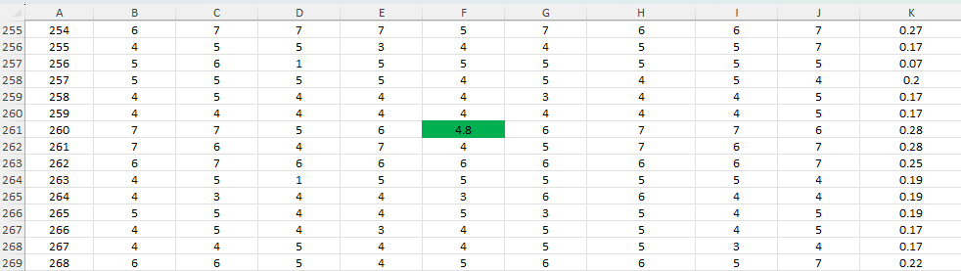
CLEANING ALZHEIMER DATA
ERRORS:
CORRECTIONS:

Slide 10
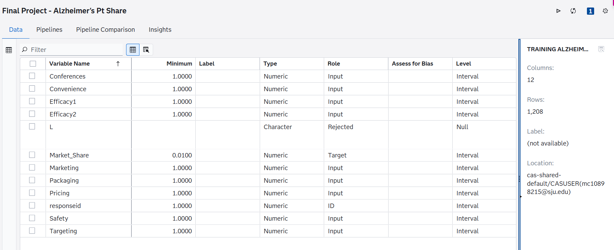
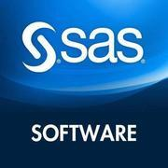
IMPORT RAW DATA TO SAS
Notes:
Image: https://www.trustradius.com/products/sas-enterprise-miner/reviews

Slide 11
MODEL

Slide 12
Predictive Models Applied (Alzheimer’s Dataset)
Gradient Boosting
Random Forest
Decision Tree
Support Vector Machine (SVM)
Linear Regression
Neural Network

Slide 13
Model Variations Tested
SVM Models:
Linear Kernel
Polynomial Kernel
Linear Regression:
Multiple linear regression model
Stepwise regression model
Neural Networks:
2 hidden layers with 50 neurons per hidden layer
1 hidden layer with 4 neurons per hidden layer
Advanced Modeling Approach:
Combined all models using an Ensemble method to improve predictive performance

Slide 14
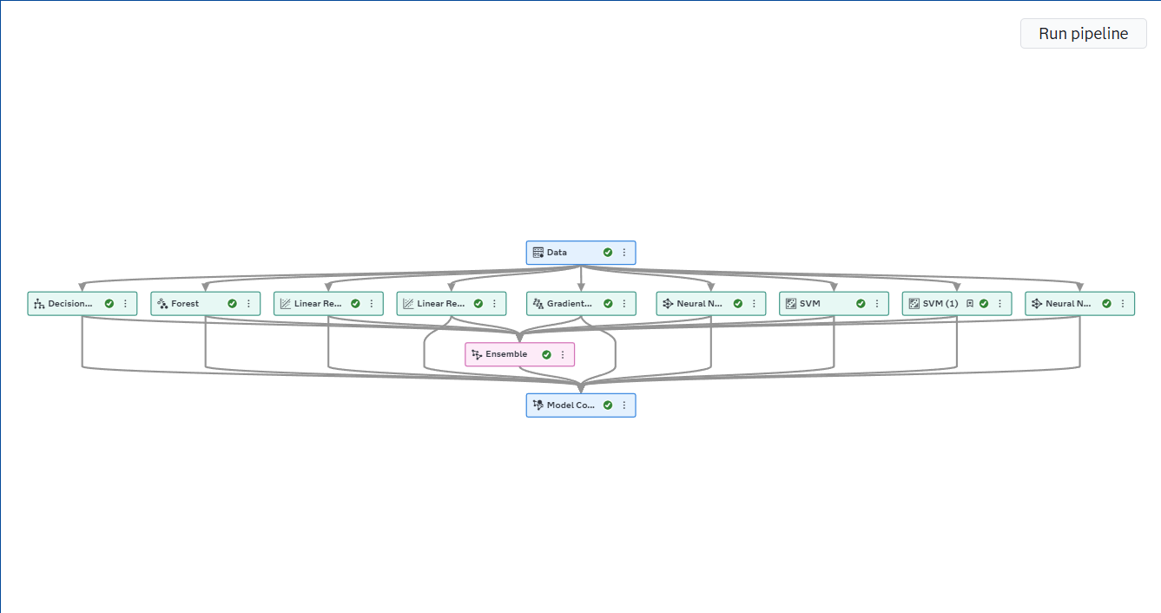
Model Variations Tested

Slide 15
MODEL COMPARISON

Slide 16
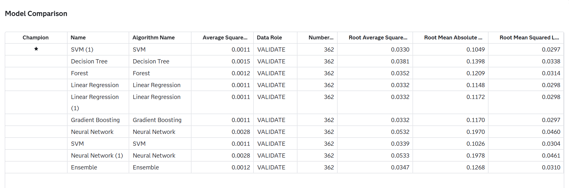
MODEL COMPARISON

Slide 17
MODEL COMPARISON
SVM (1) is the Champion Model:
SAS selected SVM (1) as the champion model on the validation data
This model uses the Polynomial Kernel, meaning it can capture more complex, non-linear relationships between the predictor variables and market share
ASE Results:
SVM (1), Linear Regression, Stepwise Regression (Linear Regression 1), Gradient Boosting, and the other SVM (Linear Kernel) all have a very similar or equal Average Squared Error (ASE) of 0.0011
This means these models performed very similar based on squared prediction error
Why SVM (1) Was Selected
Although ASE is tied, SVM (1) has the lowest Root Mean Squared Error (RMSE) at 0.0297.Gradient Boosting also has an RMSE of 0.0297, but SVM (1) has a stronger overall balance across the other metrics
SVM (1) also has a competitive Root Average Squared Error of 0.0330, which is slightly lower than Linear Regression and Gradient Boosting at 0.0332

Slide 18
MODEL COMPARISON
Comparison to Other Models:
Decision Tree performed worse, with a higher ASE of 0.0015 and RMSE of 0.0338
Forest and Ensemble were slightly weaker, with ASE of 0.0012
Neural Network models performed the worst, with ASE of 0.0028 and the highest RMSE values, suggesting they did not predict market share as accurately for this dataset
Conclusion:
SVM (1) was selected as the champion model because it provided the best validation performance overall, especially with the lowest RMSE and strong error metrics compared to the other models
The Polynomial Kernel likely helped capture non-linear patterns in the data better than the simpler models, making it the most reliable model for forecasting Alzheimer’s product market share

Slide 19
SCORE

Slide 20
RESULTS

Slide 21
FORECAST

Slide 22
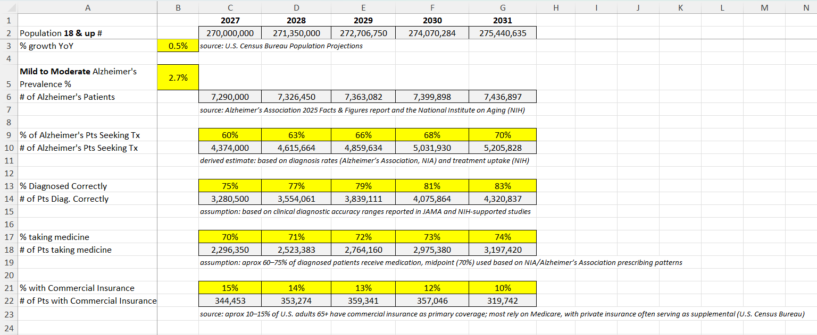
INFORMATION - Alzheimer's Disease Rx Product

Slide 23
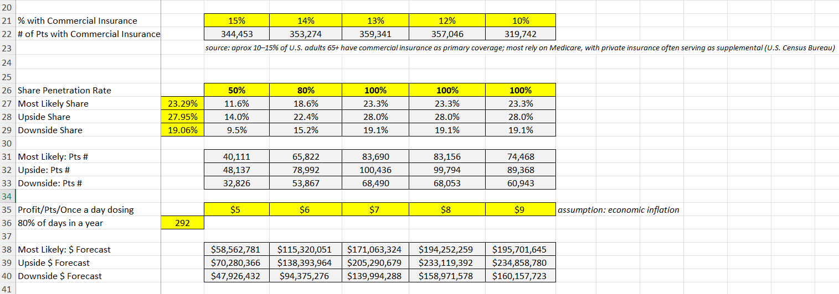
FORECAST - Alzheimer's Disease Rx Product

Slide 24
DATA PREP

Slide 25
CLEANING SCHIZOPHRENIA DATA
Averages
Data Quality Issues Identified
Variables affected: Efficacy1, Safety, Convenience, Conferences, Targeting
All variables measured on a 1–10 scale
Missing values and values outside this range were treated as invalid
Errors Detected
Efficacy1: B73 (70 – outlier)
Safety: E162 (missing)
Convenience: F22 (60 – outlier)
Conferences: I250 (60 – outlier)
Targeting: J94 (missing)
Data Cleaning Approach (Mean Imputation)
Replaced all invalid values with missing
Calculated mean for each variable using only valid observations
Imputed missing/outlier values with corresponding variable mean
Imputed Values Used
Efficacy1 = 4.73
Safety = 4.23
Convenience = 4.80
Conferences = 4.61
Targeting = 4.31
Column | Error | Average
B73 | 70 | 4.73
E162 | Missing | 4.23
F22 | 60 | 4.80
I250 | 60 | 4.61
J94 | Missing | 4.31

Slide 26
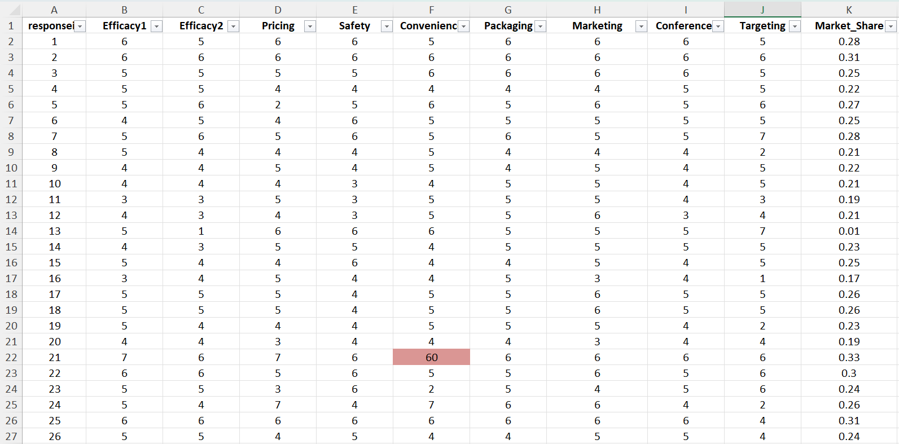
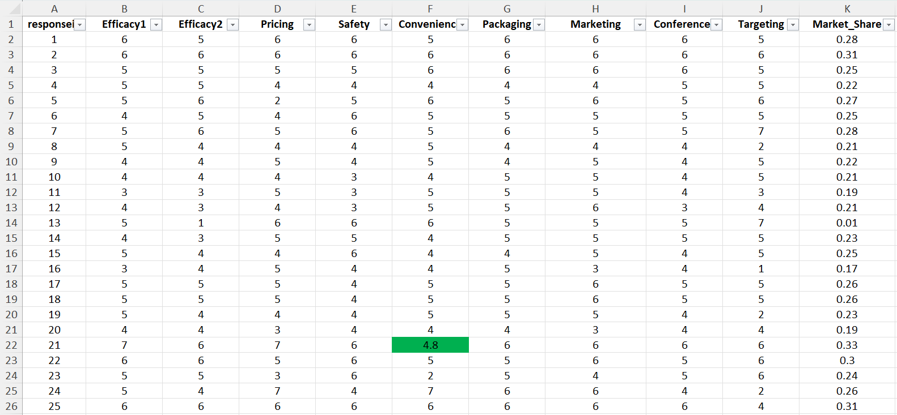
CLEANING SCHIZOPHRENIA DATA
ERRORS:
CORRECTIONS:

Slide 27
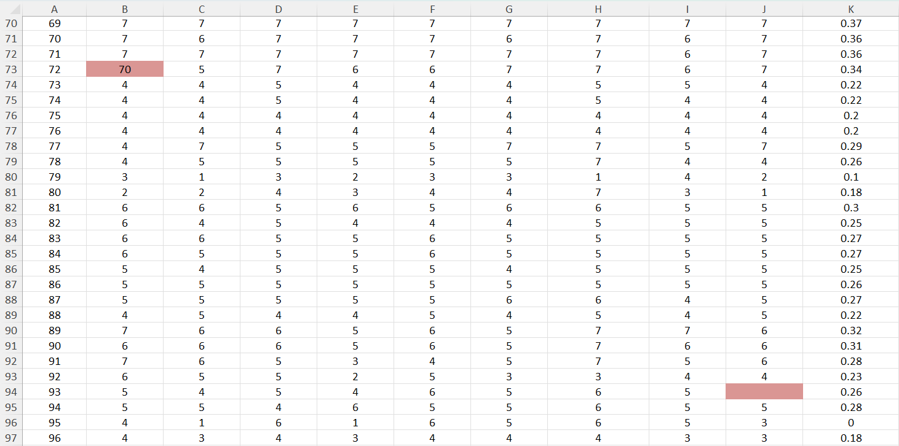
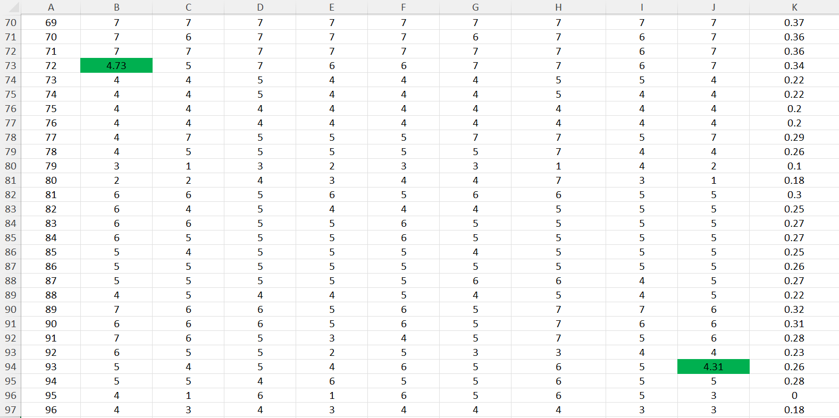
CLEANING SCHIZOPHRENIA DATA
ERRORS:
CORRECTIONS:

Slide 28
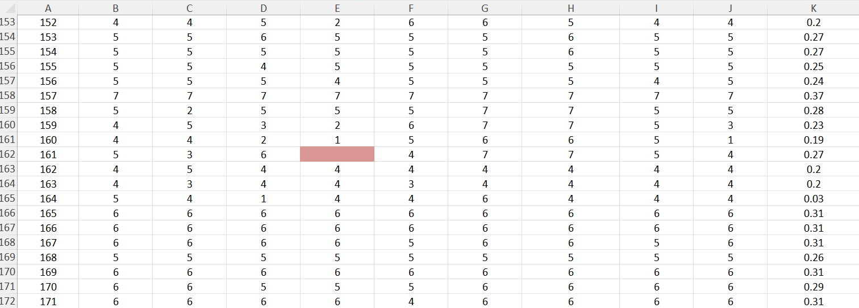
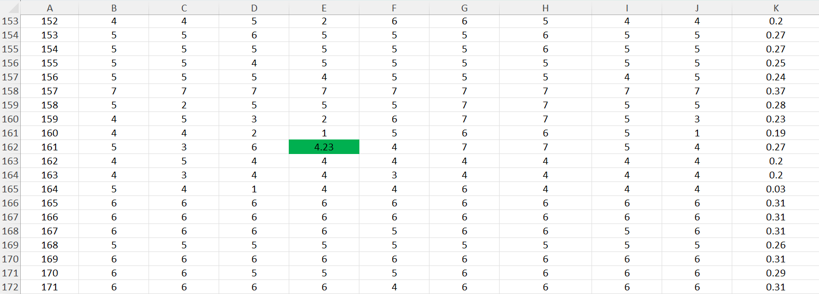
CLEANING SCHIZOPHRENIA DATA
ERRORS:
CORRECTIONS:

Slide 29
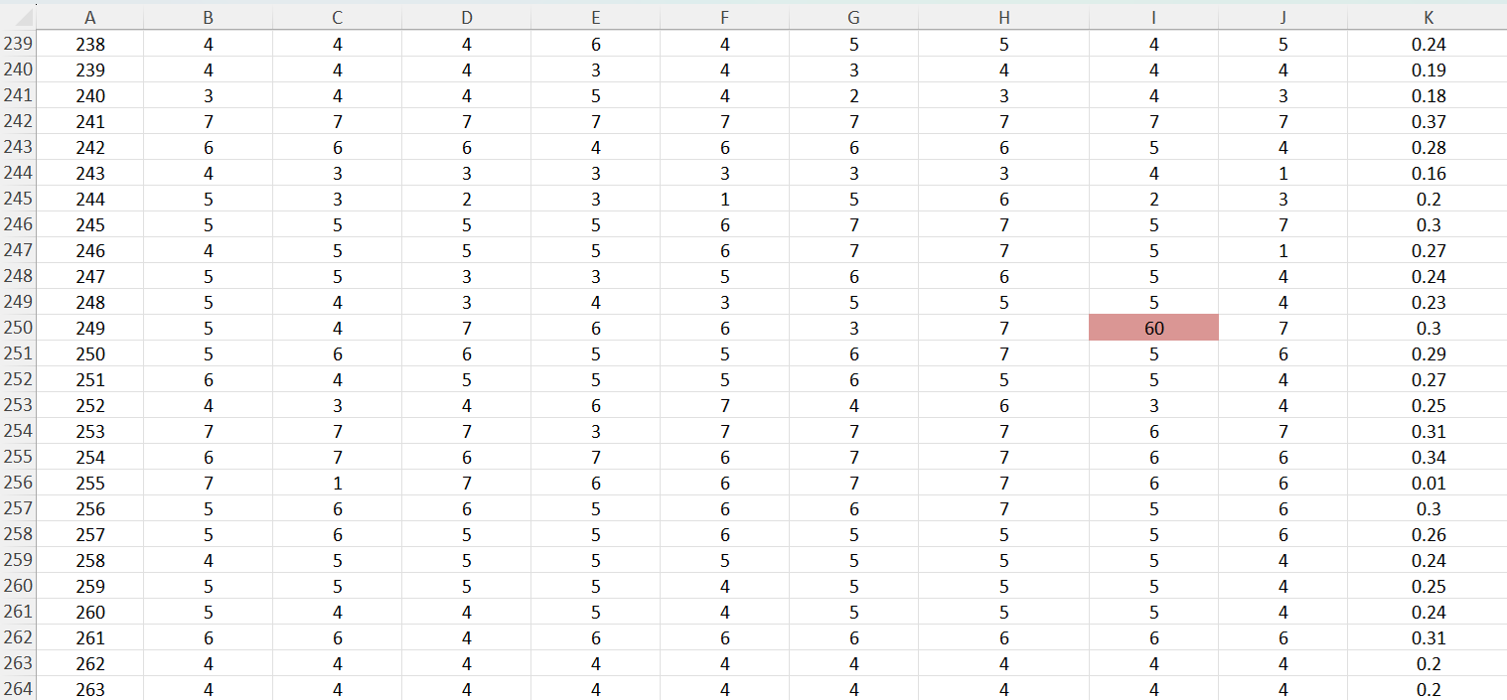
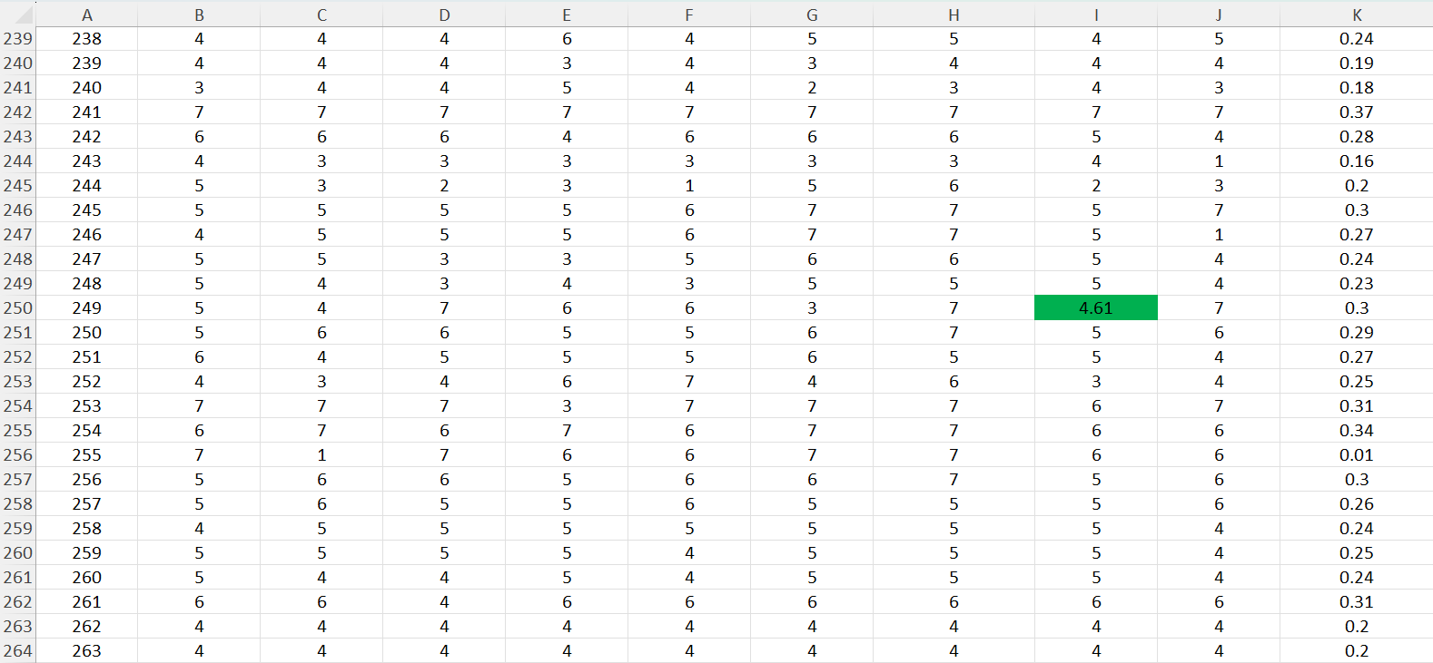
CLEANING SCHIZOPHRENIA DATA
ERRORS:
CORRECTIONS:

Slide 30
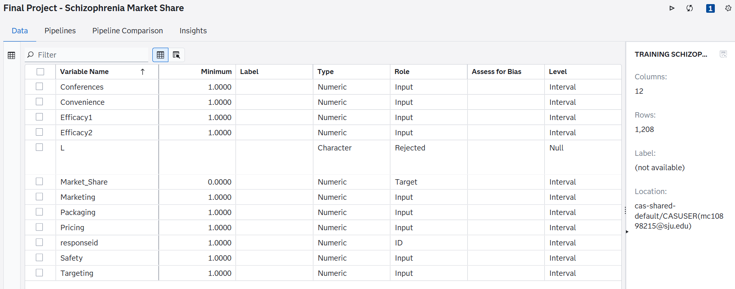
IMPORT RAW DATA TO SAS
Notes:
Image: https://www.trustradius.com/products/sas-enterprise-miner/reviews

Slide 31
MODEL

Slide 32
Predictive Models Applied (Schizophrenia’s Dataset)
Gradient Boosting
Random Forest
Decision Tree
Support Vector Machine (SVM)
Linear Regression
Neural Network

Slide 33
Model Variations Tested
SVM Models:
Linear Kernel
Polynomial Kernel
Linear Regression:
Multiple linear regression model
Stepwise regression model
Neural Networks:
2 hidden layers with 50 neurons per hidden layer
1 hidden layer with 4 neurons per hidden layer
Advanced Modeling Approach:
Combined all models using an Ensemble method to improve predictive performance

Slide 34
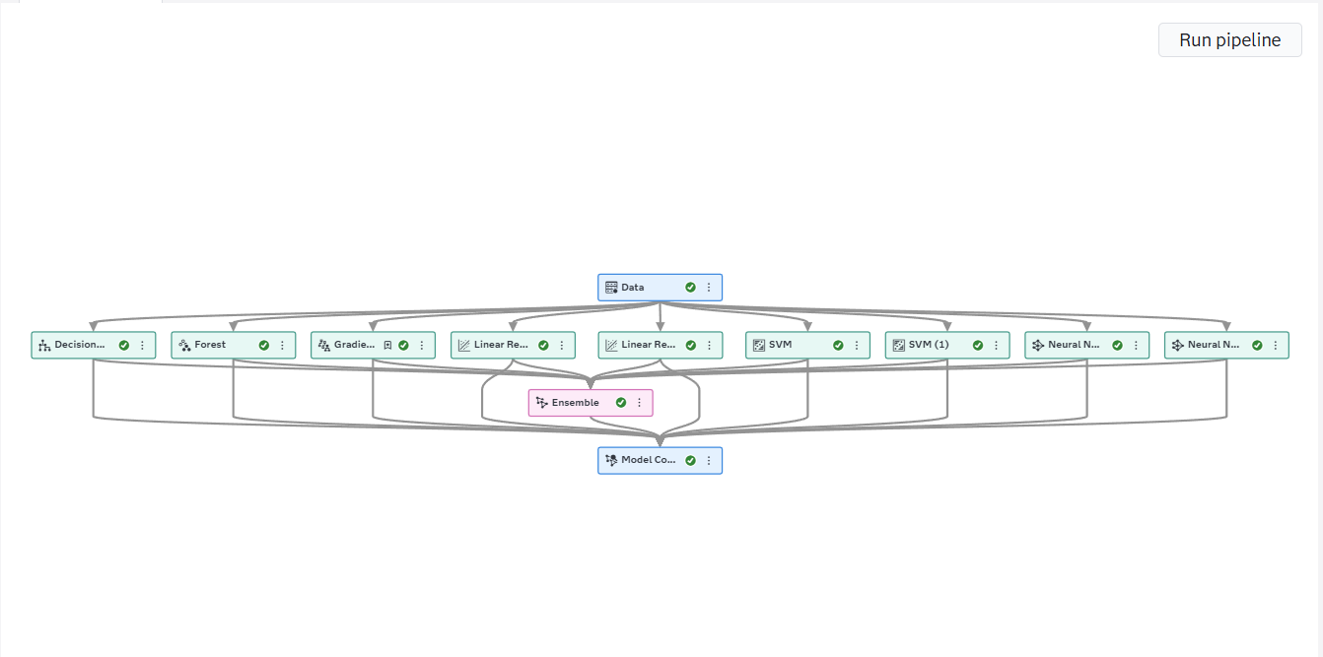
Model Variations Tested

Slide 35
MODEL COMPARISON

Slide 36
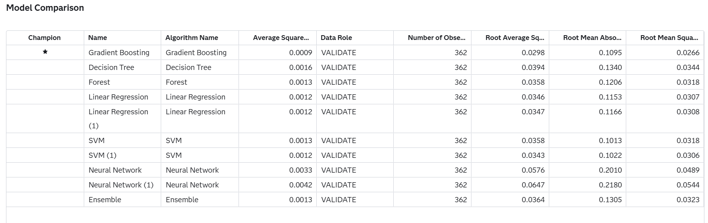
MODEL COMPARISON

Slide 37
MODEL COMPARISON
Gradient Boosting is the Champion Model:
SAS selected Gradient Boosting as the champion model on the validation data
This model captures complex, non-linear relationships and interactions between predictor variables and market share
ASE Results:
Gradient Boosting has the lowest Average Squared Error (ASE) of 0.0009, outperforming all other models
Linear Regression and SVM (1) models follow with slightly higher ASE (0.0012)
This indicates Gradient Boosting provides the most accurate predictions based on squared error
Why Gradient Boosting Was Selected:
Gradient Boosting has the lowest ASE and the lowest Root Mean Squared Error (RMSE) at 0.0266, the best among all models
It also has the lowest Root Average Squared Error (0.0298), confirming consistent performance
Overall, it outperforms other models across all key validation metrics, not just ASE

Slide 38
MODEL COMPARISON
Comparison to Other Models:
Decision Tree performed worse, with a higher ASE of 0.0016 and RMSE of 0.0344
Forest, SVM, and Ensemble models performed moderately, with ASE ranging from 0.0012–0.0013
Linear Regression models showed solid but slightly weaker performance (ASE = 0.0012)
Neural Network models performed the worst, with the highest ASE (0.0033–0.0042) and RMSE values
Conclusion:
Gradient Boosting was selected as the champion model because it provided the best overall validation performance
It achieved the lowest error across all key metrics (ASE, RMSE, etc.), making it the most accurate model
Its ability to capture non-linear relationships and interactions makes it the most reliable model for forecasting market share

Slide 39
SCORE

Slide 40
RESULTS

Slide 41
FORECAST

Slide 42
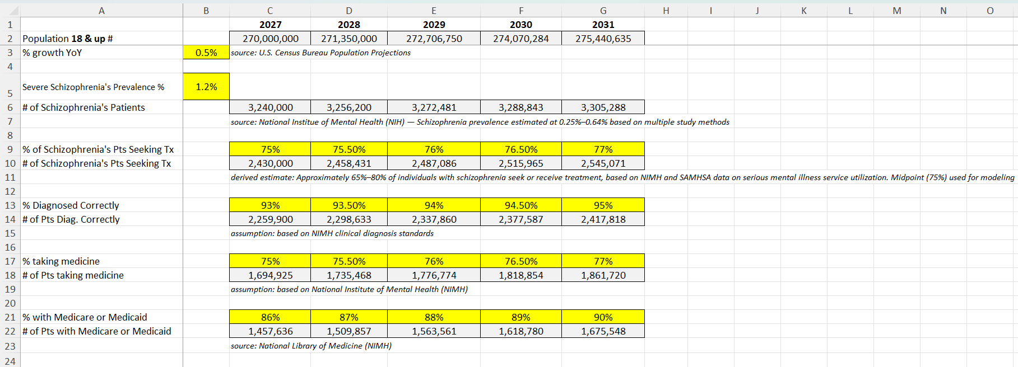
INFORMATION - Schizophrenia's Disease Rx Product

Slide 43
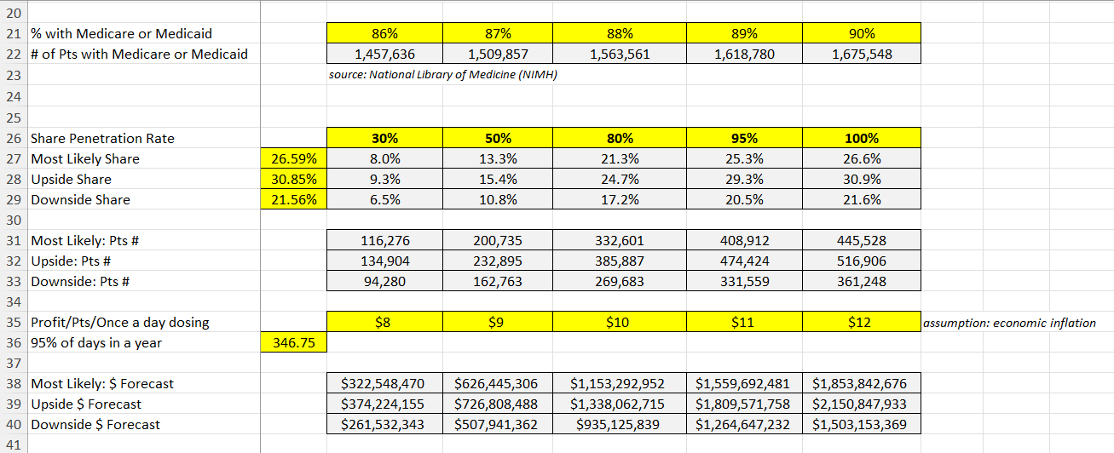
FORECAST - Schizophrenia's Disease Rx Product

Slide 44
COMPARISON
Schizophrenia vs. Alzheimer’s — Market & Revenue Comparison
Market Dynamics
  Alzheimer’s:
    Larger total population (~7.4M by 2031)
    Limited access due to commercial insurance restriction (~10–15%)
  Schizophrenia:
    Smaller total population (~3.3M)
    Broad access via Medicare/Medicaid (~85%+)
Patient Funnel Efficiency
  Alzheimer’s:
    Significant drop-off across: Diagnosis, Treatment and Insurance eligibility
  Schizophrenia:
    Higher retention through funnel
    Larger treatable population (~445K vs. ~75K in 2031)

Slide 45
COMPARISON
Schizophrenia vs. Alzheimer’s — Market & Revenue Comparison
Revenue Model Drivers
  Schizophrenia:
    Higher price ($8–$12/day)
    Longer adherence (~95% of year)
  Alzheimer’s:
    Lower price ($5–$9/day)
    Lower adherence (~80%)
Key Insight
    Access to reimbursed patients is the biggest driver of commercial success—not total disease prevalence

Slide 46
COMPARISON
Revenue Forecast Comparison (2027–2031)
Alzheimer's Disease Rx Product
    2027: ~$59M
    2028: ~$115M
    2029: ~$171M
    2031: ~$196M
    Growth plateaus early due to market constraints
Schizophrenia Rx Product
    2027: ~$323M
    2028: ~$700M
    2029: ~$1.15B
    2031: ~$1.85B
    Strong, sustained growth driven by larger treated population
Head-to-Head Outcome
  Schizophrenia generates:
    5x more revenue in Year 1 (2027)
    ~6x more in Year 2 (2028)
    ~9–10x more by Year 5 (2031)
Key Insight
  Even with a smaller population, schizophrenia significantly outperforms due to better access, pricing, and treatment dynamics

Slide 47
INSIGHTS AND RECOMMENDATION

Slide 48
INSIGHTS + RECOMMENDATION
License the Schizophrenia Rx Product
Based on the 5-year revenue forecast, Joseph’s Pharmaceuticals should license the Schizophrenia Rx Product, as it represents a significantly stronger commercial opportunity than the Alzheimer’s alternative. Although Alzheimer’s has a larger overall patient population, the schizophrenia market offers a much larger reimbursable and treatable patient base due to broader Medicare and Medicaid coverage, higher diagnosis and treatment rates, and stronger patient retention. In addition, the schizophrenia product benefits from higher pricing and longer treatment duration, which further amplifies revenue potential. As a result, it delivers substantially greater projected revenue across all scenarios, reaching approximately $1.85 billion by 2031 compared to ~$196 million for Alzheimer’s, making it the more scalable and financially attractive option for long-term growth

