Slide 1

VNPROSTHETICHAND PROJECT
Trường Đại học Bách Khoa Tp.HCM
Khoa Khoa học và Kĩ thuật Máy tính
Nguyễn Quang Đức – 1810118- KH&KTMT

Slide 2
Problem Statement

Slide 3
Problem Statement
Khó khăn
Học tập
Việc làm
Hôn nhân
Bạo lực
Tâm lý mặc cảm
Hậu quả
Bế tắc
Trầm cảm
Tệ nạn xã hội
Phân biệt đối xử

Slide 4

Problem Statement
Tương lai nào cho những nguời khuyết tật ?
Giúp họ như thế nào ?
Thay thế cơ thể khiếm khuyết bằng phần cơ thể nhân tạo
Làm sao để phần cơ thể nhân tạo có thể hoạt động ?

Slide 5

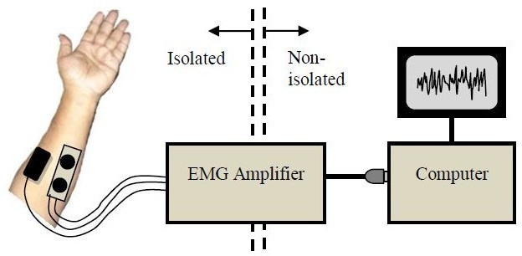
Finding solution
How to measure muscle electromyography?
Electromyography
“Electromyography is an electrodiagnostic medicine technique for evaluating and recording the electrical activity produced by skeletal muscles.”

Slide 6
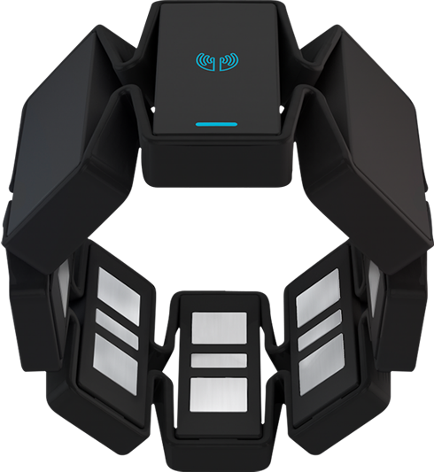

Finding solution
A powerful device
But wait a moment …
How to make it work for our purpose
Builtin 8 EMG sensors
3-axis gyroscope
3-axis accelerometer
3-axis magnetometer

Slide 7
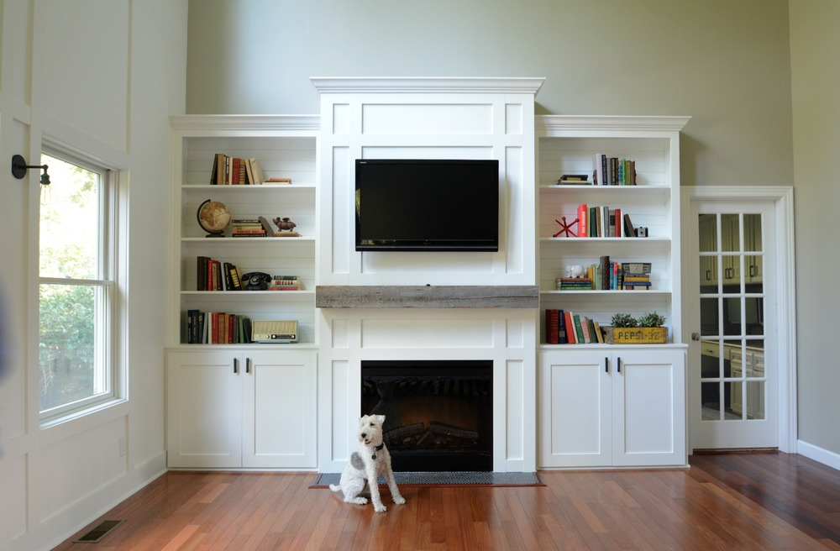
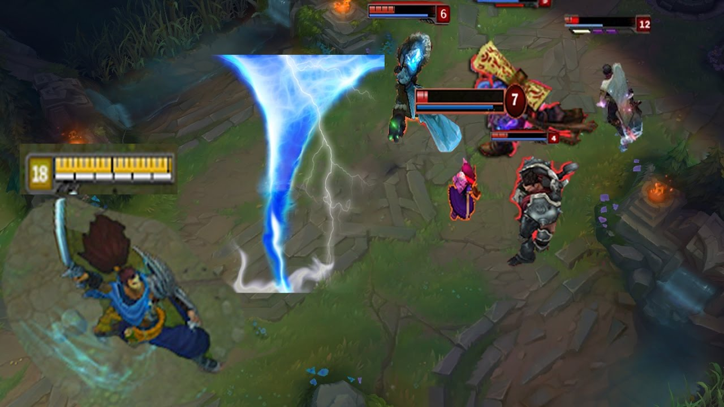
Finding solution
Micro controller with pure calculating
Use builtin grip detector
A sample for each grip for all people

Slide 8
Finding solution
Micro processor
Micro controller
Artificial Intelligent
Control motors
But final user cannot play with console or commands
Measure battery capacity
Control notification led
Something is visual and simple to use
Receive input signal from button
Web-based UI for training and configing

Slide 9
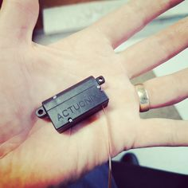
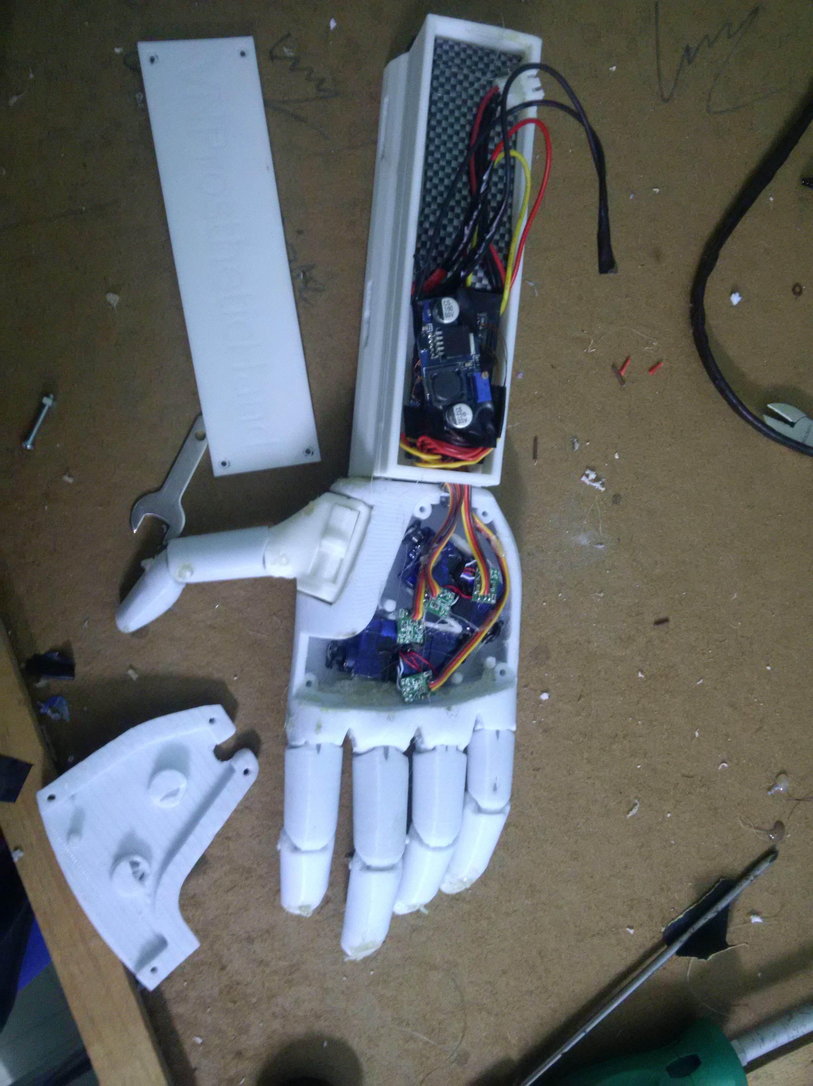
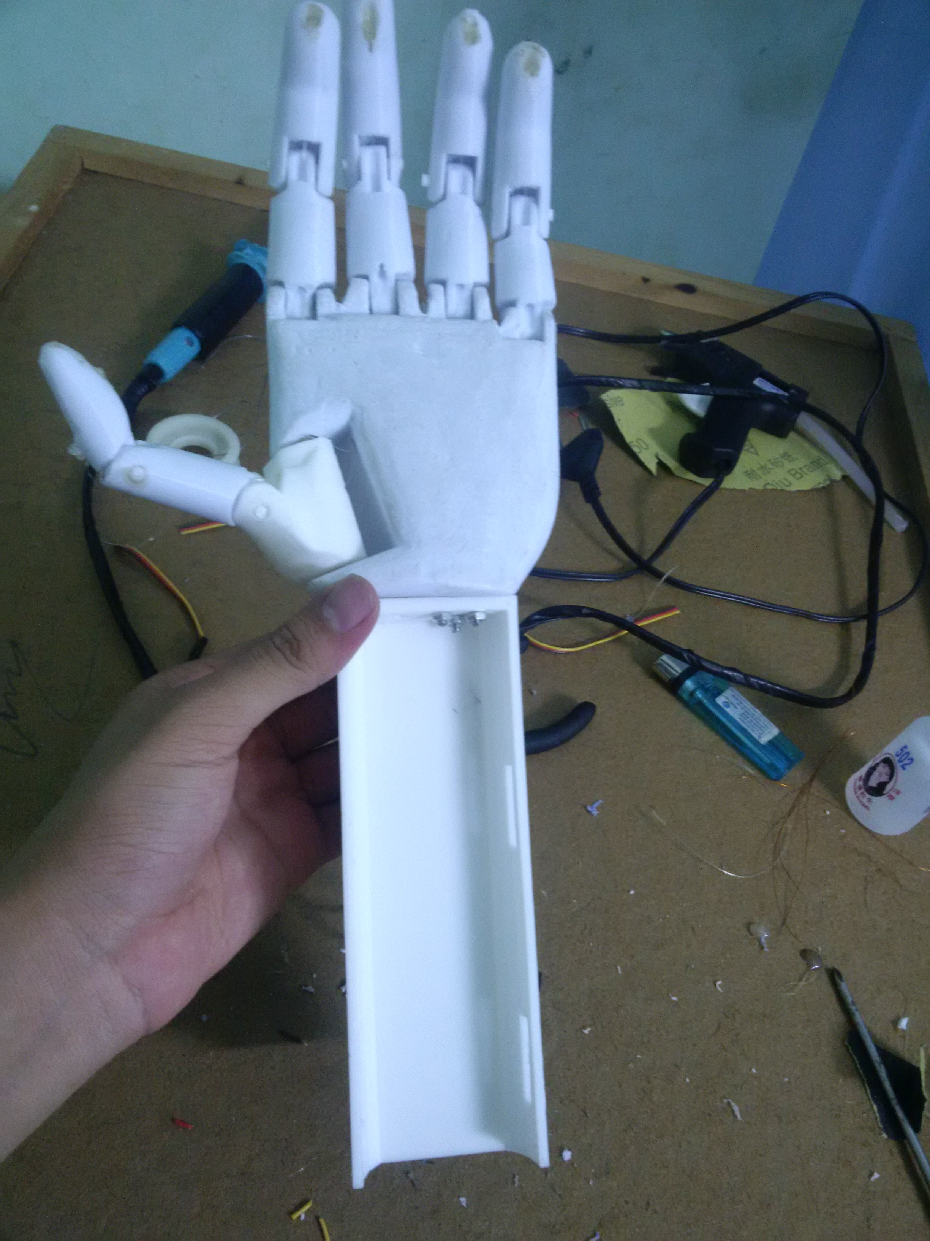
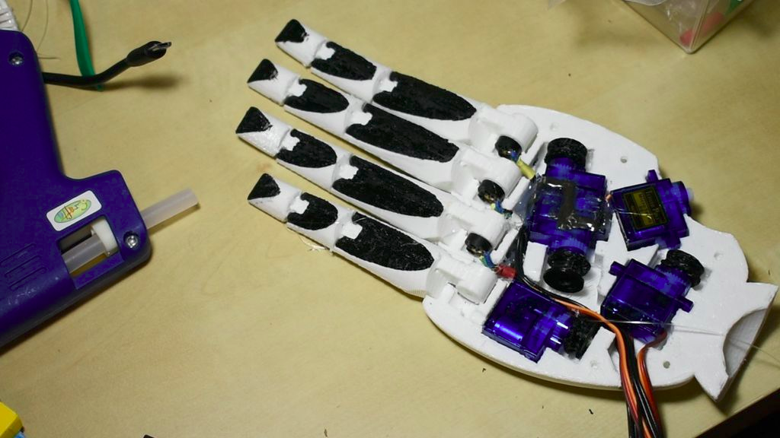
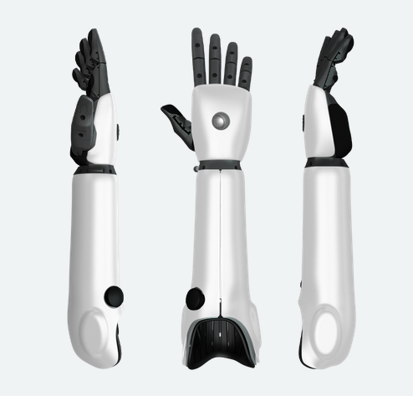
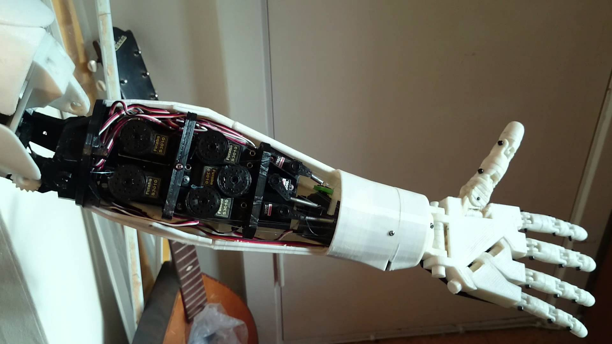
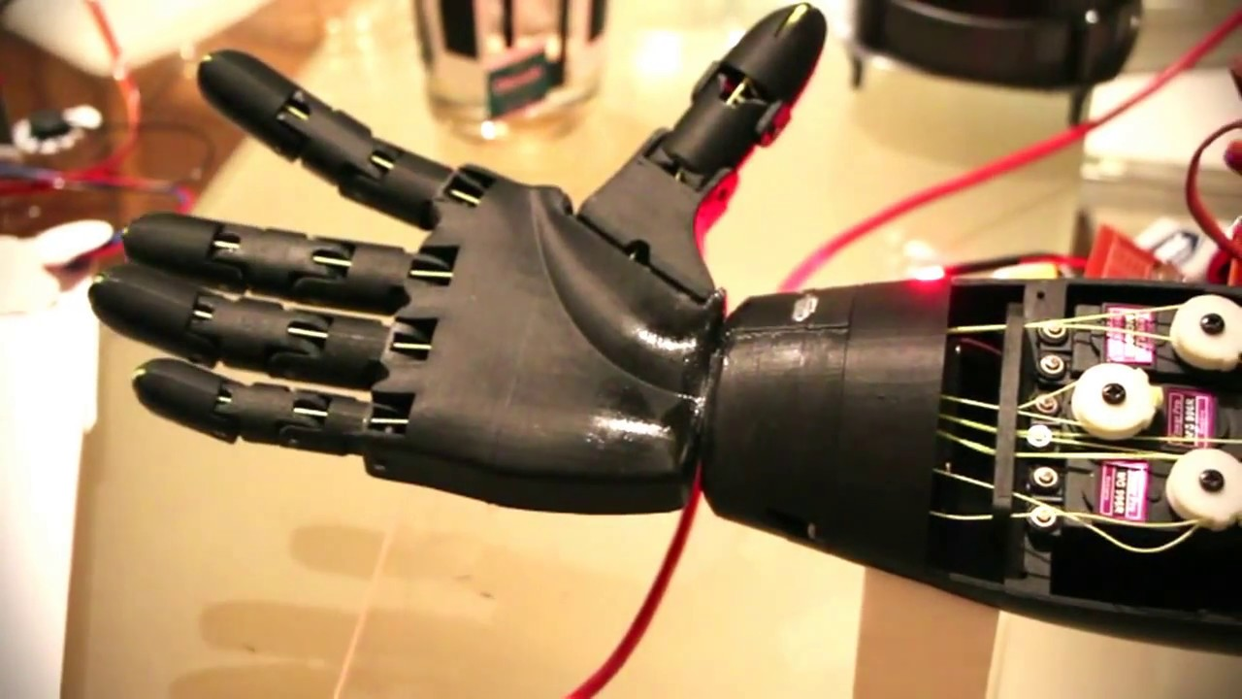
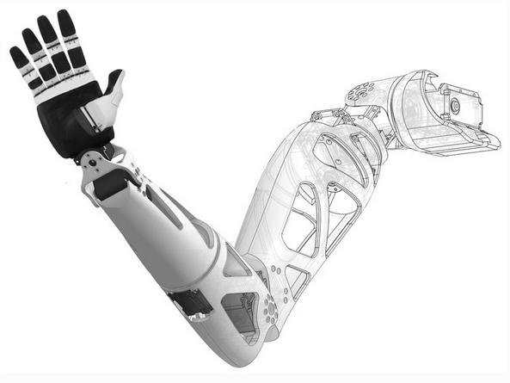
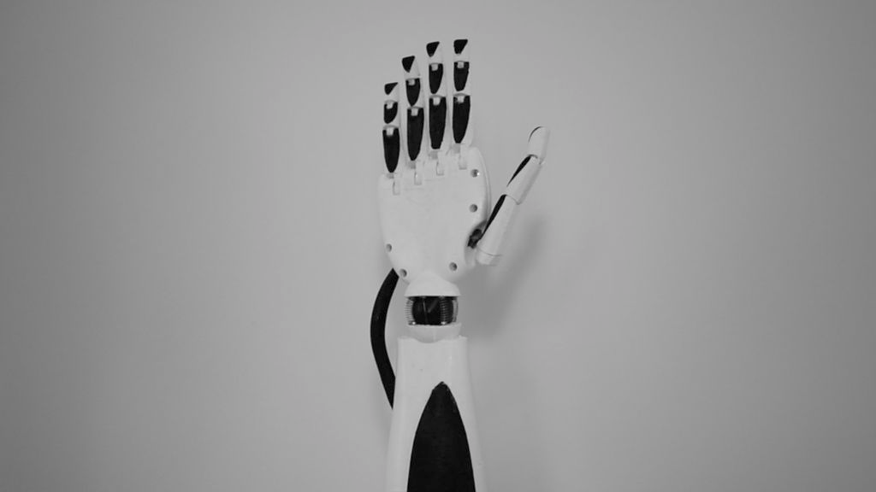
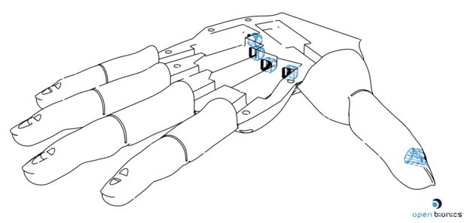

Finding solution
Not under 25 million VND
Are opensources really good?
Not under 25 million VND
This is exacly my wish

Slide 10
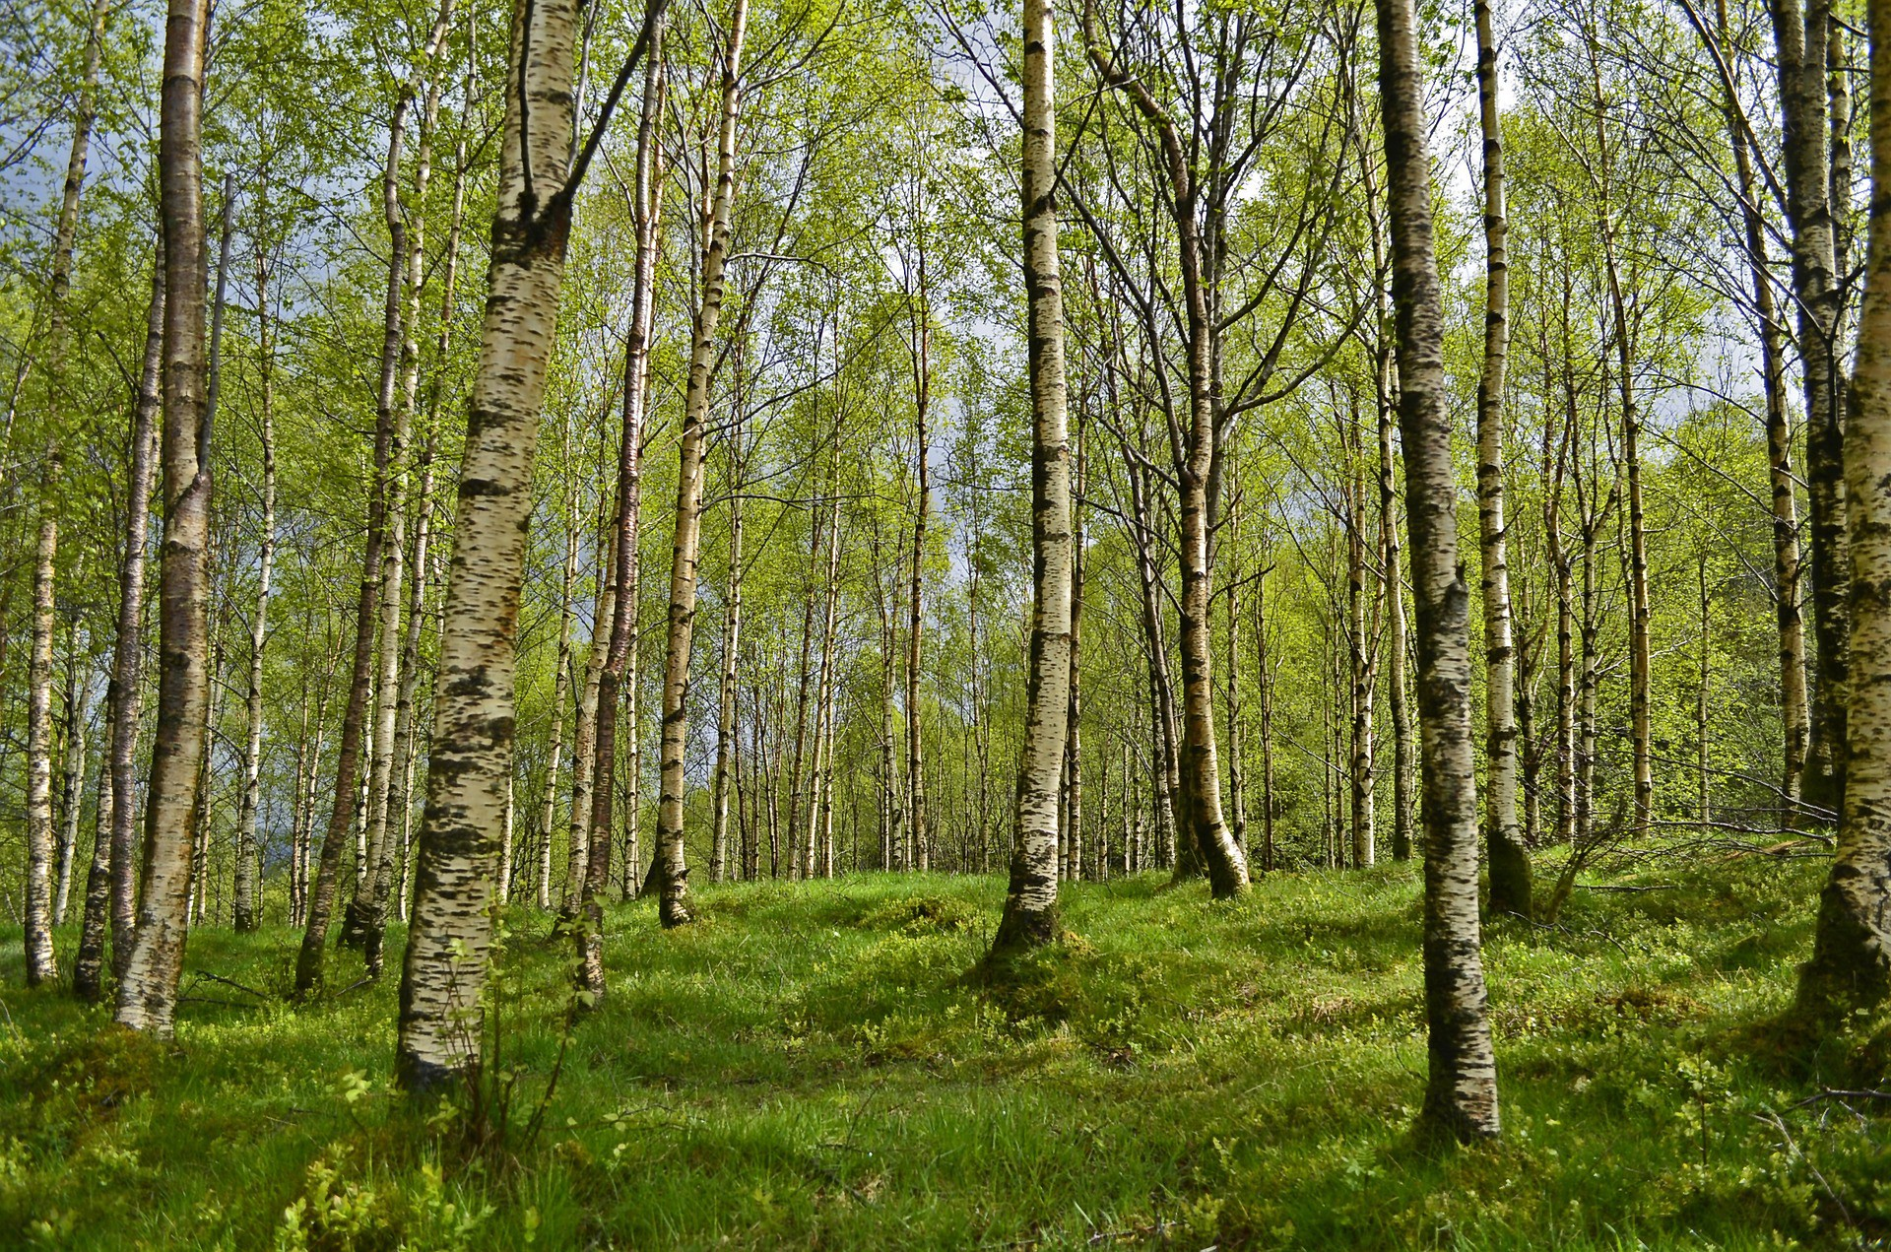
Choosing ML-algorithm
Myoband streams data with 50hz frequency.
Random Forest Classifier
50Hz ===> 20ms bewteen 2 times
Satisfied
Unsatisfied
0s < Predicting time < 20ms
Disconnect from Myoband
Short training and predicting time && High accuracy

Slide 11
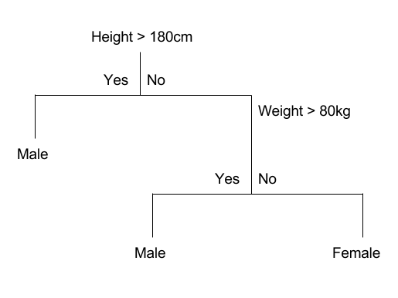
Building a tree using CART
CART: Classification and Regression Trees
Root Node
Internal Node
Branch
Leaf Node

Slide 12
Building a tree using CART
Greedy Splitting
This is a numerical procedure where all the values are lined up and different split points are tried and tested using a cost function. The split with the best cost (lowest cost because we minimize cost) is selected.
Gini Index
how “pure” the leaf nodes are

Slide 13
Building a tree using CART
1, 1, 1, 1, 2, 2, 3, 3, 3
G = 1 – ((4/9)^2 + (2/9)^2 + (3/9)^2) = 0.642

Slide 14
Building a tree using CART
1, 1, 1, 1, 2, 2, 3, 3, 3
1, 1, 1, 1, 2, 2, 3, 3, 3
1, 1, 1, 2, 2
1, 3, 3, 3
1, 1, 1, 2, 3, 3
1, 2, 3
G1 = 0.48
G2 = 0.375
G1 = 0.611
G2 = 0.667
Gsp = (5/9) * G1 + (4/9) * G2 = 0.43
Gsp = (6/9) * G1 + (3/9) * G2 = 0.642

Slide 15
Building a tree using CART
When to stop ???
All final leaf-nodes are “pure”
Leaf-node size < min sample split
Min sample split > 2
===>>> Most common label is chosen for a leaf
Ex: min sample split = 5
a leaf: [1, 5, 1, 3] => leaf:1

Slide 16
Random Forest
Create many random sub-samples of our dataset with replacement.
Train a tree with a sub-sample
The prediction: the most common class from all trees
The learning algorithm is limited to a random sample of features of which to search at split-point
The number of feature for classification: sqrt(all_features)

Slide 17
Random Forest
Y = 1
Y = 1
Y = 2
...
...
...
Y = 2
Y = 1
X: [x1, x2, x3, x4, x5, x6, x7, x8]
Random Forest
X: [x1, x2, x3, x4, x5, x6, x7, x8]
36
X: [x1, x2, x3, x4, x5, x6, x7, x8]
...
...
...
X: [x1, x2, x3, x4, x5, x6, x7, x8]
X: [x1, x2, x3, x4, x5, x6, x7, x8]
Grip: 1

Slide 18

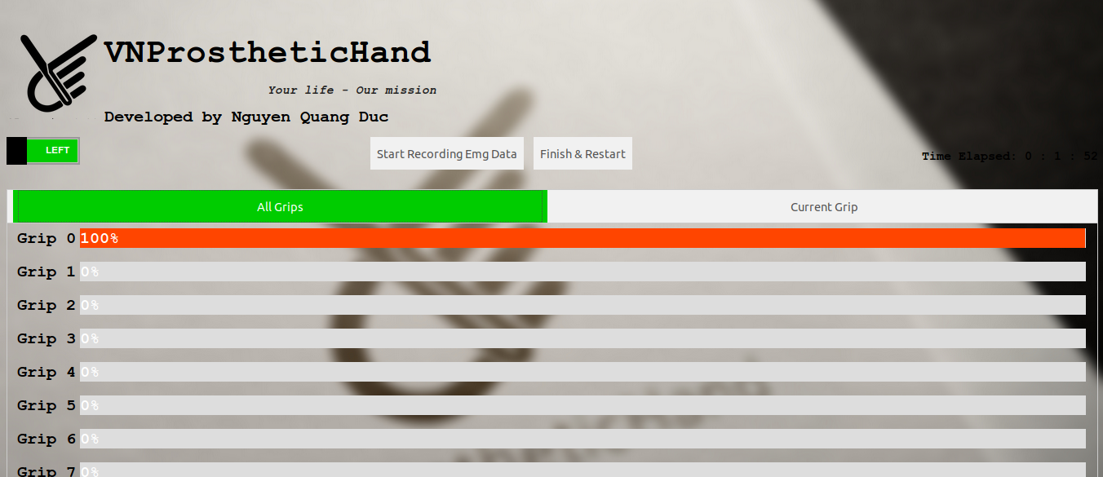
Web-based UI
Socket IO

Slide 19
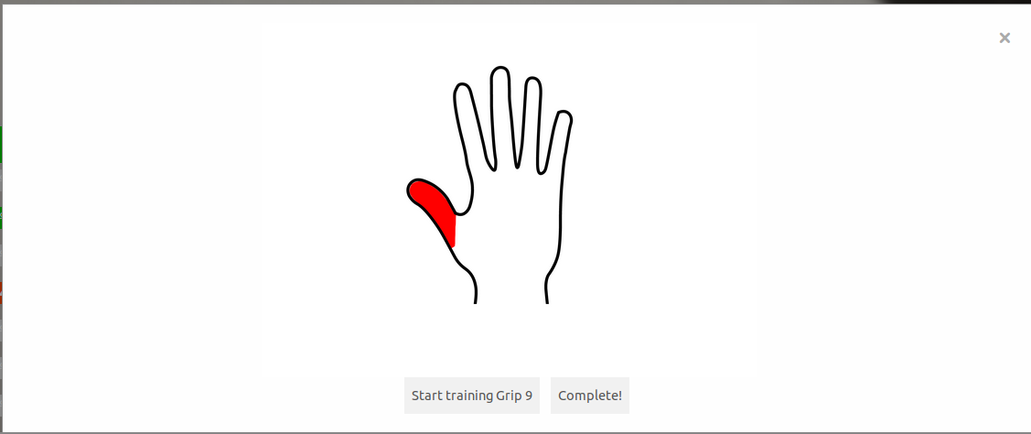
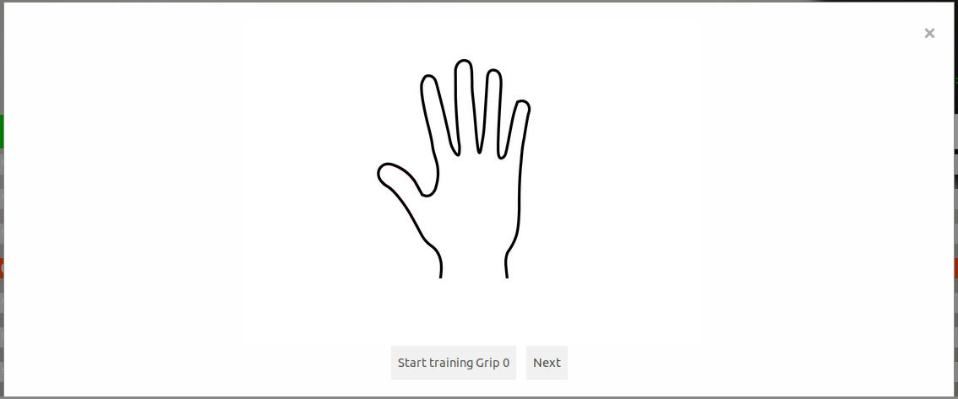
Web-based UI
Training Windows

Slide 20
Real Test On Handicap

Slide 21
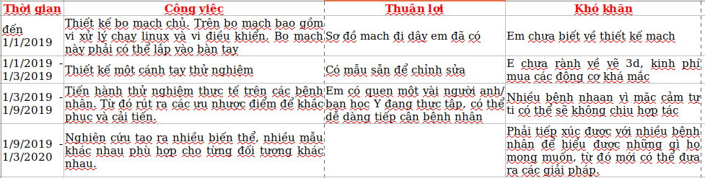
Next Planing

Slide 22


