Slide 1




Introduction to Scientific Programming with Python/NumPy/SciPy
Prof Guy-Bart Stan
g.stan@imperial.ac.uk
www.bg.ic.ac.uk/research/g.stan

Slide 2
Content
Part A Part B
Overview of Python
Getting started
Documentation and help
Variables
Matrix operations
Built-in functions
Controlling work flow
Basic input/output
Scripts and functions
Reading and writing data
Fitting a model to data
Solving differential equations
Plotting in 2d and 3d
Notes:
Note: this lecture is followed by two practicals (divided
up over 2 two-hour sessions). Two problems sets will
be provided.

Slide 3
1. Overview of Python
Intuitive, easy-to-learn, high performance language with good libraries for:
computation, visualization, and programming.
Math and computation
Algorithm development
Data acquisition
Modeling, simulations, and prototyping
Data analysis, exploration, and visualization
Scientific and engineering graphics
Application development, incl. graphical user interfaces
Python is a high level multi-paradigm programming language.
Python has many built-in functions as well as specialised add-on libraries.
Features allow fast implementation of programs to solve computational
problems.

Slide 4
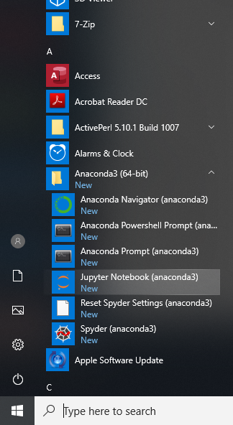
2. Getting started
We will use Python3 inside a Jupyter notebook.
We are using the “Anaconda” Python distribution which includes Jupyter and many useful libraries.
Later you may want to use python by itself.
On Anaconda in Windows you can use the “Spyder” integrated environment.
Go to the Start Menu -> Anaconda -> Jupyter

Slide 5
Different ways to use Python:
(1) Interactive mode: just type commands and define variables. Not recommended for any but the simplest commands.
(2) Jupyter notebook:
Type commands and run them in a web interface.
(3) Standalone:
Edit files and run them
Use “Spyder” in Windows
python3 myscript.py in linux

Slide 6
3. Documentation and help
Python has large amounts of documentation and tutorials:
https://docs.python.org/3/
https://numpy.org/doc/1.17/
https://www.scipy.org/docs.html

Slide 7
4. Matrices can be defined as variables
You can define matrices as numpy arrays:
import numpy as np
a=np.array([1,2,3])
Matrix assignment:
C= A + B assigns matrix C as the sum of matrices A and B
If A and B are matrices of same dimension, e.g. [3x4] with 3 rows and
4 columns, C is [3x4] matrix with element-wise addition.
Example with [2x2] matrices:
A= B= C=
a=np.array([[2,4],[3,7]])
b=np.array([[5,1],[6,2]])
c=a+b
If C existed before e.g. C=[1] (i.e. a [1x1] matrix), then C is
overwritten by this new assignment.
If dimensions of A and B don’t match, you will get an error:
ValueError: operands could not be broadcast together with shapes (3,) (4,)
Matrix dimensions must agree
4
7
1
2
5
9 9

Slide 8
Showing values:
To see content of a variable, just type its name in an interactive shell, or print()it.
c=a+b
print(c)
[[7 5]
[9 9]]
Initializing matrices:
Provide initial values, e.g.
a=3 (integer)
b=np.array([1,2,3]) ([1x3] row vector)
c=np.array([[4],[5],[6]]) or
c=np.array([4,5,6]).transpose() ([3x1] column vector)
d=np.array([[1,2,3],[4,5,6]])) ([2x3] matrix)
print(d) d gives
[[1 2 3]
[4 5 6]]
Values separated by commas in a list are put in the same row, e.g., b=[1,2,3]
Columns are made from lists of rows e.g., c=[ [4,2],[5,1],[6,7] ]

Slide 9
Making matrices from matrices:
a=np.array([[1,2,3]])
b=np.array([[4,5,6]]) c=np.concatenate((a,b),axis=1)
while
a=np.array([[1,2,3]])
b=np.array([[4,5,6]]) c=np.concatenate((a,b),axis=0)
c =
array([1,2,3,4,5,6])
c = array([[1,2,3],
[4,5,6]])
In Python arrays are indexed from 0
So x[0] is the first element you encounter. (MATLAB indexes from 1)
Using portions of matrices (SLICING):
d[0,1] returns 2
d[1,0] returns 4
d=np.array([[1,2,3],[4,5,6]])
Colons take a whole row or column
d =
1 2 3
4 5 6
d[0,:] returns
d[:,1] returns
1 2 3
2
5

Slide 10
Using more portions of matrices:
d = np.array([[1,2,3],[4,5,6]])
Variables may also be used as indices of matrices
d[1[1,2]] returns array([5,6])
d[1[2,1]] returns array([6,5])
if
z = [1,2]
then you will see that
d[1,z]
Returns
array([5,6])
You can use “:” to specify a range, e.g. 0:2 allows to access the 1st and 2nd columns
Use can use also range to produce a list of consecutive integers
Here range() makes an iterator and list() forces it to be evaluated.
d[0,range(0,2)] OR d[0,0:2] returns array([1, 2])
x = list(range(3,6)) produces list x = [3,4,5]

Slide 11
5. Matrix operations
Matrix transposition is obtained using the np.transpose() function
if x=np.array([[1,2,3]]) (Note two pairs of [[ ]]
then
x.transpose() = (column vector)
array([[1],
[2],
[3]]) (Or np.transpose(x))
Matrix addition is obtained with the + sign
Matrix subtraction is obtained with the - sign
If A is a [3x4] matrix and B is a [4x3] matrix, then
c = a + b produces
ValueError: operands could not be broadcast together with shapes (3,4) (4,3)
while c = a + b.tranpose() works fine

Slide 12
Matrix multiplication is obtained by np.matmul(a,b)
c=np.matmul(a,b)
c= a @ b # in newer versions of Python
Note that inner dimensions of the two operands must be the same,
e.g. A=[3x4] and B=[4x2] works.
Element by element (elementwise) operations are given by
c=np.multiply(a,b) (multiplication)
c=np.divide(a,b) (division)
c=np.add(a,b) (addition)
c=np.subtract(a,b) (subtraction)
c=np.power(a,2) (exponentiation)
but for the first two, matrix dimensions have to agree !
Exceptions: For addition and subtraction, as well as element-by-element
multiplication and division, matrix dimensions can be different if one of the
operand is a scalar. In this case, the scalar is applied to each element in the matrix.

Slide 13
6. Built-in Numpy functions
value=sum(arg_1,arg_2)
Examples: sum, max functions
if x=np.array([1,2,3])
then
y = sum(x) + 10
produces
y = 16
if
x=np.array([1,4,3])
then
z = 10 + np.max(x)
produces
z = 14
if x=np.array([[1,2,3],[4,5,6]])
then
x.sum(axis=0)
produces
array([5, 7, 9])
and
x.sum(axis=1)
produces
array([6,15])

Slide 14
Example: sorting function sort
if x=np.array([[1,5],[3,2],[2,8]])
then
y = np.sort( x )
produces
y =
1 2
2 5
3 8
i.e., each column is sorted separately
To obtain a record of the rows from which the sorted elements came:
[y r] = sort( x )
produces y as before and
r =
1 2
3 1
2 3
Other numpy functions are: np.mean, np.cov, np.min, np.max, np.ones, np.zeros, np. size, ….
Please do refer to the user guide of numpy for understanding how to use these built-in functions
https://numpy.org/devdocs/

Slide 15
Relational and logical operations:
Python knows six relational operations
< less than
<= less than or equal to
> greater than
>= greater than or equal to
== equal
!= not equal
and the following logical operators
and
or
not
Note:
A=B assigns to A the values of B
(A==B) tests whether A and B are equal
Confusing these is a CLASSIC source of bugs.

Slide 16
Whenever Python encounters a relational operator, it produces a boolean True if the expression is true and a Boolean False if the expression is false:
x =(1<3)produces True, while
x =(1>3)produces False
Relational operators can also be applied to matrices as long as they have the
same dimension (as relational operators then work on an element-by-element basis):
if A =
1 2
3 4
and B =
3 1
2 2
then
C = (A > B)
produces
C =
False True
True True
if A =
1 2
3 4
then
C = (A > 2)
produces
C =
False False
True True
scalar
See also np.greater(), and related functions:
np.greater(x1, x2) | Return the truth value of (x1 > x2) element-wise.

Slide 17
7. Controlling work flow
To change to a non-sequential order, use for and while loops, as well as if statements
for loops:
for j in range(1,last+1):
…..
while loops:
while (x > 0.5):
if (something):
break
True and False are of Boolean type in Python
“Truthy” values tend to be positive, “Falsey” values are to ”None” or zero.
Note: Python requires correct indentation!
Note: avoid infinite loops by including termination condition

Slide 18
if statement:
if (x > 0.5): if (x > 0.5):
# if true # if conditions is true
….. elif (x > 0.4):
# if another condition true
else:
# if nothing else is true
Nesting:
for j in range(1,n+1):
for k in range(1,n+1):
if (x[j,k] > 0.5):
x[j,k] = 1.5
Nesting should be avoided for matrix operations, since it is very slow.
For example: if holdings and prices are vectors (1D arrays) then
instead of use port_val = holdings @ prices
port_val = 0;
for j in range(0,n):
port_val = port_val + ( holdings(j) * prices(j) )
Python is strict about indentations – inner blocks must be inside outer blocks, and levels must match. Your text editor should take care of this…
This is called VECTORIZATION – essential for large calculations
The operator @ performs the dot product between the vectors holdings and prices

Slide 19
8. Basic input/output
Basic data input:
Type instructions in interactive mode or in script mode.
Examples: radius = [ 12.50 , 37.875, 12.25 ]
molecules = [ ‘sugars’, ‘amino acids’, ‘proteins’ ]
data = [ 100, 200, 300, 400 ]
Read text (CSV) file and put in array:
from numpy import genfromtxt
my_data = genfromtxt('my_file.csv', delimiter=',')
Basic data output:
Display data: print (‘test’)
np.save(“data.npy”, x) save binary .npy format file of np array x.

Slide 20
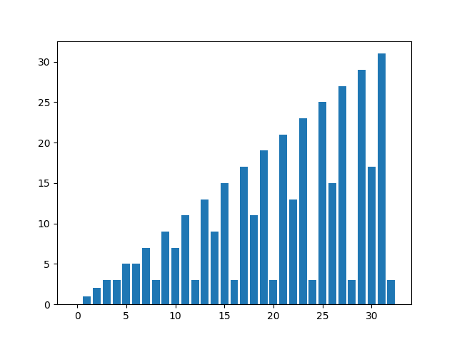
9. Scripts and functions
Example script:
A file called magicrank.py may contain the following code (and the magic() function)
def square_ranks():
""" investigate the rank of magic squares"""
r = np.arange(33)
for n in range(3,33):
r[n] = np.linalg.matrix_rank( magic(n) )
plot.bar(np.arange(33),r)
plot.show()
In an interactive shell you can import the content of magicrank.py with
import magicrank
magic.square_ranks()
executes the function square_ranks(), and computes rank of first 30 magic squares and plots bar chart of results
OR read in and run the file – not recommended.
from pathlib import Path exec(Path(“magicrank.py").read_text()) )
NOT PYTHONIC

Slide 21
Example function:
Functions have the advantage that they can be re-used in different programs.
A function starts with a line declaring the function, its arguments and its outputs.
Examples:
def port_val(holdings, prices):
return np.dot(holdings,prices)
This function can be called by
v = port_val( h, p )
can be saved in e.g. port_val.py
returns
one value
local variables
variables can be named differently
in calling statement
def port_val(holdings, prices):
total_val = np.dot(holdings,prices)
avg_val = total_val/len(holdings)
return (total_val,avg_val)
This function can be called by
(tval,aval)= port_val( h, p )
returns
two values
(actually a tuple)

Slide 22
Skipped (read by yourself)
Anonymous functions:
Named functions are made with “def funcname():”
You can also make anonymous functions with lambda – lambda returns a function, which you can call with ().
square = lambda x: x**2 # square(5) = 25
list(map(lambda x: x.upper(), ['cat','dog','cow']))
returns
['CAT', 'DOG', 'COW']
list(filter(lambda x: 'o' in x, ['cat','dog', 'cow']))
returns
['dog', 'cow']
Functions are “first class” objects in Python, which means they can be passed around as arguments to other functions. You can make functions of functions
e.g.
myfunction = sin
plot(myfunction,range)

Slide 23
Skipped (read by yourself)
Function of functions:
Functions, which operate on functions. This can be useful for:
Zero finding
Optimization
Quadrature (integration)
Ordinary differential equations
…
You can use this kind of thing if you pass a derivative function into an ODE solver
def vdp(t,y):
"""calculate Van Der Pol Derivatives"""
# y is a tuple (y0,y1)
y0dot = y[1]
y1dot = (1-y[0]**2)*y[1]-y[0]
dydt = ( y0dot, y1dot )
return dydt
We define a vdp function, which we then pass into the solver.
solution = scipy.integrate.solve_ivp(vdp,\n t_span=(0,20),y0=(0,2), method='RK45')

Slide 24
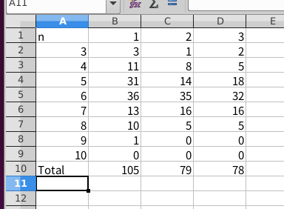
10. Reading and writing data
Many ways to read in files
You can use pandas to look at Excel sheets
import pandas as pd
csheet = pd.read_excel('Epithelia_polygon_data.xls', sheet_name='Control')
C1=csheet[0:7]['n'] # vector of polygon classes

Slide 25
Skipped (read by yourself)
11. Fitting a model to data (code avail. on BB)
In this example, we fit an exponential function of the form Ae^{–λt} to some data.
import matplotlib.pyplot as plt
import numpy as np
from scipy.optimize import minimize
def predict(xdata,params):
A, l = params[0],params[1]
ypredict = np.multiply(A, np.exp(-l*xdata))
return ypredict
def exploss(params,xdata,ydata):
"""squared difference between measured and
predicted values, for an array of data, and parameters params)"""
diff = np.sum( (predict(xdata,params) - ydata)**2)
return diff
def fitcurvedemo(xdata,ydata):
# random starting point
start_params = np.random.uniform(0,1,size=2)
model=predict
res = minimize(exploss, start_params,
method='Nelder-Mead',args=(xdata,ydata))
res.x # solution array
return (res.x, model)

Slide 26
Skipped (read by yourself)
additive noise in the data:
normal distributed random
numbers between 0 and 1
To use, create some random data first:
xdata = np.arange(0,10.1,0.1)
ydata = 40*np.exp(-0.5*xdata)+
np.random.uniform(0,1,size=len(xdata))
and then call fitting function:
[estimates,model] = fitcurvedemo(xdata,ydata)
print(estimates)
This returns the optimal parameters:
40.1334 0.5025 (similar to 40 and 0.5 as set)
and a function handle model to the model function.

Slide 27
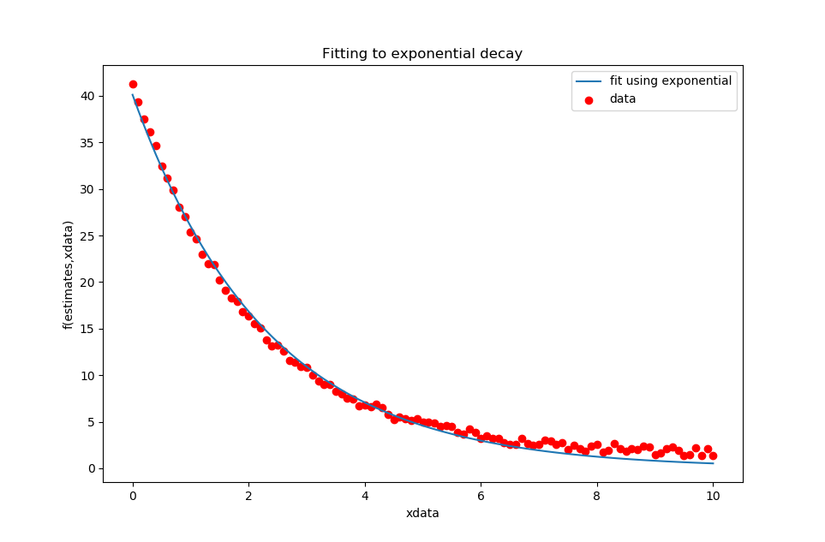
Skipped (read by yourself)
To plot data and fitted model, enter the following commands:
fig = plt.figure()
ax = fig.add_subplot(1, 1, 1)
ax.scatter(xdata,ydata,c='red',label='data')
ax.plot(xdata, model(xdata,estimates),label='fit using exponential') # plot predictions from parameters
ax.set_title('Fitting to exponential decay')
ax.set_xlabel('xdata')
ax.set_ylabel('f(estimates,xdata)')
ax.legend()
plt.show()
This produces plot:

Slide 28

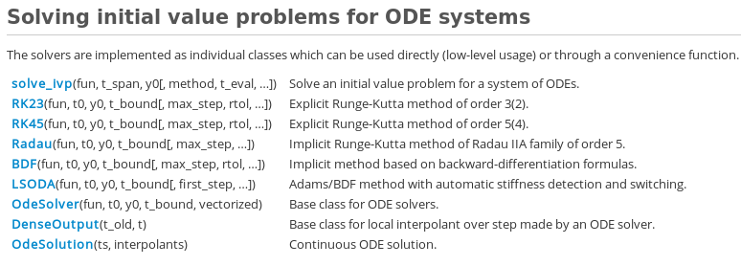
12. Solving ordinary differential equations
Numpy ODE solvers only accept first-order differential equation
Solvers provided include:
https://docs.scipy.org/doc/scipy/reference/integrate.html

Slide 29

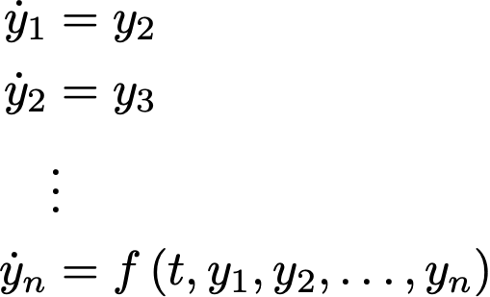
To solve n-th order ODE
write it as a set of n coupled first-order ODEs:
For that: make substitutions
and obtain

Slide 30
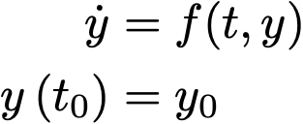
Initial value problem: since there are many potential solutions for an ODE,
you need to specify initial values:
Example: Solve two coupled ODEs with solver RK45 (equivalent to MATLAB ODE45)
def vdp(t,y):
y0dot = y[1]
y1dot = (1-y[0]**2)*y[1]-y[0]
dydt = ( y0dot, y1dot )
return dydt
solution = scipy.integrate.solve_ivp(vdp, t_span=(0,20),y0=(0,2), method='RK45')
time interval initial values

Slide 31
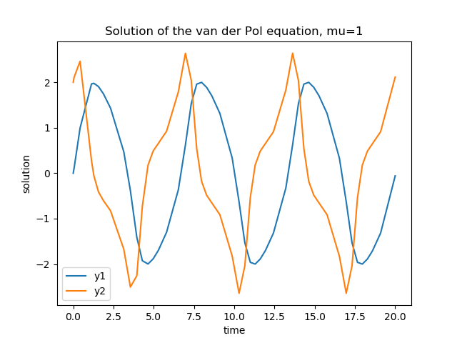
Plot result:
fig = plt.figure()
ax = fig.add_subplot(1, 1, 1)
ax.plot(t, y0, color='tab:blue',label='y1')
ax.plot(t, y1, color='tab:orange',label='y2')
ax.set_title('Solution of the van der Pol equation, mu=1')
ax.set_xlabel('time')
ax.set_ylabel('solution')
ax.legend()
plt.show()

Slide 32
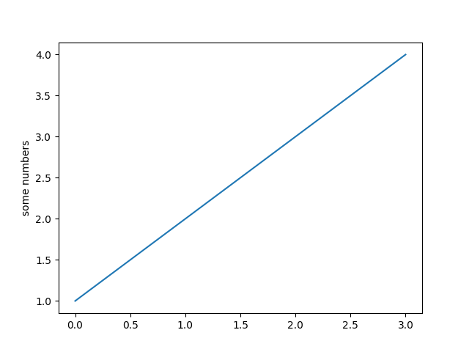
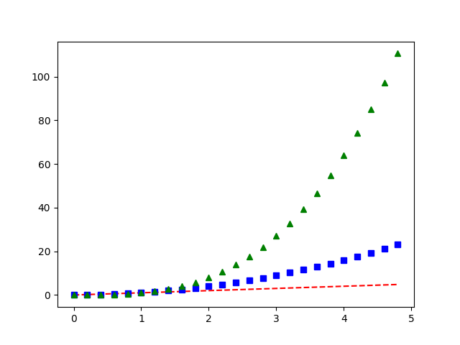
13. Plotting
https://matplotlib.org/users/index.html
To plot x versus y (2d plot), use command plt.plot(x,y,*options)
import matplotlib.pyplot as plt
plt.plot([1, 2, 3, 4])
plt.ylabel('some numbers')
plt.show()
import numpy as np
# evenly sampled time at 200ms intervals t = np.arange(0., 5., 0.2)
# red dashes, blue squares and green triangles
plt.plot(t, t, 'r--', t, t**2, 'bs', t, t**3, 'g^') plt.show()

Slide 33
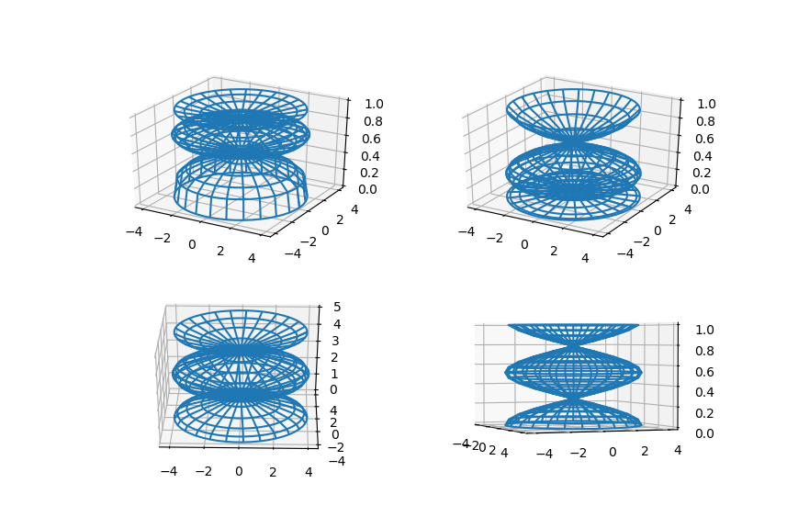
Multiple panels: To arrange plots in Example: four 3d plots
a matrix use
t=np.arange(0,2*np.pi,np.pi/10)
X,Y,Z = cylinder(4*np.cos(t),50)
# set up a square figure
fig = plt.figure(figsize=plt.figaspect(1.0))
ax = fig.add_subplot(2, 2, 1, projection='3d')
ax.plot_wireframe(X, Y, np.sqrt(Z))
ax = fig.add_subplot(2, 2, 2, projection='3d')
ax.plot_wireframe(X, Y, np.square(Z))
ax = fig.add_subplot(2, 2, 3, projection='3d')
ax.plot_wireframe(X, Y, Z*5)
ax = fig.add_subplot(2, 2, 4, projection='3d')
ax.plot_wireframe(X, Y, Z)
plt.show()
A beautiful gallery of plots
https://matplotlib.org/gallery/index.html

Slide 34
To download the files log on Blackboard:
https://bb.imperial.ac.uk
The files are also on:
http://www.bg.ic.ac.uk/research/g.stan/#Lecture_Notes

