Slide 1
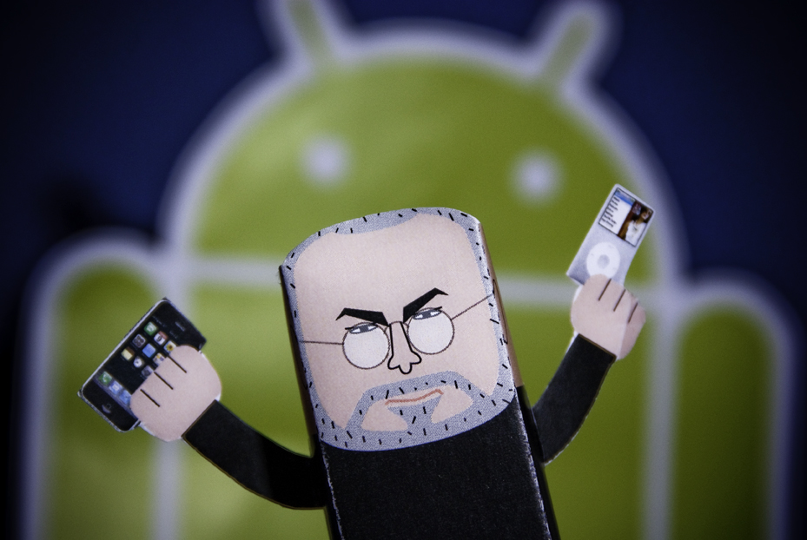
Introduction to Android
Martin Smith (martin@mbs3.org)
Image credit: http://www.flickr.com/photos/jesusbelzunce/4366759251

Slide 2
History
2005 – Google acquired Android Inc.
2007 – Open Handset Alliance formed
Android is the first OHA product
Released 2009 – ver. 1.1, 1.5, 1.6, 2.0, 2.1
Released 2010 – ver. 2.2 (May), 2.3 (Q4?)
Cupcake, Donut, Éclair, Froyo, Gingerbread…
2010 Q2 – Android ranked first among all smartphone OS handsets sold in US (33%)

Slide 3
Android Platform
Android is a ‘component’ framework
API Levels are from 1 (v 1.0) to 8 (v 2.2), generally applications are forward-compatible
Software and hardware** features:
WebKit browser with V8, SQLite, media support (MPEG4, H.264,MP3, AAC, AMR,JPG, PNG,GIF)
Networking, GFX HW Acceleration, Camera, GPS, Compass, Touch screen, Keyboard, Accelerometer
** - hardware dependent

Slide 4
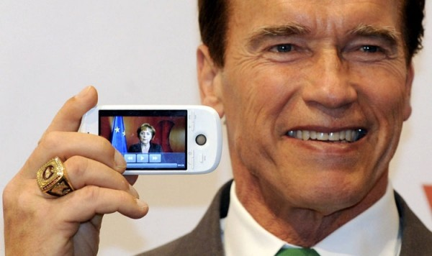
Android Platform²
Image credit: http://www.flickr.com/photos/fuxoft/3328859686/

Slide 5
Android Platform (3)
Programming abstractions:
Manifest file (metadata)
Services / Content Providers
Activities (a single screen, UI thread)
Views (UI elements)
Intents (simple message passing)
System Services: notifications, location, resources, and much, much more
Process model (not application controlled):
Foreground, Visible, Service, Background, Empty

Slide 6
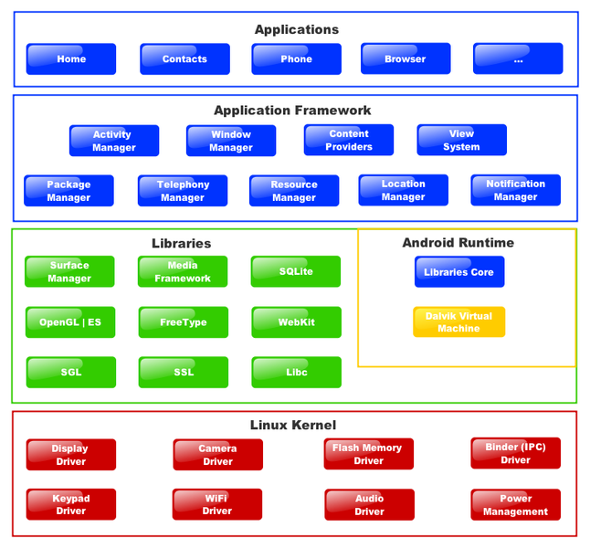




Image of platform
Notes:
Dan Bornstein is responsible for Dalvik (not the fishing village in iceland).

Slide 7
Dalvik Virtual Machine
Open source, Apache 2 license
Built on a subset of Apache Harmony
Executes on a modified 2.6.x Linux Kernel
Java bytecode is compiled to Dalvik bytecode, placed in an .apk file that is distributed
Register-based VM, extremely optimized for mobile applications and concurrent VMs
Security through permission, VM isolation
Notes:
Neat fact: Strings and constants are de-duped and appear once in dex for multiple classes
The Dalvik executables may be modified again when they get installed onto a mobile device. In order to gain further optimizations, byte order may be swapped in certain data, simple data structures and function libraries may be linked inline, and empty class objects may be short-circuited, for example.

Slide 8
Example: Hello World (Java)
package com.example.helloandroid; import android.app.Activity; import android.os.Bundle;
import android.widget.TextView; public class HelloAndroid extends Activity { /** Called when the activity is first created. */ @Override public void onCreate(Bundle savedInstanceState) { super.onCreate(savedInstanceState); TextView tv = new TextView(this); tv.setText("Hello, Android"); setContentView(tv); } }

Slide 9
More examples…

Slide 10
Alternative JVM Languages
Definitely Yes:
Webkit, Scala, C/C++, AppInventor
Rumored: AIR, C# (Mono), many translators
In Progress (60% or more):
Clojure, LUA, Rhino, Ruby, Scheme
Scripting Layer for Android (SL4A):
Beanshell, JRuby, LUA, Perl, Python, Rhino
Probably not:
Anything with dynamically generated Java bytecode
Anything that requires compilation from C on non-ARM platforms
Notes:
- Titanium mobile promises ‘web’ technologies that it can translate into iPhone and Android applications

Slide 11
Alternative: Scala
package com.example.helloandroid
import android.{app.Activity, os.Bundle, widget.TextView}
class HelloAndroid extends Activity {
override def onCreate(savedInstanceState:Bundle) : Unit = {
super.onCreate(savedInstanceState)
val tv = new TextView(this)
tv.setText("Hello Android, I'm Scala!")
setContentView(tv) }
}

Slide 12
Alternative: Python
import android
droid = android.Android()
code = droid.scanBarcode()
isbn = int(code['result']['SCAN_RESULT'])
url = “http://books.google.com?q=%d” % isbn
droid.startActivity(‘android.intent.action.VIEW’, url)

Slide 13
Development Tools
ADK (Java) and NDK (ARM, future x86)
Eclipse plugin and Ant toolchain
Other GUIs/IDEs: Motorola, IntelliJ IDEA
Android Emulator and AVDs
Debug Bridge (adb) and Monitor (ddms)
Traceview (methods) and aapt (packaging)
UI/Monkey, SQLite tools, dx, mksdcard, etc
Notes:
Emulator is QEMU based.

Slide 14
The Market
$25 fee to register, approx. 30 countries
Shows statistics, error reports, allows upload
Sales via Google Checkout merchant account
Revenue: 70% developers, 30% upkeep
57% apps are free, double Apple’s 28%
Alternative markets: Verizon, Best Buy, Amazon, and many, many others (or malware)
Automagical device capability filtering (!)

Slide 15
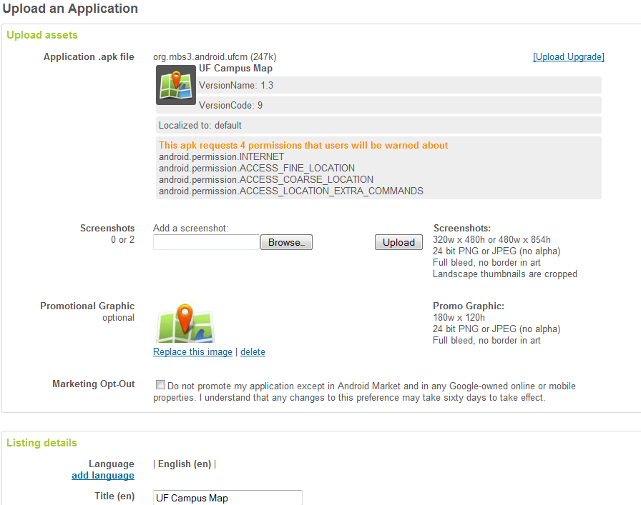
Market Screenshot (1)

Slide 16
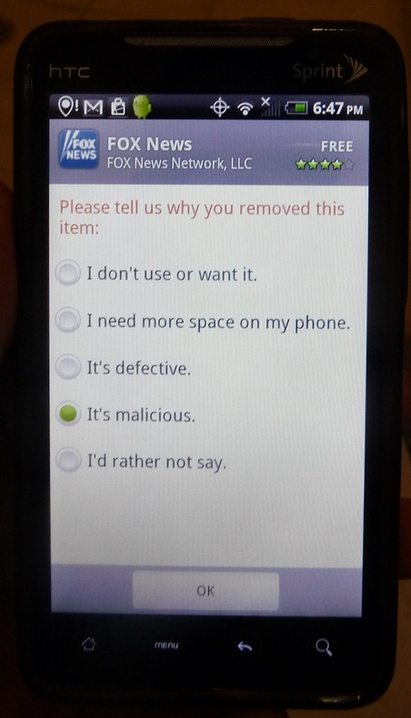
Market Screenshot (2)
Image credit: http://www.flickr.com/photos/solbronumberone/4895471094/

Slide 17
Advertising and Analytics
Only two advertising solutions in town:
AdMob, recently acquired by Google for $750M
Google AdSense for Mobile (beta-ish)
You get a UI control that displays ads, along with some choice about location-awareness and keywords
…
Profit!

Slide 18
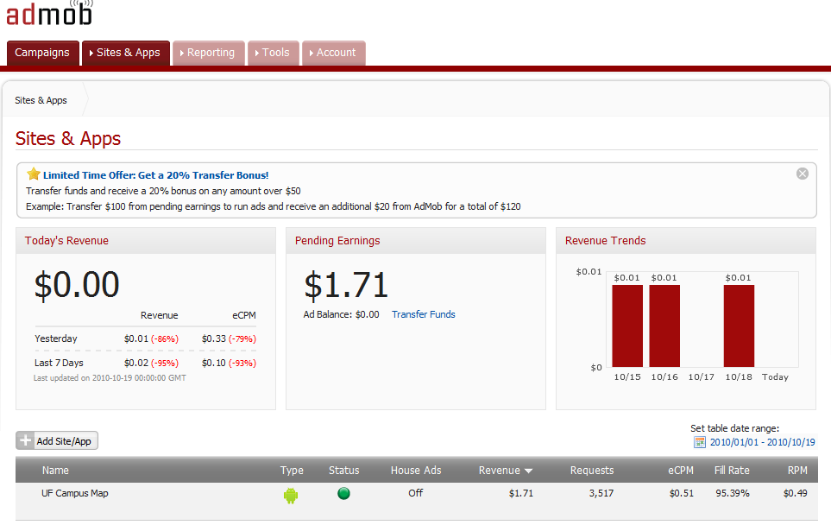
AdMob Screenshot

Slide 19
Oracle (lions), rooting (tigers), privacy (bears), and more (oh my!)
August 2010 – Oracle sues Google over patent and copyright infringement over Java IP
G2 ‘temporary’ root, modders like Cyanogen

Slide 20
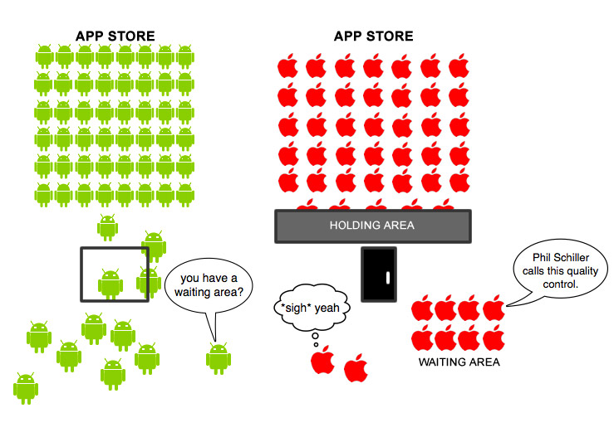
The End: Questions?
Image credit: http://www.flickr.com/photos/12905355@N05/4129780521/

