Slide 1
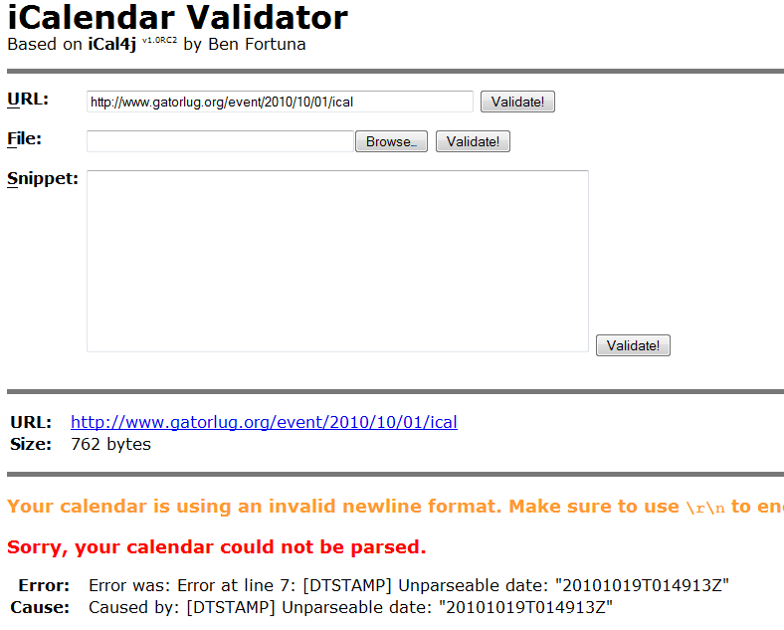
The Idea: Get people to GatorLUG

Slide 2
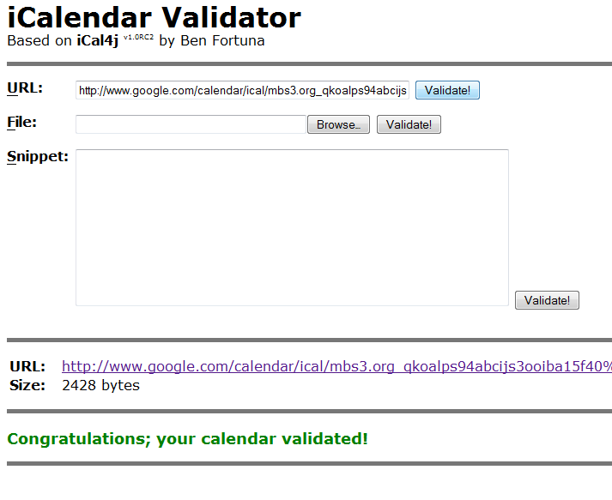
Oops, let’s try a Google calendar

Slide 3
Our software should…
Periodically wake up and check a calendar
If any events have been updated since the last visit, notify the user
Future modifications:
Only notify when events are soon
Use an intent to make a calendar item

Slide 4
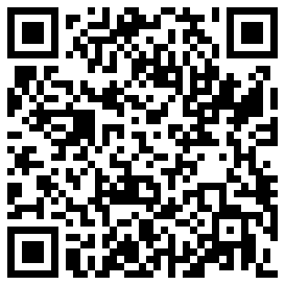
http://www.mbs3.org/android_gatorlug/trunk
market://search?q=pname:org.mbs3.android.gatorlug

Slide 5
Demo
Examine the source code
Modify GatorLUG calendar, verify notification
...

Slide 6
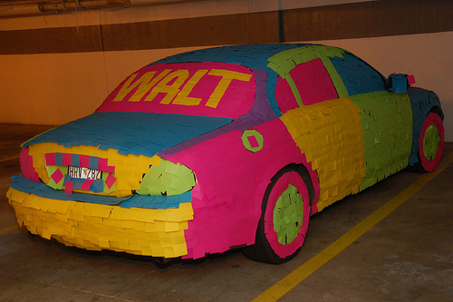
My recent experiment
Originally, it started as an offhand office joke
Image credit: http://www.flickr.com/photos/ableman/323256101/

Slide 7
UF Campus Map
Features include:
Clickable, searchable list of buildings
XML parsing, listview, drawing simple overlays, map clicking, tooltip bubbles, hyperlinks, search content providers, preferences panes, and more
Detailed map overlay from actual UF PPD GIS
Mercator projections, fast data representations, image caching, background downloading and threading, alternate coordinate systems, scrolling

Slide 8
Demo
Examine source code
Update, show upcoming work
…

