Slide 1

2004
Martin Bateman
@martinbateman
https://martinbateman.github.io/talks/rjam20-4-2020.pdf
Notes:
Cast your mind back to the Internet of 2004. This was pre youtube and broadband was just going mainstream.

Slide 2
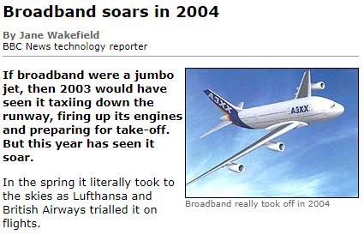
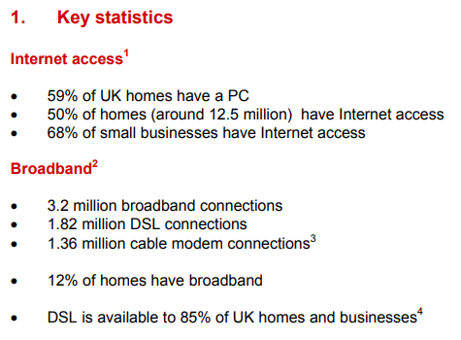
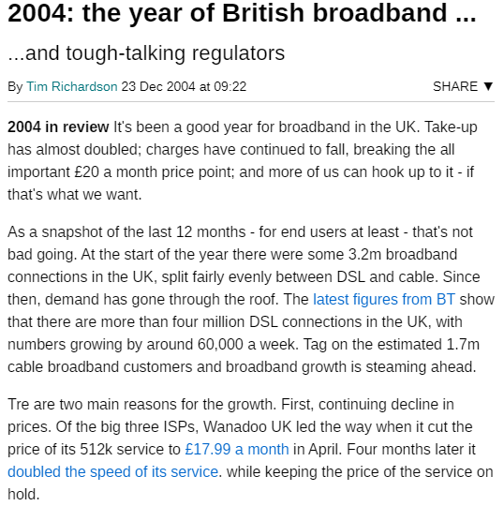
http://news.bbc.co.uk/1/hi/technology/4099457.stm
https://www.ofcom.org.uk/__data/assets/pdf_file/0010/40411/internetandbroadband.pdf
https://www.theregister.co.uk/2004/12/23/uk-broadband_review/
Notes:
In 2004 the Internet went main stream in the UK. There was an uptake in broadband in homes. It went from being expensive for a fast connection to cheap. In the late 90s I worked for a company with an ISDN connection to the Internet running at 128kbps that costs us 1000s. By 2004 a broadband connect at 4 times the bandwidth was £18 a month.
About 60% of homes had a PC and about 12% of homes have broadband with an average connect bandwidth of 512 kbps or ½ a Mbps. About 7.2 million people in the UK with broadband, and 30 million people have Internet access of some sort.

Slide 3
90s
57Kbps
2004
0.5Mbps
2020
29Mbps
Notes:
Just for a little context. Here are the various bandwidth in context. The width of the line shows represents the bandwidth. In the 90s and early 2000s we had 57Kbps. By 2004 we were up to 512Kbps and just for context I looked up the bandwidth for 2020 and got an average of 29Mbps, although that will be a lot more variable.

Slide 4
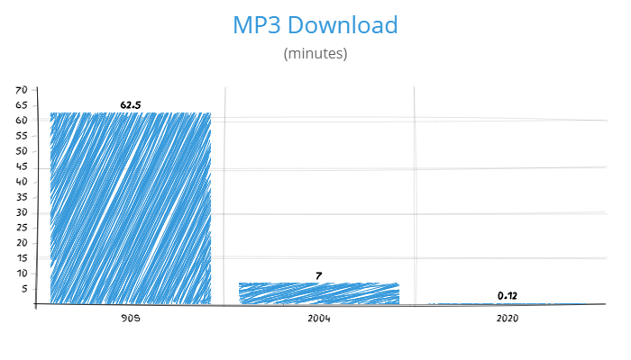
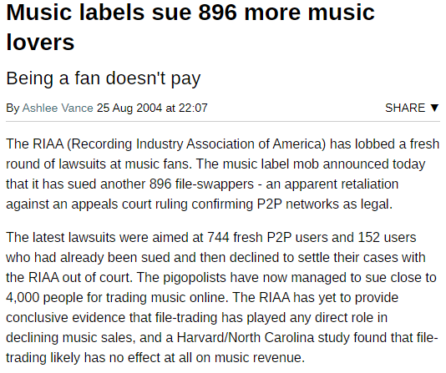
https://www.theregister.co.uk/2004/08/25/riaa_sues_896_more/
Notes:
People have always copied things they wanted but the Internet has made that a lot easier. In the 80s and early 90s to copy songs or software you had to know someone with a copy and use the sneakernet – actually walk to their house and make a copy. By the 90s we were able to copy software and music over the Internet but it was slow. A song would take nearly an hour to download, but by 2004 with the increases in broadband we are down to 7 minutes. You could decide you wanted to hear a song that you didn’t have and be listening to it within 10 minutes – a massive thing for 2004. In 2020 it is even faster, you can be listening to it within a minute, although there is no need to pirate it any more since there are services such as spotify to stream music to you instead.
But in 2004 the music industry was very worried about music piracy and was suing lots of people that were downloading and distributing music. This actually led to a lot of bad press for the music industry – they were definitely seen as the bad guys in this.

Slide 5
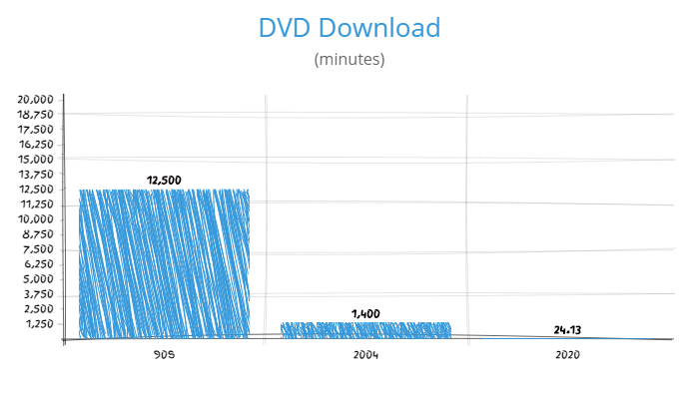
Notes:
With modems to download a movie would take 12500 minutes, 208 hours or 8.7 days since we paid for phone. Since we where paying per minute to be connected to the Internet it was cheaper to buy the DVD by 2004 that changed.
It now took 1400 minutes, about 23 hours. So just under a day. As long as you could find a copy of the movie you wanted online you could watch it in less than a day. There were online groups that were dedicated to getting high quality copies of movies online. People would take video camera into the cinema. Widespread Smart phones were still 3 years away, these were people with video cameras. You’d get copies from screeners – review copies of movies. Or ripped from DVDs. Groups were in competition to see who could get the best quality copy of a new release distributed the fastest.

Slide 6
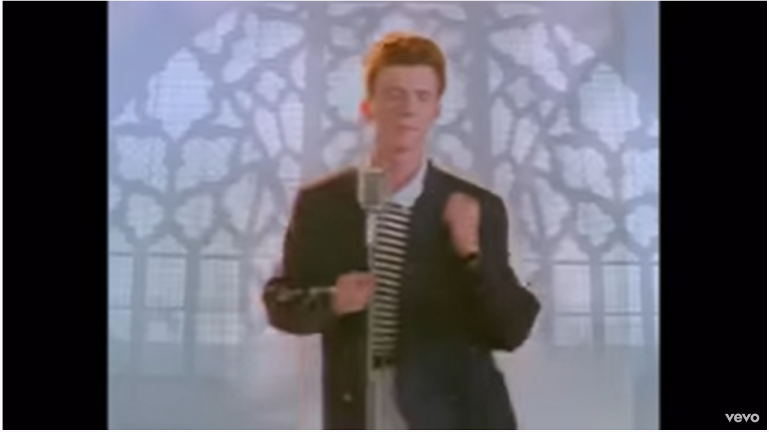
Notes:
In 2004 DivX released it feature complete MPEG-4 CODEC. It meant that video could be compressed with a much higher quality going from a blocky mess.

Slide 7
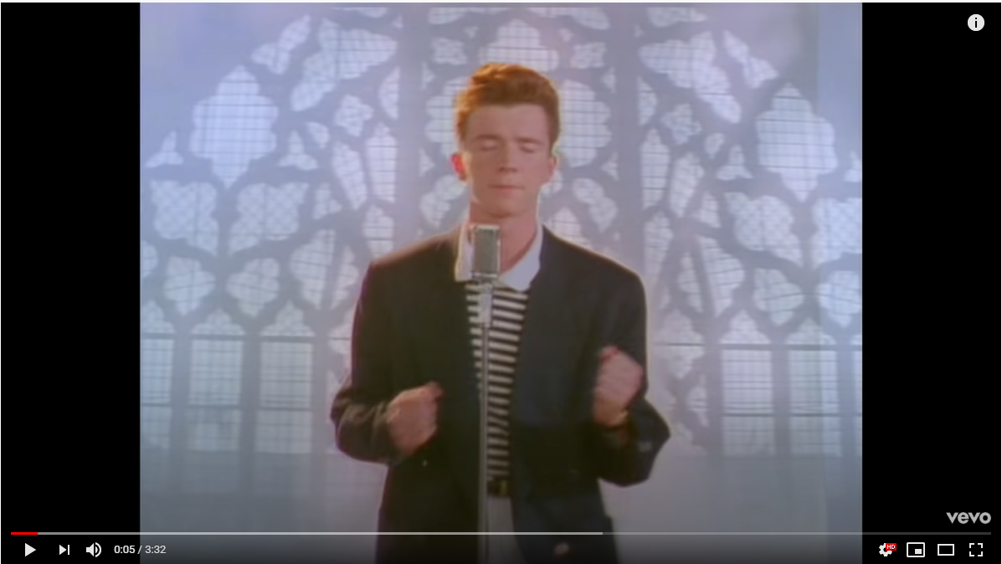
Notes:
To a good visual quality for the same storage space. It meant that you could take a Hollywood film and store it on a single CD-R with a capacity of 700MB. Even though we didn’t have huge amounts of disk space you could have hundred of films for cheap.

Slide 8





Notes:
We also saw a large number of p2p file sharing applications pop up such as napster which was mainly aimed at music to limewire, bearshare, bitorrent etc etc etc.
All of which meant that it was a lot easier to download films and music.

Slide 9
2004 and piracy
Broadband gets ‘good’
Video compression gets good
Writable CDROMs are common on computers
Infinite storage for all the copied movies
P2p file transfers explodes
Before the likes of napster, bittorrent etc you had to know about IRC and DC++
Notes:
If we look at everything that happened around 2004, some a little before we end up with a set of technologies that seem to be designed for file sharing.

Slide 10
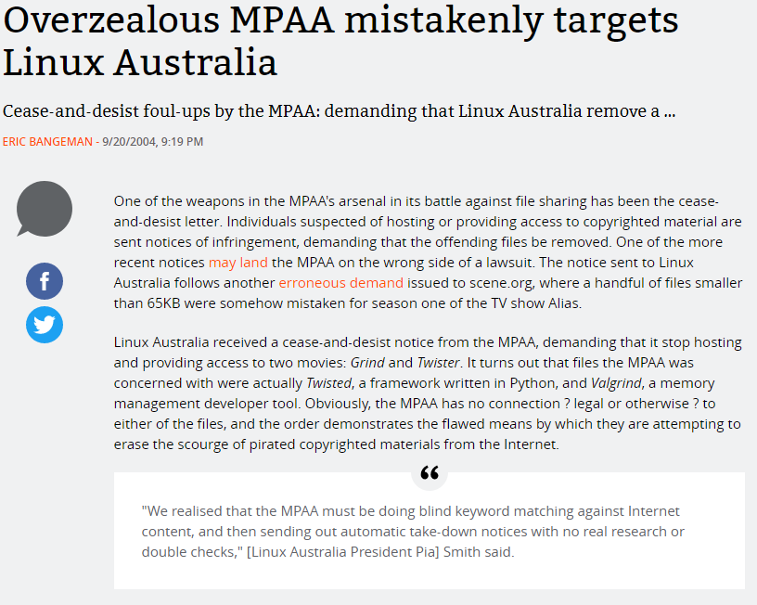
https://arstechnica.com/uncategorized/2004/09/4203-2/
Notes:
Around 2004 new reports like this started appearing. The movie industry was doing the same sort of thing as the music industry and suing anyone it though was copying its content. For example they were sending letters to people for hosting python frameworks because they had similar names to Hollywood movies.
At that time I was just writing up for my degree so anything was interesting and I got thinking about automatic video identification.

Slide 11
Identifying video
Can’t use filenames
Can’t use file size
Can’t use metadata
Any embedded data
Have to use things that are important for video

Slide 12
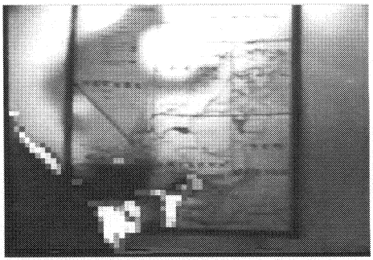
Notes:
That got me thinking about the motion. Without the motion video is just an image. There is a framerate range that make sense for video, anything below about 12 frames per second looks like a series of static images. Films are normally 24fps, so anything more than that will involve showing frames twice – which is a waste of file size. I thought that people that were creating the videos would optimise for video size and video quality. So I came up with the idea of measuring the motion in a video to create a fingerprint of the video. Using the thing that was important to people watching the video as the identification mechanism.
Since images are just a 2d set of numbers subtracting number 0,0 from frame 2 from number 0,0 in frame 1 will tell you how much it changed. It lets you measure the motion quickly and easily. We could do any complicated video processing or AI on the video since the computers weren’t fast enough back then to give an answer in a reasonable amount of time.

Slide 13
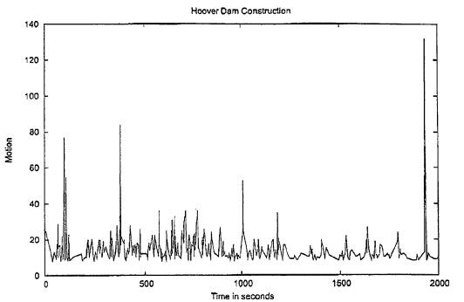
Notes:
If you measure the motion on a video (+ a bit of maths) you get a graph like this. For the identification of the video you just have to compare the shapes of the graphs.

Slide 14
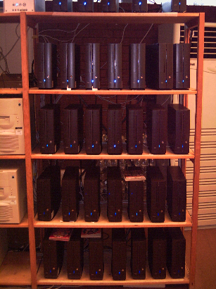
I applied for a bit of money to investigate the idea
Built a small Beowulf cluster
Got a couple of people together
Transcoded video change
Bitrates
Framerates
Framesize
Borders
Colours
Test transcoded video to see if it is identifiable
Eventually handed in my project write up and got my degree ☺

Slide 15
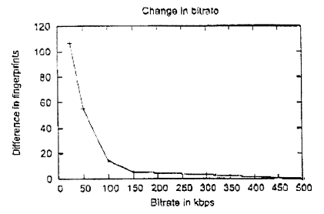
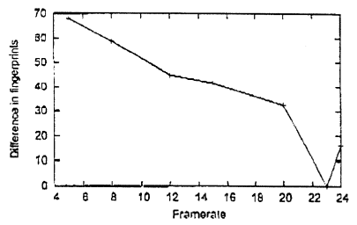
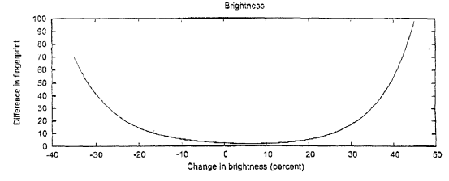
Notes:
This is just three of the results that popped out of the project. They all show that measuring motion was a pretty good way of identifying a piece of video. Ended up getting a few patents on the idea.

Slide 16












Notes:
2004 was a really good year for people that like quick access to entertainment. It led to wide spread adoption of streaming video and music. In the years following 2004 the argument was made that the entertainment industry had to make access to movies and music easier than pirating it which they pretty much have, if you are willing to pay for the service.

Slide 17
Questions
Martin Bateman
@martinbateman
https://martinbateman.github.io/talks/rjam20-4-2020.pdf

