Slide 1
HMM modelling for the spread of the SARS-CoV-2
Midterm presentation
Martin Beneš
Supervisor: Krzysztof Bartoszek
25 Mar 2021
Notes:
Hello,
My name is Martin Benes.
welcome to my midterm presentation for my master thesis HMM modelling for the spread of the SARS-CoV-2.

Slide 2
Presentation structure
Research questions
What has been done?
Changes against proposal
What is yet to do?
Possible extensions out of time frame
Notes:
The presentation is split into several logical blocks:

Slide 3
Research questions
Data: To what extent are the collected data reliable?
Model: What are the distributions of parameters of Covid-19?
Incubation period
Infection fatality ratio
Reproduction number
Duration of disease
Simulation: Are the reported statistics projected in the results?
Simulation: Are there visible patterns or similarities between regions?
Simulation: Are the introduced restrictions in the region/country projected in the numbers yielded by the simulation?

Slide 4
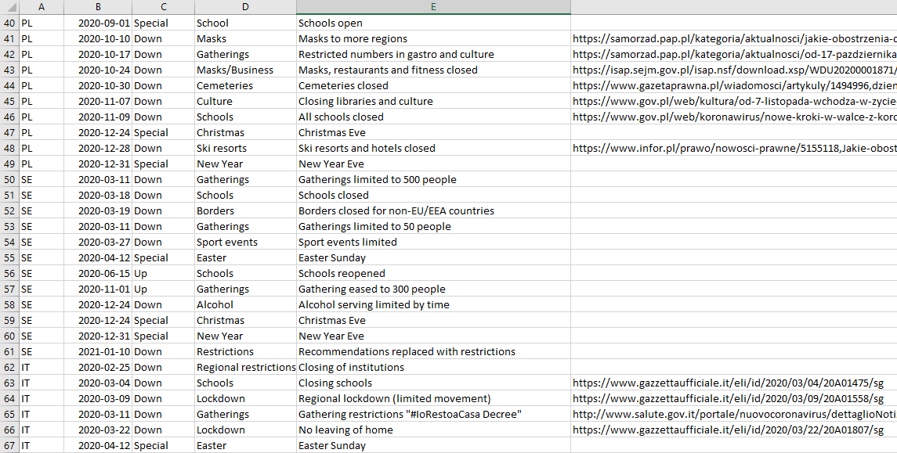
Data collection
Covid-19 statistics
Demography
Calendar

Slide 5
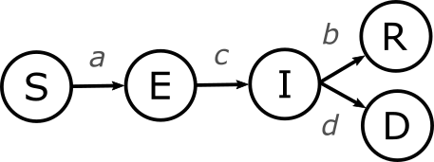
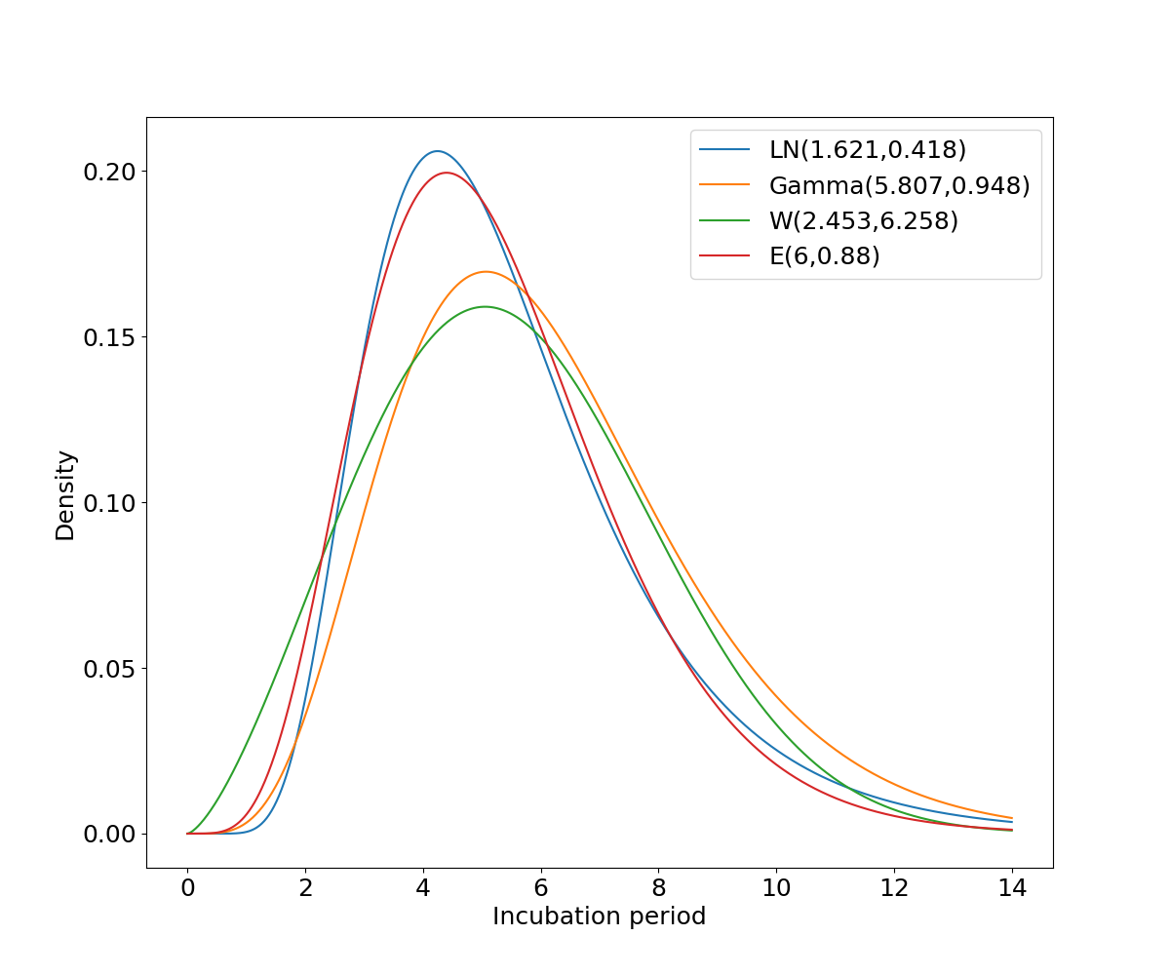
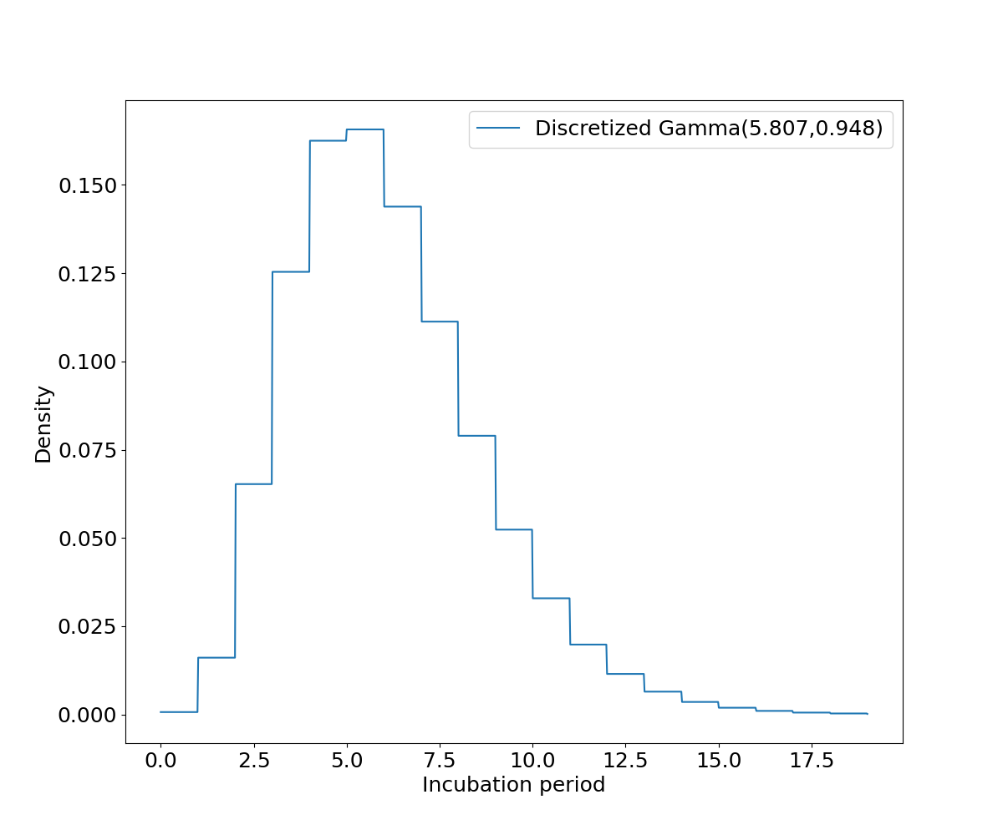
Model: What are the distributions of parameters of Covid-19?
SIR* model
Parameters a,b,c,d needed
Objective of other papers
Source: 10.7326/M20-0504
Notes:
True ratio of infected is population prevalence.
a – infection risk | reproduction number
c – incubation period
b,d – duration of symptoms
Characteristics taken from other papers.
Biggest difference against proposal = Bayesian HMM

Slide 6
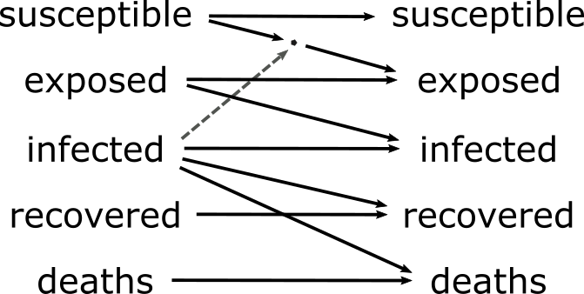
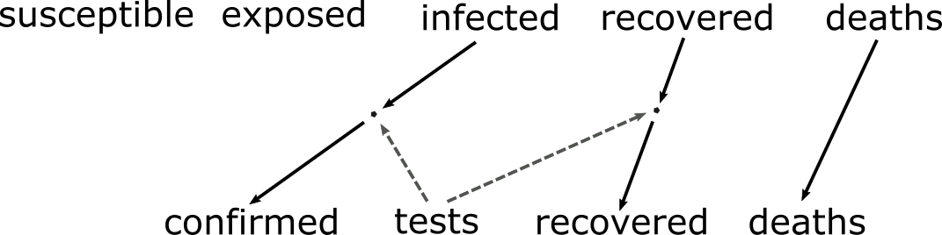
Model: What are the distributions of parameters of Covid-19?
HMM model
Transition/emission matrices based on SIR*
SIR* model
Parameters a,b,c,d needed
Emission matrix structure
Transition matrix structure

Slide 7
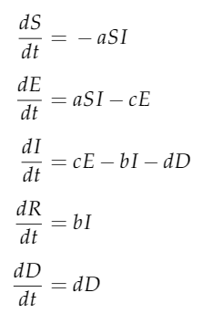
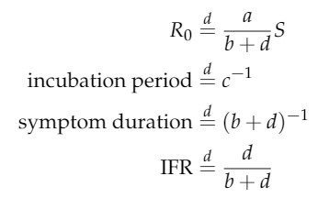



Model: What are the distributions of parameters of Covid-19?
SIR* model
Source: Master thesis
Notes:
Some parameters are number of days (incubation period, duration of symptoms).
The distribution of these is then transformed into multiple daily timesteps of HMM (conditional probability).

Slide 8
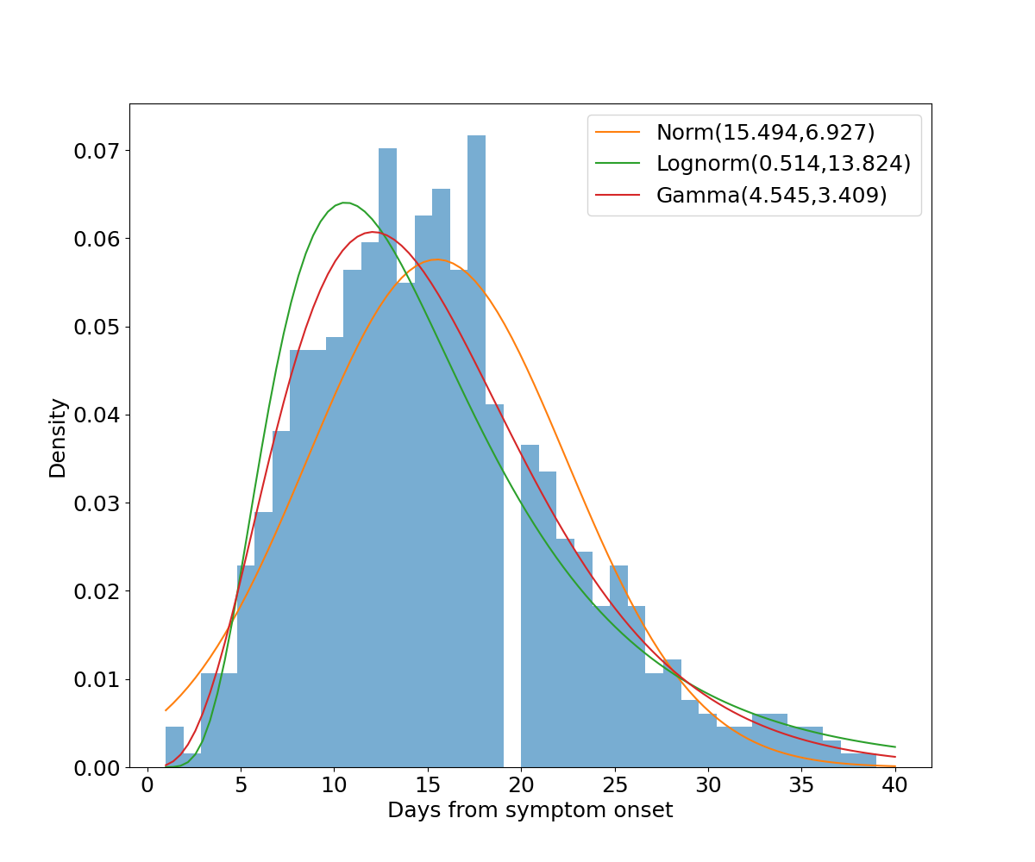
Model: What are the distributions of parameters of Covid-19?
Covid-19 characteristics
Source: Master thesis

Slide 9
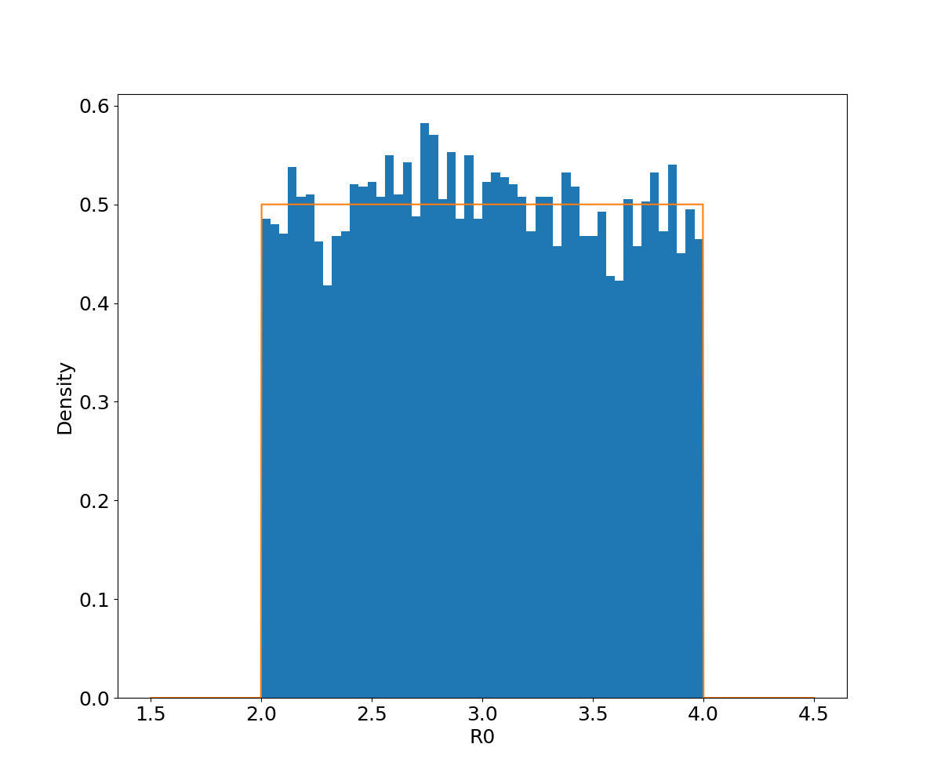
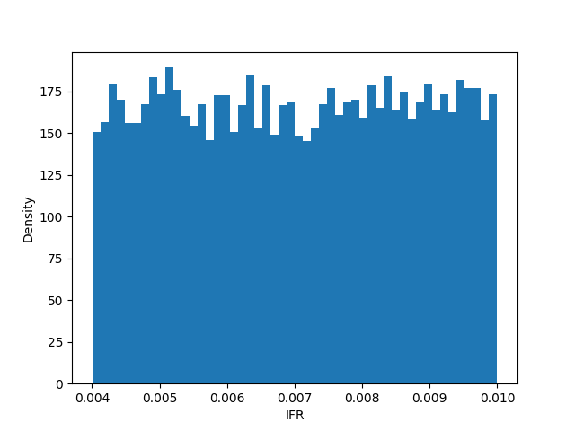
Model: What are the distributions of parameters of Covid-19?
Covid-19 characteristics
Source: Master thesis

Slide 10
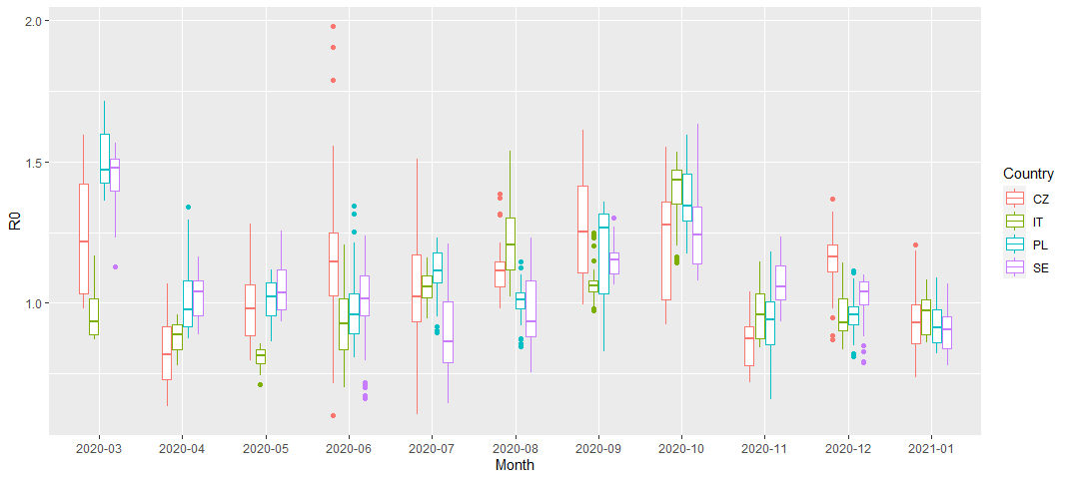
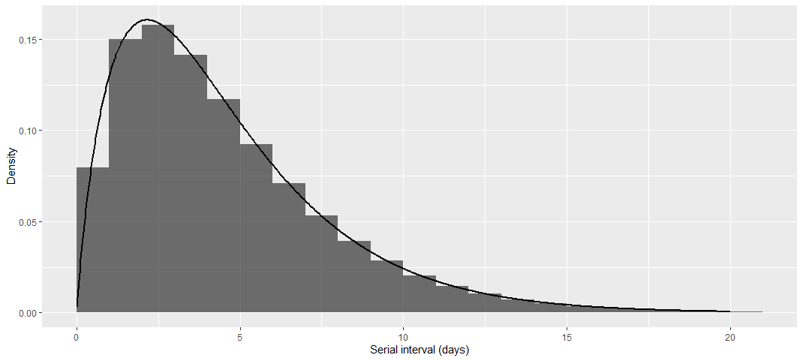
Model: What are the distributions of parameters of Covid-19?
R0
Source: Master thesis
Notes:
Incidence

Slide 11
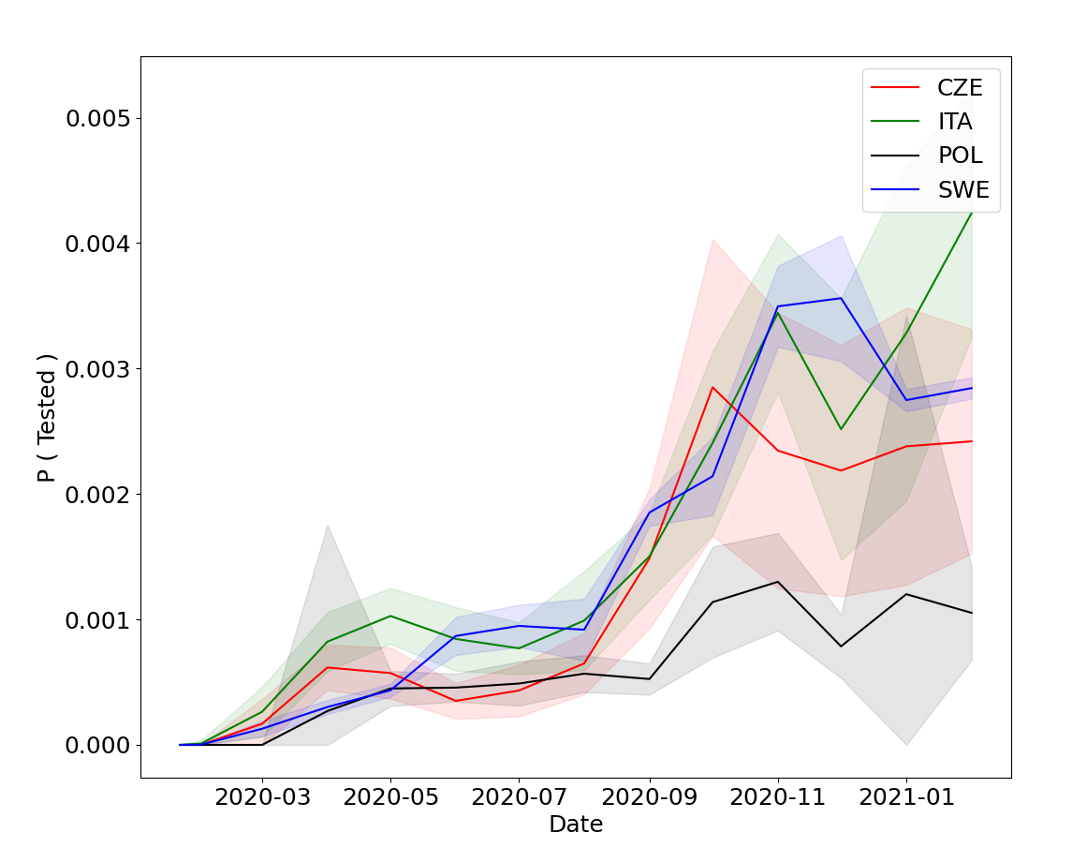
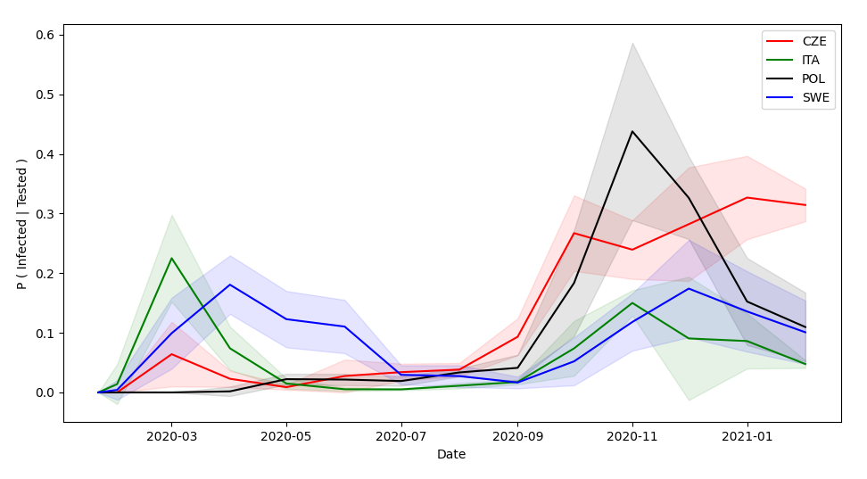
Model: What are the distributions of parameters of Covid-19?
Tests
Source: Master thesis

Slide 12


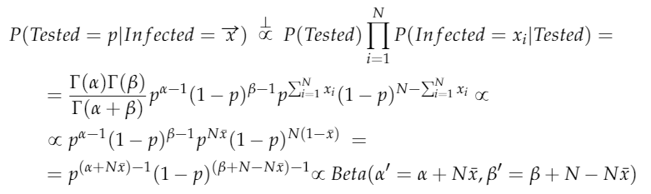
Model

Slide 13
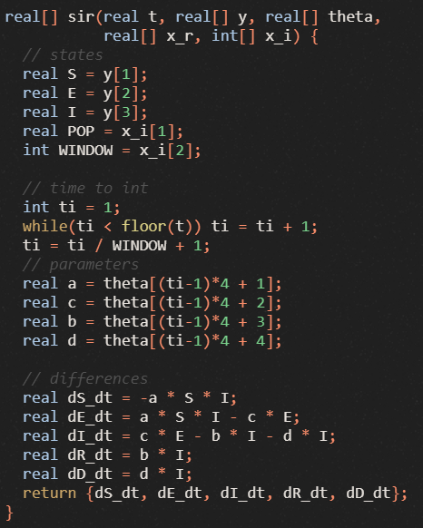
Model: Implementation
Python
Stan / RStan

Slide 14
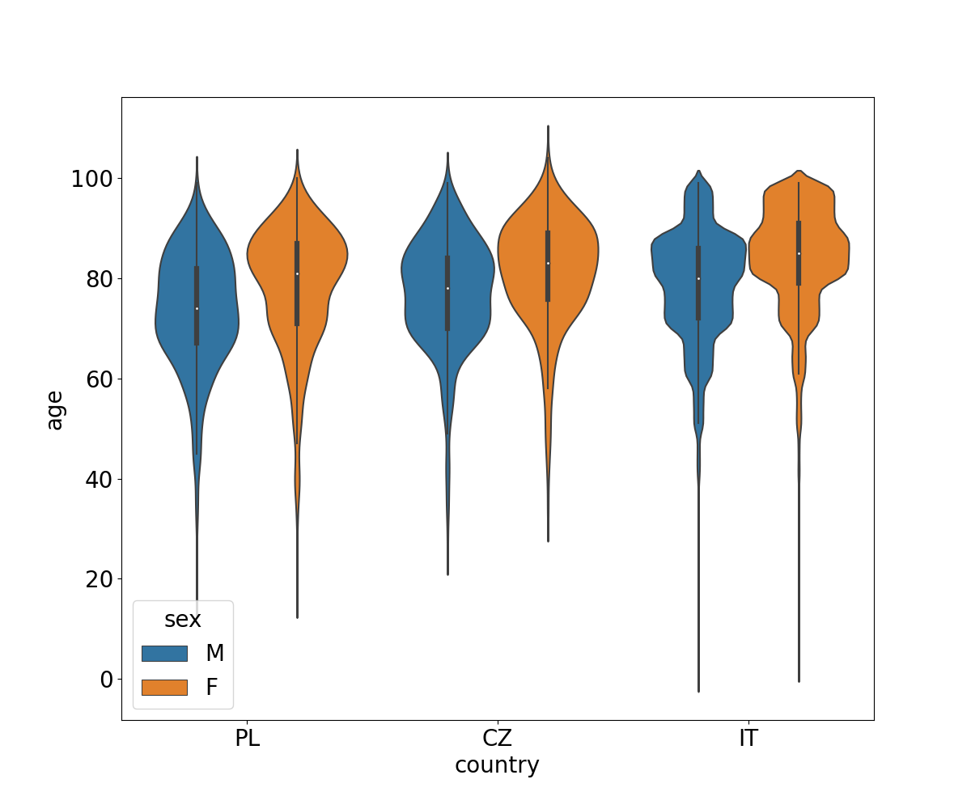
Discussion: Interpretation of the results
Lethality
Source: Master thesis

Slide 15
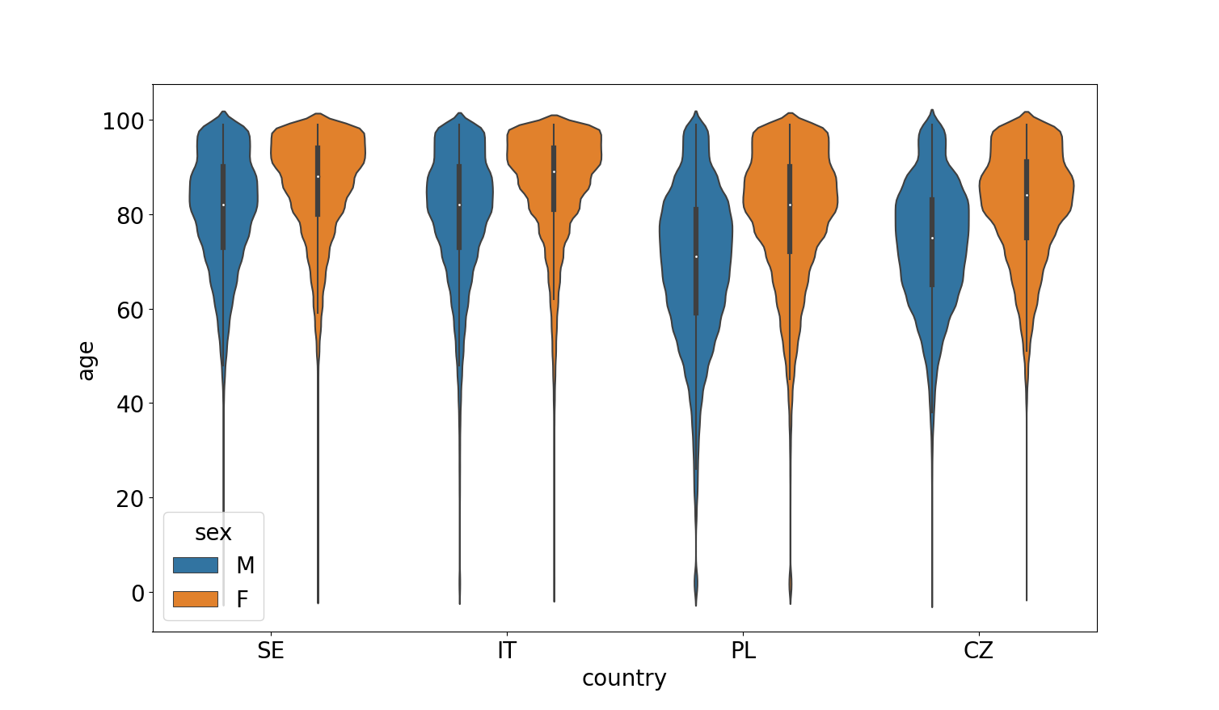
Discussion: Interpretation of the results
Mortality vs. lethality
Source: Master thesis

Slide 16
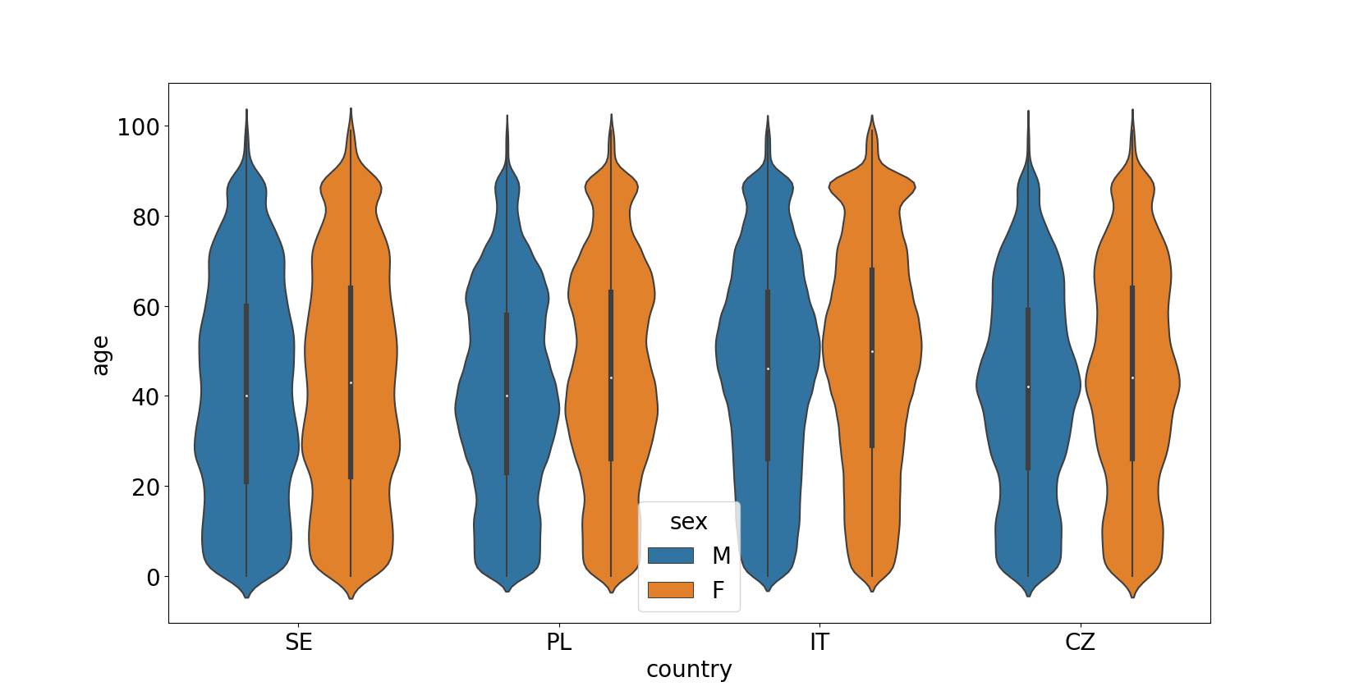
Discussion: Interpretation of the results
Population vs. lethality
Source: Master thesis

Slide 17
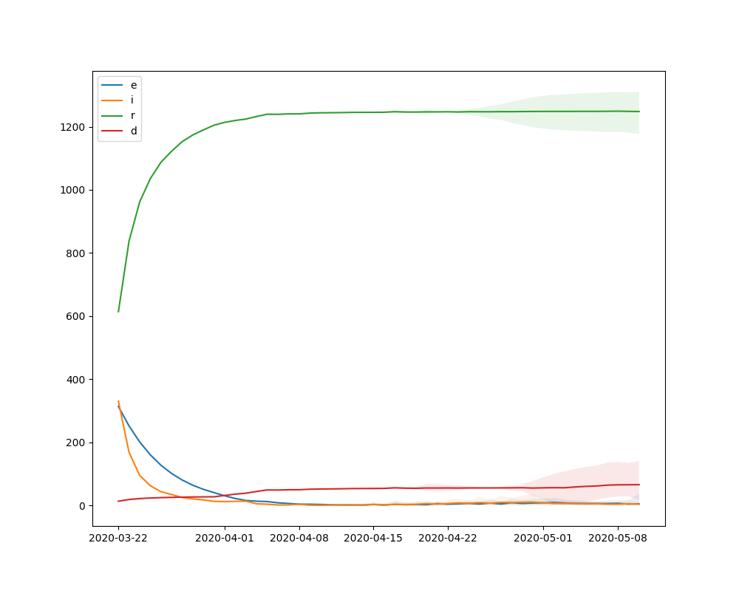
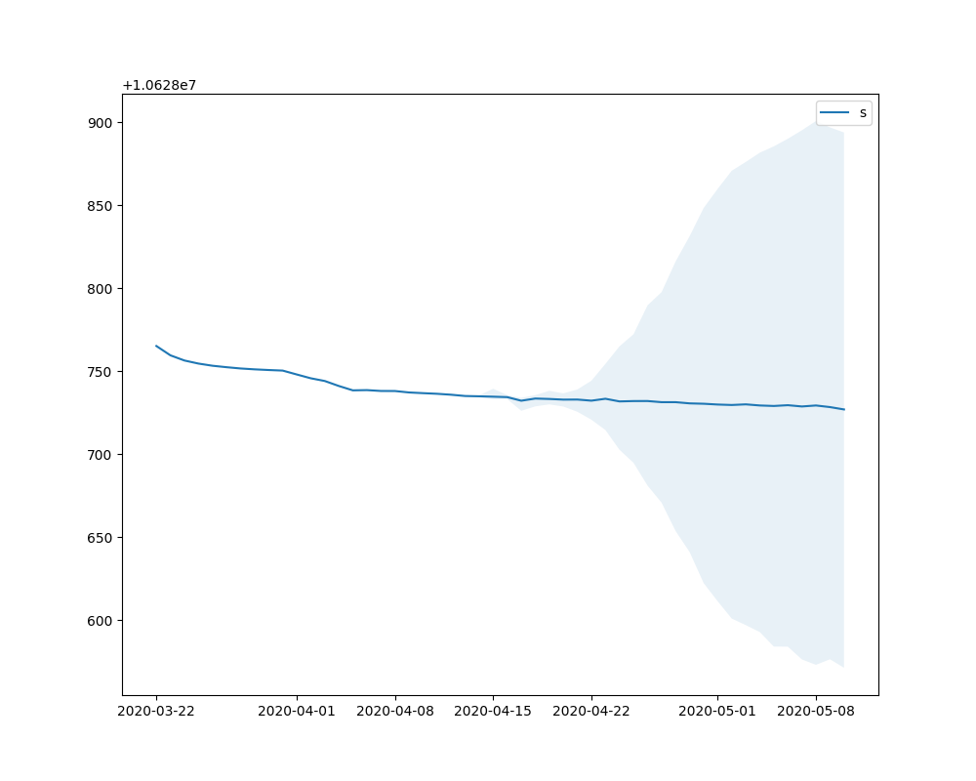
Simulation: Are the reported statistics projected in the results?

Slide 18
Yet to be done
Simulation: Are the reported statistics projected in the results?
Make sure the epidemic is initiated
Simulation: Are there visible patterns or similarities between regions?
Regional comparison
DTW + Czekanowski’s diagram
Simulation: Are the restrictions projected in the simulated data?
Calendar

Slide 19

Possible extensions
Vaccination
$$S_{t}^{′}=S_{t}∗v_{t}$$
Non-permanent immunity
$$\frac{dS}{dt}=−aSI+eR$$
$$\frac{dR}{dt}=−eR+bI$$

Slide 20
Possible extensions

Slide 21
Extensions out of time frame
Symptom / asymptomatic
Different R0 number distribution (less cautious)
Different probabilities of being tested
Mobility
Additional additive terms
Test errors
Clinical tests might be wrong (specificity + sensitivity)
Infectiousness / symptoms
Not the same

Slide 22
Thank you for attention.
Martin Beneš
25 Mar 2021

