Slide 1
HMM modelling for the spread of the SARS-CoV-2
Midterm presentation
Martin Beneš
Supervisor: Krzysztof Bartoszek
25 Mar 2021
Notes:
Hello,
My name is Martin Benes.
welcome to my midterm presentation for my master thesis HMM modelling for the spread of the SARS-CoV-2.

Slide 2
Presentation structure
Research questions
Changes against proposal
Yet to be done
Notes:
The presentation is split into several logical blocks:

Slide 3
Research questions
Data: To what extent are the collected data reliable?
Model: What are the distributions of parameters of Covid-19?
Incubation period
Infection fatality ratio
Reproduction number
Duration of disease
Simulation: Are the reported statistics projected in the results?
Simulation: Are there visible patterns or similarities between regions?
Simulation: Are the introduced restrictions in the region/country projected in the numbers yielded by the simulation?

Slide 4
Model: What are the distributions of parameters of Covid-19?

Slide 5
Simulation: Are the reported statistics projected in the results?

Slide 6
Simulation: Are there visible patterns or similarities between regions?

Slide 7
Simulation: Are the restrictions projected in the simulated data?

Slide 8
Yet to be done

Slide 9
Thank you for attention.
Martin Beneš
25 Mar 2021

Slide 10
Covid-19 statistics
Daily, weekly
Attributes
Tests = number of performed tests (RT-qPCR + antigen)
Confirmed cases = number of newly positively tested people
Deaths = number of deceased on/with Covid-19
Hospitalized = number of new hospitalized
Recovered = number of recovered/released from hospital
Country-wise, regions, municipalities
Notes:
Let’s get to what is the usual shape of data that national governments publish about the pandemic.
Performed tests create a sample over the population.
Number of tests is the sample size.
Confirmed cases are the positive tests.
Sample bias – ratio of probabilities of infected / healthy getting tested.
Deaths and hospitalized are more reliable in this sense.
Interpretation of recovered depends on dataset.

Slide 11
Covid-19 statistics: Czechia
https://onemocneni-aktualne.mzcr.cz/api/v2/covid-19
Country: RT-qPCR + antigen tests
District: deaths, tests, hospital capacities, hospital stock states
Per age group: incidence, prevalence, hospitalized, vaccinated
Cases with age and gender: confirmed, deaths
Municipality: confirmed
Notes:
Ministerstvo zdravotnictví – Ministry of Health of the Czech Republic

Slide 12
Covid-19 statistics: Poland
https://www.gov.pl/web/koronawirus/pliki-archiwalne-powiaty
https://twitter.com/MZ_GOV_PL
Country: tests, recovered, hospitalized, quarantined
Region/municipality: confirmed, deaths,
Notes:
Ministerstwo Zdrowia – The Ministry of Health

Slide 13
Covid-19 statistics: Sweden
https://www.folkhalsomyndigheten.se/smittskydd-beredskap/utbrott/aktuella-utbrott/covid-19/statistik-och-analyser/
https://scb.se/om-scb/nyheter-och-pressmeddelanden/overdodligheten-fortsatter-att-sjunka-efter-toppen-i-april/
Country: deaths, icu, confirmed (daily)
Region: icu (weekly), vaccines, tests - antibody
Municipality: confirmed, deaths (weekly)
Notes:
Folkhälsomyndigheten – The Public Health Agency of Sweden
Statistikmyndigheten – Statistics Sweden

Slide 14
Covid-19 statistics: Italy and others
https://covid19datahub.io/
Unified datahub for Covid-19 data
Italy + Switzerland:
Municipality: deaths, confirmed, tests, recovered, hospitalized, icu
Implemented: https://github.com/covid19datahub/COVID19/blob/master/inst/extdata/src.csv

Slide 15
Demographical statistics
Mortality
https://ec.europa.eu/eurostat/web/products-datasets/-/demo_r_mweek3
Population
https://ec.europa.eu/eurostat/web/products-datasets/-/tgs00096
Area, …
Notes:
Sources either Eurostat or national sources.

Slide 16
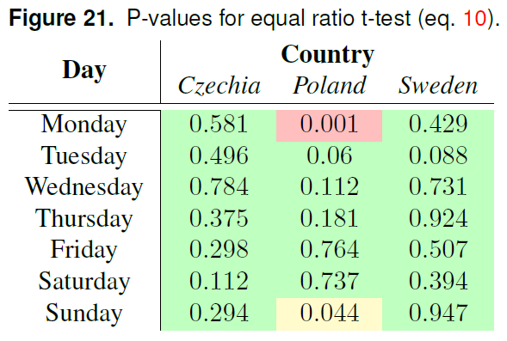
Data: To what extent are the collected data reliable?
Evaluate the sampling method.
Is number of performed tests sufficient?
Analyze the data for discrepancies.
Source: own unpublished research project
Notes:
Sampling or collection method might differ dataset to dataset.
If the number of tests is low, we don’t know enough about the epidemic.
Data might contain odd defects.

Slide 17
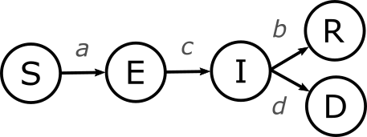
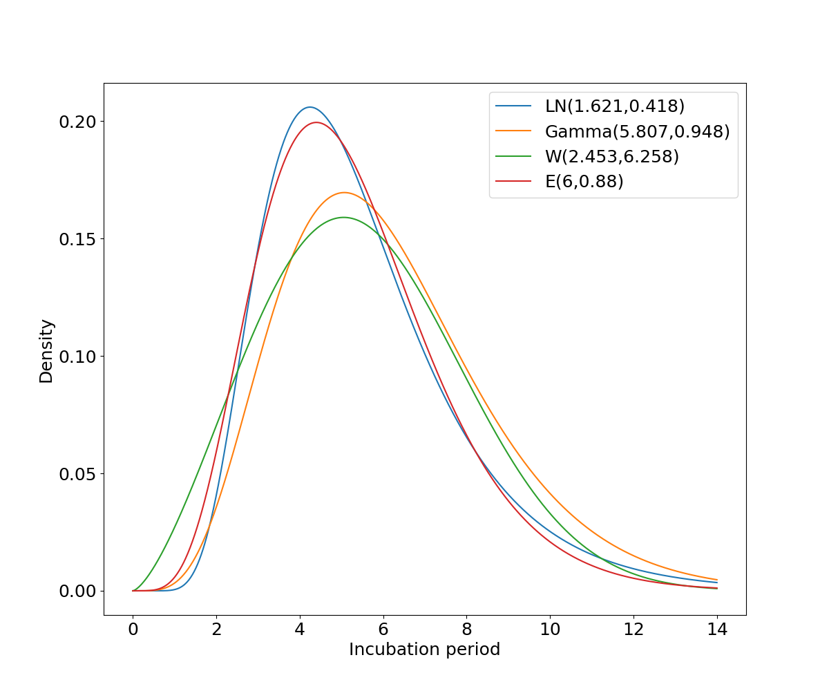
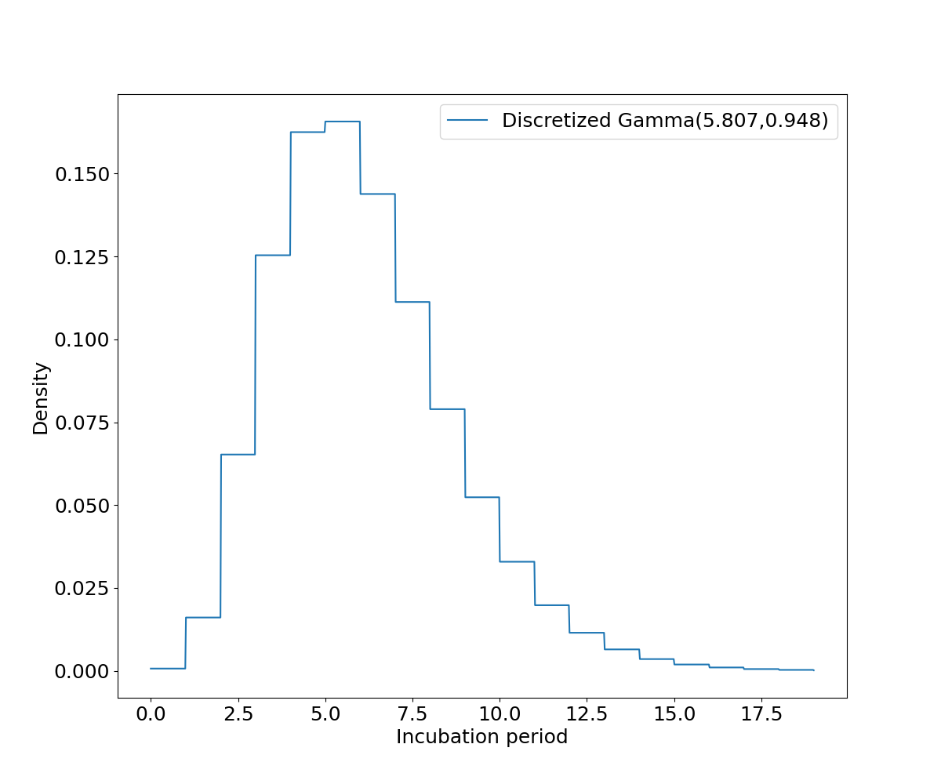
Model: What are the distributions of parameters of Covid-19?
SIR* model
Parameters a,b,c,d needed
Objective of other papers
Source: 10.7326/M20-0504
Notes:
True ratio of infected is population prevalence.
a – infection risk | reproduction number
c – incubation period
b – duration of symptoms
d – infection mortality rate
Characteristics taken from other papers.

Slide 18
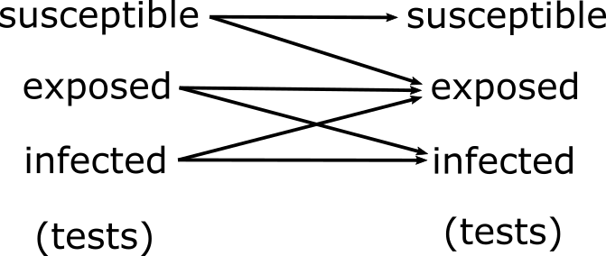
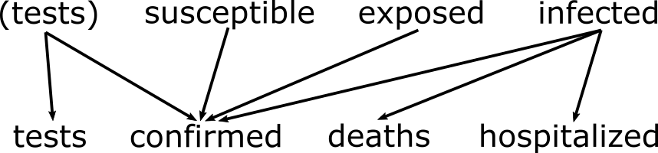
Model: What are the distributions of parameters of Covid-19?
HMM model
Transition/emission matrices based on SIR*
Transition matrix structure
Emission matrix structure

Slide 19
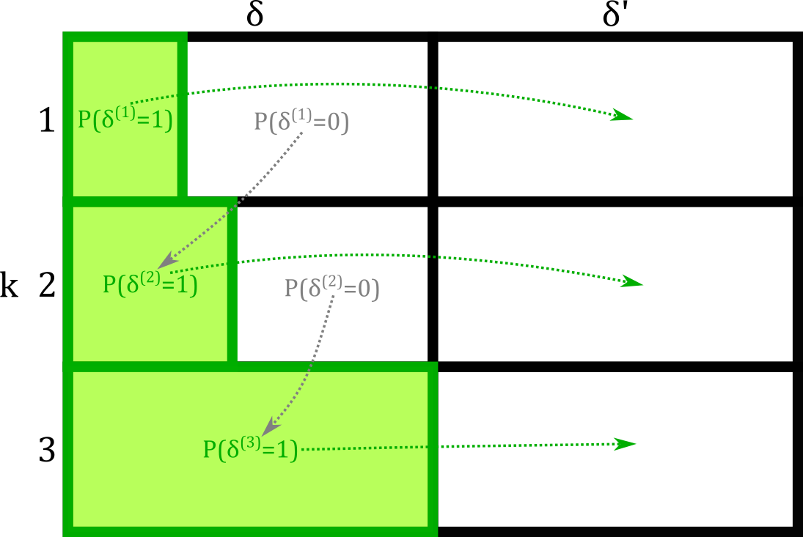
Model: What are the distributions of parameters of Covid-19?
HMM model
Source: Master thesis
Source: Master thesis
Notes:
Some parameters are number of days (incubation period, duration of symptoms).
The distribution of these is then transformed into multiple daily timesteps of HMM (conditional probability).

Slide 20
Simulation: Are the reported statistics projected in the results?
Do the reported statistics describe similar situation as the simulation results?
Are confirmed cases a good measure of the situation?
Is there a visible connection with testing strategy?
Simulation: Are there visible patterns or similarities between regions?
Comparison of infected.
Possible usage of EM to drop less certain parameters.

Slide 21
Simulation: Are the restrictions projected in the simulated data?
Evaluation of the situation in different regions in the context of local implemented restrictions.
Evaluation of restriction efficiency.
Data of restrictions: media, official websites, Covid-19 Data Hub

Slide 22
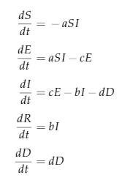
Bottlenecks
Symptoms / asymptomatic
Different R0 number distribution (less cautious)
Different probabilities of being tested
Non-permanent immunity
Additional connection of R → S
Infectious incoming from abroad
Additional additive term in the equation
Vaccination
Lower susceptibles
Problem of data
Test errors
Test is wrong with a certain probability (specificity + sensitivity)
Infectiousness / symptoms
Not the same
Source: Master thesis
Notes:
Currently I am aware of following limitations,
These are aspects that might be added to the algorithm if there is enough time for them.
The rest will be discussed.

Slide 23
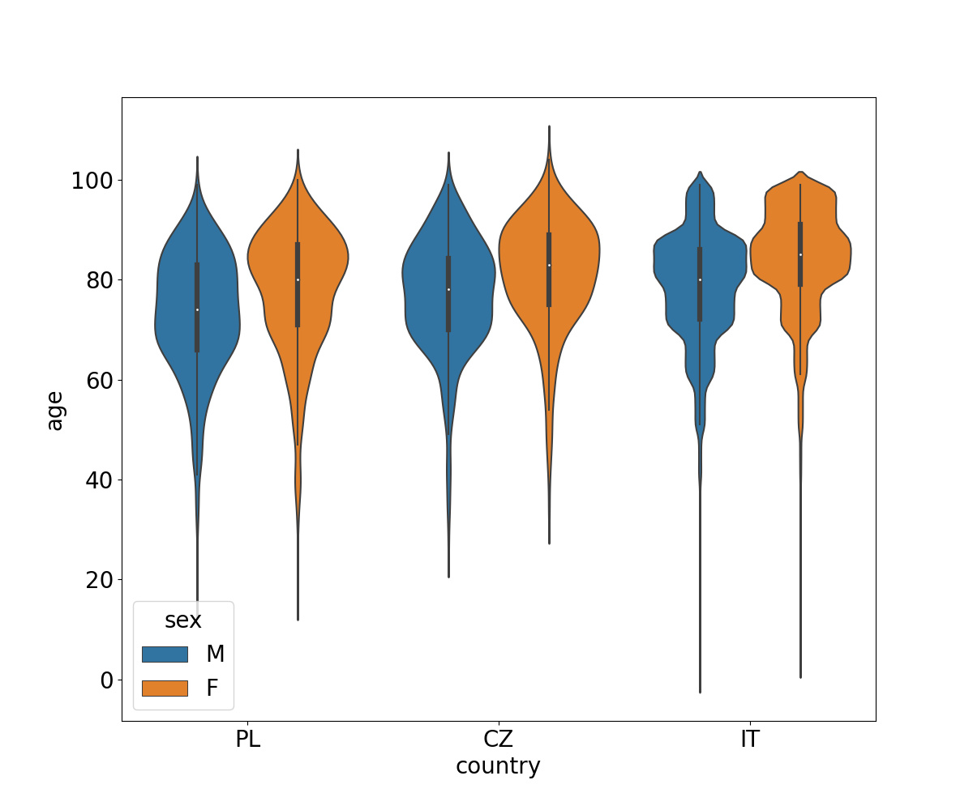
Similar research
Similar research already exists
From second half of the year 2020
Parameters per population, not per-age
Source: Master thesis
Notes:
Research papers presenting compartment models for Covid-19 already exists.
The idea is not novel.

Slide 24
Similar research
Tracking the early depleting transmission dynamics of COVID-19 with a time-varying SIR model
https://www.nature.com/articles/s41598-020-78739-8
Compartment model
Data from Malaysia
Latent variable is R0

Slide 25
Similar research
COVID-19 dynamics in an Ohio prison
https://doi.org/10.1101/2021.01.14.21249782
Compartment model
Measured in Ohio prison, where was outbreak
Might include very different parameter estimates
Not reviewed preprint

Slide 26
Similar research
Symptom-based testing in a compartmental model of Covid-19
https://doi.org/10.1101/2020.10.11.20211037
Compartment model
Does not specify what data is used
Not reviewed preprint

