Slide 1

Counting people using pir sensor
Martin Beneš
Supervisor: Drahanský Martin, prof. Ing., Dipl.-Ing., Ph.D.
Consultant: Kemptner Guido, prof., FHV

Slide 2
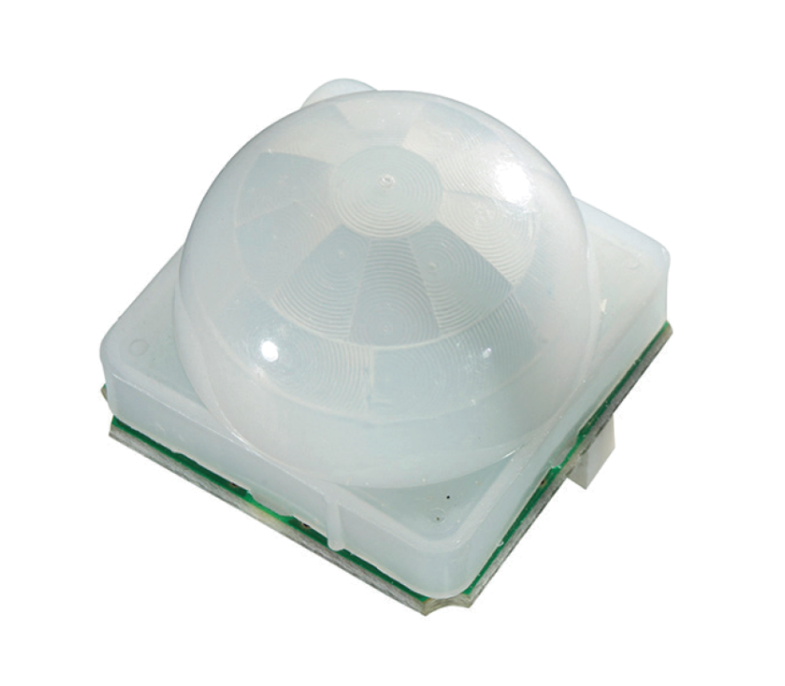
Assignment
Study
Design
Implement
Analyze

Slide 3
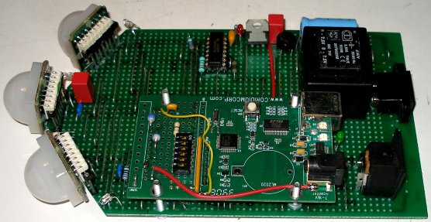
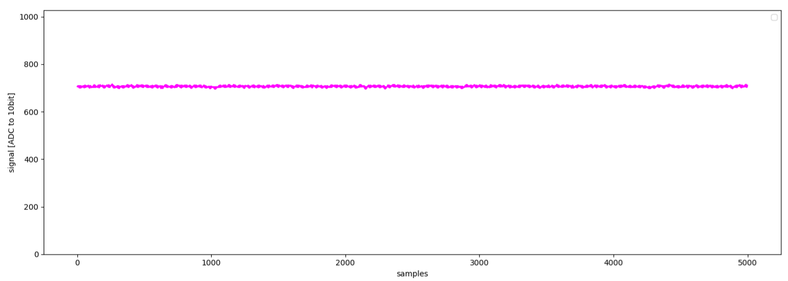
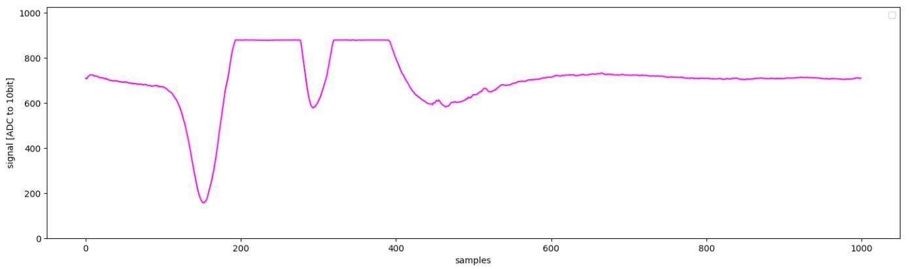
Accomplished
Hardware model
Reading data

Slide 4
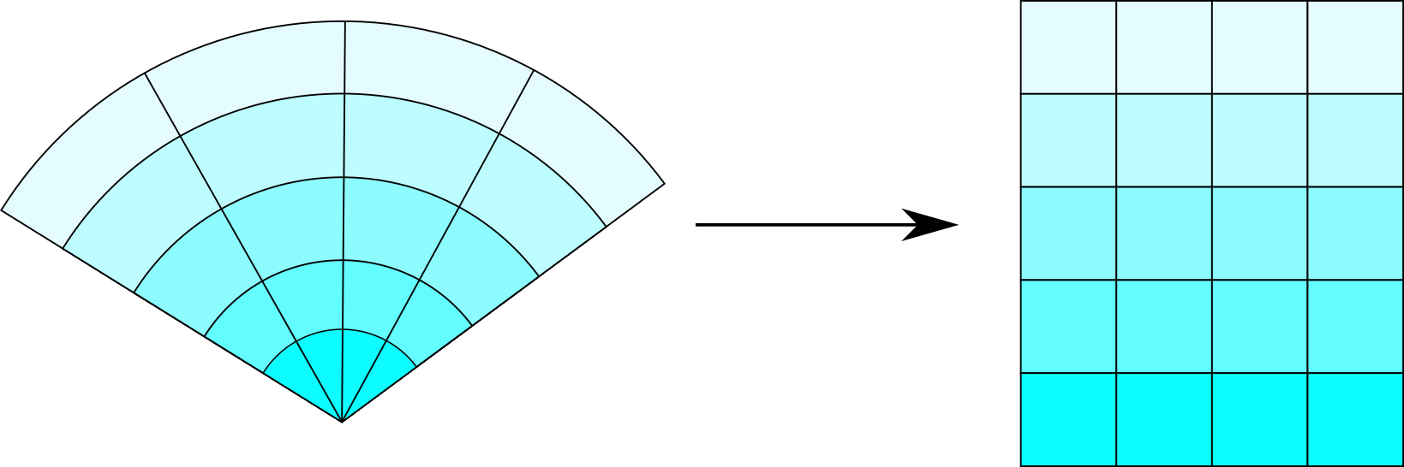
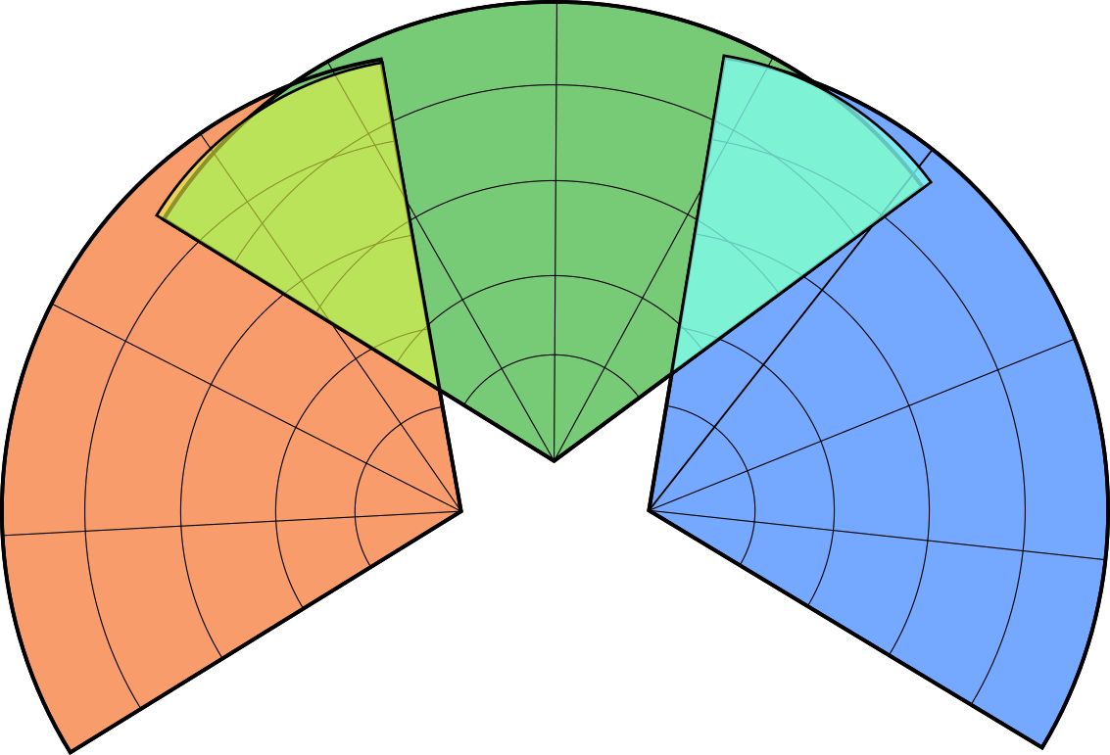
Accomplished
Area representation
Fuzzy fusion system
Clusters-analysing postprocessor

Slide 5
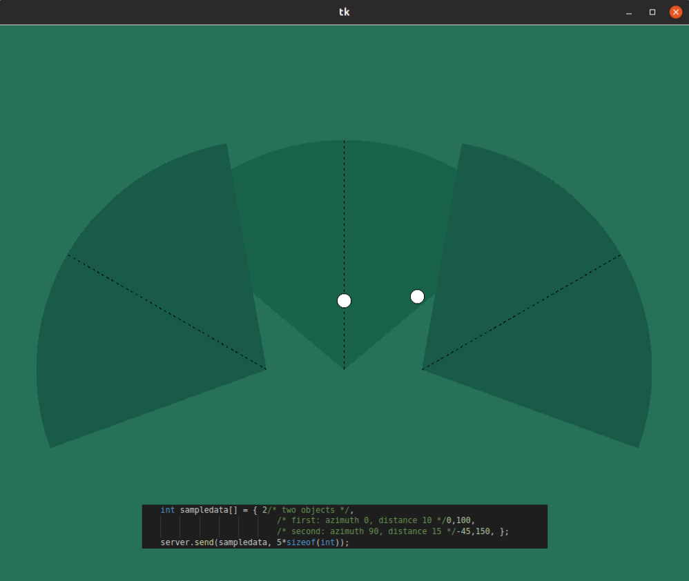
Accomplished
collector
visualizer

Slide 6
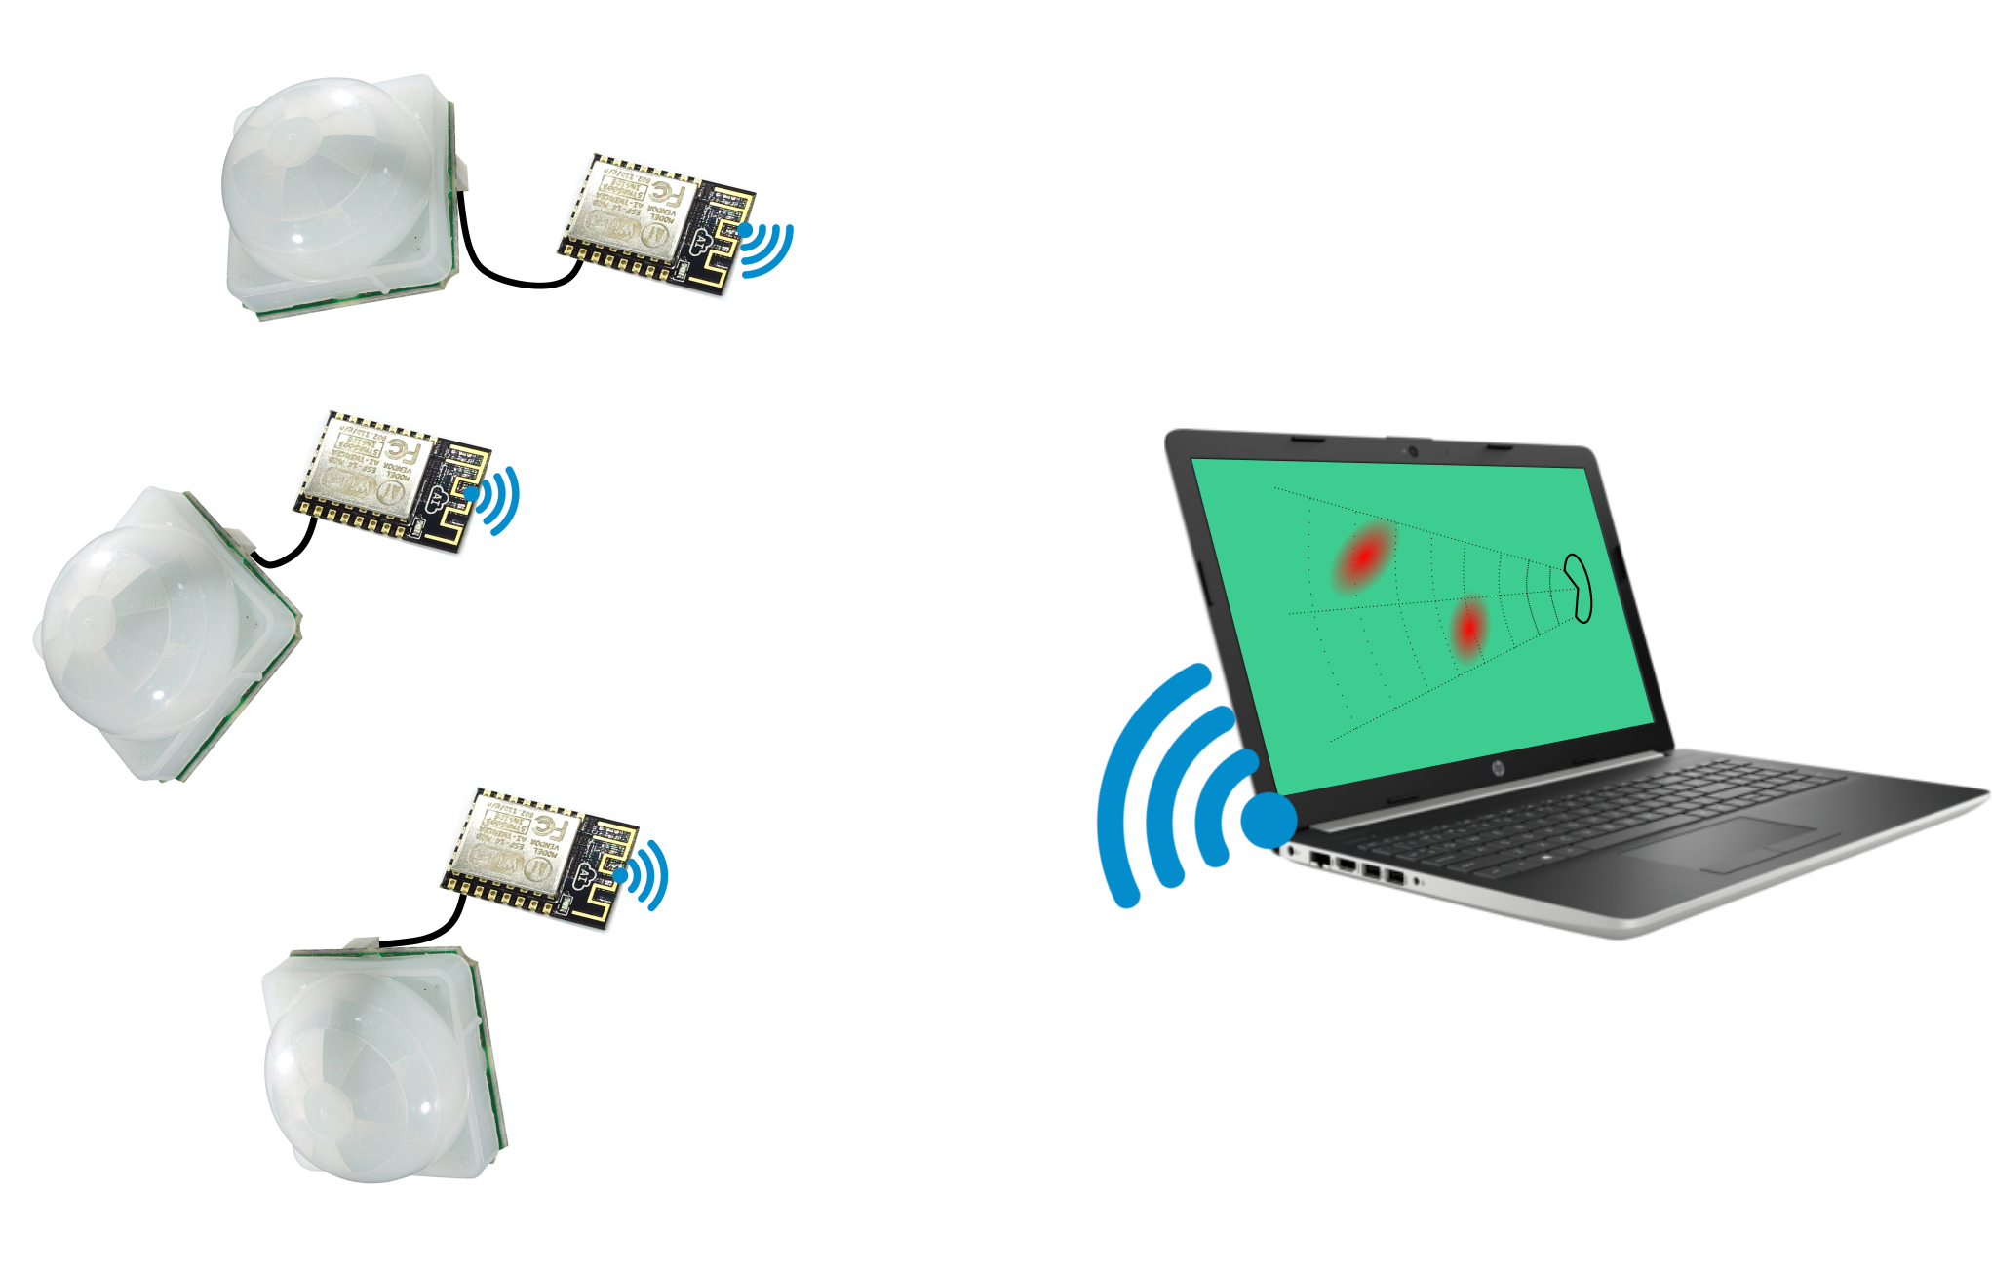
To do
Constructing the module
Programming MCU to send data RT as WiFi client

Slide 7
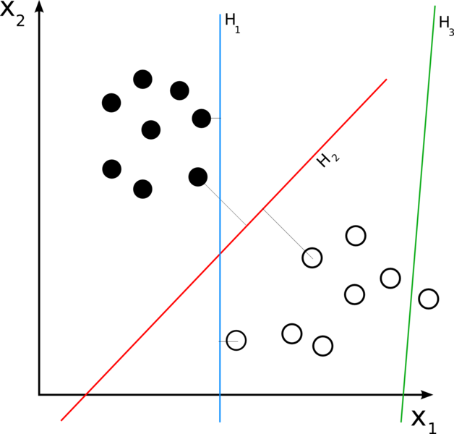
To do
Features
Fuzzification

Slide 8
To do
Implementation of classification (inside collector)
Testing, optimizing the parameters

Slide 9
Statistics
No. of standard pages: 15
No. of pictures: 18
No. of references: 22
Internet: 10
Books: 12

Slide 10
Reference
Dr. Godfried-Willem Raes: Infrared sensing devices useful as gesture controllers for robotic musical instruments
https://www.flickr.com/photos/christiaancolen/
https://www.flaticon.com/authors/zlatko-najdenovski
https://www.freepik.com/
https://www.flaticon.com/authors/monkik

Slide 11
Thank you
xbenes49@stud.fit.vutbr.cz

