Slide 1

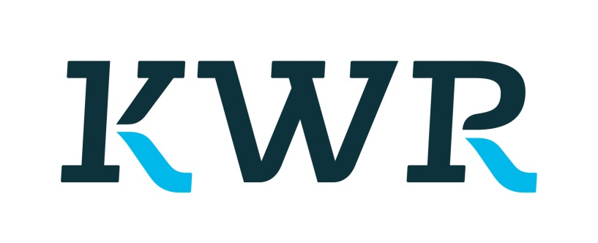
PySeawATES
Python Seawat ATES model developed by KWR and TU Delft
Contact: j.m.bloemendal@tudelft.nl
Stijn.beernink@kwrwater.nl

Slide 2
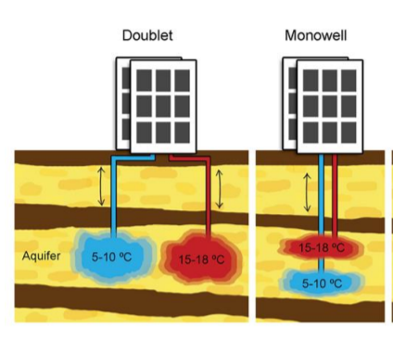
PySeawATES
Model to calculate thermal impact and performance of ATES systems
Monowells
Doublets
HT-ATES
Grid functionality
Axisymmetrical (1 [mono] or 3 layers [doublet])
3D
Easy input file and understandable settings

Slide 3
Requirements
Python 3.6
Swtv4 executable
Developed in/for spyder
Pip install flopy → add flopy folder in working directory of your model
https://modflowpy.github.io/flopydoc/
https://www.usgs.gov/mission-areas/water-resources/science/modflow-and-related-programs?qt-science_center_objects=0#qt-science_center_objects

Slide 4
Main structure
Wells are handled as object and for the basis of the model for grid building and control
wellData.xlsx→Wells and subsurface composition are specified
pyseawATES.py → main code controls simulation
Agent_functions.py → definition of well objects
Grid_functions.py → definition of the grid objects

Slide 5
Structure of PySeawATES.py
[A] Load data/packages etc main model inputs an charateristics
[B] detailed inputs, parameter values, grid charateristics
[C] iterate the model NB. model is run for each time step separately. This allows for control of flows at run-time.
[D] post processing of data, calculate efficiencies, prepare data for plotting
[E] plot figures

Slide 6
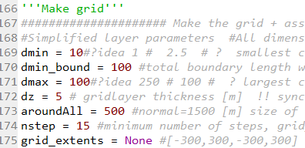
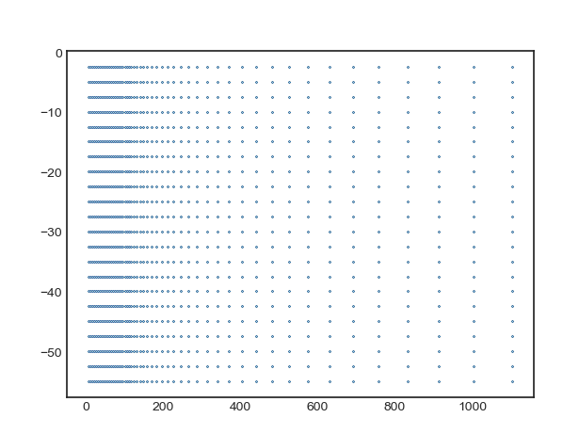
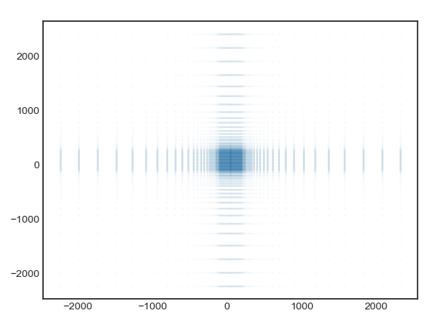
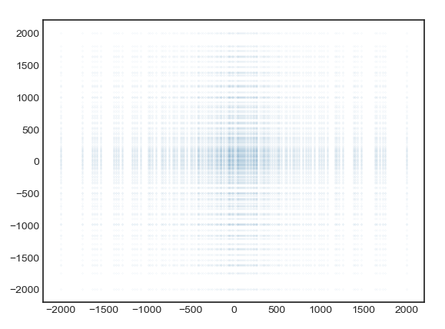
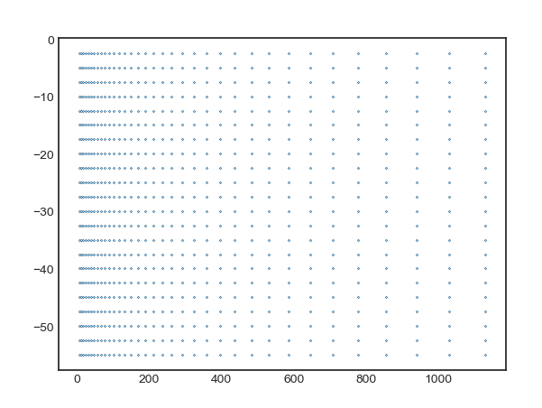
Grid functions
2 Options
Linear/uniform (close to well) + logarithmic at boundaries
All logarithmic
3D AXI
INCL. ‘grid cleaner’

Slide 7
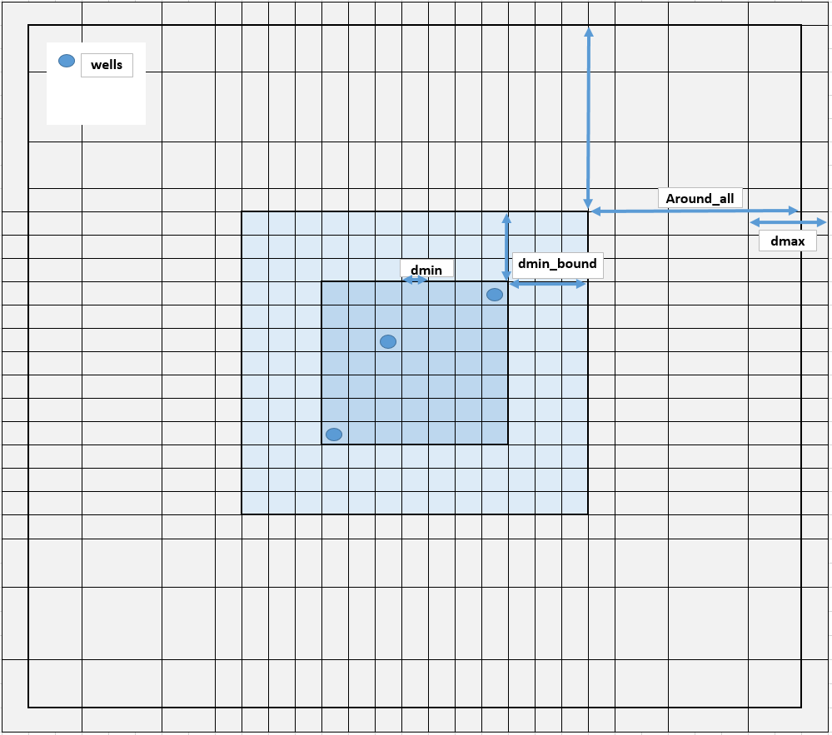
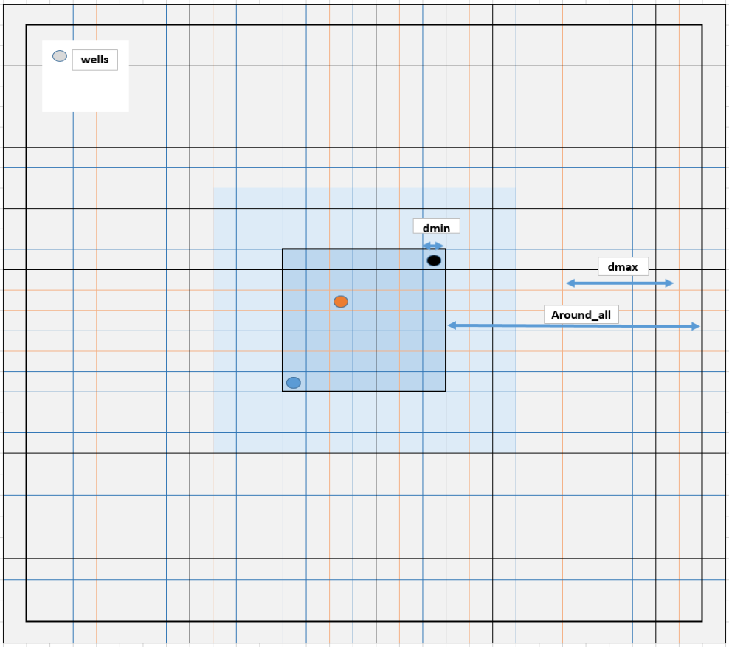
Grid settings 3D
3D, topview, linear 3D, topview, logarithmic
[No ‘dmin_bound’]

Slide 8
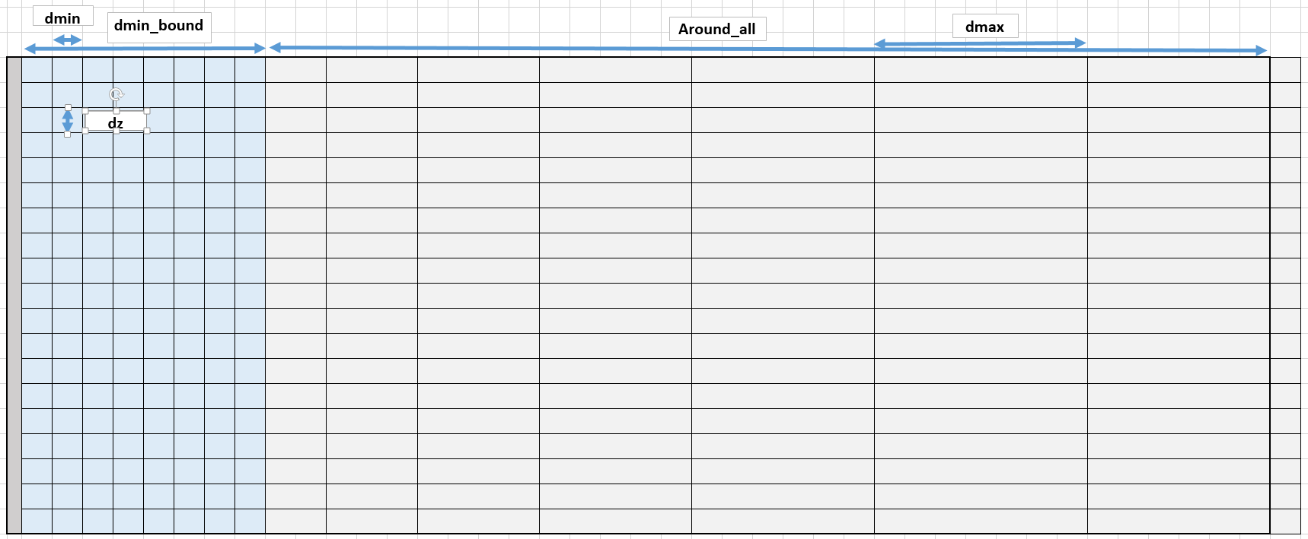
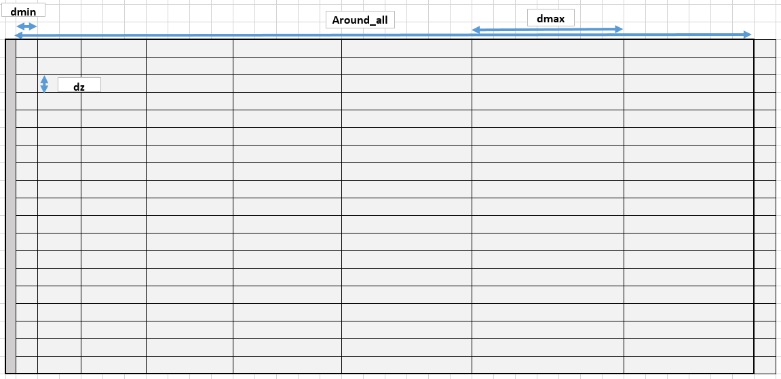
Grid settings Axial symmetric
AXI, sideview, linear AXI, sideview, logarithmic
[No ‘dmin_bound’]

Slide 9
You are using the pyhton code developed to simulate
Aquifer Thermal Eneregy Storage (ATES) systems in MODFLOW/MT3D-MS/SEAWAT
This code is developed at Delft University of Technology and
KWR water research institute Various researchers have contributed to
key elements of this code: dr. Martin Bloemendal, dr.Marc Jaxa-Rozen,
prof.dr.Theo Olsthoorn, Stijn Beernink. If you have any questions or
remarks please contact:
Martin BLoemendal: j.m.bloemendal@tudelft.nl
Stijn Beernink: stijn.beernink@kwrwater.nl
The authors take no responsibility for any damage the may follow from
using or implementing (the results produced by) this model infrastructure

