Slide 1


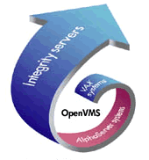







OpenOffice.org porting to OpenVMS
OpenVMS
Open Source
OpenOffice.org
Ton van der Zwet
TUD 11 October 2006 32

Slide 2
Introduction...
Member of the OpenOffice.org to OpenVMS porting team
Several ICT jobs since 1983
  mostly data center related
  Capacity management (server, network, storage)
  Platform independent
Hobbyist since 1976
No programmer....
I Use OpenVMS, Open Source, OpenOffice.org
Decus – NLCUG – Interexmember
http://www.oooovms.dyndns.org/
TUD 11 October 2006 32

Slide 3
Agenda
Introduction Open Source, OpenOffice.org
  OpenOffice.org, not only a word processor
Open Source & OpenVMS
  Porting Open Source to OpenVMS
Why (porting) OpenOffice.org on OpenVMS
Porting OpenOffice.org to OpenVMS
What's next, road maps
Tricks, tips, do's and dont's, links
Questions?
TUD 11 October 2006 32

Slide 4
  Introduction
  Open Source
  &
  OpenOffice.org
TUD 11 October 2006 32

Slide 5
Our definition of “Open”
(open) standards based
Agreements
Inter operative
Platform independent
Free to use protocols
Described Interfaces
Publication (Internet)
TUD 11 October 2006 32

Slide 6
Open Source/Open Standards
OSOSS
  Open Source als Onderdeel van je Software Strategie
Demanded by government
  Motie Vendrik 2002
  Addendum 2 Archiefwet 2002 Nederland, simular situations in USA, EU, several countries, local governments
Different cost structure
  license and maintenance cost versus cost of support
Home users
  Internet is an enabler
  www.gnu.org, www.sourceforge.net, www.opensource.org, linux-distributions
TUD 11 October 2006 32

Slide 7
  OpenOffice
  not only a word processor
TUD 11 October 2006 32

Slide 8
OpenOffice.org 2.0
Everything you need in an office productivity suite
  Writer - a word processor for creating dynamic documents
  Calc - a spreadsheet for analysing data
  Impress - for designing eye-catching presentations
  Draw - for producing dramatic illustrations
  Base – database access made easy
  supports standard XML (OpenDocument) and legacy (MS-Office) file formats
  creates portable document format (.pdf) files
and it’s completely free!
TUD 11 October 2006 32

Slide 9
The complete office suite
OpenOffice.org was designed as a single package – not put together from a collection of bought-in packages
Consistent easy-to-use 'look and feel'
Open any document from any application
Common 'learn once use everywhere' tools like the Help system, Navigator, and styles and formatting
Information can be transferred easily between all the packages
One single installation gives you all the office software you need – no hidden costs in the future
TUD 11 October 2006 32

Slide 10
OpenOffice.org (v2.x) data formats
ODF (Open Document Format)
  Oasis (http://www.oasis-open.org)
  ISO-approved
  http://support.openoffice.org/
Propriety formats (filters)
  Microsoft office formats (95,97,...)
  Wordperfect
  RTF
  Grafic formats (GIF, JPEG,TIFF,...)
  Lotus 1-2-3, Quattro Pro
  Etc ...
TUD 11 October 2006 32
Notes:
OpenOffice.org v 2.x is based on ODF
Odf is defined by the Oasis community
ODF is certified by ISO
Documentation is available at several places on the internet fi support.openoffice.org
OpenOffice.org (and Staroffice) are able to process external data formats

Slide 11
  Open Source
  &
  OpenVMS
TUD 11 October 2006 32

Slide 12
OpenSource
Available for OpenVMS
Apache (AKA SWS), OSU, CERN, WASD
Mozilla (AKA SWB), (LYNX, Netscape)
SAMBA (CIFS,...)
OpenLDAP (LDAP)
MySQL
PHP, Python, Perl
OpenSSL,GnuPG,CDSA
GTK+
Lib* (*=IDL,PNG,XML2,JPEG,...)
Freetype
Kerberos
Freeware archives on the internet f.i. Jouk's pages
Many more on the OpenVMS freeware CD's
Etc, etc, etc, ....
TUD 11 October 2006 32

Slide 13
    Porting
    Open Source
    to
    OpenVMS
TUD 11 October 2006 32

Slide 14
Porting Open Source
VAX (only traditional porting)
  Many code patches needed
  File system only ODS-2
  CRTL gives you VMS-based behavior
Alpha (starting with 7.3-2 better suited for porting)
  All¹ possibilities available on VAX
  UNIX-like file-handling based on ODS-5
  Symbolic links
  CRTL supports UNIX-like behavior
  UNIX-like environment
    GNV,porting library (shell, utilities, file-structure&names)
TUD 11 October 2006 32
Notes:
Due to lack of resources, we don't attempt open source porting to VAX
ODS2 doesn't support long filenames, multiple dots, 'strange characters', deep directories
see the manuals for descriptions of CRTL features and behavior switches (feature switches)
ODS5 supports the above mentioned features...
symbolic links are used many times in a unix environment
¹ All = if applicable (no VAX (HW) specific features

Slide 15
Porting Open Source
Itanium
  Platform is here to stay...
  Industry standard hardware platform
  Industry standard compiler suite, object format
  All² possibilities of Alpha
  UNIX-like file-handling based on ODS-5
  Symbolic links
  CRTL supports UNIX-like behavior
  UNIX-like environment
    GNV,porting library (shell, utilities, file-structure&names)
TUD 11 October 2006 32
Notes:
² All = Excluding the VAX and Alpha specific (HW) features.

Slide 16
  Why
  (Porting)
  OpenOffice.org
  on
  OpenVMS
TUD 11 October 2006 32

Slide 17
OpenOffice.org on OpenVMS
Do we need an office suite on a back-end system?
  OpenVMS takes care of your data
OpenVMS supports also desktop users...
It's all about the data...
  Present your data the way you want!
  OpenOffice.org is not only GUI...
  Batch processing your data, transforming it into information
Porting OpenOffice.org is THE ultimate portability test
We port, because we can, AND we like it!
Hobbyists would like a office suite on OpenVMS (We do!)
TUD 11 October 2006 32

Slide 18
  Porting
  OpenOffice.org
  to
  OpenVMS
TUD 11 October 2006 32

Slide 19
Porting OpenOffice.org
Looking back
  VMS 7.1, ODS-2 (2001)
  At first it was not possible to unzip source tree...
  VMS 7.2, ODS-5, Linux assisted...
  Porting method: DCL code, code-analyses
  VMS 7.3-2 DII COE
  First UNIX-like porting efforts
  Port DMAKE
  GNV debugging (GNV 1.5-6)
  Fieldtest VMS (8.2, GNV 1.6-2)
TUD 11 October 2006 32

Slide 20

Porting OpenOffice.org
Looking back (continued)
  VMS 8.2, GNV 1.6-4
  Searching for missing tooling (Perl, python, ...)
  Writing porting guide
  How-to's Java, Perl, Python integration with GNV
  Fieldtest VMS (8.3, GNV T2.1-0)
  Visited all OooCon's:
    2003 Hamburg
    2004 Berlin
    2005 Koper
    2006 Lyon
TUD 11 October 2006 32

Slide 21
Porting OpenOffice.org
Current status
  Current porting environment: VMS 8.3, GNV 2.1-0
  Using Alpha and Itanium
  Bughunting in GNV (distribution has serious flaw)
  Repairing GNV-features
  Adding needed features to GNV
  Updating integration of needed tooling (Java, perl, ...)
  Updating porting guide
  During fieldtest we processed 75% of the configure script (15.000 lines out of 20.000)
TUD 11 October 2006 32

Slide 22
  What's next
  &
  road maps
TUD 11 October 2006 32

Slide 23
Porting OpenOffice.org
What's next...
  Expanding porting team
  Improve porting environment (GNV, Perl, TCSH, ...)
    If needed: more recent versions of GNV-components
    Adding missing tools
  Working with OpenVMS-engineering to improve Unix Portability
  Publish updated porting guide
  Bootstrap OpenOffice.org
  Upload OpenVMS patches in Open Source projects
TUD 11 October 2006 32
Notes:
To get things going/done we need more people working on all aspects of the port
A good, recent version of the porting environment is mandatory for fast and succesfull porting of Opensource and thus OpenOffice
The BASH version in the current GNV is 1.4 we need at least bash 2.x perfect would be 3.x.
The perl integration has some problems. The pipe mechanism used is broken...

Slide 24
OpenVMS-UNIX Portability Roadmap
2006
2007
2008
2009
2010
OpenVMS V8.2
Symbolic Links SDK
CRTL APIs
DCL support
NFS support (in TCP/IP ECO)
OpenVMS V8.x
Ongoing enhancements
OpenVMS V8.3
Symbolic Links
Byte range locking
POSIX Pathname SDK
Support for OpenVMS 8.2-1 and 8.3
GNV update
OpenVMS V8.4
POSIX style pathname support
Semaphores
Shared write for stream files
ioctl()
GNV update
Shared memory APIs
TUD 11 October 2006 32
Notes:
In VMS 8.2 the OpenVMS C Run-Time Library includes the following enhancements:
Implement new file Lock APIs: flockfile(), funlockfile() and ftrylockfile()
statvfs() and fstavfs file system APIs
The stat structure was enhanced to be standard compliant for ease of porting UNIX applications
fcntl(): This file control API has been enhanced to provide the ability to set and get file control flags via F_SETGL and F_GETFL options
pipe() enhanced to provide an optional stream oriented implementation for UNIX compatibility
GNV continues to add more tools and add in improvements to the Make and configure routines to allow for Unix written applications to be compiled onto OpenVMS systems without needing significant changes. Standard Unix Utilities like VI and GnuTAR are being added to our growing Unix style development environment on OpenVMS.
As a Post VMS 8.2 SDK kit Symbolic links or (soft links) will be delivered. These UNIX file link are akin to logical names on OpenVMS except they will span across systems. As a result of this the TCP/IP services NFS also has an understanding of Symbolic Links. DCL will also be enhanced to enable management of symbolic links. This functionality will be incorporated into the OpenVMS 8.3 release
In VMS 8.3, the full Symbolic links support will be delivered and Byte Range Locking will be introduced with a 4Gigabyte limit for our initial implementation.
Post VMS 8.3, a SDK will be delivered for POSIX style pathnames to support the Symbolic names and to implement a true UNIX tree. This SDK will support OpenVMS 8.2-1 and 8.3 and will include an update to GNV.
In future releases of OpenVMS the CRTL and the Base Operating systems will continue to be changed to support major Unix functions like “fork()”. A list of investigations is provided.
Semaphores are similar to VMS locking and is used to coordinating or synchronizing activities in which multiple processes compete for the same operating system resources.
Shared Write for Stream files allows for two processes to have coordinated write access to the same file.
GNV (Gnu Not VMS) is the Unix shell and utilities for OpenVMS. This will be expanded over time so that Unix developers will be able to port applications to OpenVMS like any other flavor of UNIX.

Slide 25
Porting OpenOffice.org
roadmap
  GNV 2.1-x, GNV 2.x, GNV 3.x?
  BASH 2.x, 3.x, TCSH
  Integration Perl, JAVA, X11-SDK, ... for Unix Portability
  Demo bootstrap OpenOffice.org on OpenVMS at the OooCon 2007?
  ODF (batch) processing (XML transformations)
  Full OpenOffice.org port to OpenVMS
TUD 11 October 2006 32

Slide 26
  Tricks
  Tips
  do's and dont's
  Links
TUD 11 October 2006 32

Slide 27
Tricks, tips, do's and dont's
Get connected!
  Mail lists GNV, OpenOffice.org, perl, ...
Use software and tell maintainers what you like or dislike
Tell OpenVMS-engineering what you use and what you want
Report bugs
Join our team (we appreciate every contribution)
Upload OpenVMS patches in Open Source projects
Use the porting guide and report back your experiences
Read the excellent book for VMS developers:
“The Minimum You Need to Know
to Be an OpenVMS Application Developer”
TUD 11 October 2006 32

Slide 28
Tricks, tips, do's and dont's continued
DO
Make your own root (f.i. sys$sysdevice:[gnu] BEFORE GNV installation
Use GNV 1.6-2 + bash hack
Use ODS-5 disks with hardlinks enabled
Use standard compliant CRTL features as much as possible (Unix style)
Give improvements back to the Open Source community
DONT
Use defaults during GNV V2.1 installation
Use VAX for Unix Portability development
Use GNV 1.6-4 or 2.1
Use ODS-2 disks for porting
Rewrite Open Source the VMS way
Keep good Open Source hidden from other users
TUD 11 October 2006 32

Slide 29
Some links
http://www.openoffice.org/
http://www.oooovms.dyndns.org/
http://www.4ovms.dyndns.org/
HP OpenVMS Open Source Tools website
http://www.gnu.org/
http://www.sourceforge.org/
SourceForge.net: GNU for VMS
Open Source Initiative OSI
Jouk's OpenVMS Freeware pages
Alpha porting hardware Netherlands
Alpha porting hardware USA
TUD 11 October 2006 32

Slide 30
Get OpenOffice.org
Download from http://download.openoffice.org/ or local mirrors
Local CD-Distributors (see web site)
Watch for magazine covers etc
Ask your friends!
included free in many Linux distributions
TUD 11 October 2006 32

Slide 31
  ???
  Questions
  ???
TUD 11 October 2006 32

Slide 32
OpenOffice.org writer
The powerful word processor
  Wizards to produce standard documents such as letters, faxes, agendas, minutes.
  Styles and Formatting to put the power of style sheets into the hands of every user.
  AutoCorrect dictionary, which can check your spelling as you type.
  AutoComplete to make typing easy
  Text frames and linking for newsletters, flyers, etc. .
  Table of contents, index for complex documents
  OpenDocument and MS-Word .doc format compatibile

Slide 33
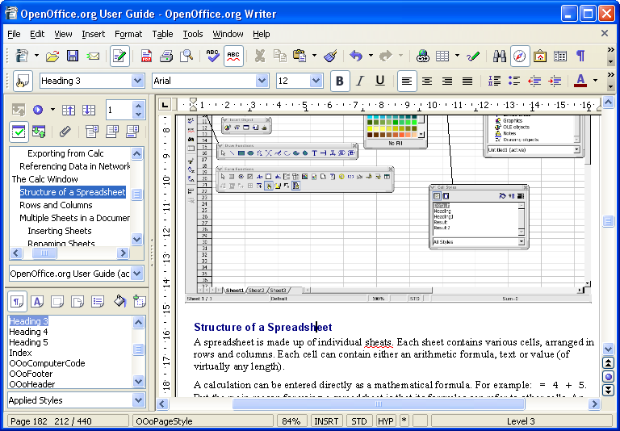

Slide 34
OpenOffice.org calc
The full-featured spreadsheet
  Natural language formulas let you create formulas using words (e.g. "sales - costs").
  Hundreds of spreadsheet functions with built-in expert help
  Scenario Manager allows "what if ..." analysis at the touch of a button.
  Powerful graphics to extract the meaning from your numbers
  Pull in data from external databases with DataPilot technology
  OpenDocument and MS-Excel .xls file format compatibility

Slide 35
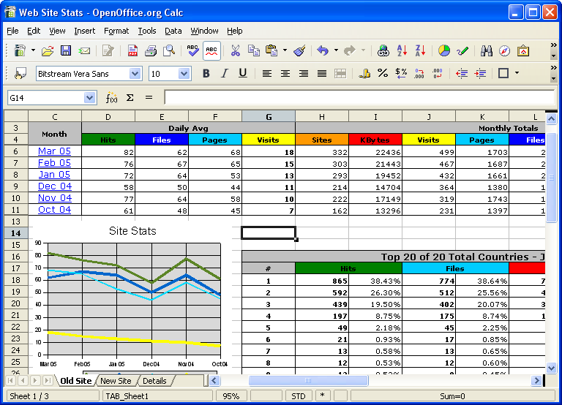

Slide 36
OpenOffice.org impress
Impress your audience
  Master Pages and Layouts simplify the task of preparing your materials.
  Complete range of Views are supported: Normal / Outline / Slide Sorter / Notes / Handouts to meet all the needs of presenters and audiences.
  Easy-to-use drawing and diagramming tools to spice up your presentation.
  Slide show Animation and Effects to bring a presentation to life.
  Fontworks provides stunning 2D and 3D images from text.
  OpenDocument and MS-Powerpoint .ppt file format compatibility

Slide 37
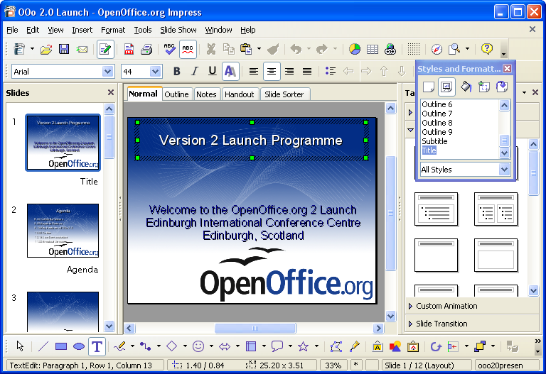

Slide 38
OpenOffice.org draw
Stunning Graphics Tool
  Single click access to common drawing objects
  Arrange objects, rotate in two or three dimensions with the 3D controller
  Smart connectors for flowcharts, organisation charts, network diagrams etc
  Sophisticated rendering for photorealistic images
  Import graphics from all common formats (including BMP, GIF, JPEG, PNG, TIFF, and WMF)
  store drawings in OpenDocument format

Slide 39
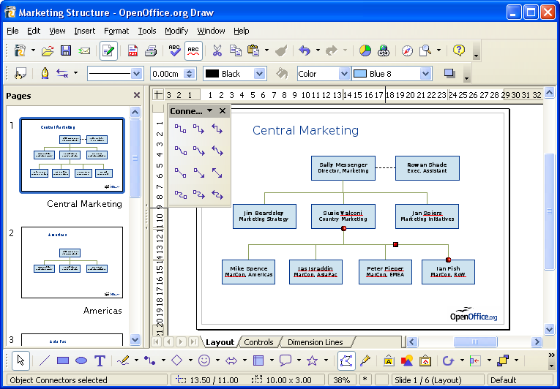

Slide 40
OpenOffice.org base
Database Access made easy
  Use Wizards to create 'instant' database applications
  View a table in an editing grid and add, change, and delete records
  Drag and drop data into other OpenOffice.org applications
  Create powerful queries to show your data in new ways, including summaries and multi-table views
  Create and modify tables and indexes
  Use the built-in HSQLDB database or access existing ODBC or JDBC compliant databases

Slide 41
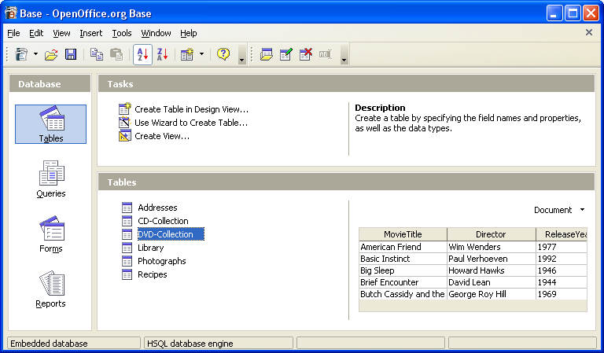
OpenOffice.org base

Slide 42
How free is ‘free’?
Free to use - e.g. download via the internet
Free from licence fees
Free to give away to friends, family, employees, students...
Free to choose the computers you use: Microsoft systems, Linux systems, Sun Solaris, and Mac OS X under X11
Free up your hard disk - Microsoft Office format documents take up to twice the disk space!
Free for developers to enhance with open-source code, published APIs and file formats
You're free to use your legacy Microsoft Office files

