Slide 1
Vodafone Technical Interview
Martin Čadek

Slide 2
Tasks
1) A colleague has finished a survey (data file attached) to measure the satisfaction on buying our Pay Monthly product. He is reporting an overall satisfaction of 4.5 out of 5. What questions or concerns would you have at this point to assess whether the results are reliable and representative?
2) You are tasked with assessing the feedback from customers using the main website while buying a Pay Monthly contract. The survey to collect this feedback would be designed by you. The business requirements include measuring the customer's satisfaction with the digital flow, perception of content understandability and propensity to buy again. How would you design this survey and which data points would you use for your analysis?

Slide 3
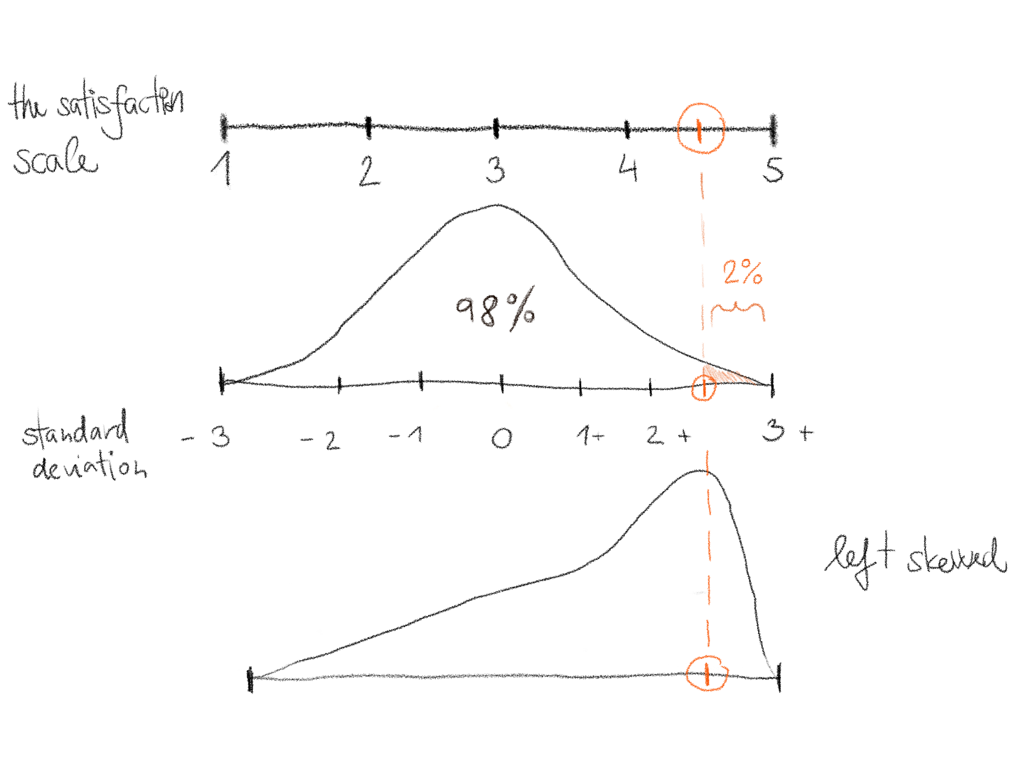

Slide 4
Task 1
What was the sample size, their demographics, time of visit?
What about people who left the website, i.e., nonrespondents?
How did we ensure there were no biases? Self-selection, availability bias, subgroup bias.
Was this longitudinal measurement or ad-hoc? How would such measurement differ across time?
Do we have a chance to cross-validate that the customers were unique?
How was the scale developed and tested? For example, how many points on the scale were available, i.e., 1 – 5 or different?
What was the description of the scale points, and how was it ensured that participants comprehended the description?

Slide 5
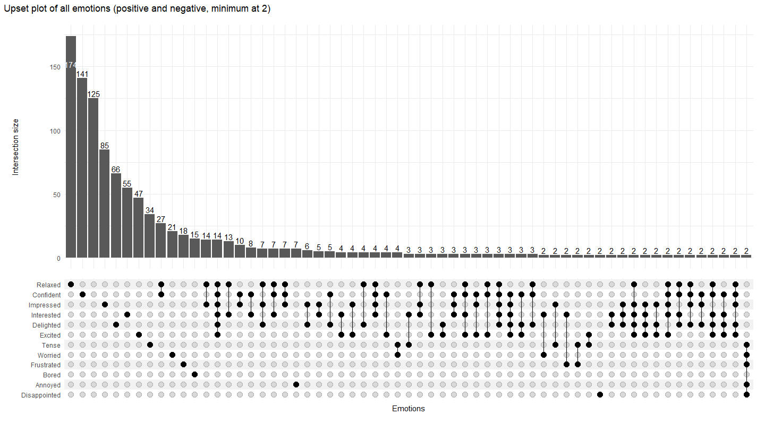

Slide 6
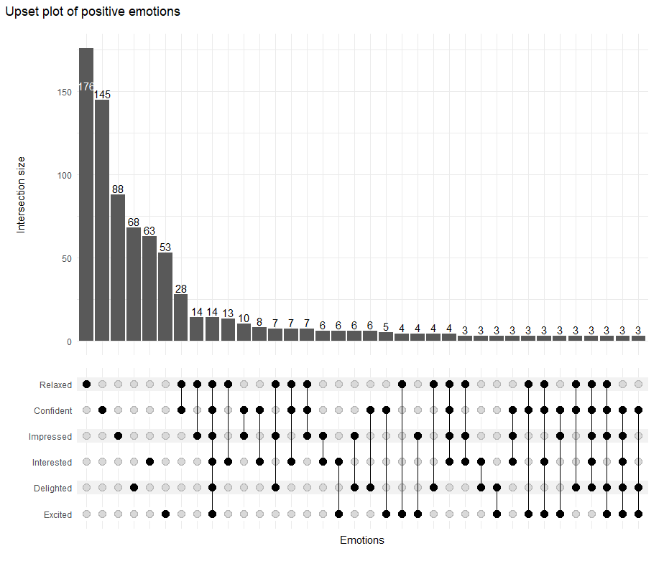
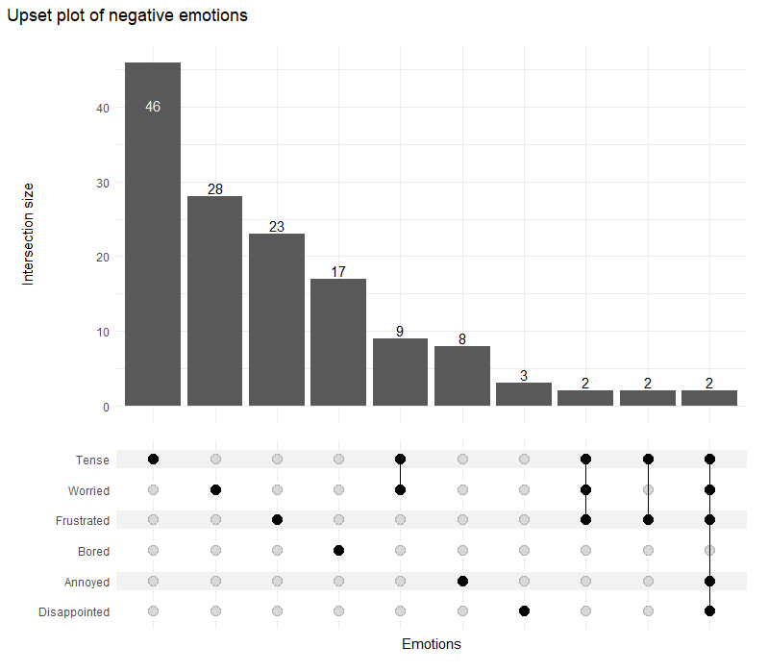
Comparisons of positive / negative emotions

Slide 7
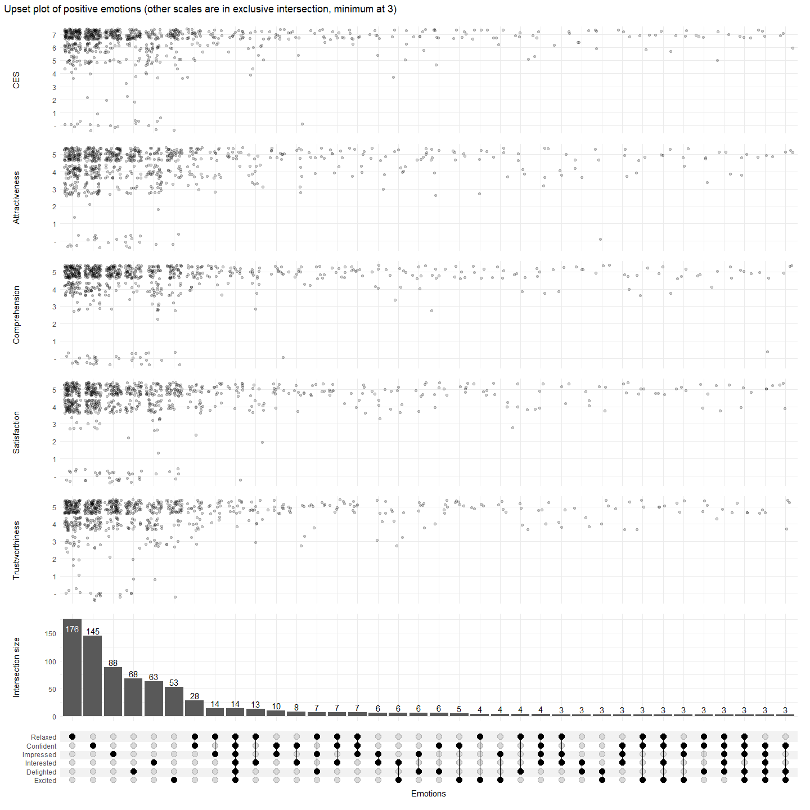
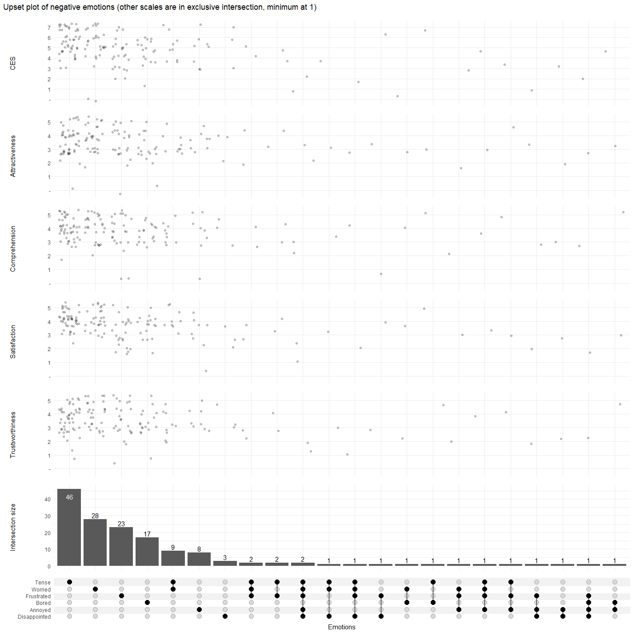
Comparisons of positive / negative emotions

Slide 8
Task 2
The survey would focus on the following domains:
Comprehension/readability of content
How tense or relaxed the person is at the moment (or simplified emotional scale)
Overall satisfaction
The anticipated outcome of their visit: i.e. plan to purchase now, about to leave the website and will not return, about to leave the website but will return (prompted when a user is leaving)
The actual outcome (if possible).
The survey would use two designs. Cross-sectional and longitudinal.
The cross-sectional will be measuring the experience across the flow through the website. The users would be separated into those asked at the begging of the process, in the middle, and at the end. Those groups would be then compared.
Longitudinal will map the user’s path from the starting point to the ending, leaving the website or making a purchase.
Both designs will be compared.
The analysis would utilise visualisations using Sankey diagrams and regression modelling.

Slide 9
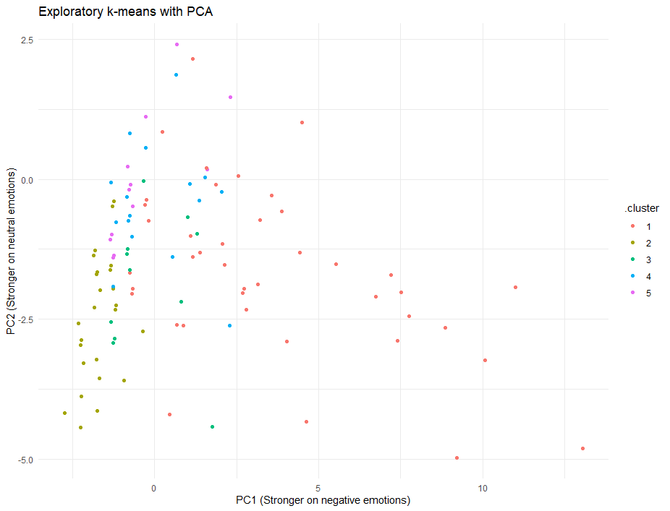
Potential further analysis
Exploratory k-means analysis fitted on emotions
Emotions further transformed using PCA and the two dominant components were displayed in the graph on the right
There seems to be separation between positive and negative emotions, however, there could be

