Slide 1
Getting Started with PowerShell Jump Start
Jeffrey Snover | Distinguished Engineer & Lead Architect
Jason Helmick | Senior Technologist, Concentrated Technology

Slide 2

Meet Jeffrey Snover | ‏@jsnover
Distinguished Engineer & Lead Architect for Windows Server & System Center Division
Inventor of Windows PowerShell
Responsible for setting long term technical vision for these products and running the technology planning for the releases
Over 30 years of industry experience
Microsoft, Tivoli, NetView, DEC
Held 8 patents prior to joining Microsoft, and has registered 30 since.
Frequent speaker at industry and research conferences on a variety of management and language topics

Slide 3
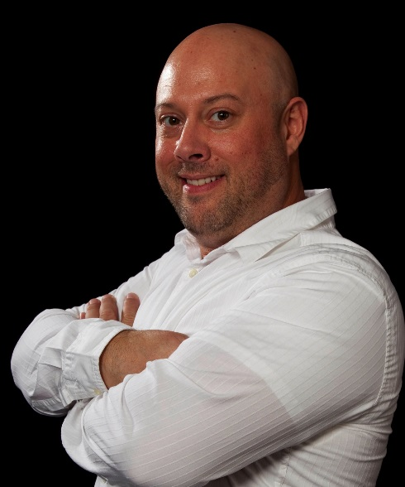
Meet Jason Helmick | ‏@theJasonHelmick
Senior Technologist, Concentrated Technology
Board member and CFO – PowerShell.Org
Author “Learn Windows IIS in a Month of Lunches”
Contributing author “PowerShell Deep Dives”
25 year IT veteran
Speaker at a variety of industry conferences
Teaches PowerShell for the IT pro to maximize management and automation
Frequent contributor to TechNet Magazine and other industry publications

Slide 4


Course Topics
Getting Started with PowerShell
01 | Don’t fear the shell | 06 | The pipeline : Deeper
02 | The Help system | 07 | The Power in the Shell - Remoting
03 | The pipeline : Getting connected | 08 | Getting prepared for automation
04 | Extending the shell | 09 | Automation in scale - Remoting
05 | Objects for the Admin | 10 | Introducing scripting and toolmaking

Slide 5
Setting Expectations
Target Audience
Tailored for the IT pro that needs to improve management and automation
Fast paced for the real world
Suggested Prerequisites/Supporting Material
Experience working as a Windows IT pro/Admin/Help Desk
Get answers in the forums at PowerShell.Org
Check out “Learn Windows PowerShell 3 in a Month of Lunches” by Don Jones and Jeffery Hicks

Slide 6

Join the MVA Community!
Microsoft Virtual Academy
Free online learning tailored for IT Pros and Developers
Over 1M registered users
Up-to-date, relevant training on variety of Microsoft products
“Earn while you learn!”
Get 50 MVA Points for this event!
Visit http://aka.ms/MVA-Voucher
Enter this code: PowerJump1 (expires 8/15/2013)

Slide 7
01 | Don’t fear the shell
Jeffrey Snover | Distinguished Engineer & Lead Architect
Jason Helmick | Senior Technologist, Concentrated Technology

Slide 8
Module Overview
The purpose for PowerShell
Installing PowerShell – Windows Management Framework
Launching PowerShell for the administrator
Customize the shell for comfort
Getting familiar with the shell

Slide 9



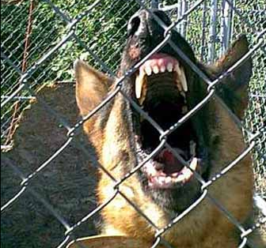
The Purpose to PowerShell
YOU
THEM
YOU
YOU
YOU
Improved management and automation
Manage real-time
Manage large scale

Slide 10
Installing PowerShell – Windows Management Framework
PowerShell V3 – Windows 8 and Server 2012
PowerShell V2 – Windows 7 and Server 2008
Download the Windows Management Framework 3.0 at
http://www.microsoft.com/en-us/download/details.aspx?id=34595
Windows XP and Server 2003 can run V2

Slide 11
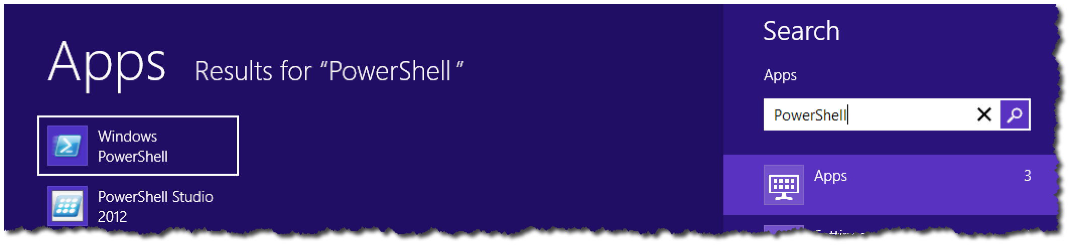

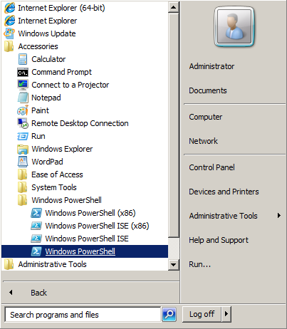
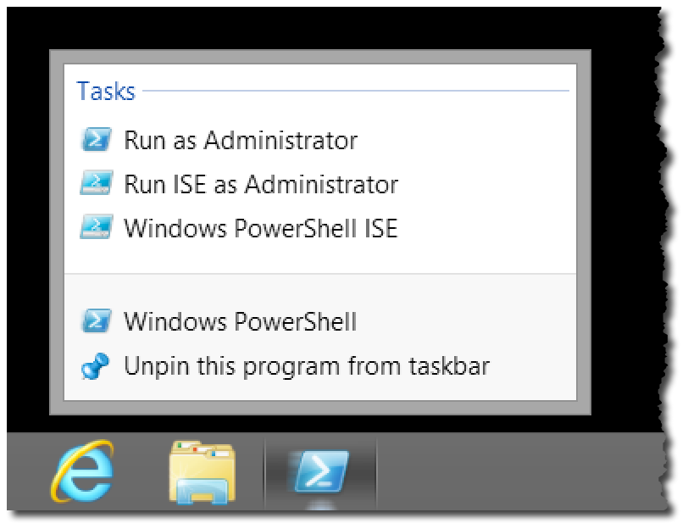
Launching PowerShell for the Administrator

Slide 12
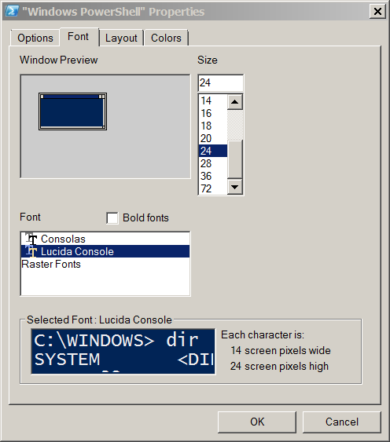
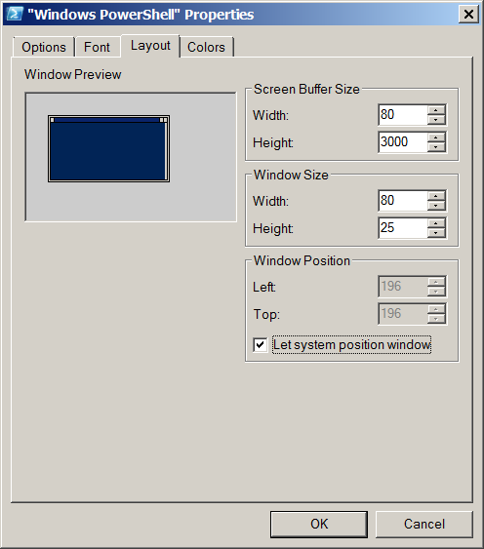
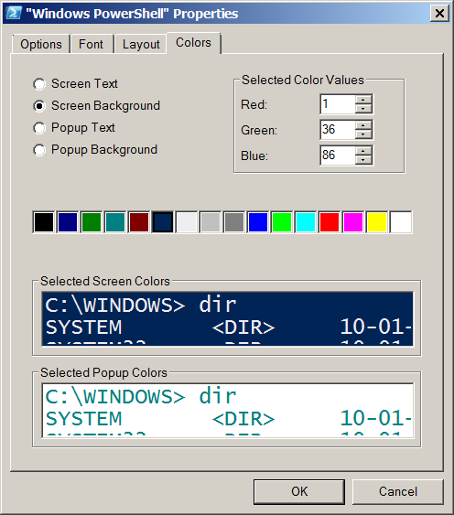
Customize the shell for comfort

Slide 13

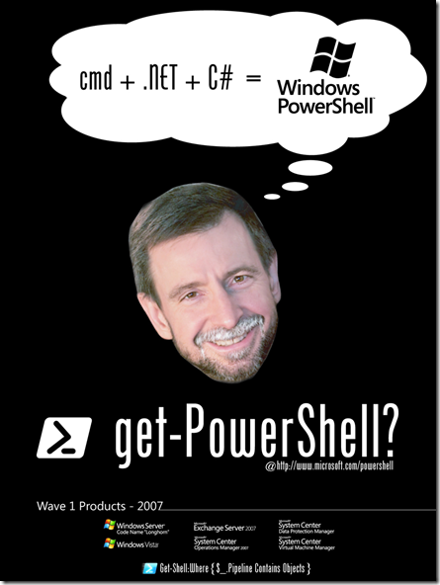
Getting familiar with the shell
Cmdlets : Verb – Noun
Native commands work!
Examples – Ping, IPConfig, calc, notepad, mspaint
cls - Clear-Host
cd - Set-Location
dir, ls - Get-Childitem
type, cat - Get-Content
Copy, cp - Copy-item

Slide 14
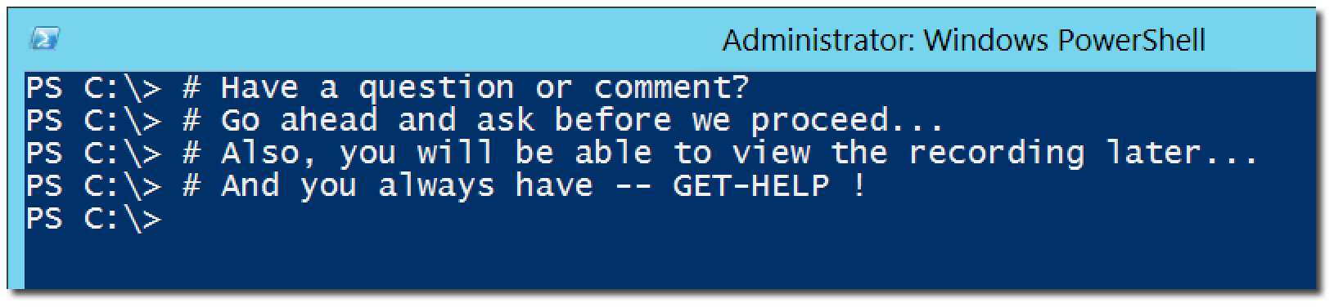
Questions or comments?

