Slide 1
03 | The Pipeline : Getting Connected
Jeffrey Snover | Distinguished Engineer & Lead Architect
Jason Helmick | Senior Technologist, Concentrated Technology

Slide 2


Course Topics
Getting Started with PowerShell
01 | Don’t fear the shell | 06 | The pipeline : Deeper
02 | The Help system | 07 | The Power in the Shell - Remoting
03 | The pipeline : Getting connected | 08 | Getting prepared for automation
04 | Extending the shell | 09 | Automation in scale - Remoting
05 | Objects for the Admin | 10 | Introducing scripting and toolmaking

Slide 3
Module Overview
What’s the pipeline and what does it do?
Exporting/Importing CSV
Exporting/Importing XML
Other files and printers
Displaying information in a GUI
Making a webpage of information
Cmdlets that kill

Slide 4

What’s the pipeline and what does it do?
Pipe character located above the Enter key
Connects cmdlets to produce better results
Can be broken into several lines to increase readability

Slide 5
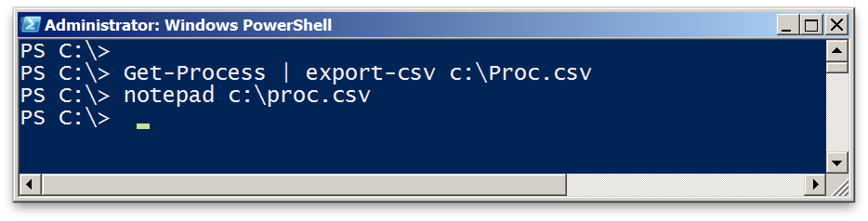
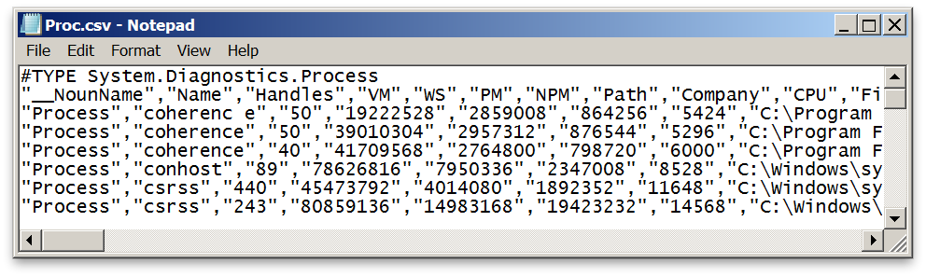
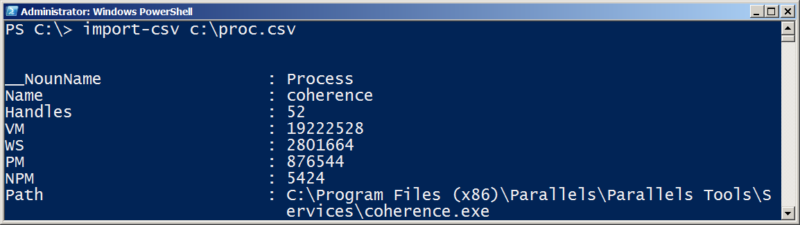
Exporting/Importing CSV

Slide 6
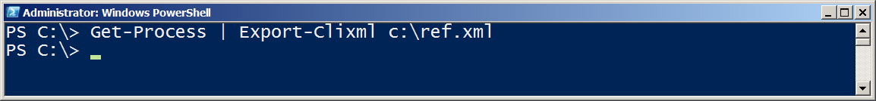
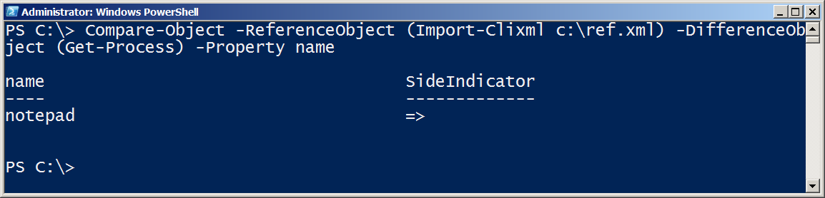
Exporting/Importing XML

Slide 7
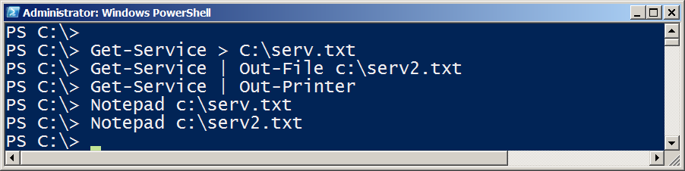
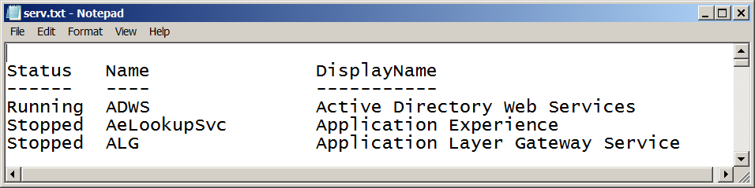

Other files and printers

Slide 8
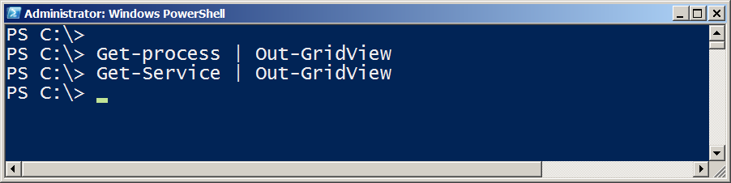
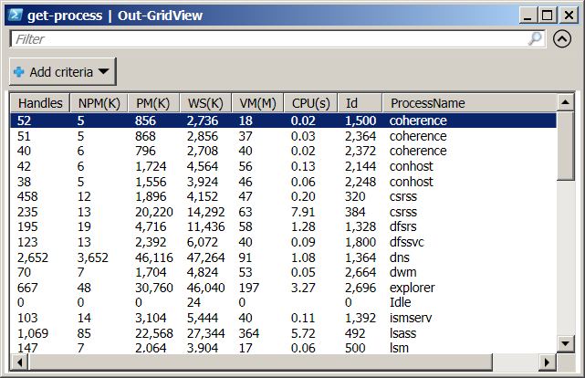
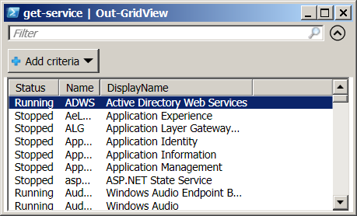
Displaying information in a GUI

Slide 9
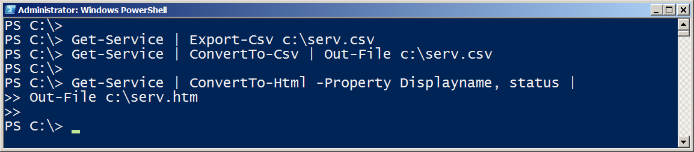
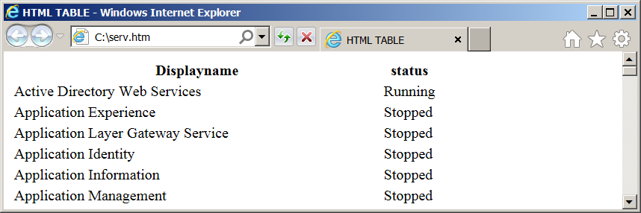
Making a webpage of information

Slide 10
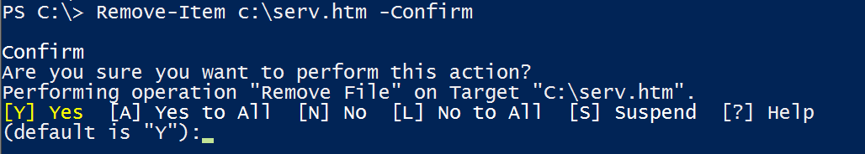
Cmdlets that kill
Stop-Process / kill
Stop-service
$ConfirmPreference
$WhatIfPreference
-Confirm
-Whatif

Slide 11
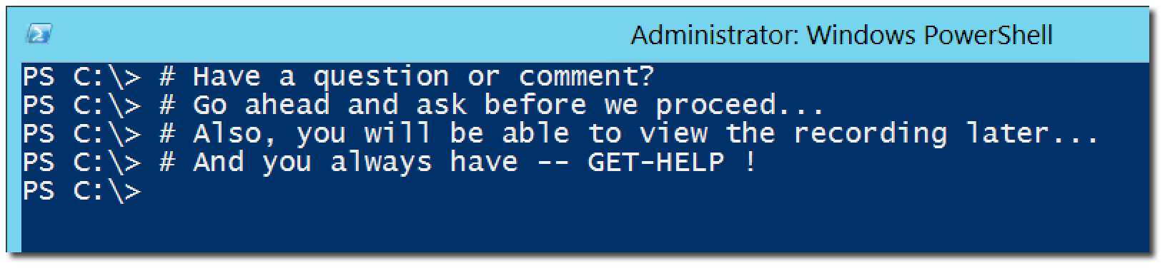
Questions or comments?

