Slide 1
04 | Extending the Shell
Jeffrey Snover | Distinguished Engineer & Lead Architect
Jason Helmick | Senior Technologist, Concentrated Technology

Slide 2
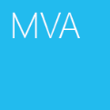

Course Topics
Getting Started with PowerShell
01 | Don’t fear the shell | 06 | The pipeline : Deeper
02 | The Help system | 07 | The Power in the Shell - Remoting
03 | The pipeline : Getting connected | 08 | Getting prepared for automation
04 | Extending the shell | 09 | Automation in scale - Remoting
05 | Objects for the Admin | 10 | Introducing scripting and toolmaking

Slide 3
Module Overview
Like the MMC – One Shell does it all
Finding and adding Snap-ins
Finding and adding Modules
Discovering new commands
The real world of cmdlets

Slide 4
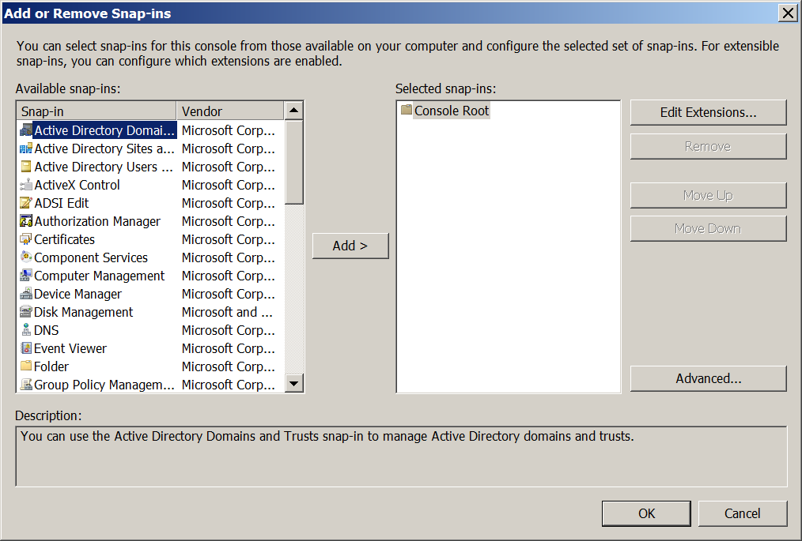
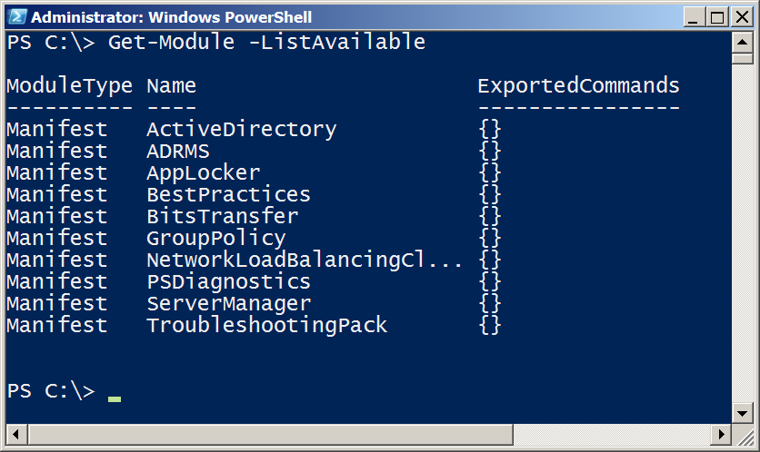
Like the MMC - One Shell does it all

Slide 5
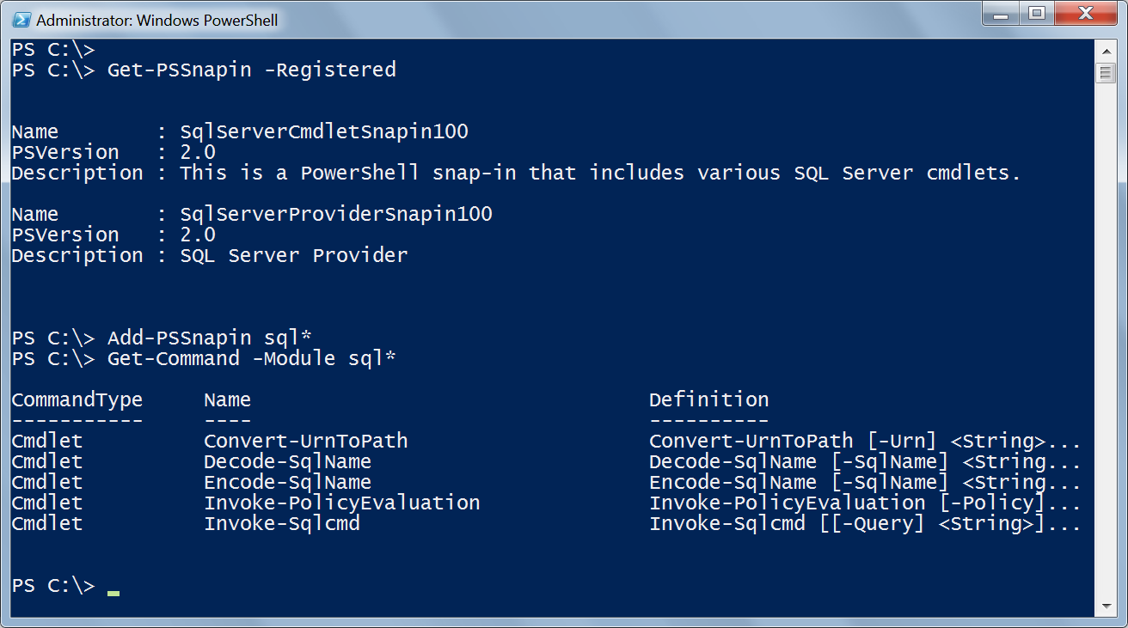

Finding & Adding Snap-ins

Slide 6
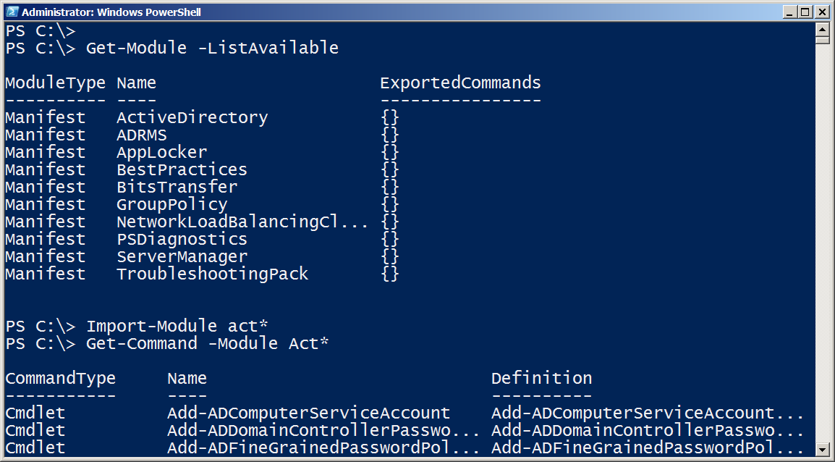
Finding & Adding Modules
PowerShell V3 dynamically imports modules when you use the cmdlet

Slide 7
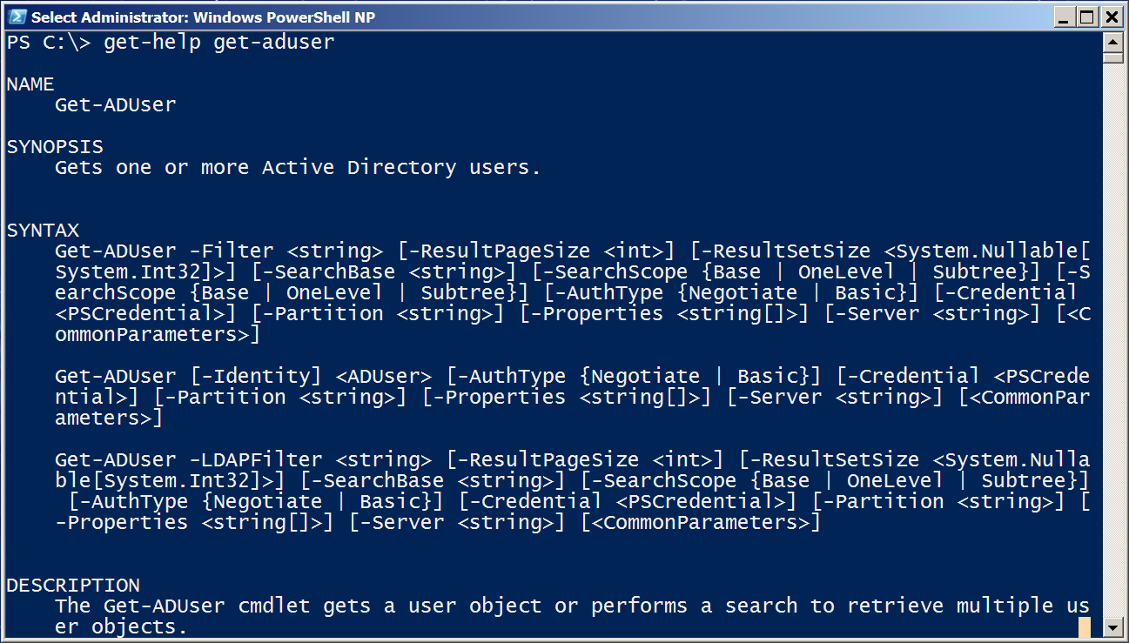
Discovering new commands

Slide 8
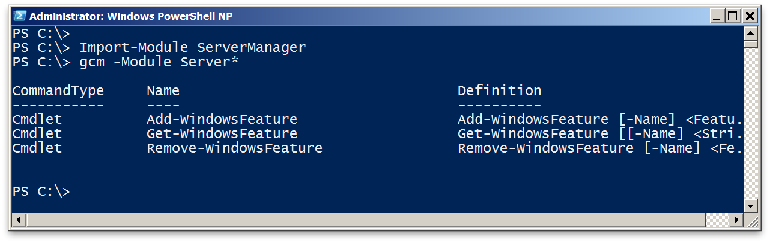
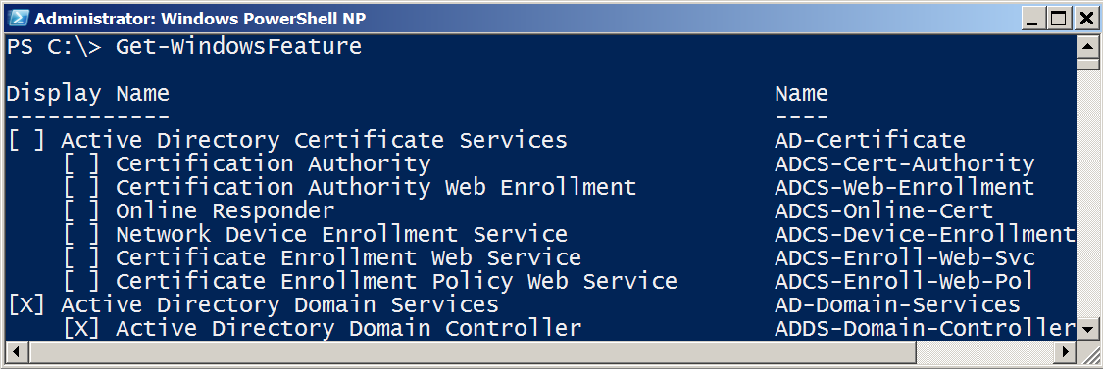
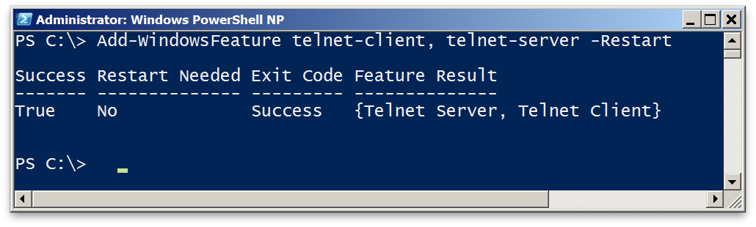
The real world of cmdlets

Slide 9
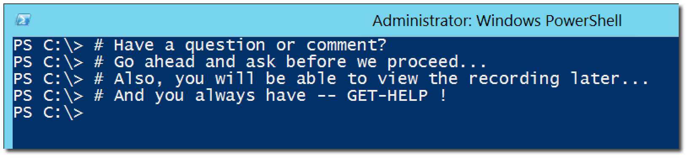
Questions or comments?

