Slide 1
05 | Object for the Admin
Jeffrey Snover | Distinguished Engineer & Lead Architect
Jason Helmick | Senior Technologist, Concentrated Technology

Slide 2


Course Topics
Getting Started with PowerShell
01 | Don’t fear the shell | 06 | The pipeline : Deeper
02 | The Help system | 07 | The Power in the Shell - Remoting
03 | The pipeline : Getting connected | 08 | Getting prepared for automation
04 | Extending the shell | 09 | Automation in scale - Remoting
05 | Objects for the Admin | 10 | Introducing scripting and toolmaking

Slide 3
Module Overview
Object across the pipeline
Getting the information you need
Sorting Objects
Selecting Objects
Custom Properties
Filtering data
Methods – When no cmdlet exists

Slide 4
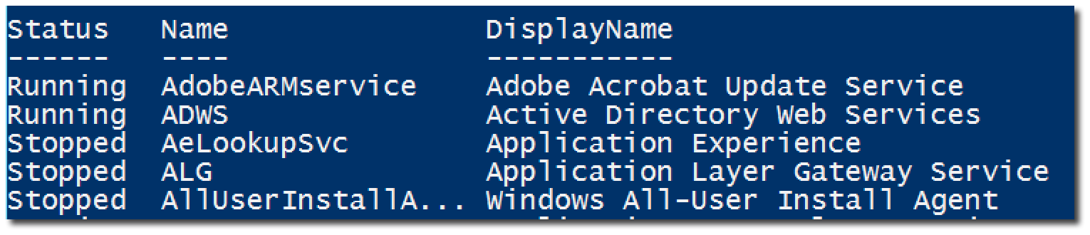
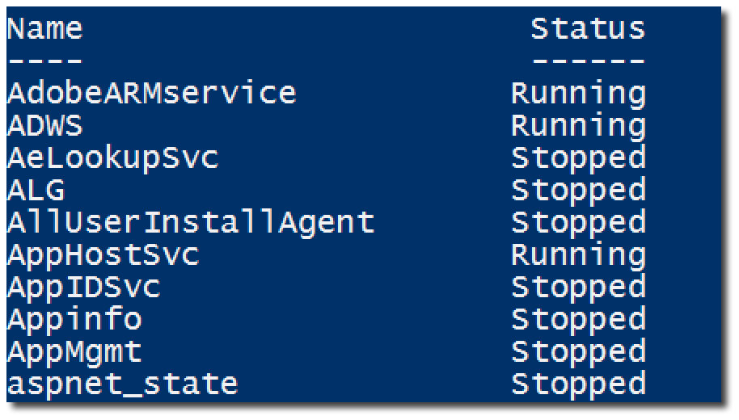
Object across the pipeline

Slide 5
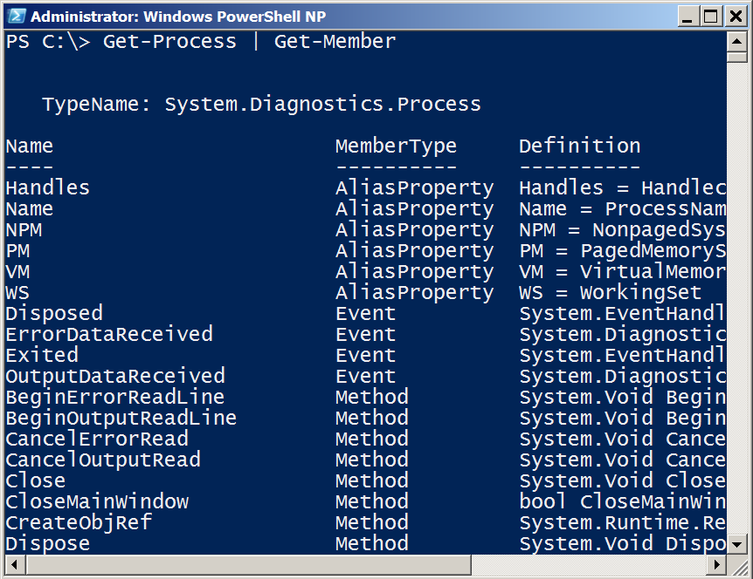
Getting the information you need
Get-Member (gm)
TypeName is a unique Windows assigned name
Displays the properties and methods of an object
Properties are potential columns of information
Methods are the potential actions that can be taken

Slide 6
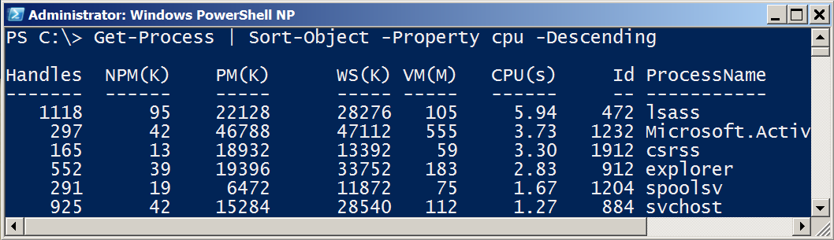
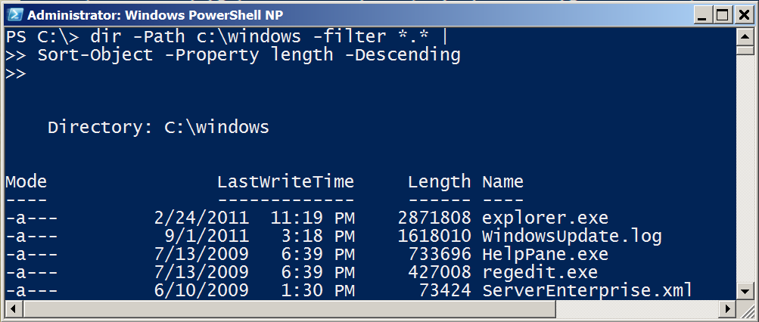
Sorting Objects
Sort-Object sorts properties.
Use Get-Member to see a list of properties

Slide 7
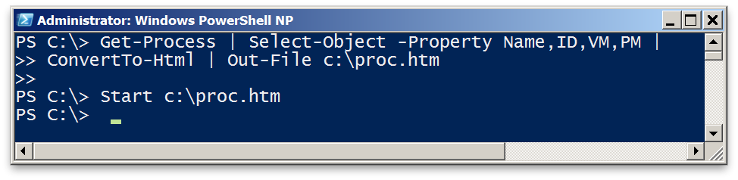
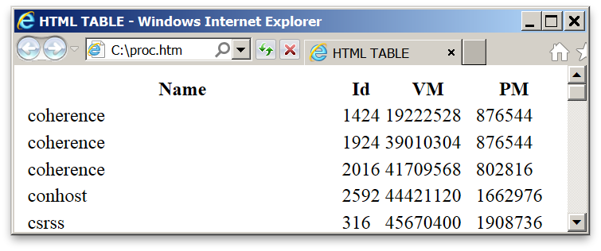
Selecting Objects
Select-Object selects properties.
Use Get-Member to list properties to select from.
-first and -last restrict list of rows displayed.

Slide 8
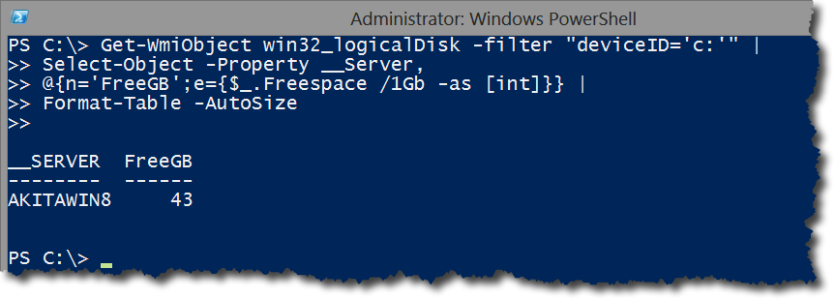
Custom Properties

Slide 9
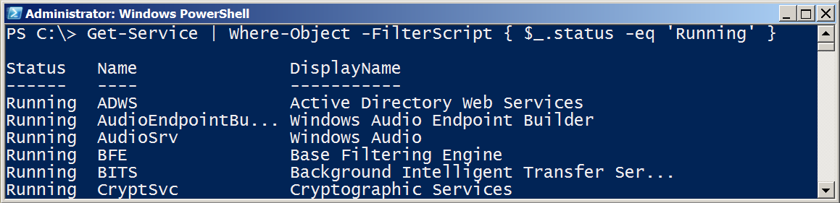
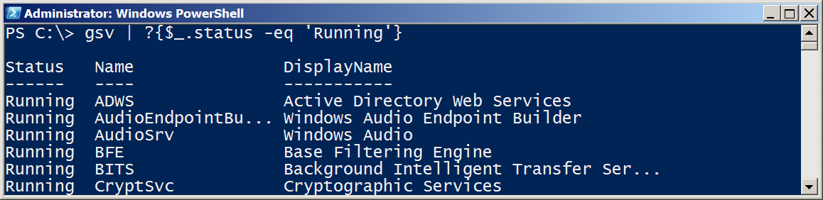
Filter Object Out of the Pipeline

Slide 10
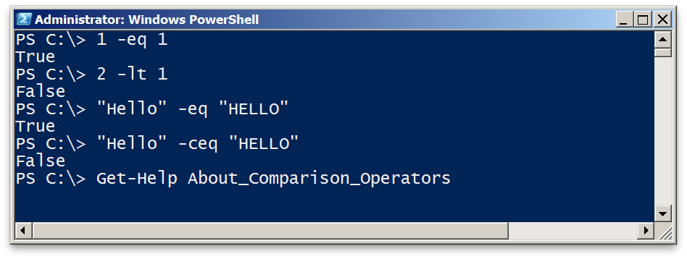
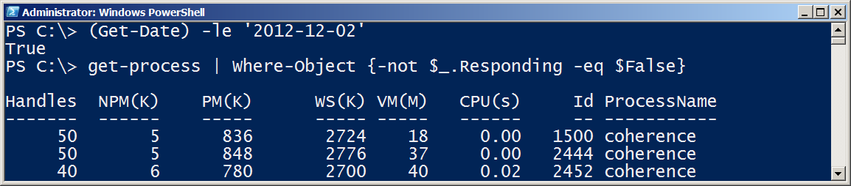
Comparison Operators
Comparison returns boolean True or False
Comparison can be case-sensitive using ‘c’ prefix
For complete description, see About_Comparison

Slide 11
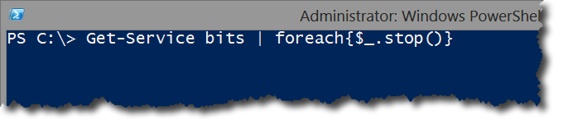
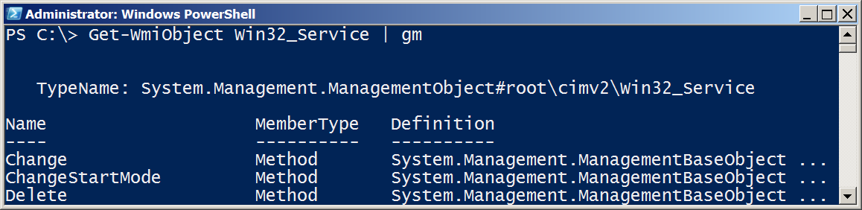
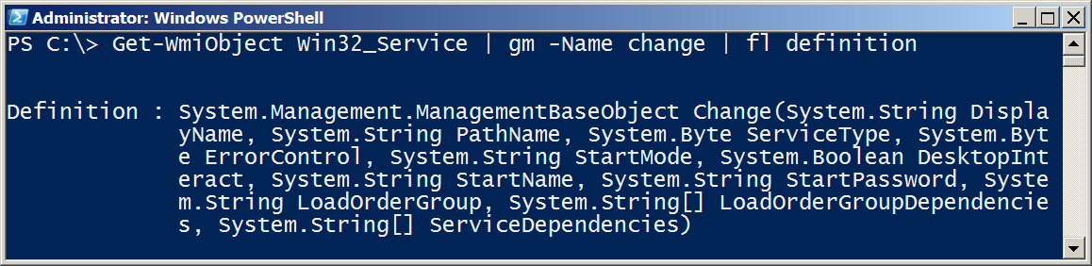
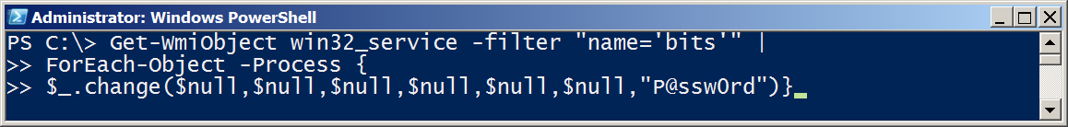
Methods – When no cmdlet exists

Slide 12
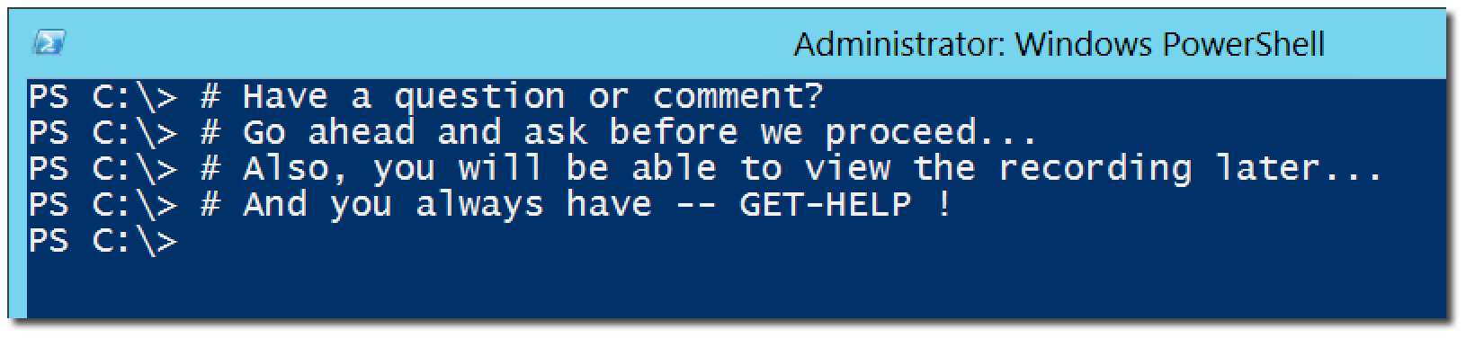
Questions or comments?

