Slide 1
02 | The Help system
Jeffrey Snover | Distinguished Engineer & Lead Architect
Jason Helmick | Senior Technologist, Concentrated Technology

Slide 2
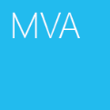

Course Topics
Getting Started with PowerShell
01 | Don’t fear the shell | 06 | The pipeline : Deeper
02 | The Help system | 07 | The Power in the Shell - Remoting
03 | The pipeline : Getting connected | 08 | Getting prepared for automation
04 | Extending the shell | 09 | Automation in scale - Remoting
05 | Objects for the Admin | 10 | Introducing scripting and toolmaking

Slide 3
Module Overview
Why you need help
Updatable Help
Discoverability with the Help system
Understanding Syntax
Real-World using Help

Slide 4
Why you need help
Vast resource at your finger tips to help make you successful
Don’t memorize – Discover!
Thousands of cmdlets – all have help!
Scripting resources and information
Advanced PowerShell configuration information

Slide 5
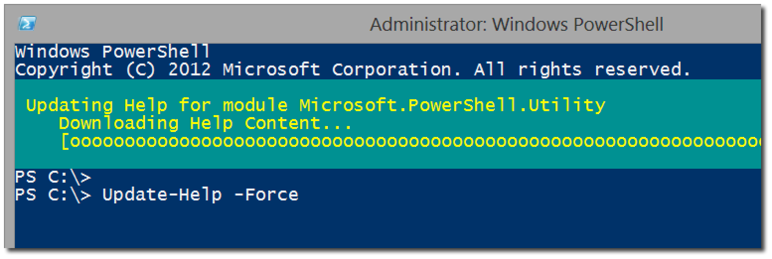
Updatable Help
Update to the latest version of Help
Save-Help to save to a local location

Slide 6
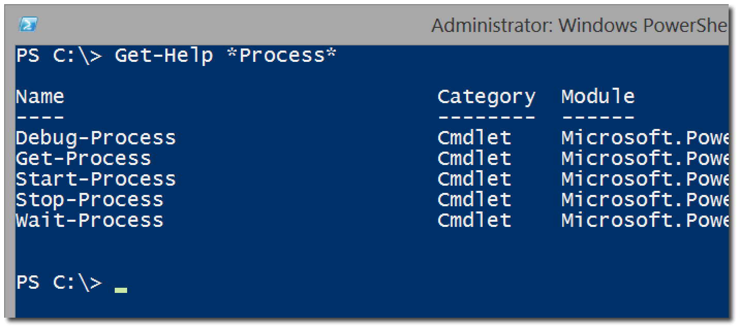
Discoverability with the Help system
Get-Help versus Help and Man
Help <cmdlet>
Help *partial*
Help <verb/noun>
Help <cmdlet> -Full
Help <cmdlet> -Online
Help <cmdlet> -ShowWindow
Get-Help About_*

Slide 7
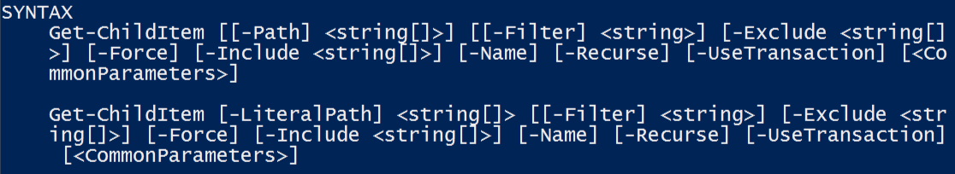
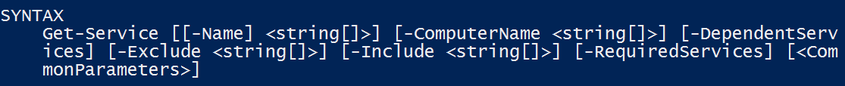
Understanding Syntax
Parameter sets
The meaning of Syntax
- Indicates A Parameter
[] Argument Accepts Multiple Values
[Param] is Positional
<> Indicates Arguments
[Param Arg] is Optional

Slide 8
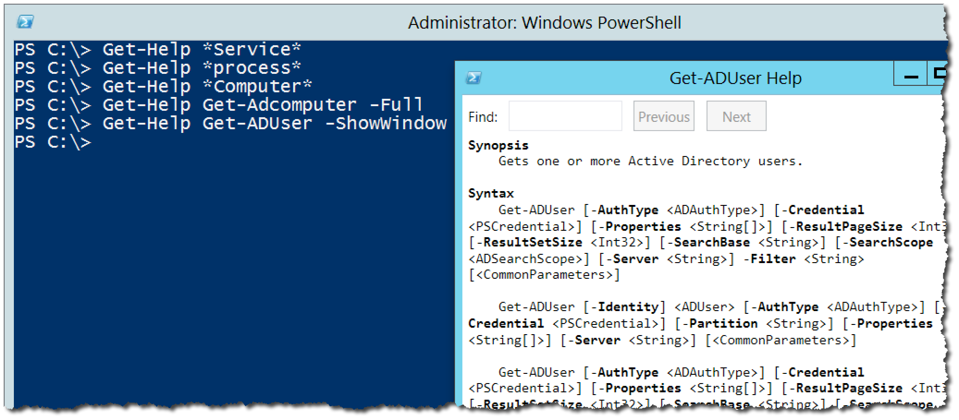
Real-World using Help

Slide 9
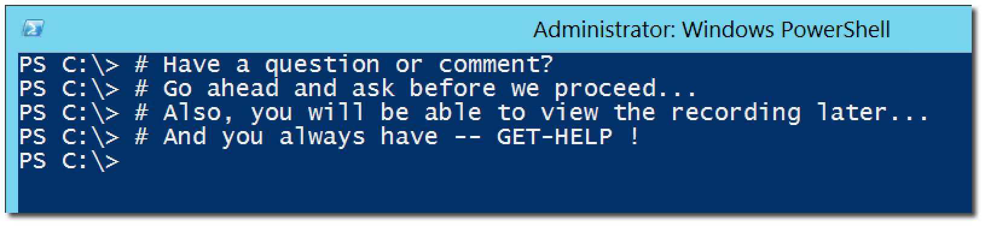
Questions or comments?

