Slide 1
Longitude
(-180, 90)
(-90, 90)
(0, 90)
(90, 90)
(-90, 0)
(0, 0)
(90, 0)
(180, 0)
Latitude
(-180, 0)
(-90, -90)
(0, -90)
(90, -90)
(180, -90)

Slide 2
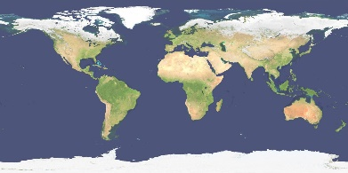


Image Pyramid / Overviews

Slide 3
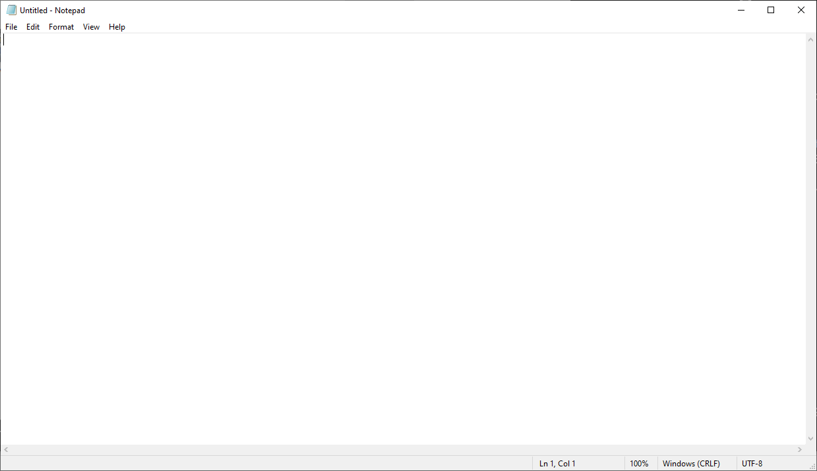
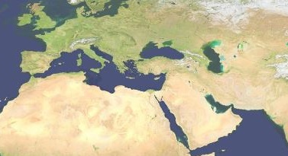


Data (Overviews)
Display
20000 Pixels
400 Pixels
10000 Pixels
5000 Pixels

Slide 4
Tiled Data
https://gdal.org/drivers/raster/gtiff.html
gdal_translate -of GTiff -co TILED=YES –co BLOCKXSIZE=512 –co BLOCKYSIZE=512 -co COMPRESS=LZW

Slide 5


Data (Overviews)
Display
20000 Pixels
400 Pixels
10000 Pixels
5000 Pixels

