Slide 1
Upgrading / Migrating to Drupal 7
02.18.2013

Slide 2
I'm on D6. Let's do this the easy way:
drush sup

Slide 3
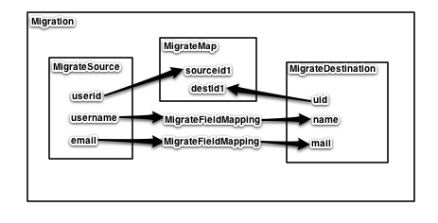
How Migrate works:

Slide 4
Ok, that didn't work. Now what?
Migrate
http://drupal.org/project/migrate
Migrate Extras
http://drupal.org/project/migrate_extras

Slide 5
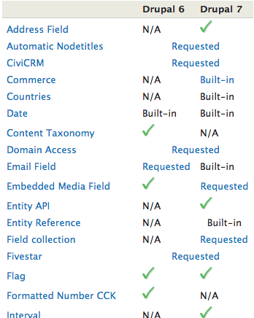
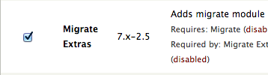

Migrate Extras - Gotcha
Part of the Migrate Extras
Part of that Module

Slide 6
How to use and write your first Migrate Module!
Download / Enable Migrate, Migrate Extras, and module specific Migrate Extensions (Date)
      migrate
      migrate_extras
      date_migrate
      migrate_ui
Create / Enable your migration module
Enable your content migration types in the Migrate UI
Migrate it!

Slide 7
Creating our first migrate module:
Pre-Reqs
Migrate uses PHP Classes heavily:
class cats {
protected $type = '';
protected $adult = TRUE;
public function __construct($type) {
$this->type = $type;
}
}
class kittens extends cats {
protected $adult = FALSE;
}

Slide 8
Creating our first migrate module:
Pre-Reqs
Migrate uses DBTNG:
$query = db_select('node', 'n')
->fields('n', array('nid', 'uid', 'title', 'body')
->condition('n.created', '1361224788', '>')
->orderBy('n.nid', 'DESC');

Slide 9
Creating our first migrate module: migrate_cats.info
name = "Migrate Cats"
description = "Example Cat Migration."
package = "Migration"
core = 7.x
dependencies[] = taxonomy
dependencies[] = image
dependencies[] = comment
dependencies[] = migrate
dependencies[] = list
dependencies[] = number
files[] = migrate_cats.module
files[] = cats.inc

Slide 10
Creating our first migrate module: migrate_cats.module
<?php
/**
* @file
* THIS SPACE INTENTIONALLY LEFT BLANK.
*
* Yes, there is no code in the .module file. Migrate
* operates almost entirely through classes.
*/

Slide 11
Creating our first migrate module: migrate_cats.migrate.inc
<?php
function migrate_cats_migrate_api() {
$api = array(
'api' => 2,
'migrations' => array(
'CatNode' => array('class_name' => 'catNodeMigration')
),
);
return $api;
}

Slide 12
Creating our first migrate module: cats.inc
<?php
class catNodeMigration extends Migration {
/* Set up migration / mapping */
public function __construct() {
parent::__construct();
$this->description = t('Migrate them cats.');
$this->map – MigrateMap Class instance
$this->source – MigrateSource Class instance
$this->destination – MigrateDestination Class instance
$this->addFieldMapping – Field Mappings
}
/* Finesse data / fix it before saving. */
public function prepareRow($current_row) {
$current_row->{property}
return TRUE;
}
}

Slide 13
Creating our first migrate module:
Map the information
<?php
class catNodeMigration extends Migration {
/* Set up migration / mapping */
public function __construct() {
parent::__construct();
$this->map = new MigrateSQLMap($this->machineName,
array(
'fid' => array(
'type' => 'int',
'not null' => TRUE,
'description' => 'Feline ID.',
'alias' => 'c',
)
),
MigrateDestinationNode::getKeySchema()
);

Slide 14
Creating our first migrate module:
Setting up the source (MySQL).
<?php
class catNodeMigration extends Migration {
/* Set up migration / mapping */
public function __construct() {
parent::__construct();
$query = db_select('cats', 'c')
->fields('c', array('name', 'adult', 'age', 'fur'));
// Create a MigrateSource object, which manages retrieving the input data:
$this->source = new MigrateSourceSQL($query);
MigrateSourceCSV
MigrateSourceList
MigrateSourceMSSQL
MigrateSourceMultiItems
MigrateSourceOracle
MigrateSourceSQL
MigrateSourceXML

Slide 15
Creating our first migrate module:
XML Source.
<?xml version="1.0" encoding="UTF-8"?>
<cats>
<cat>
<felineid>0001</felineid>
<name>Felix</name>
<age>2</age>
</cat>
<cat>
<felineid>0002</felineid>
<name>Grumpy</name>
<age>15</age>
</cat>
</cats>

Slide 16
Creating our first migrate module:
Setting up the source (XML).
<?php
class catNodeMigration extends Migration {
/* Set up migration / mapping */
public function __construct() {
parent::__construct();
$fields = array(
'name' => t('Cat name'),
'age' => t('Actual Age')
);
$xml_folder = drupal_get_path('module', 'migrate_cats') . '/xml/';
$cats_url = $xml_folder . 'cats.xml';
$cat_xpath = '/cats/cat';
$cat_ID_xpath = 'felineid';
$this->source = new MigrateSourceXML($cats_url, $cat_xpath, $cat_ID_xpath, $fields);

Slide 17
Creating our first migrate module:
Setting up the destination (Node).
<?php
class catNodeMigration extends Migration {
/* Set up migration / mapping */
public function __construct() {
parent::__construct();
// Set up our destination - nodes of type cats
$this->destination = new MigrateDestinationNode('cats');
MigrateDestinationComment
MigrateDestinationFile
MigrateDestinationNode
MigrateDestinationTerm
MigrateDestinationUser
MigrateDestinationProfile2
MigrateDestinationPrivateMsg
MigratePathautoHandler

Slide 18
Creating our first migrate module:
Setting up the Field Mapping.
<?php
class catNodeMigration extends Migration {
/* Set up migration / mapping */
public function __construct() {
parent::__construct();
$this->addFieldMapping('title', 'name')
->description(t('Mapping cat name in source to node title'));
// Unmapped destination fields
$this->addUnmigratedDestinations(array('age'));

Slide 19
Creating our first migrate module:
Finesse the data.
<?php
class catNodeMigration extends Migration {
/* Finesse data / fix it before saving. */
public function prepareRow($current_row) {
$current_row->created = time();
// Make sure those pesky yard diggers don't get in!
if($current_row->name == 'Dog') {
return FALSE;
}
return TRUE;
}

Slide 20
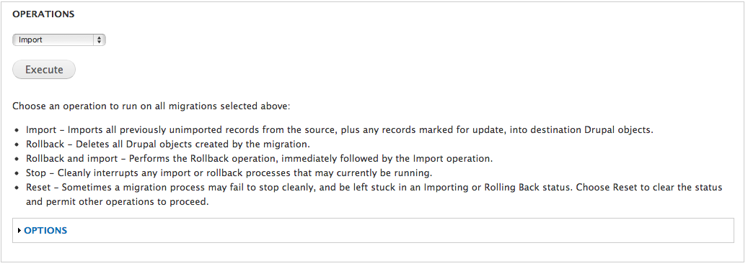
Running our first migrate module:
admin/content/migrate

Slide 21
Migrate Classes
MigrateSource
      http://drupalcontrib.org/api/drupal/contributions%21migrate%21includes%21source.inc/class/MigrateSource/7
MigrateDestinationEntity
      http://drupalcontrib.org/api/drupal/contributions%21migrate%21plugins%21destinations%21entity.inc/class/MigrateDestinationEntity/7

Slide 22
Migrate Resources
Migrate Examples:
      migrate_example
      migrate_example_baseball
      migrate_example_oracle
XDEB Migration (dated - 2011):
      http://xdeb.org/node/1539
RedCat Migration (dated - 2011):
      http://btmash.com/article/2011-02-25/migrating-content-using-migrate-module

